Slide 1
TRUE FASTING ISAIAH 58:6-9 Cartoon and scripture resource
www.caritas.org.au/CST
Last updated February 2018

Slide 2
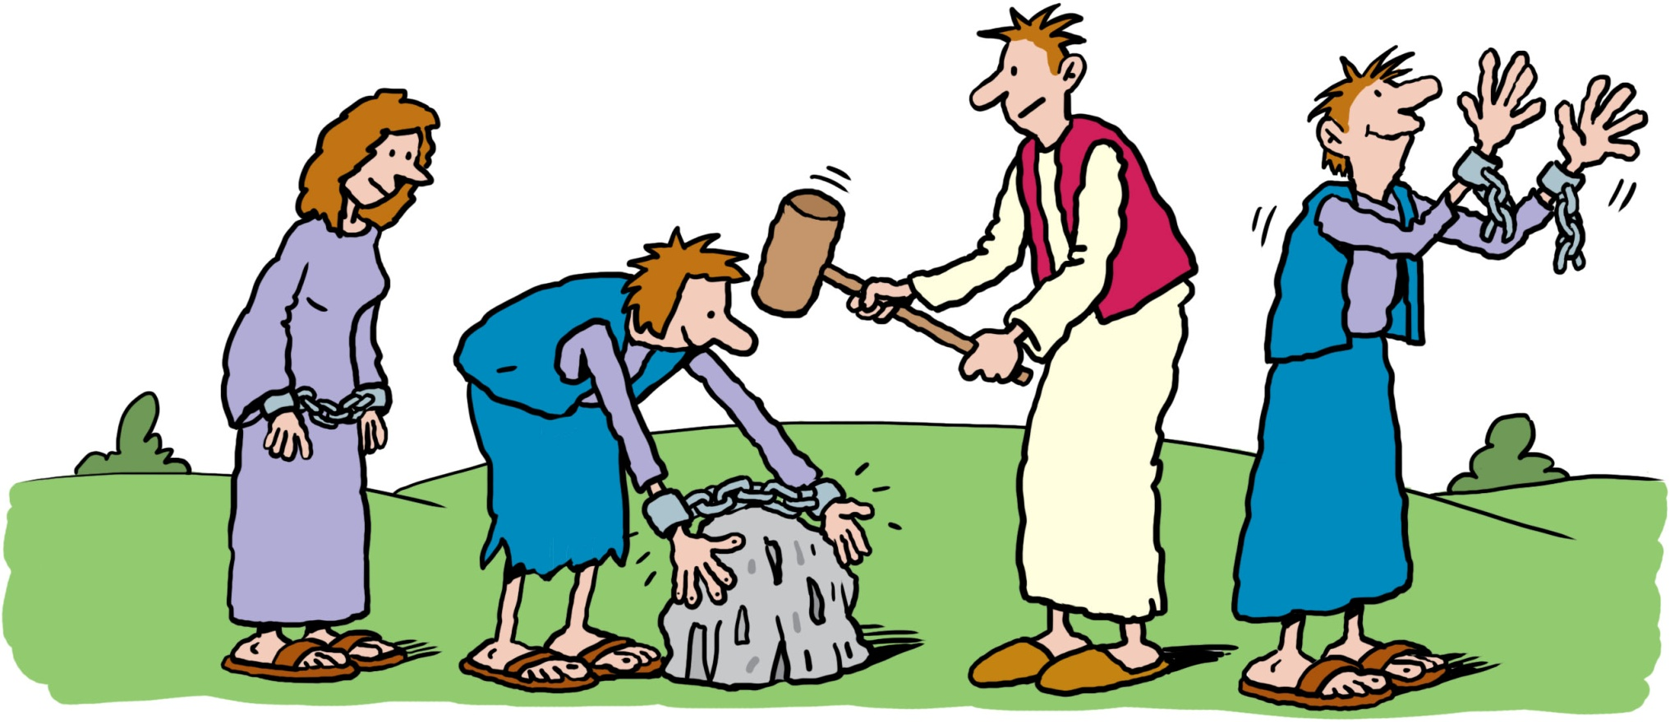
Is not this the kind of fasting I have chosen:
to loose the
chains of injustice
and untie the cords of the yoke,
to set the oppressed free and break every yoke?

Slide 3
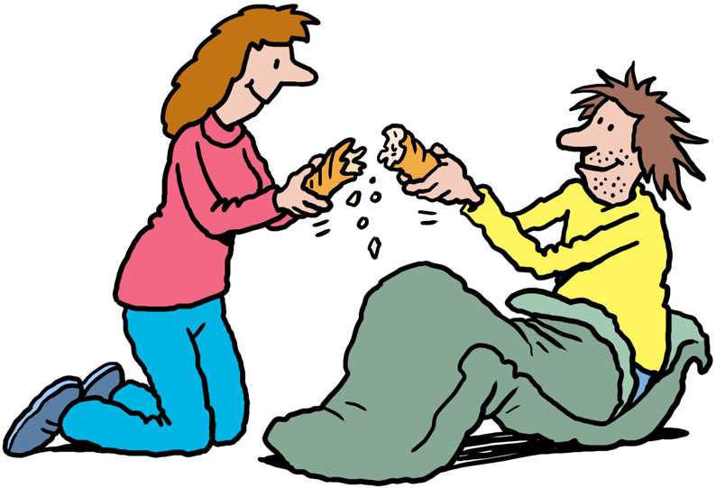
Is not this the kind of fasting I have chosen:
Is it not to
share your food
with the
hungry?

Slide 4
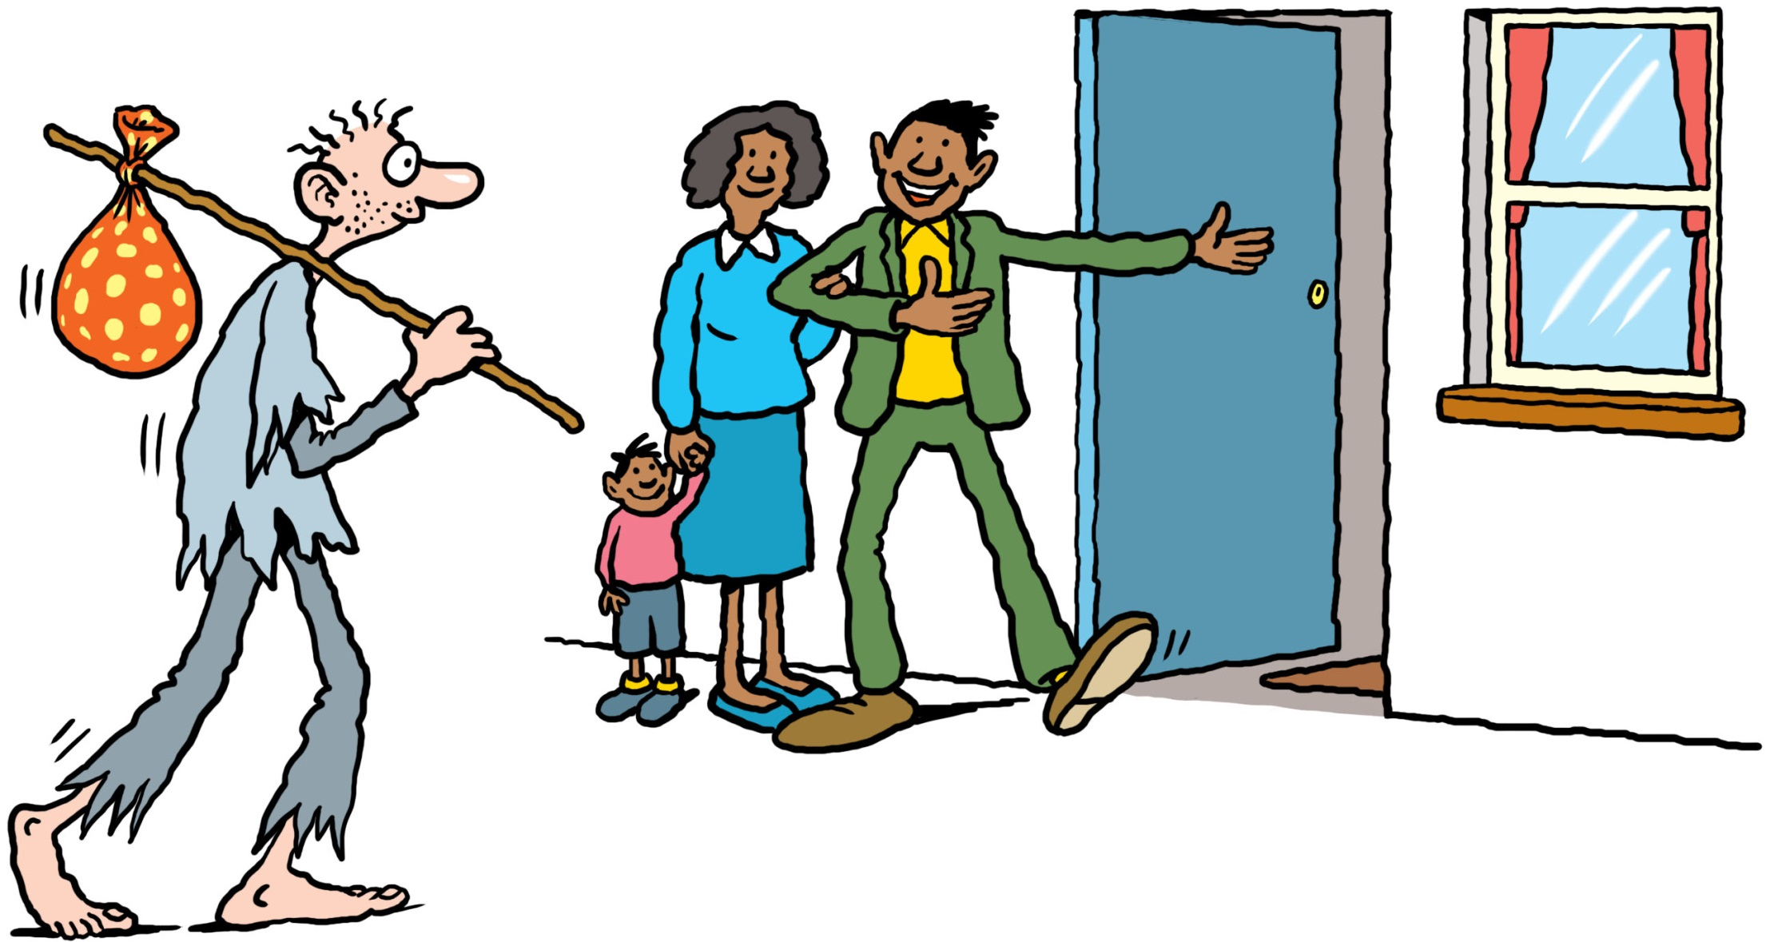
Is not this the kind of fasting I have chosen:
and to provide the poor wanderer
shelter,
with

Slide 5
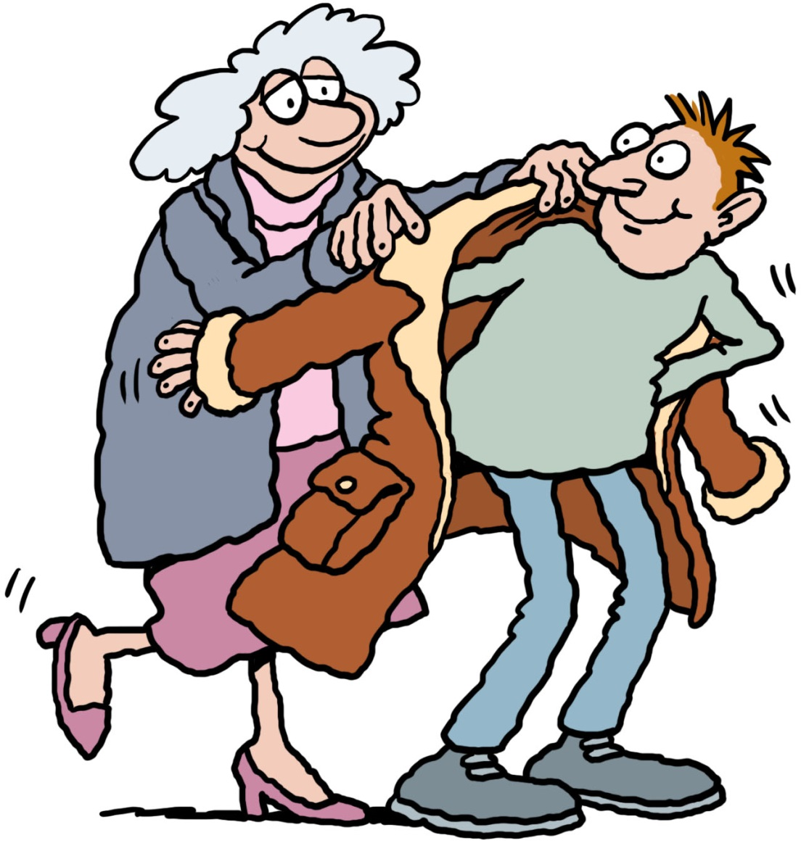
Is not this the kind of fasting I have chosen:
when you see the naked
to
clothe him,

Slide 6
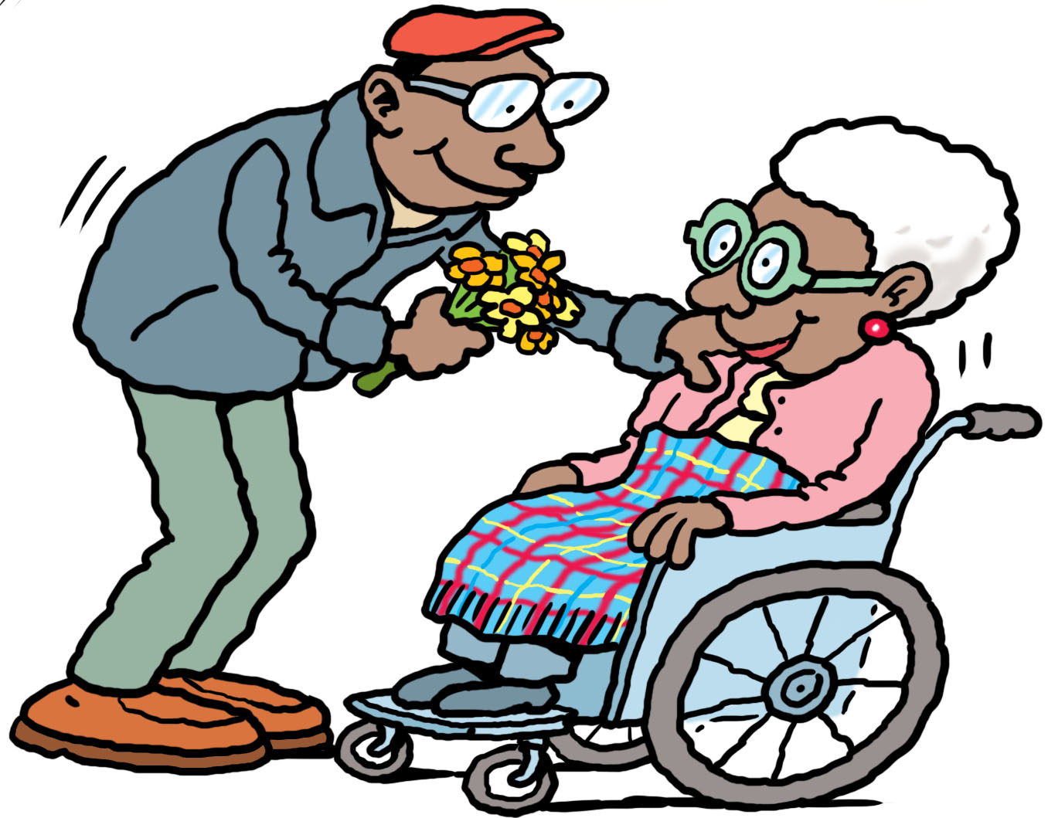
Is not this the kind of fasting I have chosen:
and not to
turn away
from
your own
flesh and blood?

Slide 7
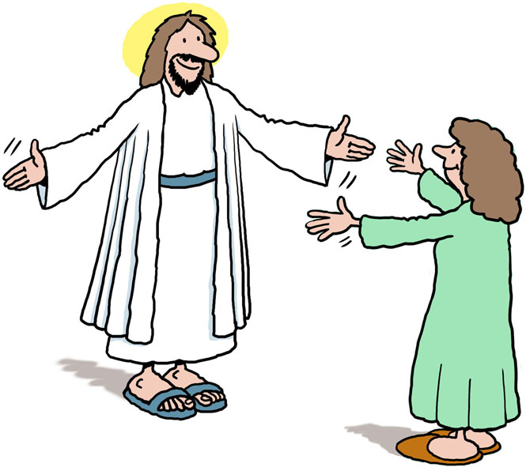
Then you will call,
and
the Lord
will answer;
you will
cry for help and
he will say,
“Here I am”

Slide 8
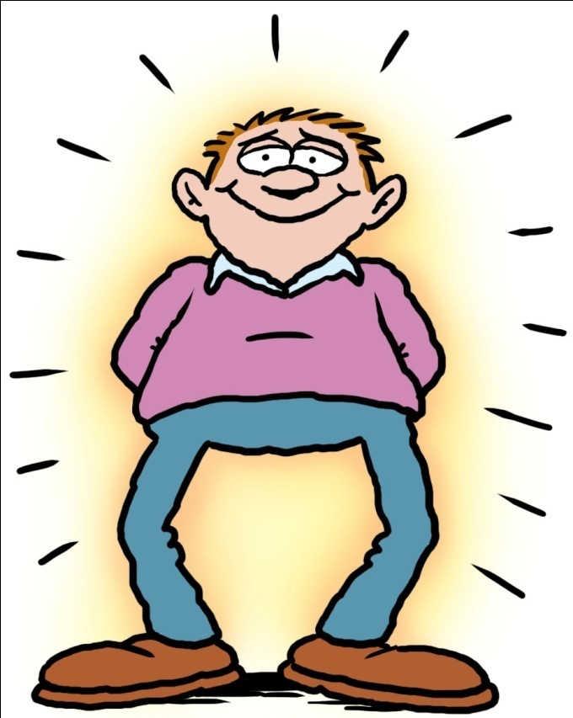
Then your light will break forth
like the dawn,
and your healing will quickly appear;
then
your righteousness
will go before you
and the glory
of the
Lord
will be your rear guard.

Slide 9
For more information
Please see our learning experiences for Lower, Middle and Upper Primary on the Catholic Social Teaching principal ‘Preferential option for the Poor’.
https://www.caritas.org.au/learn/cst/preferential-option-for-the-poor
Acknowledgements
Cartoons adapted with permission from a resource produced by CAFOD (Caritas England and Wales).
Illustrations by Ellis Nadler

