Slide 1
First Nations people are advised that this resource and external links may contain images, voices and names of people who have died.

Slide 2
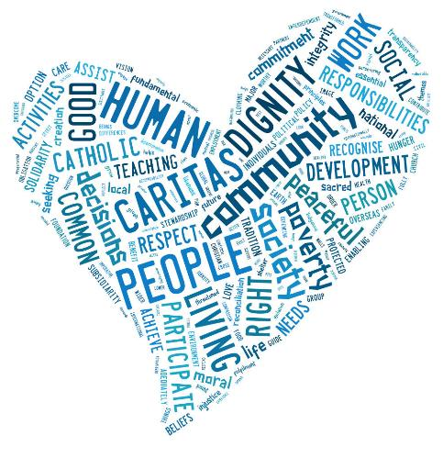
Catholic Social Teaching Prayer
Created with tagxedo.com
Notes:
Word cloud produced with tagxedo.com

Slide 3
WE BELIEVE
IN HUMAN DIGNITY
Rosalie harvests plants used for natural medicine which she has grown in a neighbour’s garden near her home in Bukavu, eastern Democratic Republic of Congo. Photo: Arlette Bashizi

Slide 4
Reader:
Loving God,
We believe that every person is created in your image and that all life is sacred.
May we always work to eliminate poverty and injustice so all people can live a life equal to their dignity.
Lord hear us.
ALL:
Lord hear our prayer.

Slide 5
WE BELIEVE
IN THE PREFERENTIAL OPTION FOR THE POOR
Biru and his wife Budhni sit with their children outside their house in their village in the state of Jharkhand, India. Photo: Sameer Bara

Slide 6
Reader:
Loving God,
May we always remember that by serving the women, men and children most vulnerable to poverty and injustice, we are loving and serving you.
Give us the wisdom to see the structures which create and perpetuate poverty and the passion to make a change.
Lord hear us.
ALL:
Lord hear our prayer.

Slide 7
WE BELIEVE
IN SOLIDARITY
Caritas Australia’s local partners help communities access supplies in the Horn of Africa. Photo: Caritas Australia

Slide 8
Reader:
Loving God,
May we recognise each other as sisters and brothers in our one global human family, all equal in your eyes. May we recognise the responsibilities we have to each other, and take an active role in helping each person achieve their full potential.
Lord hear us.
ALL:
Lord hear our prayer.

Slide 9
WE BELIEVE
IN THE COMMON GOOD
Maria looks at school work with her children outside their home in Tanzania. Photo: August Lucky

Slide 10
Reader:
Loving God,
You call us to look beyond our own interests to what is good for all people and our planet.
May we care for the Earth, our common home, and work towards a world where everyone has their fair share in order to live life to the full.
Lord hear us.
ALL:
Lord hear our prayer.

Slide 11
WE BELIEVE
IN CARE FOR OUR COMMON HOME
Aloma working to grow and nurture mangrove seedlings, to protect the community from the effects of natural disasters and storm surges in the Philippines. Photo: Richard Wainwright

Slide 12
Reader:
Loving God,
We give thanks for your gift of all creation. May we care for, regenerate and be good stewards of the Earth’s resources, always mindful of the link between our social and environmental justice.
Lord hear us.
ALL:
Lord hear our prayer.

Slide 13
WE BELIEVE
IN SUBSIDIARITY AND PARTICIPATION
Janice (left) is seated on a mat with her two young adult daughters, demonstrating how to prepare pandanus leaves for weaving. Photo: Richard Wainwright

Slide 14
Reader:
Loving God,
We give thanks for our talents.
May all people have the opportunity to participate in making the decisions that impact their own lives and in creating a just and peaceful society where no one is left vulnerable to poverty.
Lord hear us.
ALL:
Lord hear our prayer.
Amen.

Slide 15
THANK YOU

