Slide 1
Presenter notes
This PowerPoint has been developed to raise awareness about climate-related migration.
If you would like further information about Caritas Australia’s climate advocacy see the following pages:
Primary Schools: Hearts 4 Climate
Secondary Schools: Community Climate Petition
Please note:
There is some additional information and discussion questions in the ‘Notes’ section of some of the slides.

Slide 2
Curriculum links
GEOGRAPHY:
Year 4
The importance of environments, including natural vegetation, to animals and people (ACHASSK088)
Year 9
The challenges to food production, including land and water degradation, shortage of fresh water, competing land uses, and climate change, for Australia and other areas of the world. (ACHGK063)
Year 10
Human-induced environmental changes that challenge sustainability. (ACHGK070)
Environmental world views of people and their implications for environmental management. (ACHGK071)
Senior Curriculum:
Unit 3- Land Cover Transformations
The relationship between land cover change and climate change and the long-term impact of climate change on land cover. (ACHGE071)

Slide 3
Curriculum links
SCIENCE:
Year 10
Global systems, including the carbon cycle, rely on interactions involving the biosphere, lithosphere, hydrosphere and atmosphere. (ACSSU189)
Scientific understanding, including models and theories, are contestable and are refined over time through a process of review by the scientific community. (ACSHE191)
RELIGIOUS EDUCATION:
Students construct moral decision-making processes using informed personal, social and cultural perspectives;
Students develop and implement strategies to promote just ways of acting in the local community.

Slide 4
CLIMATE-RELATED DISPLACEMENT
OF PEOPLE
Notes:
Photo captions from left:
Photo credit: Caritas Australia- The land in both Tanzania and Malawi is arid and drought-like most of the year. The lack of roads to the communities, vulnerability to disasters such as drought, as well as erosion and dry soil conditions mean that the communities have experienced shortages of food supply. This photo is taken in Endashang’wet in Tanzania where the program is working to increase food security and improve access to water.
Photo credit: Caritas Switzerland- Community garden in Chawir where women plant and harvest herbs, leafy vegetables, carrots and onions. In Chawir there are two large communal gardens. Around 200 women work here every day. They plant and harvest herbs, leafy vegetables, carrots and onions.
Photo credit: Richard Wainwright- Cyclone victims. People in the Gabura area affected by cyclone Aila.

Slide 5
What is climate change?
Climate change refers to the changing average weather patterns over a period of time.
These changes are caused by both natural and human factors.
Climate change is linked to the increase in greenhouse gases in the earth’s atmosphere.
People going to work through heavy rain in Bangladesh. Photo credit: Richard Wainwright.
Notes:
DISCUSS:
What do you know about climate change? What have you heard? Where have you heard this information? What questions do you have?
How does this definition fit in with what you have heard or what you know?
What kinds of weather pattern changes can you think of?
Do you any recent events come to mind?
What kind of natural and human factors can you think of?
Can you name any leaders you know who have discussed climate change?

Slide 6
How can climate change affect people?
Climate change in itself does not directly displace people.
However, climate change may have environmental effects that make it difficult for people to survive where they are.
A farmer who has received help with sustainable agriculture techniques in Afghanistan. Photo credit: Caritas Australia.
Notes:
DISCUSS:
What does ‘displace’ mean?
What kind of environmental effects make it difficult for people to survive?

Slide 7
How are People affected?
There are many reasons people are forced to leave their homes.
Today, climate-induced migration affects millions of people, as they are forced to leave their homes as a result of climate change.
As they do not meet the definition of a refugee, they receive no legal protection.
Bangladesh Floods 2004
Pakistan. Photo credit: Laura Sheahan/Catholic Relief Services.
Notes:
DISCUSS:
Can you think of some reasons for the displacement of people?
We traditionally associate displacement with people being forced to leave their homes due to conflict, injustice or persecution.

Slide 8
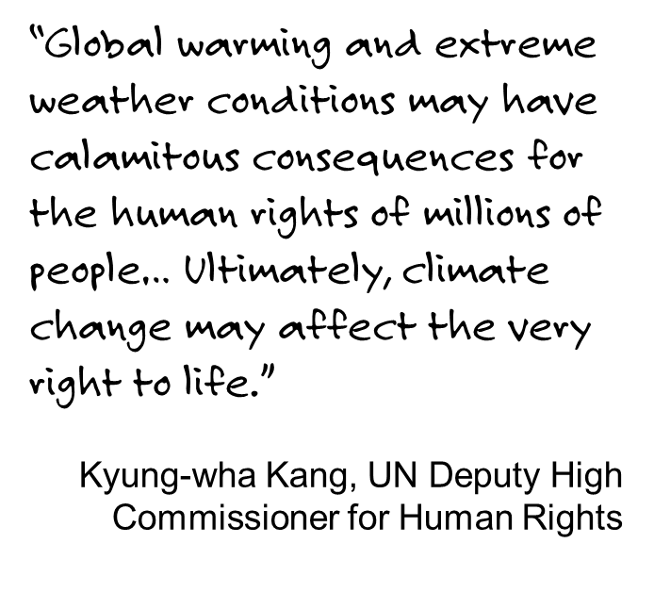
HUMAN RIGHTS
A Bangladeshi man carries his son as he wades through chest-deep waters at a flooded village in July 2004. Floods engulfed vast areas in Bangladesh killing at least 11 people and leaving two million marooned. Photo credit: REUTERS/Rafiqur Rahman
Notes:
Floods engulfed vast areas in Bangladesh killing at least 11 people and leaving two million marooned.
Discussion:
“Climate change may affect the very right to life.” What does this statement mean to you?

Slide 9
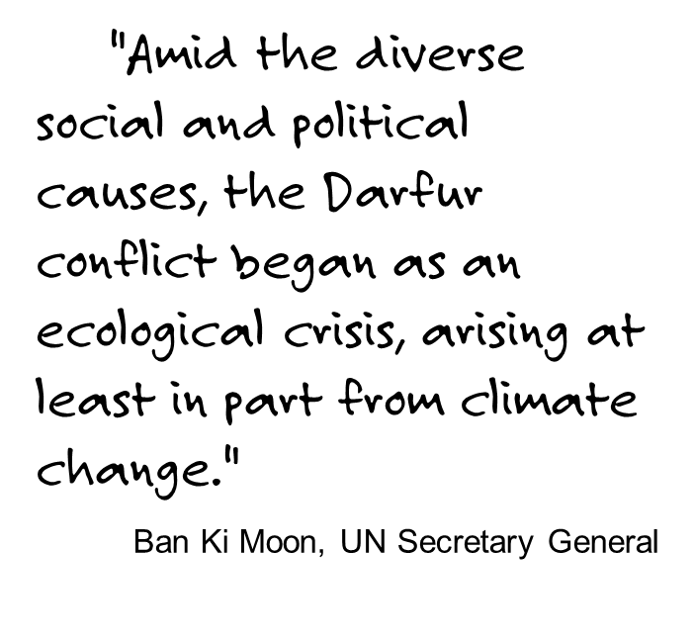
HUMAN RIGHTS
Helping with the distribution of sorghum during the food crisis in Chad. Photo credit: Caritas Switerzerland
Notes:
Caritas is helping with the distribution of sorghum so that people here get at least one meal a day until the next harvest. Sorghum is a main food source for people in Chad during the food crisis.
DISCUSS:
Where is Darfur? What do you know about the conflict there?
What might be some social and political causes and how might they be linked to ecological crises?

Slide 10
The scale of the problem
Climate change disasters cause more population displacement than war and persecution.
It is estimated that at least 25 million people are currently displaced by climate change.
This could increase to 150 million by 2050.
Philippines. Photo credit: Eoghan Rice- Trocaire Caritas Ireland.
Asian tsunami
Notes:
Source: International Federation of Red Cross

Slide 11
Why people may be displaced by climate change:
1) Sudden natural disasters, e.g. floods, volcanic eruptions, cyclones or earthquakes.
2) Long-term environmental effects occurring over time, e.g. desertification, rising sea levels, soil erosion, land degradation, changing water table or seasonal river flow changes.
Notes:
Photographs clockwise from top left: Burma, Indonesia, Samoa, India- Richard Wainwright.

Slide 12
What could happen if there was an increase of a few degrees centigrade?
Decreased ability to generate an income from agriculture
Increased food prices
More people at risk of hunger
Food and water insecurity
Resurgence and spread of many diseases including malaria, cholera and respiratory tract infections
Intergovernmental Panel on Climate Change (IPCC)

Slide 13
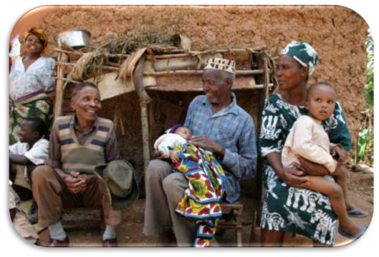
People move to new areas to:
grow their crops
find food, water and shelter
find employment
But these areas are often already overcrowded or unsafe due to conflict.
Poor harvests have left millions hungry across West Africa with many eating only one meal a day, Mali. Photo credit: Caritas Switzerland

Slide 14
Internally displaced people (idpS):
are people forced to leave home, but who remain in their own country
find themselves in situations similar to those faced by refugees
rarely have the same levels of protection and assistance as refugees.
Solomon Islands. Photo credit: Richard Wainwright.
East Timor IDP camp

Slide 15
People displaced by climate change
People displaced by climate change:
are people forced to undertake climate-induced migration, leaving their homes and country due to the impacts of climate change
are not recognised as refugees under international law and so are often denied protection and assistance.
Bangladesh. Photo credit: Caritas Australia
Asia floods 2007
Notes:
Photograph caption: Flood affected area in Bangladesh.

Slide 16
People displaced by climate change
Call upon industrialised
countries to reduce their
greenhouse gas emissions
and assist them to mitigate
and adapt to climate change.
Teriba of Nusabaruka in the Solomon Islands drinks water from a Caritas water project. This project is in response to the El Nino drought. Photo Credit: Joanne Hickey
Asia floods 2007

Slide 17
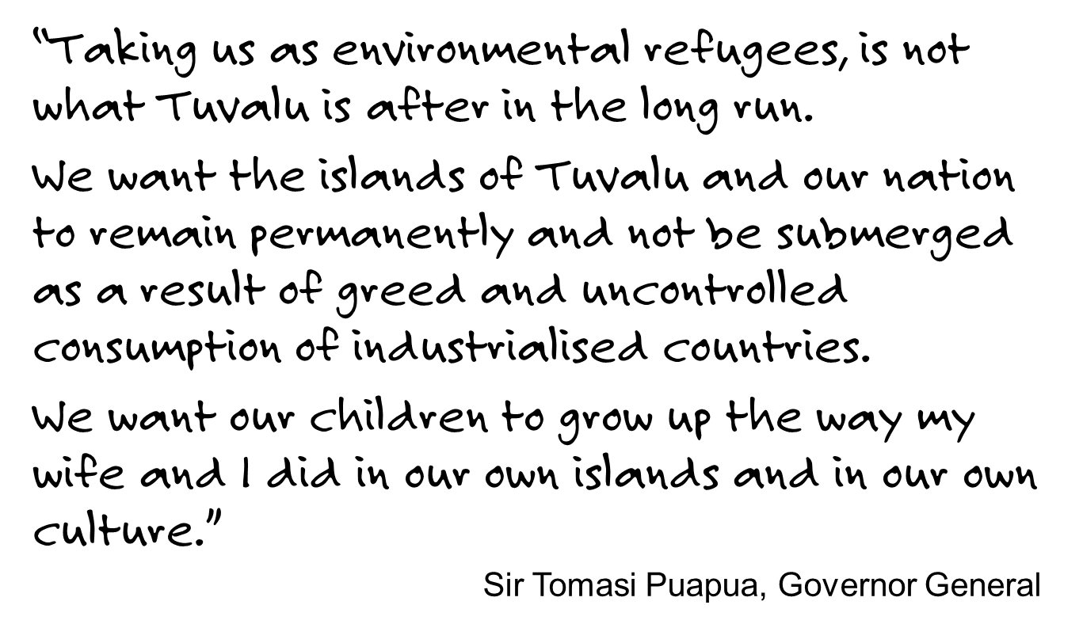
TUVALU
Notes:
Source: http://www0.un.org/webcast/ga/57/statements/020914tuvaluE.htm

Slide 18
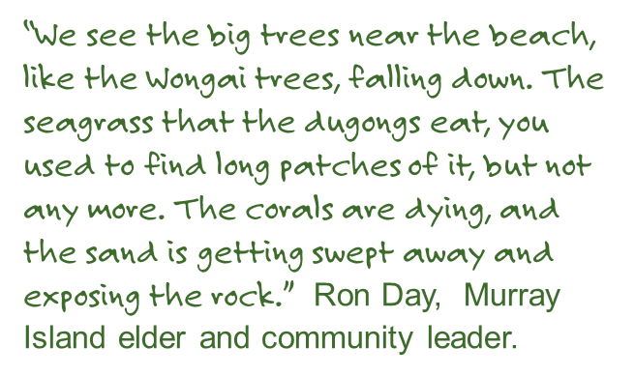
australia
The low-lying Torres Strait
Islands face similar
challenges to South Pacific
nations, yet their concerns
are barely known by other Australians.
Torres Strait Islands. Photo credit: OceanWildImages.com

Slide 19
What is caritas Australia doing?
Caritas Australia works through local partners to address both the short and long-term needs of people affected by climate disasters.
We assess the threats and
support vulnerable
communities to adapt to new weather conditions and to reduce the risks of disasters.
Gusto and family in Bangladesh. Photo credit: Richard Wainwright.
Notes:
Photo caption: Gusto and his family in Bangladesh

Slide 20
What is caritas Australia doing?
We train communities in sustainable agricultural practices and help them to build local water points and water tanks.
Women carrying home water in Miel, Abala district, Niger, where the Caritas network is helping improve village wells that now must serve Malian refugees as well as local people affected by the Sahel crisis.. Photo credit: Catholic Relief Services.
Notes:
Photo caption: Women carrying home water in Miel, Abala district, Niger, where the Caritas network is helping improve village wells that now must serve Malian refugees as well as local people affected by the Sahel crisis.

Slide 21
What is caritas Australia doing?
Climate change makes life even harder for people living in poverty.
Caritas Australia aims to help people lift themselves out of poverty, without making climate change worse.
Gosto, Bangladesh. Photo credit: Richard Wainwright.

Slide 22
What is caritas Australia doing?
We work in collaboration with other organisations to address structural injustices.
Together, we challenge
policies and practices that
increase displacement due
to climate change.
Photo credit: Caritas Internationalis.

Slide 23
What is caritas Australia doing?
Caritas is looking at ways to reduce our own ecological footprint through work practices and policies such as recycling, teleconferencing to reduce air travel, hybrid car hire and auditing and reviewing our ecological footprint.
Festival of Global Concern

Slide 24
What is caritas Australia doing?
Caritas Australia is also
calling on its supporters to
take action on climate change by re-examining their lifestyles so as to live
sustainably and in solidarity
with the world’s poorest
communities.
Australia. Photo credit: Kissphotogrpahy
Festival of Global Concern
Notes:
Photo caption: With students after an activity making lanterns from old Project Compassion posters are (front centre) Caritas Australia diocesan director Joe Foley and (back centre, in blue) Latin America program co-ordinator Siobhan Jordan and global education advisor Susan Bentley. The annual campaign was launched in Brisbane on March 4. Photo: kissphotography.
Source: http://catholicleader.com.au/news/cuts-hit-the-poor

Slide 25
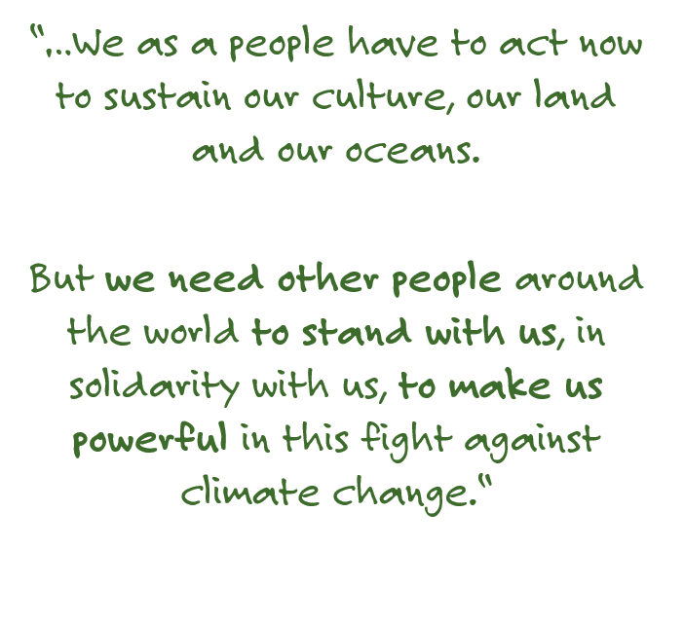
Amelia Ma’afu
CEO of Caritas Tonga, Caritas Australia’s sister agency.

Slide 26
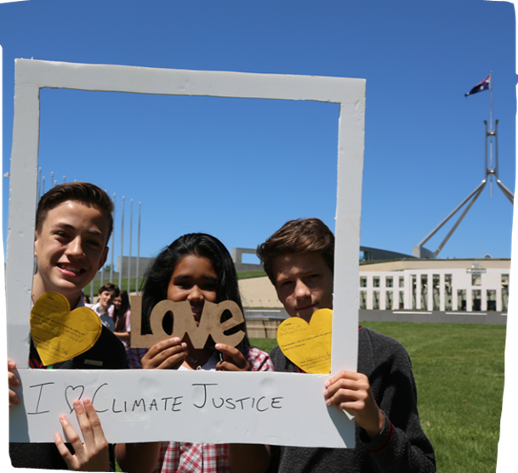
you can help!
Write to the Minister for Immigration and Citizenship, to call on the Australian Government to develop an integrated strategy to assist people displaced by climate change.
Reduce your greenhouse gas emissions
Raise awareness of the issues of climate-induced migration
Support Caritas Australia to help communities vulnerable to the effects of climate change.
Parliament House, Canberra. Photo Credit: Caritas
Notes:
Students across the country were writing heart-shaped love letters to Prime Minister Malcolm Turnbull, urging him to have a Heart4Climate, as part of the Caritas Australia Our Common Home campaign, inspired by Pope Francis’ Encyclical on climate change. The Hearts4Climate letters urged Mr Turnbull to think about future generations and to commit to strong emission reduction targets post 2020. Other actions included asking the government to give Australia’s fair share of funds for climate change adaptation in poorer countries.
Churches and other faith groups represent surprising and often powerful constituencies on climate change. If they are seen to take the lead across multiple electorates, this can generate public and political influence (as our Federal Parliament has a disproportionately large number of people professing Christian faith compared to the general population.

Slide 27
Community climate petition:
Community Climate Petition
This petition calls on the Australian Government to take stronger action to reduce our emissions, transition away from fossil fuels and towards renewable energy, and support our poorest and most vulnerable neighbours as they face the increasing impacts of climate change.
Learn more about how to take part: www.caritas.org.au/climate-petition
Caritas Australia and many other faith-based organisations are coordinating a huge campaign for climate justice: a multi-electorate, 150-petition campaign involving every MP in the country.

Slide 28
Discussion questions
Where would you go if your home was affected by extreme climate changes?
Who should be responsible for providing homes for people displaced by climate change?
Should people forced to flee their home due to environmental effects be recognised under international law as refugees? Why/ why not?
Young Bangladeshi women who have learnt about climate change through a Caritas Australia supported program. Photo credit: Caritas Australia.

Slide 29
CATHOLIC SOCIAL TEACHING
How do the Catholic social teaching principles of solidarity, stewardship and the common good fit into the discussion about climate-related displacement?
How might the future of people displaced by climate change differ if governments were to provide assistance to deal with the effects of climate change?
What action has the current government taken on climate change and what further changes need to be made?
What can we do individually and collectively to reduce the effects of climate change?
Children working in their school garden, Timor Leste. Photo credit: Caritas Australia

