Slide 1
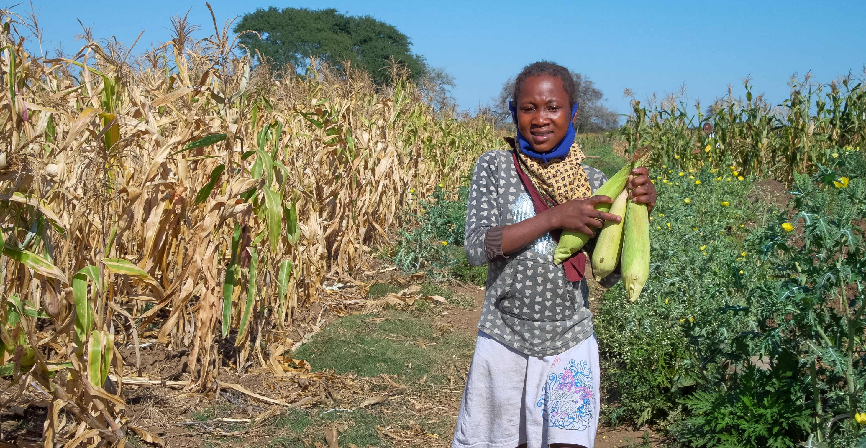
The Gift of Me
I am a special person.
God gave me the gift of life and I thank God for making me, Me.
No-one looks the way I do!
I have noticed this is true.
No-one speaks just like me or thinks or writes or climbs a tree.
I am somebody!
Photo: Emidio Josine
Notes:
Anatercia (12) carries corn next to her fields in Gaza province, Mozambique. Anatercia helps her elderly grandmother on the farm where they grow corn, beans, sweet potato, casava and lettuce. The farm is over an hour walk away from home so when her grandmother can’t make the journey, other community members help Anatercia. She goes to the fields about four times a week.

Slide 2
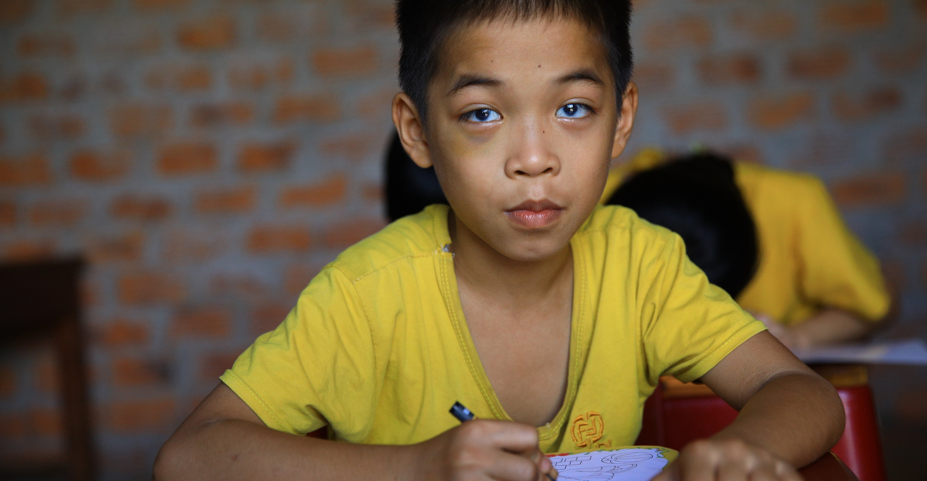
You know why I’m glad today?
‘Cause Jesus loves me, just this way
And I can love Him back you see.
So, I’m mighty glad I’m me!
Photo: Caritas Australia
Notes:
Quan* (8) has vision impairment and has been able to join a community-based classroom where they have been able to interact with other children living with disabilities.

