Slide 1
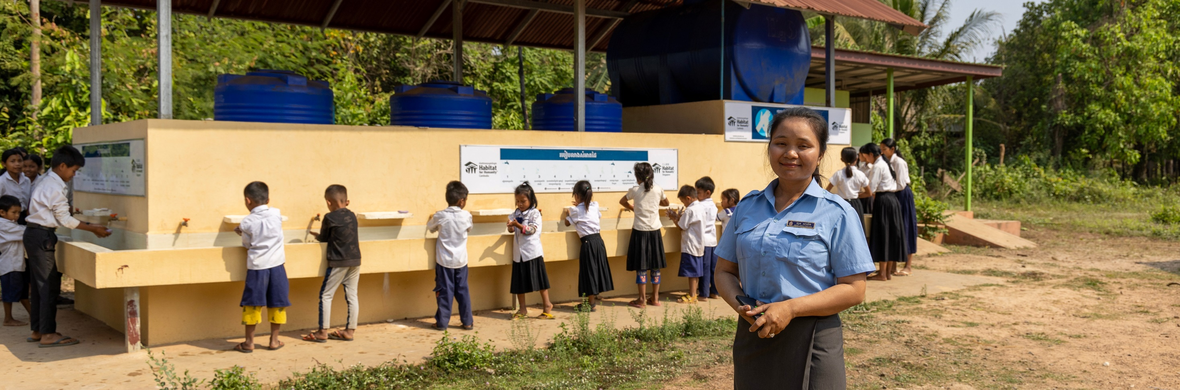
Lower Primary
Notes:
Salin stands in front of school children in Cambodia who are all lined up accessing safe and clean water. Photo: Caritas Australia

Slide 2
First Nations people are advised that this resource and external links may contain images and names of people who have died.
* Photo captions and credits are in the ‘Notes’ section of each slide.
Created September 2024

Slide 3
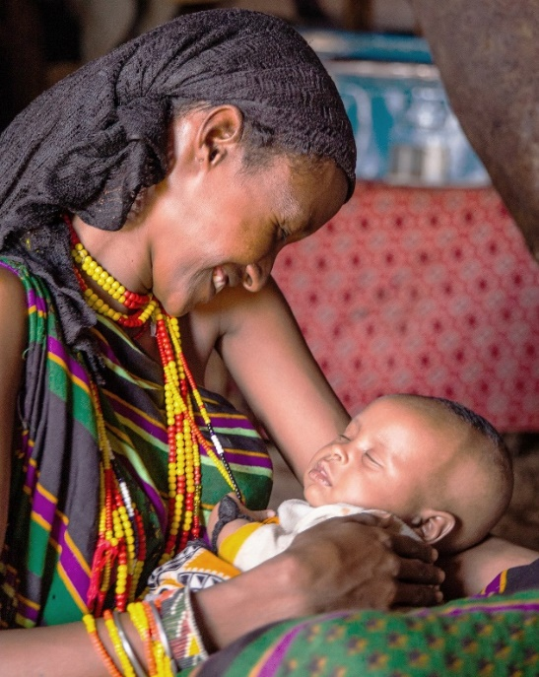
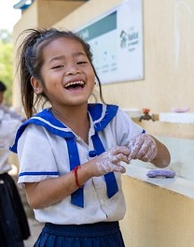

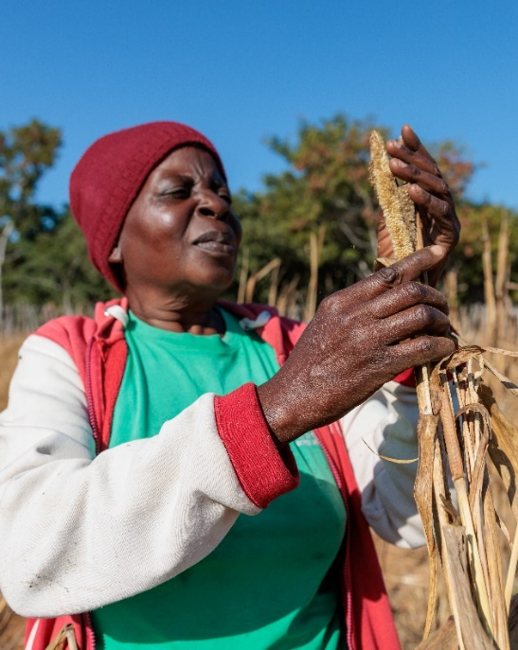
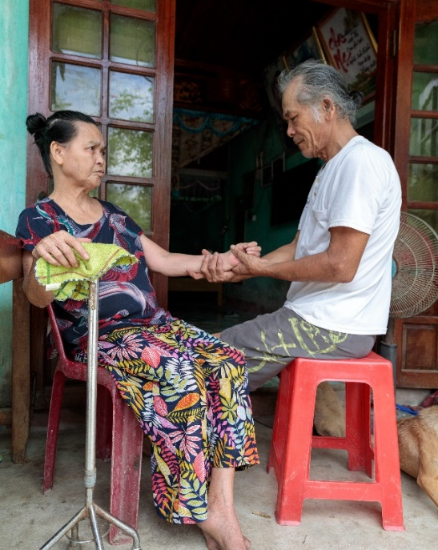
Fruits Of The Holy Spirit
Love
Joy
Peace
Patience
Kindness
Notes:
L-R Photo: This young family are members of a pastoralist community who are experiencing extreme drought in northern Kenya. The drought is making it challenging for members the community as they are dependent on livestock to feed and support their family. Photo: CAFOD; A young girl washing her hands at her school in Cambodia. Photo: Caritas Australia; Shaniella looks out over the ocean from a Rural Training Centre near the capital Honiara, Solomon Islands. Photo: Neil Nuia; Priscilla inspects her drought affected fields of millet next to her home in Hwange district, north-western Zimbabwe. Photo: Caritas Australia; Thu gives his wife, Linh, who suffered a stroke, a massage at their home in Quang Tri province, Vietnam. Photo: Caritas Australia.

Slide 4
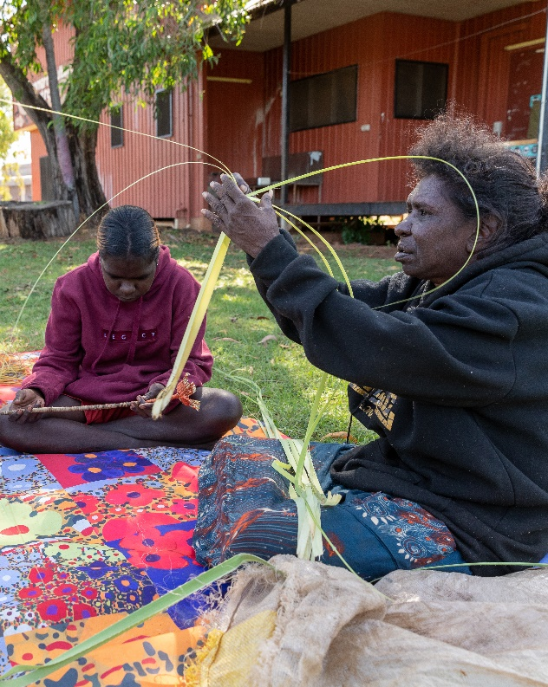
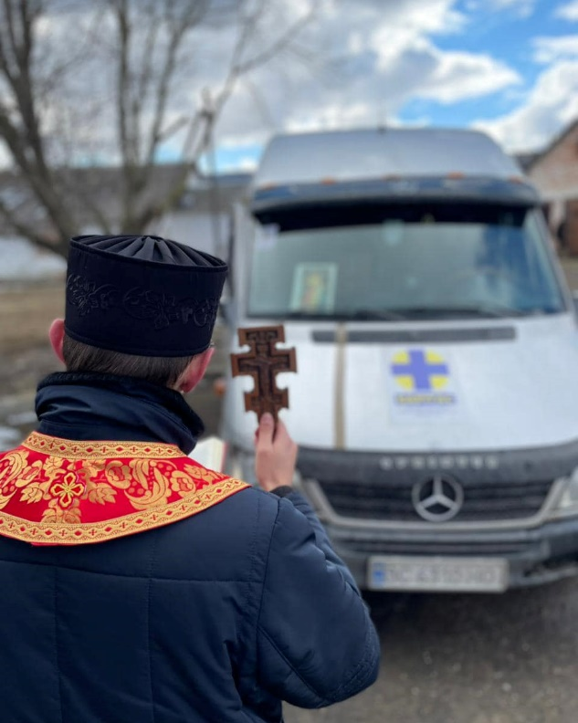
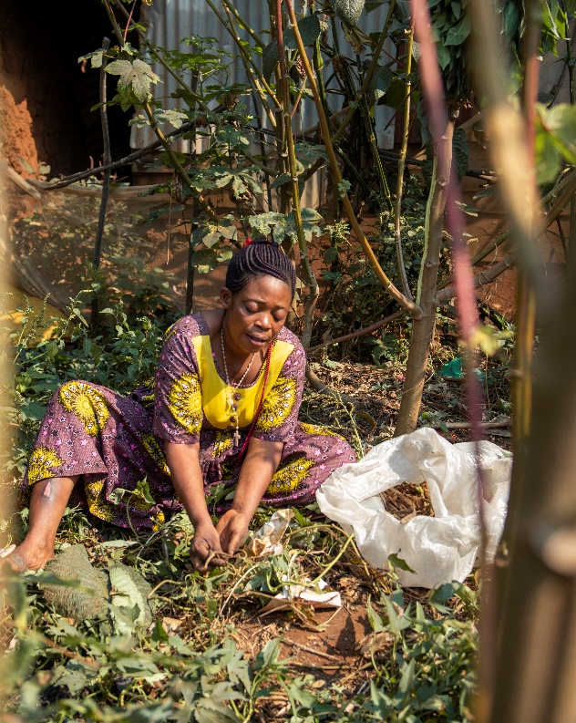
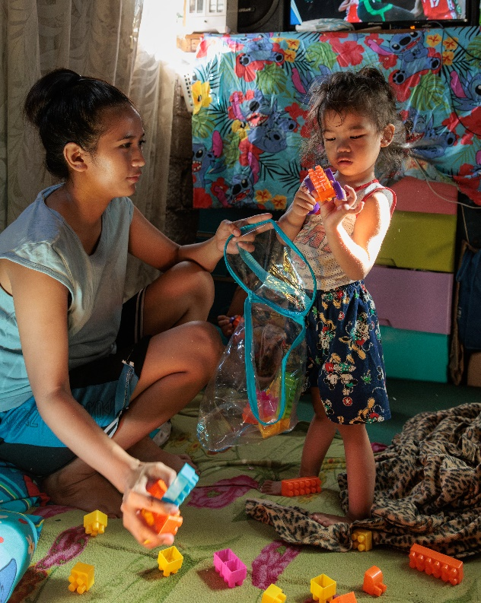
Fruits Of The Holy Spirit
Goodness
Faithfulness
Gentleness
Self-Control
Notes:
Photo L-R: Janice shows her daughters how to prepare pandanus leaves collected from a forest near Djilpin Arts in Beswick, Northern Territory, Australia. Artists at Djilpin Arts weave the pandanus leaves, tinted with natural dyes, into dramatic, round fibre artworks for sale in the shop. Photo: Caritas Australia; Rosalie harvests plants used for natural medicine which she has grown in a neighbours garden near her home in Bukavu, eastern Democratic Republic of Congo, July 2021. As well as selling second-hand shoes, Rosalie makes an income by growing and selling natural medicine at her local market. Photo: Caritas Australia. Harnessing the Church network to respond to crisis. Photo: Caritas Ukraine; Ronita (22) plays with her youngest son Egzy Grey (3) at their home in Quezon City, Philippines. Photo: Caritas Australia.

Slide 5
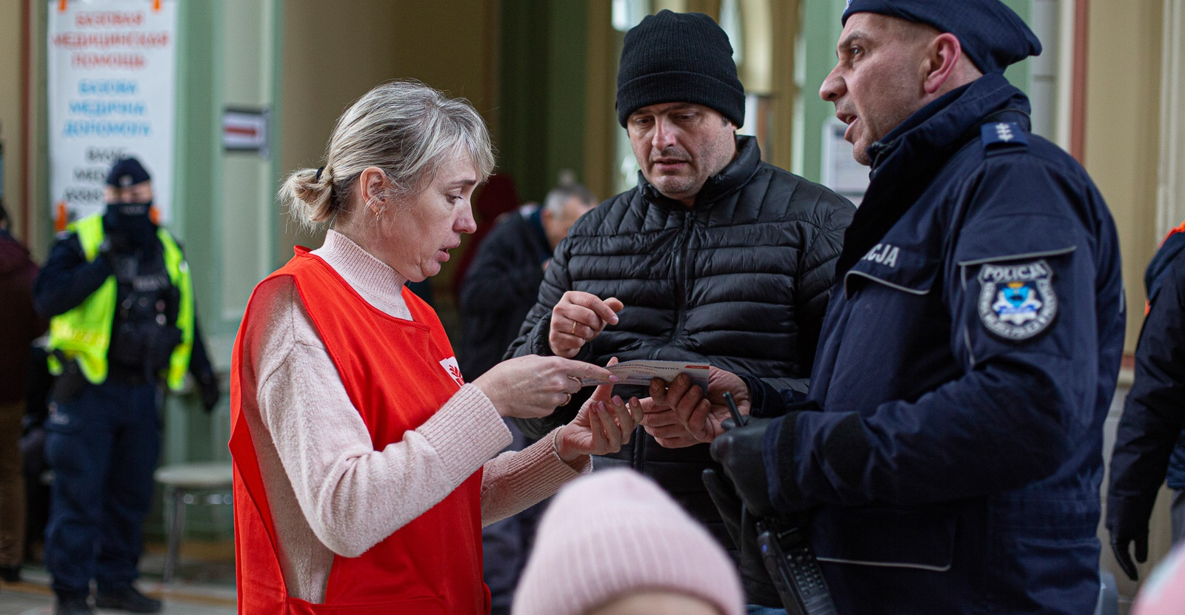
‘use your gifts to serve one another.’
1 Peter 4:10
Photo: Caritas Poland
Notes:
Khalina uses her Polish and Ukrainian language skills to translate to displaced people feeling conflict in Ukraine on the boarder of Poland and Ukraine.

