Slide 1
Caritas and Works of mercy
Tip: see the ‘Notes’ section to learn more about Caritas Australia’s work.
WARNING: Aboriginal and Torres Strait Islander viewers are warned that the following presentation may contain images of deceased persons.
Secondary
Religious Education
Updated May 2018

Slide 2
Caritas Australia’s mission
Children, women and men most vulnerable to extreme poverty and injustice are rich in the eyes of Jesus, whose life and compassion inspires Caritas Australia.
Through effective partnerships in humanitarian relief and development and by transforming hearts and minds in the Australian community, Caritas Australia helps to end poverty, promote justice and uphold dignity.

Slide 3
Caritas Australia’s mission
Caritas organisations around the world demonstrate mercy. By supporting Caritas Australia to end poverty, promote justice and uphold dignity, you are participating in the work of mercy.
Together we can be God’s love in the world today.

Slide 4
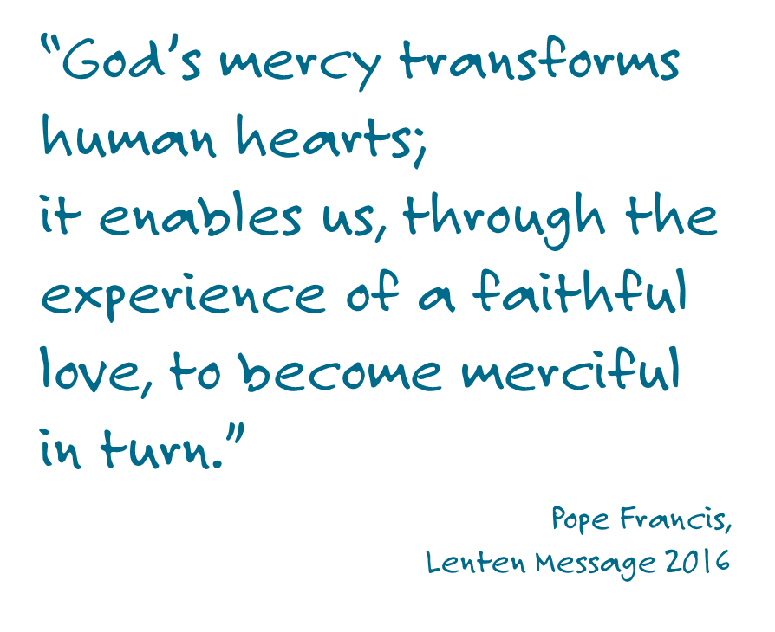

Slide 5
What are the Corporal works of mercy?
feed the hungry
give drink to the thirsty
clothe the naked
welcome the stranger
heal the sick
visit the imprisoned
bury the dead
East Timor Photo credit: Sean Sprague

Slide 6
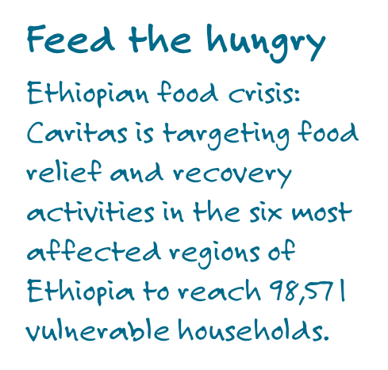
Photo credit: David Snyder for Catholic Relief Services
Notes:
In recent reports (January 2016) the number of people who need emergency food assistance in Ethiopia has risen to over 18 million due to one of the worst droughts in 50 years.
The majority of people in Ethiopia are small scale farmers who entirely depend on rain-fed agriculture. The lack of a harvest this year and uncertain weather predictions for next year mean they will not be able to feed their families. The prolonged lack of clean water and sanitation could lead to disease outbreaks that could endanger millions of children.
How is Caritas responding?
Caritas Ethiopia is currently responding to this crisis situation with the support of the international Caritas network, including Caritas Australia which is committing funding support. The Caritas network is providing emergency food aid, water, health and sanitation services, and improved nutrition.
Caritas Australia has to date pledged $75,000 and is seeking to commit more funding as it is raised, to this dire situation.
To learn more: http://www.caritas.org.au/learn/emergency-response/ethiopia-food-crisis

Slide 7
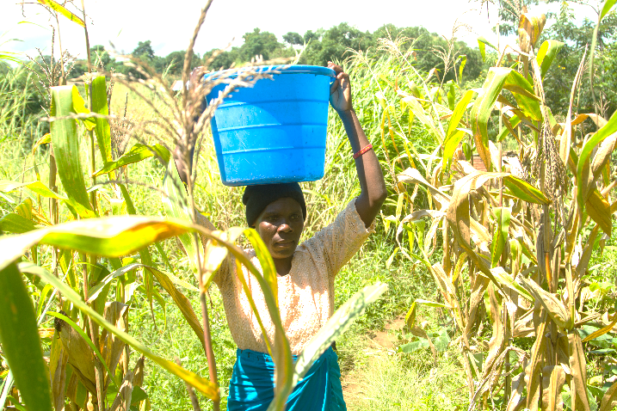
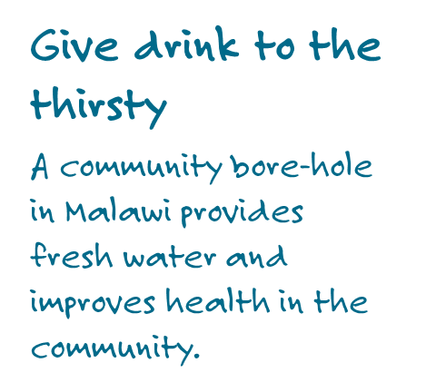
Photo credit: Andrew Garrick and Andrew McClymont
Notes:
Doney lives in Malawi in Africa. Many families have very small blocks of land. They are subsistence farmers – they grow enough for their families to eat. Yet many are hungry.
When Caritas Australia and the local Caritas, called CADECOM (the Catholic Development Commission in Malawi), began a program in Doney’s village, they didn’t simply see poverty, isolation and food shortage: they saw people filled with God’s gifts. Some were able to think of good ideas. Others were strong enough to dig and plant, while others were great organisers.
Encouraging the community to make the most of their land, CADECOM worked with families to demonstrate new farming techniques, so crops would be more plentiful and reliable. The villagers learned the best way to build up the soil, to make compost and how to make plants more productive.
People began to make money and so a village bank began. Doney’s husband, Nedson borrowed money to buy material to make clothes. “We sell the products and through this we get money to pay our children’s school fees,” says Doney.
As the community looked at their strengths, Doney’s skills and passion for education were quickly recognised. Despite only finishing primary school, Doney gained the skills to teach literacy and numeracy to adults in the village. “I was chosen by the community and after that CADECOM took me for training in Adult Literacy as a Facilitator,” she says. “In the past people didn’t know how to read and write. Now many are able to read and write as well as know how to count money.”
Through the program, families have built hand-washing facilities at their homes and have learnt about better hygiene. The community has dug a borehole that provides fresh water. These days there are far fewer cases of diseases like diarrhoea, which used to stop children from going to school.
To learn more: http://www.caritas.org.au/docs/default-source/pc-16/secondary-doney-story.pdf

Slide 8
Photo credit: Caritas Australia
Notes:
Nepal Earthquake Response
On 25 April 2015, a 7.8 magnitude earthquake struck Nepal. This was followed by a second earthquake 17 days later. Caritas Australia has been working with our local partner to provide emergency relief to nearly 300,000 people.
The earthquakes caused immense devastation throughout the country. Nine thousand people lost their lives and many more were injured. Over 800,000 houses were fully or partially destroyed in addition to the damages caused to the infrastructures, schools, government and community buildings. Nearly 1/3 of the total population or 8 million people in 39 of Nepal’s 75 districts were affected by these massive earthquakes.
How has Caritas been helping?
Caritas has been working hard to reach as many people affected by the earthquake as effectively as possible. We have been working with our local partner Caritas Nepal to support households in rebuilding their communities, by providing:
70, 000 basic shelter support
37, 000 water and hygiene kits
23, 000 food and seed packs
24, 000 corrugated iron sheeting packs
Reaching remote communities has been a key challenge in this emergency response. In some instances, staff have travelled by foot to reach mountainous areas, or used helicopters to deliver relief items. Caritas Australia continues to provide support as part of the Humanitarian Partnership Agreement between the Australian Government and six of Australia's leading international NGOs.
Looking ahead
We are now moving into the next phase of response, focusing on strengthening and rebuilding communities for the long term. Our integrated human development approach will continue to support whole communities and the whole person, in every dimension of life. Caritas Australia were on the ground before and during the disaster and will continue to support our partners in solidarity towards a brighter and more resilient future.
To learn more: http://www.caritas.org.au/learn/emergency-response/nepal-earthquake-appeal

Slide 9
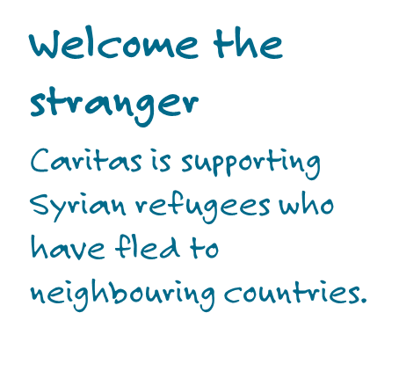
Photo credit: Caritas Switzerland
Notes:
The conflict in Syria and the Middle East is described as the largest humanitarian crisis in recent years by the UNHCR.
12.2 million people are in need of assistance, including 5.6 million children. At least four million of these people have fled the country since the conflict started on 15 March 2011.¹
How Caritas is helping
For many years, Caritas Australia has been working in partnership with our local Caritas agencies in the Middle East to help in many of the countries where the Middle East migrants and refugees originate from, including Syria. Our work in Syria, Turkey, Lebanon, Jordan and Iraq is prioritising the displaced families, as well as supporting the neighbouring countries that host refugees.
We are working with multiple partners from the Caritas network to identify a coordinated response and deliver emergency aid to best help thousands of families affected by the violence. We have supported emergency relief and recovery activities in Jordan, Lebanon, Syria, Iraq, Turkey, Egypt and Gaza. These responses have included help for displaced families and host communities such as:
Food assistance
Healthcare, including GP clinics, secondary services (such as surgery) and psychosocial / mental health support
Educational and social services, including protection to vulnerable refugees
Water, sanitation and hygiene (WASH)
Shelter
Non-food items (such as blankets, clothing, hygiene kits, heaters and bedding materials)
Our sister agencies in the Caritas network across Europe are currently playing a significant role in providing support to tired and traumatised refugees. With the support of the Australian community, Caritas Australia will continue to respond to the affected communities’ needs and partner requests as they emerge. To learn more: www.caritas.org.au/Syria

Slide 10
Photo credit: Simon Hewson
Notes:
When Nankamarra received her diagnosis of kidney failure, she learned that she had to move to Alice Springs, 550km away. Living in a hostel, Nankamarra desperately misses home. “I have to sleep indoors all the time. I have no family here. I stick to myself. I am homesick.” Nankamarra is deeply connected to culture, her mob and their dreaming. “My mother and father […] live in Kintore. […] They are getting old now. I am not there to look after them.”
To keep her spirits up, Nankamarra visits The Purple House, which supports patients who have been dislocated from country and culture.
“At The Purple House I ring home and speak to my family. Sometimes we cook kangaroo tails in the fire, go for picnics and pick bush medicine to make. There is a big mob of Aboriginal people working here. It is our place; we are welcome all the time.”
Caritas Australia supports a new income generating enterprise at The Purple House –making and selling bush balms. “My favourite balm is Irremenke Irremenke. It is a good bush medicine that our grandmothers used to make. It is good for pain and headaches. […] I love the smell of the bush balm mix boiling up. It reminds me of home”, says Nankamarra. “There are young people learning these things too. That is good, so the old ways are not lost.”
Until Nankamarra is palya (well enough to return to her country), The Purple House is her home away from home.
To learn more: http://www.caritas.org.au/learn/programs/australia---the-wellbeing-project/lorraine-our-place
Update: Sadly, Nankamarra passed away in 2018.

Slide 11
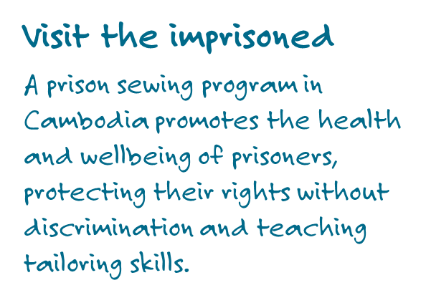
Photo credit: Caritas Cambodia
Notes:
A mother of four from Kandal Province in Cambodia, Bopha, 31, was sent to Kratie prison in September 2013. Thanks to a sewing program supported by Caritas Australia and Caritas Cambodia, which aims to promote the health and wellbeing of prisoners, protect their rights without discrimination and teach tailoring skills, she left the prison full of hope.
When Bopha was growing up, she helped her widowed mum by caring for her five younger brothers. Arranged by her mother, Bopha married a man from her village, and very soon, she had to care for three young sons of her own. After persistent acts of violence from her husband, Bopha left him and took her children to her mother’s home so she could earn a living as a karaoke girl. Although this meant she had to live away from her young family, it also meant she could earn an income. Life soon took a different turn when Bopha fell pregnant. “Because I did not know how to read or write and could not make enough money to sustain my family, I was selling illegal drugs with my boyfriend and went to prison,” she says. Four months pregnant at the time, Bopha attended regular maternal healthcare checks at Kratie prison.
“I felt like the Caritas and prison staff were
close friends with me. They took care of
my pregnancy, gave me good advice, good
healthcare, medicine and food supplement for
my baby.”
When Bopha heard about a Caritas-supported sewing program, she started to dream about a better life. She tells Caritas Cambodia that while staying at the prison she was no longer depressed, as every day she wanted to sew. “I’ve become very good, very skilled,” she says proudly. “I suddenly got a lot of hope and started dreaming that I could become a tailor … the program gave me skills and hope for the future. “Now that I’ve learned new skills, I can go back to my village. I can live with my mother and my four children; I will be a tailor in my village.”

Slide 12
Bury the dead
The international Caritas network, through Catholic Relief Services, supported the District Medical Office with the safe and dignified burials of Ebola victims in three districts in Sierra Leone.
Photo credit: Caritas Internationalis/CRS
Notes:
An outbreak of Ebola led to a humanitarian emergency in West Africa in 2014/15. The international Caritas network responded to the outbreak by working to reduce transmission of the virus, and helping families affected by the outbreak.
Caritas Internationalis member agency, CRS, supported the District Medical Office with the safe and dignified burials of Ebola victims in 3 districts in Sierra Leone. In the district of Port Loko, CRS supported 9 out of the 11 burial teams to bury anywhere from 20 to 30 deceased per day. CRS also supported the cemetery teams (grave diggers) in 3 designated cemeteries. Every death is treated as an Ebola victim as an extra precaution.
Caritas Australia, along with three other Australian humanitarian agencies, received funding from the Australia Government’s Humanitarian Partnership Agreement to respond to the Ebola outbreak in Sierra Leone. The wider international Caritas network also worked in other West Africa countries affected by Ebola, including Guinea and Liberia through existing partnerships.
To learn more: http://www.caritas.org.au/learn/emergency-response/ebola-outbreak

