Slide 1
The beatitude of Blessed are the poor in spirit
Matthew 5:2-3

Slide 2
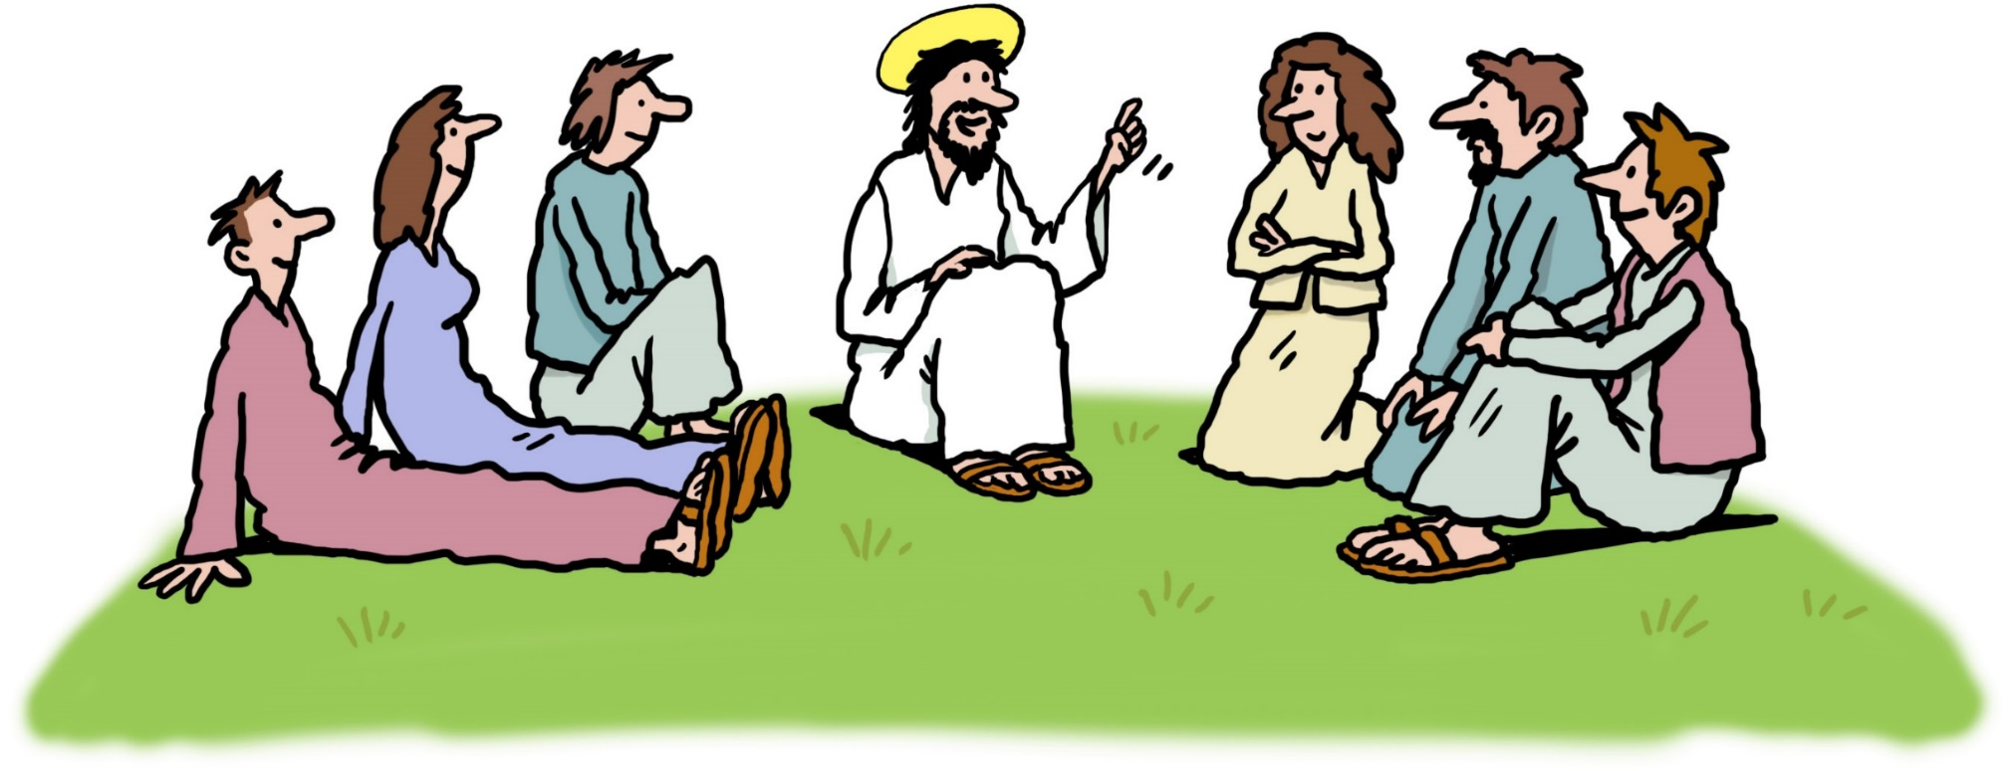

Slide 3
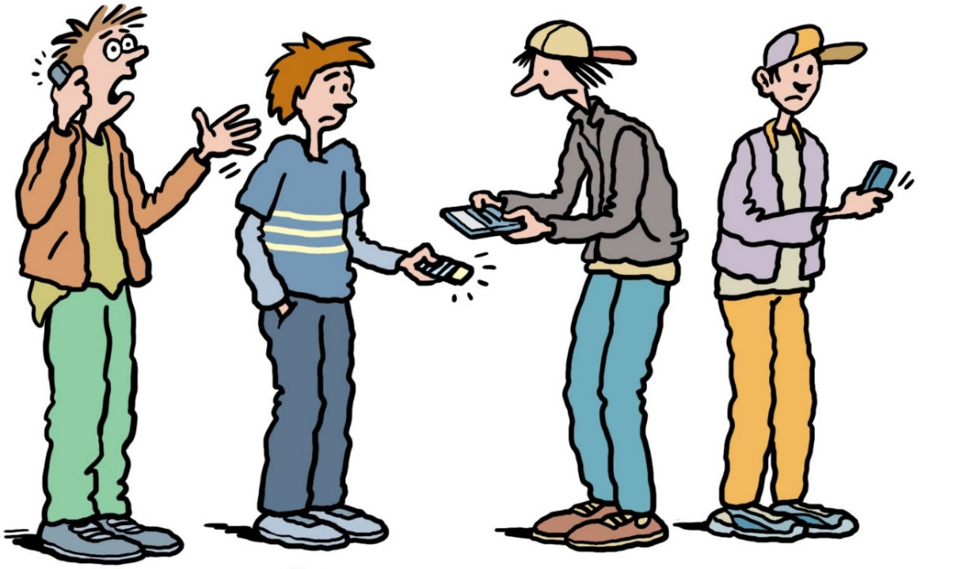

Slide 4
“First of all, try to be free with regard to material things…

Slide 5
…The Lord calls us to a Gospel lifestyle marked by […] a refusal to yield to the culture of consumerism. This means being concerned with the essentials and learning to do without all those unneeded extras which hem us in…

Slide 6
…Let us learn to be detached from possessiveness and from the idolatry of money and lavish spending….

Slide 7
…We must be ready to change our lifestyle and avoid so much wastefulness. Just as we need the courage to be happy, we also need the courage to live simply.”

Slide 8
Acknowledgements
Adapted with permission from a resource by CAFOD (Caritas England & Wales)
Illustrations by Ellis Nadler
Text from Pope Francis, Message for the 29th World Youth Day.

