Slide 1
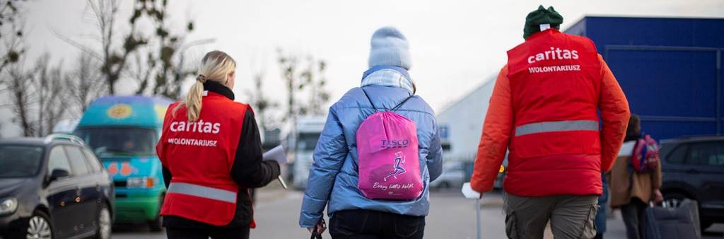
CST: Solidarity
Lower primary: Foundation to Year 2
What is Love?
Photo: Philipp Spalek
Notes:
Caritas Poland supporting refugees coming from Urkaine in Prezemysl, Poland.

Slide 2
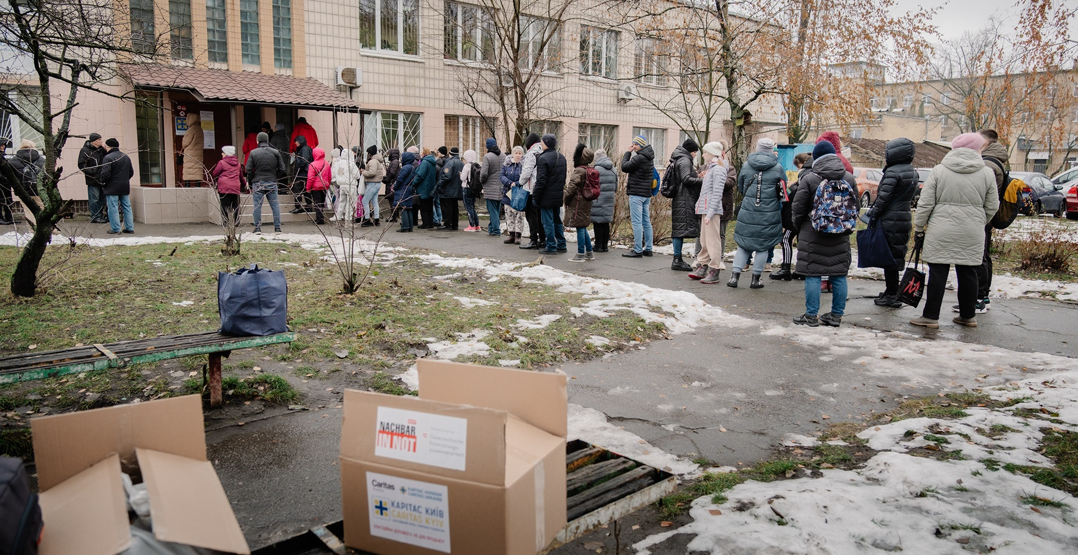
Feeding of The Five Thousand
Photo: Caritas Wien Elisabeth Sellmeier
Notes:
Photo: People queue for Caritas food distributions in Ukraine, 2024.
Scripture Reference: Matthew 14: 13-21
Explanation: Jesus shows the importance of sharing what we have with others, regardless of how much or how little we have.

Slide 3
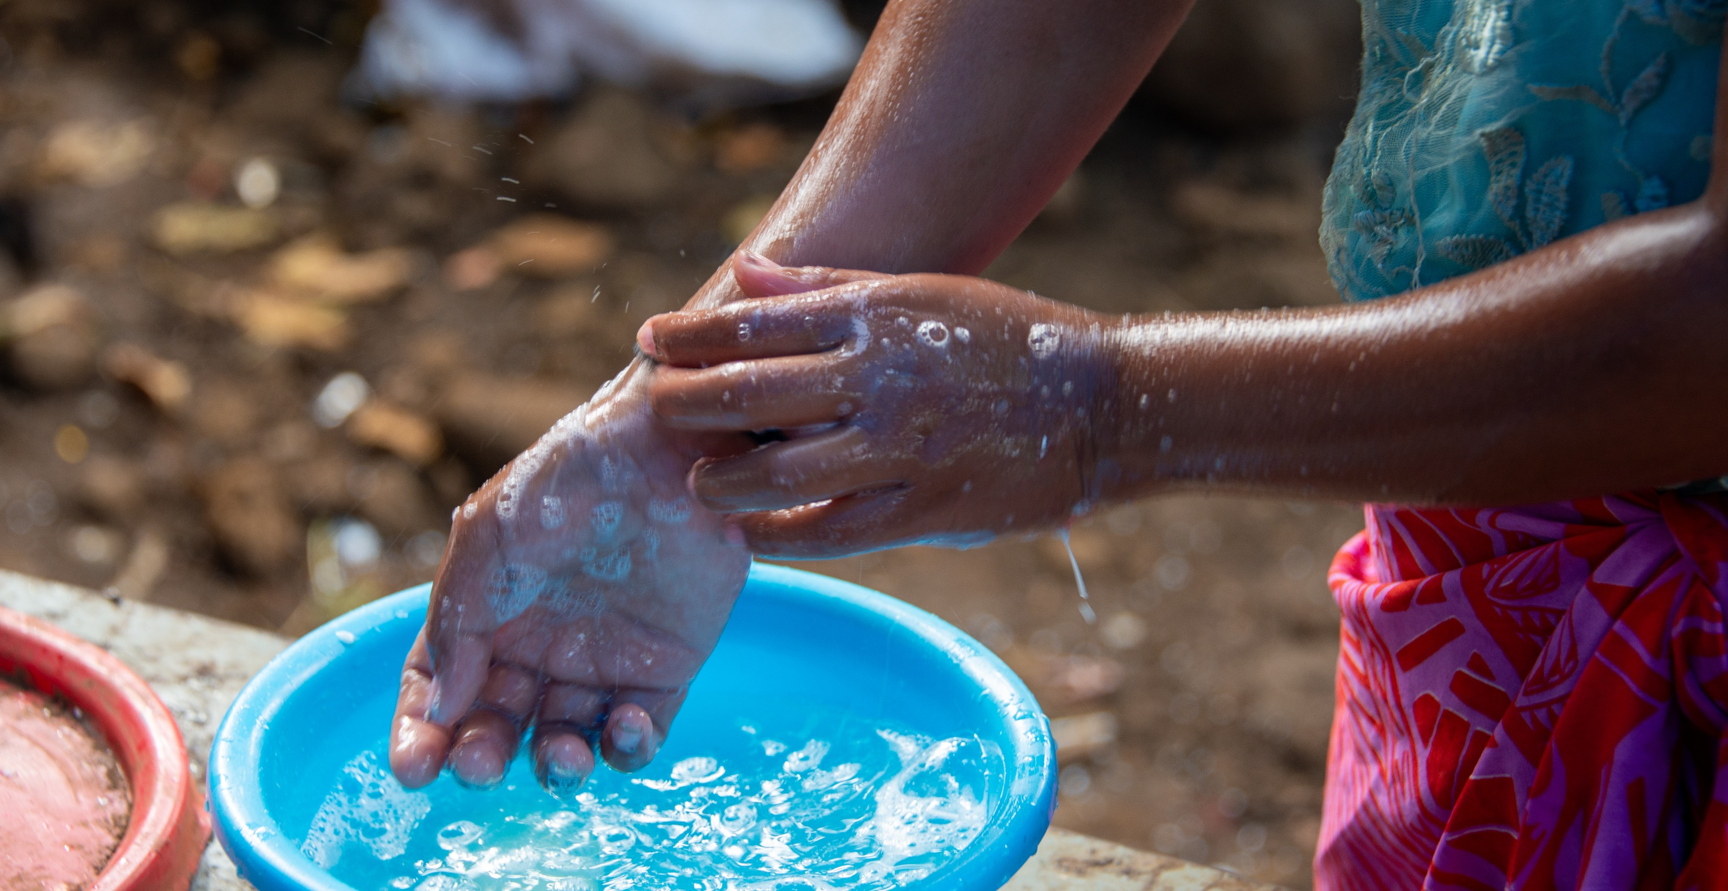
Washing the Disciples’ Feet
Photo: Caritas Australia
Notes:
This young girl can access clean and safe water after Caritas Samoa installed a water tank. They used to drink and clean themselves using water that was stored in old fridge and buckets.
Scripture Reference: John 13: 1 - 17
Explanation: Jesus’ teachers us about the importance of showing kindness to one another. Washing someone else’s feet is not easy act to do.

Slide 4
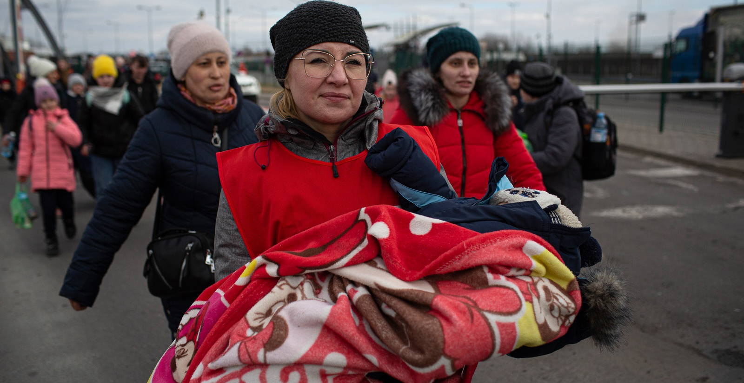
The Good Samaritan
Photo: Caritas Poland
Notes:
Anna volunteers for Caritas on the border crossing in Dorohusk, where she offers warm clothing to arrivals, distributes food and drinks, and accompanies them across the boarder into Poland.
Scripture Reference: Luke 10: 25-37
Explanation: Jesus teacher’s us the importance of helping someone who needs care regardless of their ethnicity, religion or gender.

