Slide 1
EXPLORING THE DEFINITION OF THE ‘THE COMMON GOOD’ These slides were originally designed to be used with the Secondary schools ‘Common good’ Learning experience.
CST online toolkit www.caritas.org.au/cst

Slide 2
The human person, made in God’s image, is both a sacred being and a social being.
Photo credit: Erin Johnson
Notes:
Maristely plays with friends from her favela, Nova Divineia, in Sao Paulo, Brazil.
Text Credit: Education for Justice

Slide 3
The human person can only flourish in community.
Photo credit: Erin Johnson
Notes:
Maristely, Getulio and friends from Maristely’s community in Nova Divineia favela, Sao Paulo.
Text Credit: Education for Justice

Slide 4
The rights and duties of human persons are realised and carried out in community, which includes the community of the family along with the wider society and world.
Photo credit: Erin Johnson
Notes:
Andre, an MDF educator, talks with a family living in Vila Prudente favela in Sao Paulo, Brazil. Caritas Australia’s partner, MDF, work with favela residents to raise awareness of their dignity and human rights, and help uphold them through community meetings and joint actions.
Text Credit: Education for Justice

Slide 5
The good of each individual in society is intimately connected to the good of the wider group or society.
Photo credit: Erin Johnson
Notes:
Favela residents from Nova Divineia favela in Sao Paulo, Brazil. Favela residents often experience widespread discrimination from members of the wider community.
Text Credit: Education for Justice

Slide 6
Participation, subsidiarity, peace, and the safeguarding of rights are necessary conditions for the principle of Common Good.
Photo credit: Erin Johnson
Notes:
Maristely at a Youth Empowerment Program workshop on violence against women and children.
Text Credit: Education for Justice

Slide 7
Extreme individualism
Extreme collectivism
Notes:
NOTE: The common good differs from the ‘greatest good of the greatest number’ in that it is more inclusive of those on the margins, and we define the common good in the Vatican Council’s Church in the Modern World (#26) as “the sum of those conditions of social life which allow social groups and individual members relatively thorough and ready access to their own fulfilment”.

Slide 8
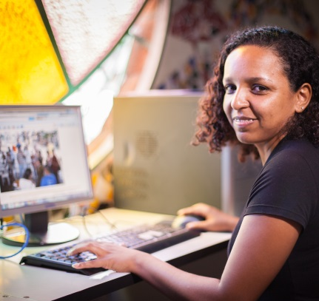
Everyone has the right to access the technologies they need in order to live they life they value without harming others now or in the future.
Activity: watch the Caritas ‘Common Good’ film and consider:
Is the technology needed?
Does writing blogs and using social media help the favela residents live the life they value?
Is it a technology that can be used to work towards the common good?

Slide 9
Find out more
www.caritas.org.au/CST
Last updated November 2017

