Slide 1
Catholic social teaching
Care for
Our common
home
www.caritas.org.au/cst

Slide 2
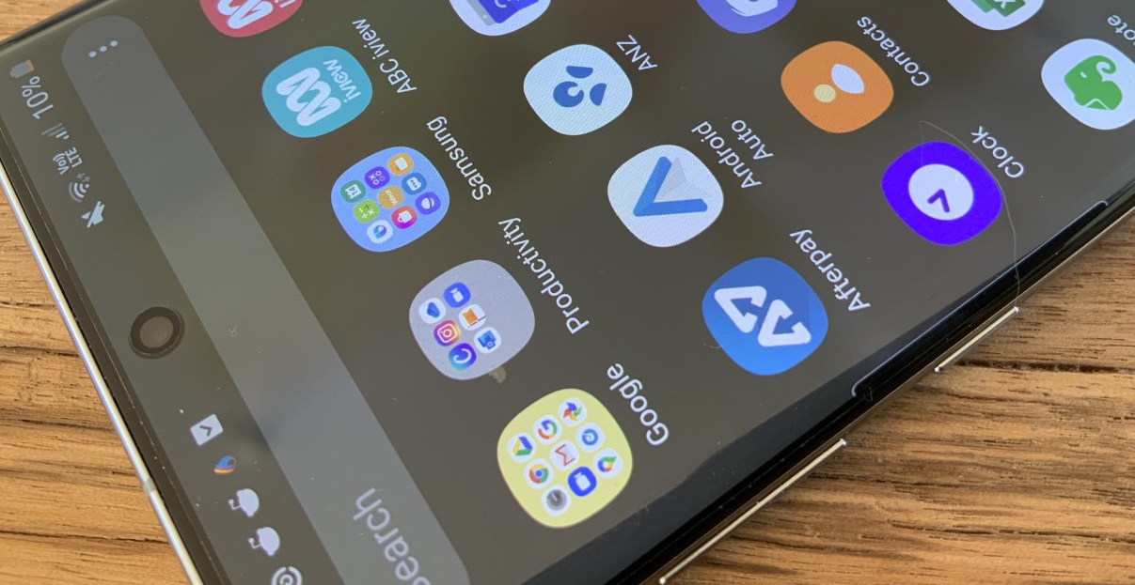
Love thy neighbour as thy phone!
Globally, 1.5 billion smartphones were sold in 2019.
I know that I would be completely lost if I misplaced mine.
Notes:
Source: https://www.statista.com/statistics/263437/global-smartphone-sales-to-end-users-since-2007/
Smartphone photographs: Clare Vernon/Caritas Australia

Slide 3
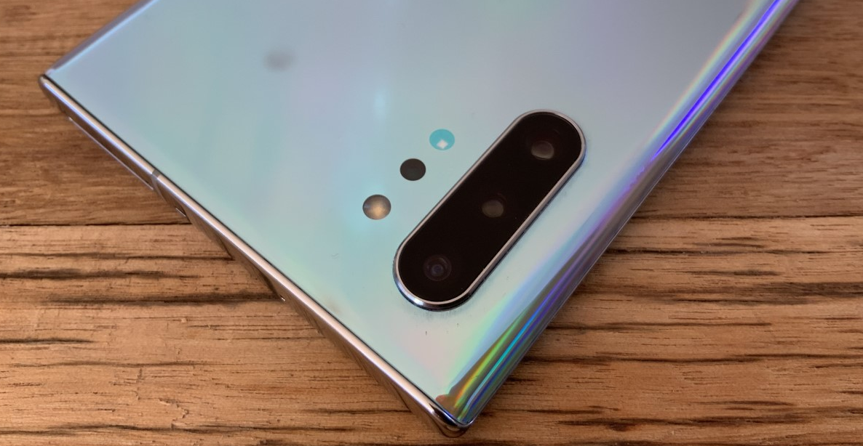



It goes almost everywhere with me. It knows everything I do each day
It gets me up in the morning
It holds my precious memories
It relaxes me
It makes sure I don’t miss important events
It entertains me
It helps me keep up with the important issues of the world…
Notes:
Smartphone photograph: Clare Vernon/Caritas Australia

Slide 4



I can watch my favourite show
It assists me to stay in touch with my friends
It keeps me up to date with the live footy scores
It tells me the weather
It keeps track of my steps
It sends and receives my emails
And I can even use it as a phone- if I need to!
Notes:
Smartphone photograph: Clare Vernon/Caritas Australia

Slide 5
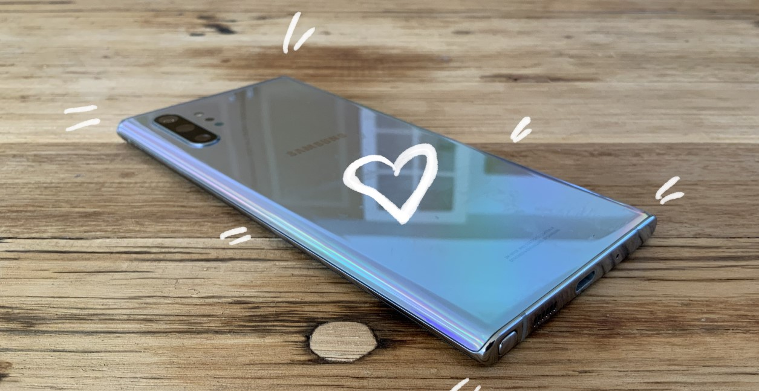
I love my phone, and I would be lost without it!
I love my phone, and I would be lost without it!
I look after it and make sure nothing happens to it. I’m sure most people do the same.
Most people would take care of their $1000+ Smartphone, wouldn’t they?
Notes:
Smartphone photograph: Clare Vernon/Caritas Australia

Slide 6
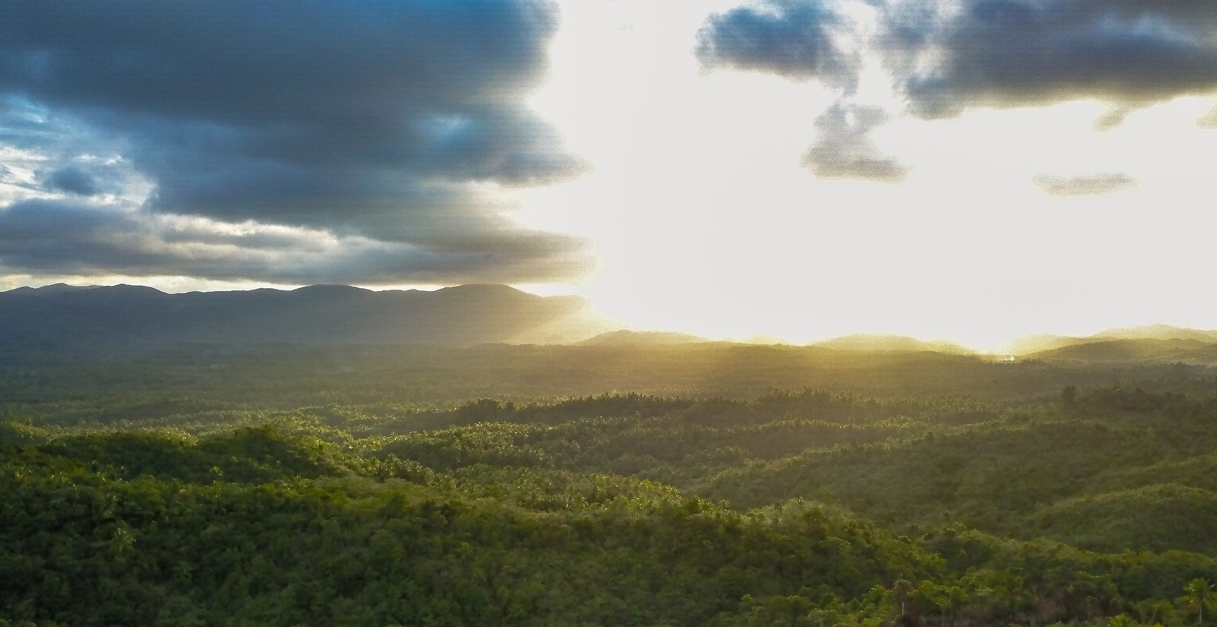
Imagine how much better the world would be if we took as much care of other people and the environment as we do of our technology.
© Richard Wainwright

Slide 7
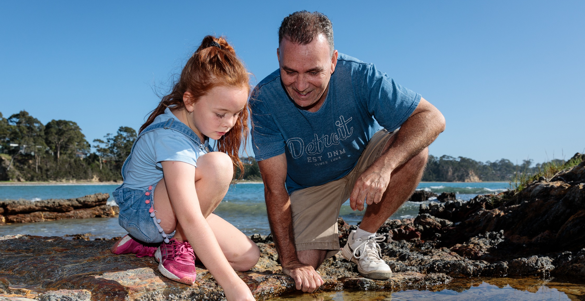
Imagine if other people and the world meant as much to us as our phone.
Barry looks in rock pool with his daughter (7) on a beach near his home in Bateman's Bay. © Richard Wainwright

Slide 8
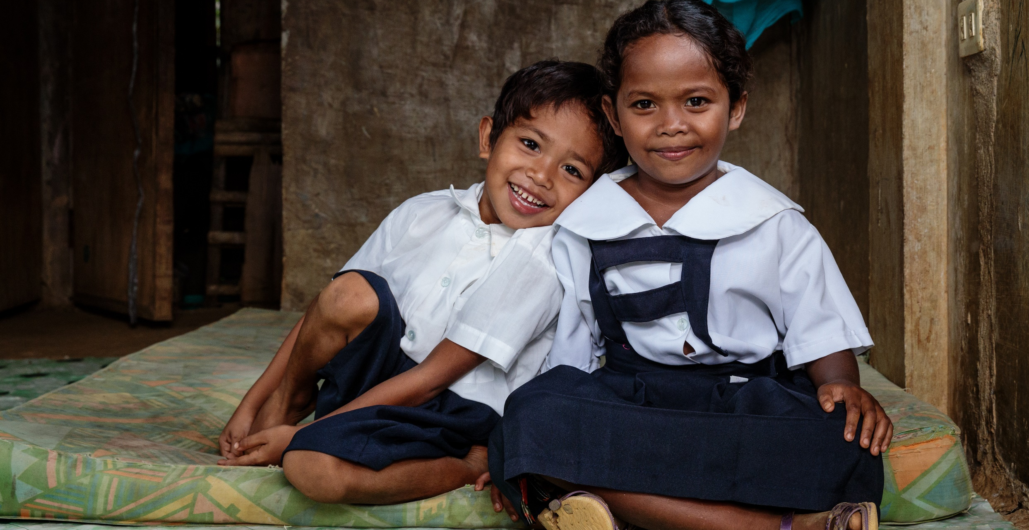
We would live in a caring world where everyone is important.
We wouldn’t be harming our planet for our own gain, not considering the impact on our global family and future generations.
Angel and Angelo play at home before leaving for the local school which is close to their Manide community in Camarines Norte, Philippines. © Richard Wainwright

Slide 9
So I say, in a clear and loud voice, “Listen to a new commandment-Love thy neighbour as thy phone!”

Slide 10
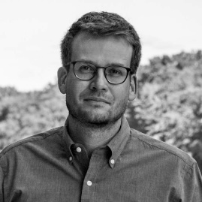
“People were created to be loved.
Things were created to be used.
The reason the world is in considerable chaos is because things are being loved and people are being used.”
- John Green, host of YouTube channel vlogbrothers,
motivational speaker and young adult
author of theThe Fault In Our Stars

Slide 11
Find out more
www.caritas.org.au/CST

