Slide 1
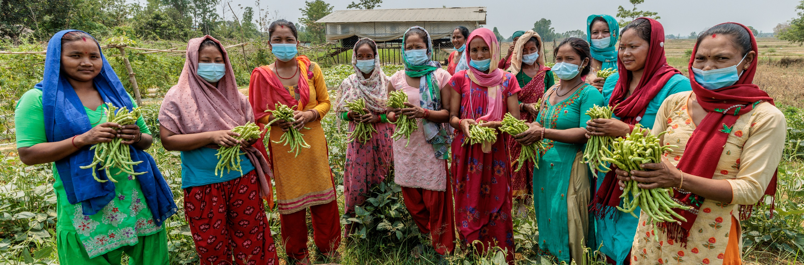
CST: Common Good
Lower primary: Prep to Year 2
Why is sharing with others important?
Photo: Caritas Nepal
Notes:
Women collecting beans from a vegetable garden in Nepal.

Slide 2
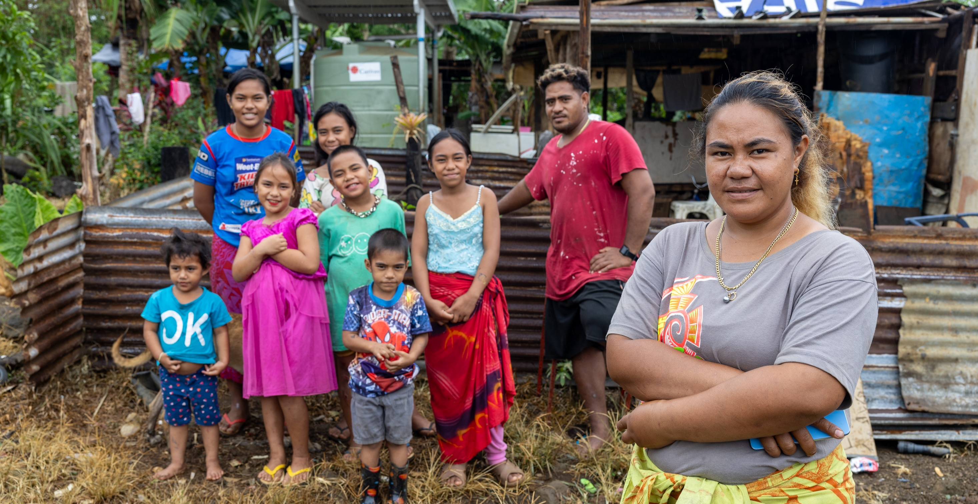
We should always try to think about what is good for everyone, not just ourselves.
Photo: Caritas Australia
Notes:
Leaia (front), her children, her brother (right) and her younger niece (left) and nephew (front-centre) outside their home in Samoa.

Slide 3
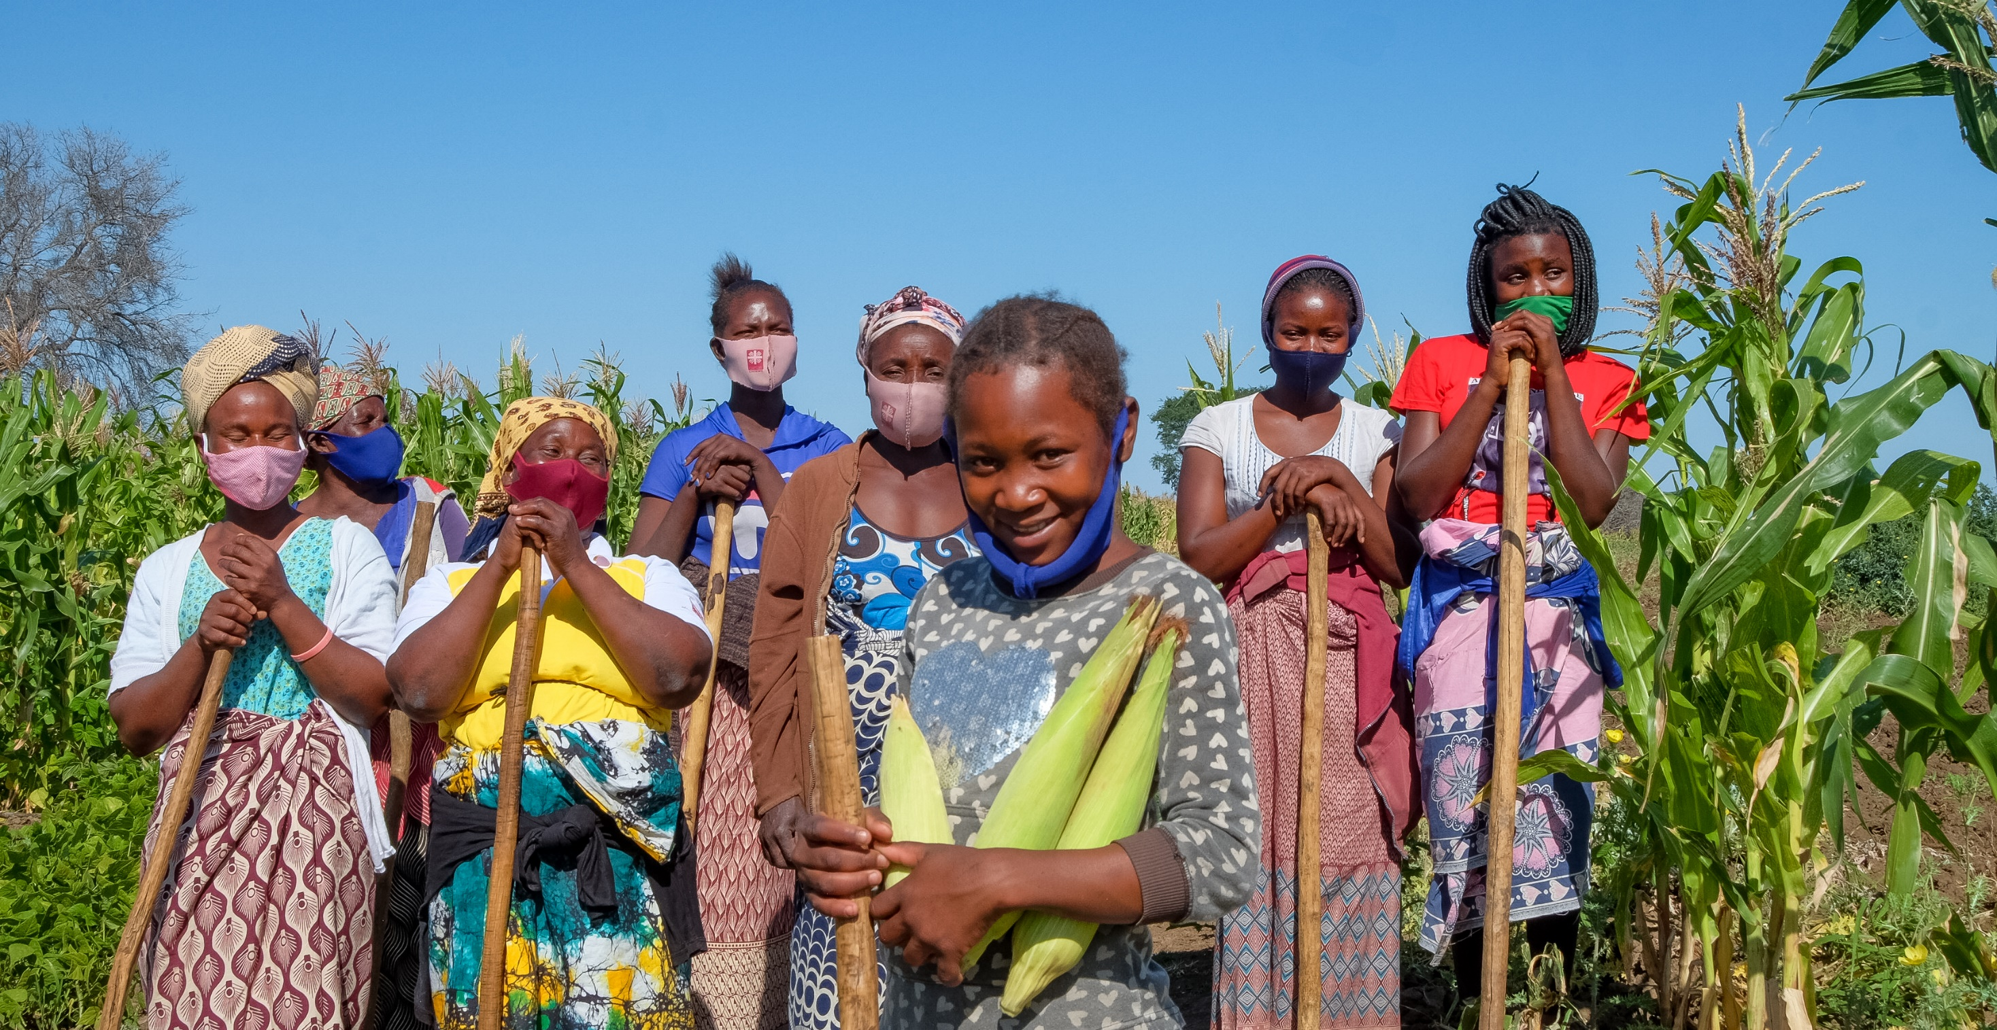
It’s about living together in a community
Photo: Emidio Losine
Notes:
Anatercia (12) poses for a photograph with other community members next to her fields in Gaza province, Mozambique. Anatercia helps her elderly grandmother on the farm where they grow corn, beans, sweet potato, casava and lettuce. The farm is over an hour walk away from home so when her grandmother can’t make the journey, other community members help Anatercia. She goes to the fields about four times a week.

