Slide 2
Our love is not to be just words or mere talk, but something real and active.
1 John 3:18

Slide 3
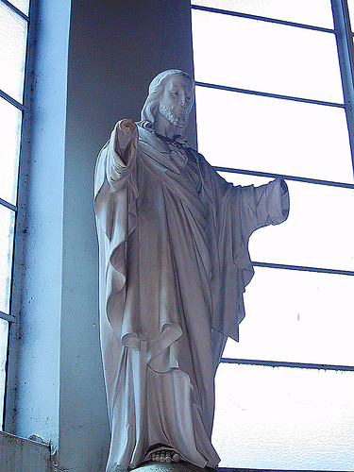
"Christ has no body now on earth but yours, no hands but yours, no feet but yours."
St. Teresa of Avila
Notes:
There is a story that during WWII a statue at the centre of a small Italian village was blown apart by German bombs. After the fighting the villagers worked together to rebuild the statue out of the rubble. It was an arduous task that took many hours but after weeks they finally rebuilt the statue with the exception of its hands. Some villagers wanted to buy a new one, others to throw it away saying “A Christ with no hands is no Christ at all.” The priest who had remained silent during the debate finally intervened, saying, “Leave it, for it reminds us, that we have to be the hands of Christ in this world.” Together we are the body of Christ on earth.
In one sense the villagers who said “A Christ with no hands is no Christ at all” were right. If the people of God are not active on earth, then Jesus is not present.

Slide 4
We are all part of one body.
The foot cannot say because I am not an eye I am not part of the body or if the ear were to say I am not the nose so I am not part of the body.
1 Corinthians 12:12-27

Slide 5
The body has many parts and each part needs to work properly and in harmony with the other parts for the body to function. Each person’s role is important.
1 Corinthians 12:12-27

Slide 6
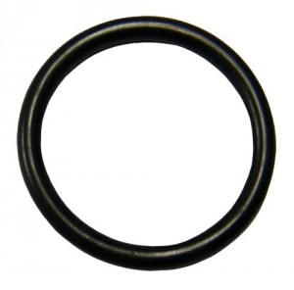
If you decide not to use your gifts - no matter how small or insignificant we think they are - the whole body will not be able to do what it is supposed to do.
Notes:
Who thinks a rubber ring is a very important part of the shuttle?
It is when it doesn’t do its part – because the o ring failed the whole shuttle exploded.
We all need to make sure we do our part, no matter how small we think it is.

Slide 7
There are 27 to 30 million slaves in the world today.
Notes:
Yes, slaves.
Have you ever wondered how companies like H&M and Forever 21 can sell t-shirts for 5 dollars?
There are people in countries such as Uzbekistan, Cambodia, Bangladesh and India who are forced to work against their will. Whether they’re picking cotton or tanning leather, they aren’t being paid to make your clothing. They are literally bound to a life of enslavement with very little hope of getting out.
Factory workers who are being paid are probably who you would think of as “sweatshop” workers and are most likely earning less than a living wage — that means they can’t afford to feed or shelter themselves, let alone their families. In 2012, a Swedish broadcaster reported that workers in Cambodia were being paid so little they had to borrow money for food.

Slide 8
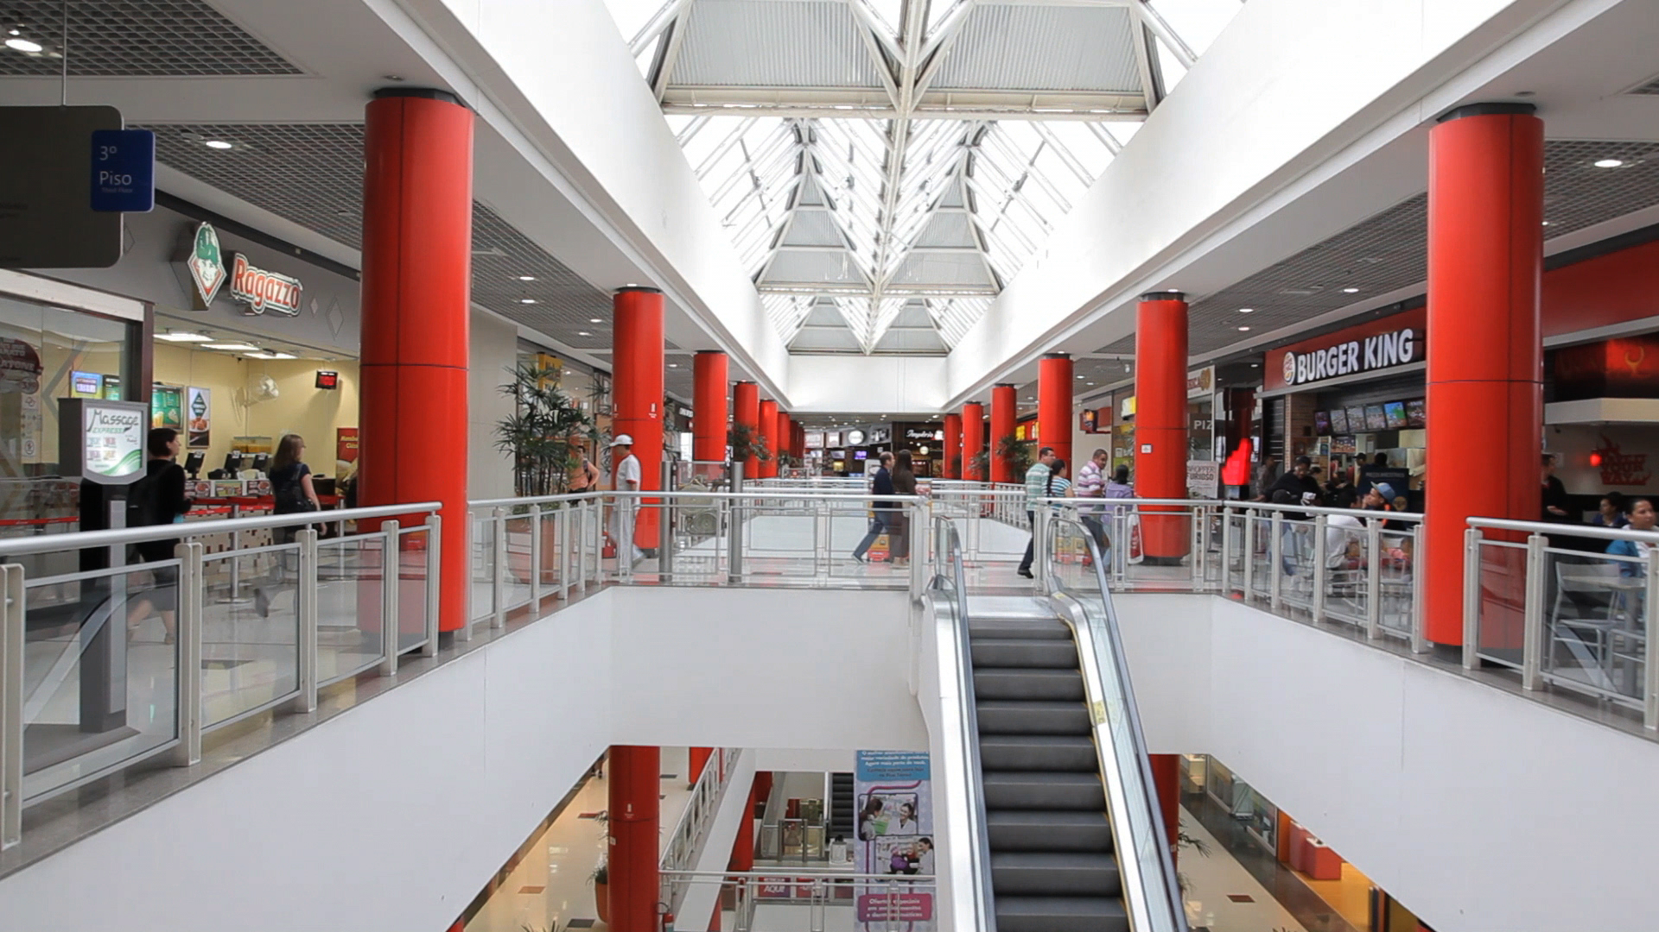
Big retailers are a big problem.
Notes:
Our bargain shopping, big sale seeking, cheap consumer mentality is directly related to the people making our clothing. Because we expect to be able to buy a shirt for less than $20, retailers are forced to find ways to lower costs and compete in a highly-saturated market. This usually requires cutting corners in manufacturing overseas.
In November, H&M made a public statement saying it plans to deliver a “living wage” to more than 850,000 textile workers by 2018. While it sounds like a noble gesture, it raises the question of why the giant retailer wasn’t paying its workers fairly in the first place. In the past, H&M has been accused of promoting poverty pay, unsafe working environments and malnutrition.
H&M is not alone — Forever 21, Inditex (the parent company of Zara), GAP, JC Penney, and many more, are major players in human rights and labour issues around the world.

Slide 9
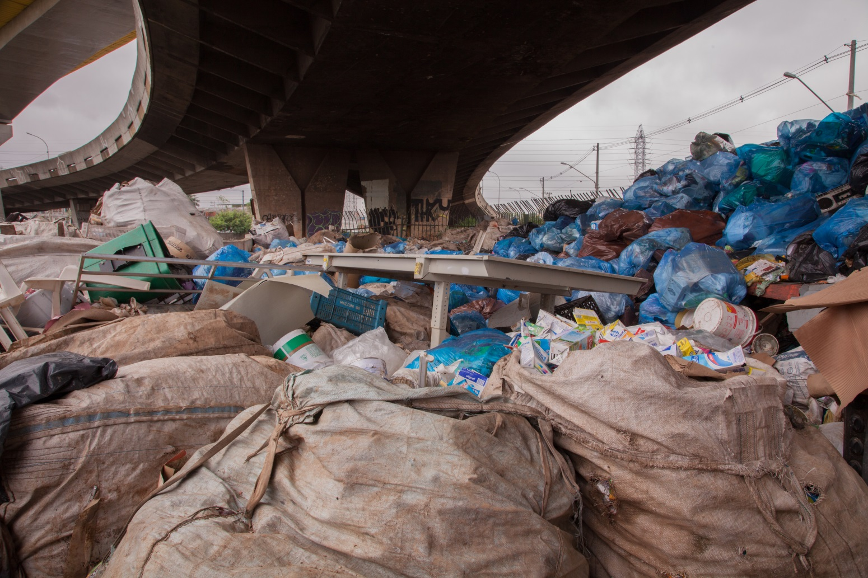
It takes decades for your clothing to decompose in a landfill.
Notes:
The fast fashion industry has turned four regular seasons into 52 “microseasons” to push new trends and encourage rapid consumption. Retailers make it easy for shoppers to buy a cheap dress, wear it once, and never wear it again. We don’t think about where those clothes go after we’re done with them.
Nylon, rayon, polyester and other synthetic materials are essentially plastics that will most likely be around for far longer than you will. At the rate consumer waste is piling up, it doesn’t look good for the future of the planet.

Slide 10
It’s not helpless.
Buy local
Buy “indie” (including Fair Trade)
Buy used
Buy less
Notes:
Consumers have the purchasing power. We all have the ability to change the industry by choosing which companies deserve our dollars. It comes down to educating yourself and adjusting your lifestyle in a way that doesn’t require excessive consumption of disposable clothing.
Education can be as simple as following a few ethical fashion blogs on Facebook. You’ll learn something throughout the day just from reading the headlines. (e.g. Ecouterre, EcoSalon & Ethical Fashion Forum.)
Buy local: At the most basic level, when you buy from a local designer or from a local boutique more money stays in the community. According to SustainableConnections.org, “Several studies have shown that when you buy from an independent, locally owned business, rather than nationally owned businesses, significantly more of your money is used to make purchases from other local businesses — continuing to strengthen the economic base of the community.” Not only are you investing in your own city, but you’re also reducing your individual environmental footprint, creating jobs, and putting your tax dollars to good use. Putting that into dollars and cents, Businessweek reported “for every $100 spent at a locally owned store, $45 remains in the local economy, compared with about $13 per $100 spent at a big box store.”
Buy “indie”: Support independent designers who are conscious of the production process all the way through. Many of these designers are mindful of where they source their fabric and are involved in the manufacturing from front to back. Some are even doing the sewing themselves in small independent sew shops or incubators. The stories behind companies like Etiko are a refreshing glimpse into transparent clothing production.
Buy used: Huge progress can be made by consumers purchasing second-hand. It is imperative that we start making use of the resources already available to us instead of buying new clothing. Not only are the price tags competitive with the fast fashion giants, but many of the garments appear to be practically new. It’s a win-win for your wallet and for the planet.
Buy less: Buying less is ultimately the solution that can change the world. (And no, it will not lead to an economic Armageddon.) Considering the fact that society’s throwaway consumption habits are at an all-time high, there are ways to use our dollars more economically and efficiently than buying six H&M dresses for $9.99. Instead, you can use that same $59.94 (6 x $9.99) to buy one ethically-produced dress from a local designer and wear it for years to come. I’m not advocating to stop spending. I’m advocating to use your purchasing power in ways that go beyond wearing something once and throwing it away.

Slide 11
Picture credits
Slide 1: Erin Johnson/room3
Slide 7: James Foley
Slides 8-9: Erin Johnson
Slides 7 to 10: Text used with permission from Shannon Whitehead, Sustainable Fashion Consultant.
Find out more
www.caritas.org.au/CST
Last updated April 2014

