Slide 1
A note to teachers:
We hope this PowerPoint is a useful resource for you to introduce or explore the work of Caritas Australia , as the Catholic Church’s international aid and development agency, with your primary students.
The presentation generally takes around 25 minutes. You may choose to use only some slides to suit the length you need.
Please note we have included many teaching notes and ideas for how to present this to a primary audience in the slide notes sections.
Additionally, at the end of the presentation we have suggested some follow up Caritas activities that you may like to use.

Slide 2
?

Slide 3
Some quick facts…
Notes:
There is abundant information regarding world poverty. We present just a few facts to help contextualise the situation.

Slide 4
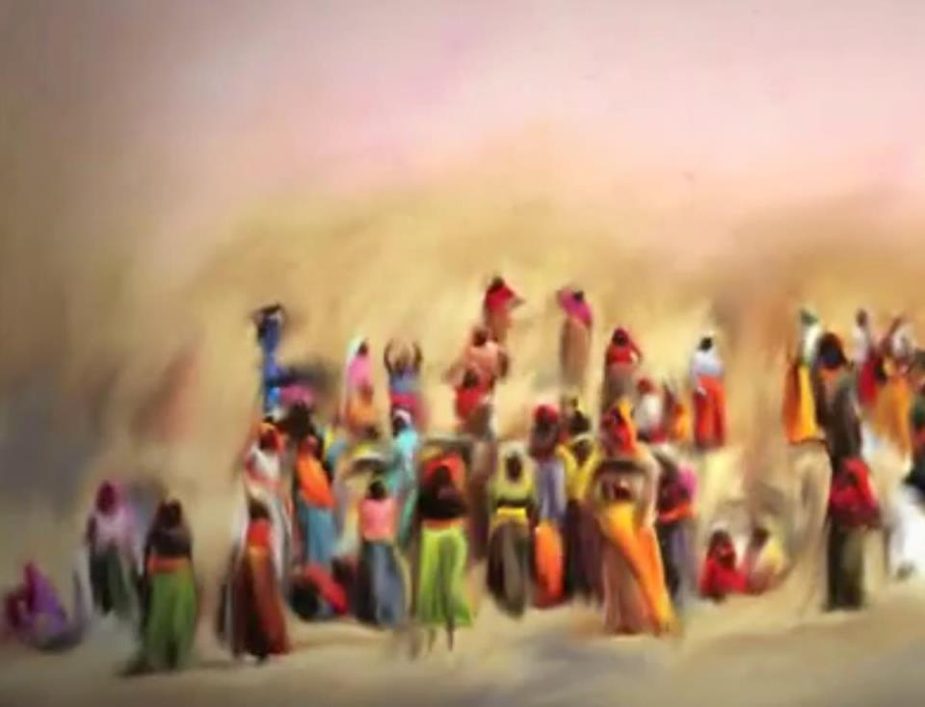
800
live on less than
million people
$1.25 a day
Notes:
Source: https://www.un.org/millenniumgoals/poverty.shtml 800 million people live on less than US$1.25 a day. Living on less than US$1.25 is defined by the World Bank as ‘extreme poverty’.
You may like to give students a moment to consider how they might spend $1.25.
When you consider needing to obtain shelter, food and clothing, US$1.25 a day is very little.
‘Billions’ are big numbers for primary school students to conceptualize; here are some examples to help your students picture it.
If you started counting out loud from 0 all the way to 1 billion, it would take 33 years.
The Melbourne Cricket Ground seats approximately 100 000 people- 1.2 billion people is around 12 000 Melbourne Cricket Grounds seated at full capacity.

Slide 5
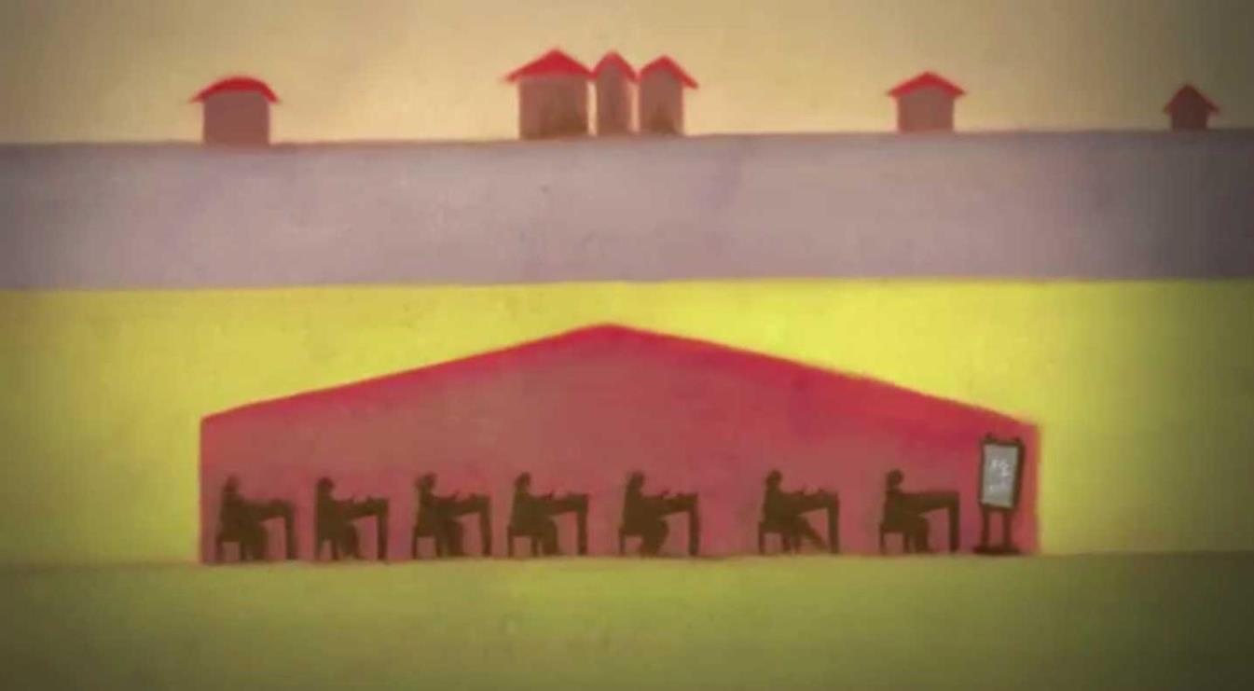
58 million children don’t get the chance to go to school.
Notes:
Poverty is a direct barrier to education, and a lack of education increases the likelihood that children won’t have access to clean water and sanitation, and be more susceptible to malnutrition and sickness. Free primary education is a human right that provides children the opportunity to work towards a better future.

Slide 6
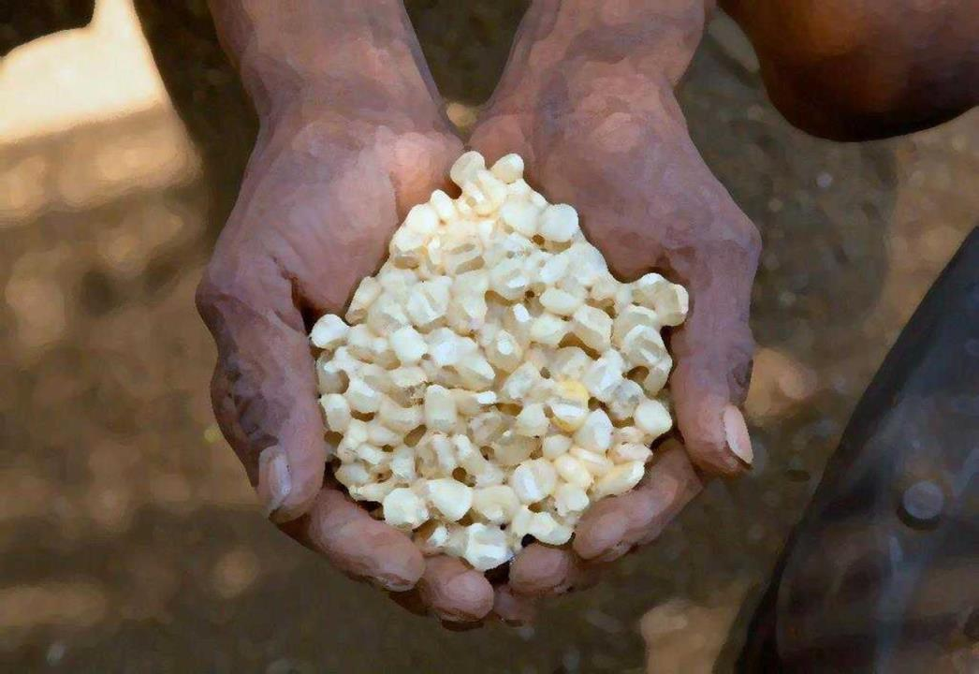
795 million people don’t have enough nutritious food to eat.
Notes:
Source: https://www.un.org/millenniumgoals/poverty.shtml
Even though the world produces enough food to feed everyone, too many people go hungry every day. This is not just about providing food for everyone, but addressing the structures that prevent people from equally accessing food. Poverty is the main cause of hunger, and the world’s poor on average spend 70% of their income on food. This food in most cases is still inadequate to maintain good health. Malnutrition significantly increases the risk of diseases, infection and mortality, and impacts on people’s ability to go to school and work.

Slide 7
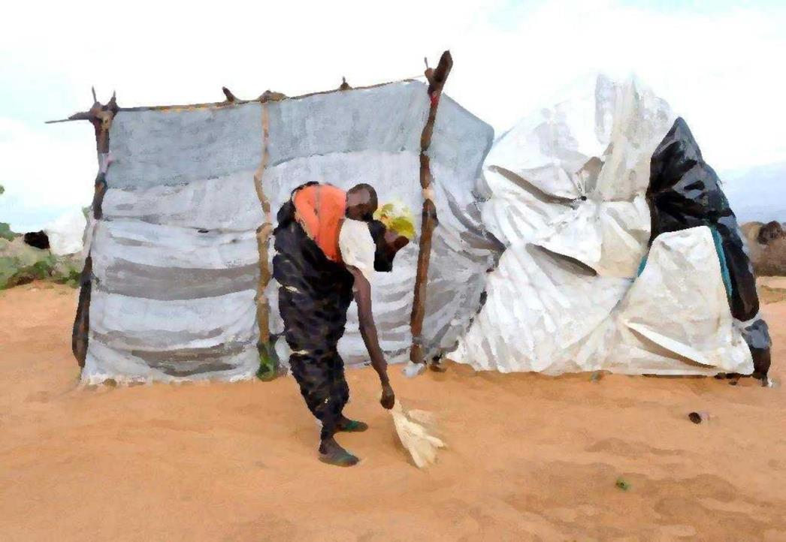
1 billion people don’t have a safe and secure house to live in.
Notes:
A safe and secure home is a basic human right that also links to the ability to access safe water and sanitation facilities, health services and education.
1 billion people do not have a safe and secure house to live in, often building shelters out of any materials they can find. This includes people who may be refugees in camps, internally displaced people, people who live in urban slums, and others.

Slide 8
Caritas means
LOVE
Notes:
The world ‘Caritas’ is Latin for Love and Compassion. This communicates the motivational foundation for our Aid and Development work.

Slide 9
Is officially part of the Catholic Church
We help people in need in Australia and other countries
Notes:
Caritas Australia is officially part of the Catholic Church- it is the church’s international aid and development agency. We assist with aid, development, education and advocacy for people in many countries, including Australia; with our First Australians.

Slide 10
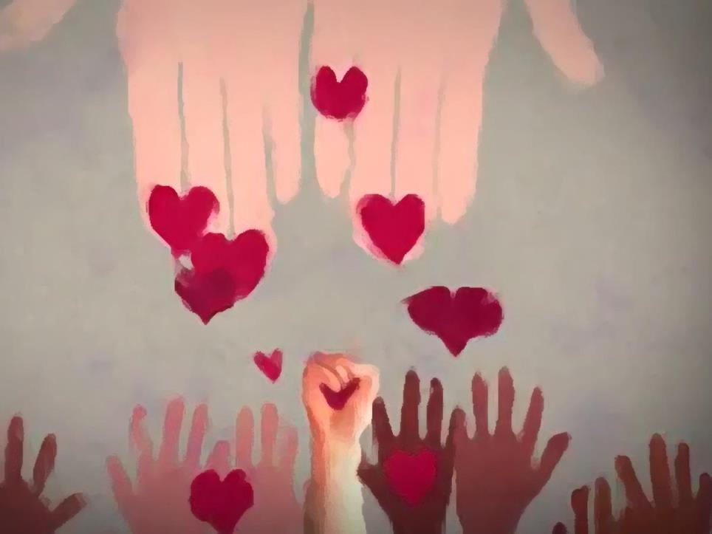
LOVE and COMPASSION
in ACTION
Notes:
We aim to put this love and compassion in action, through our aid, development and education and advocacy work. The bible says “Children, our love must not be just words or mere talk, but something active and genuine” 1 John 3:18.

Slide 12
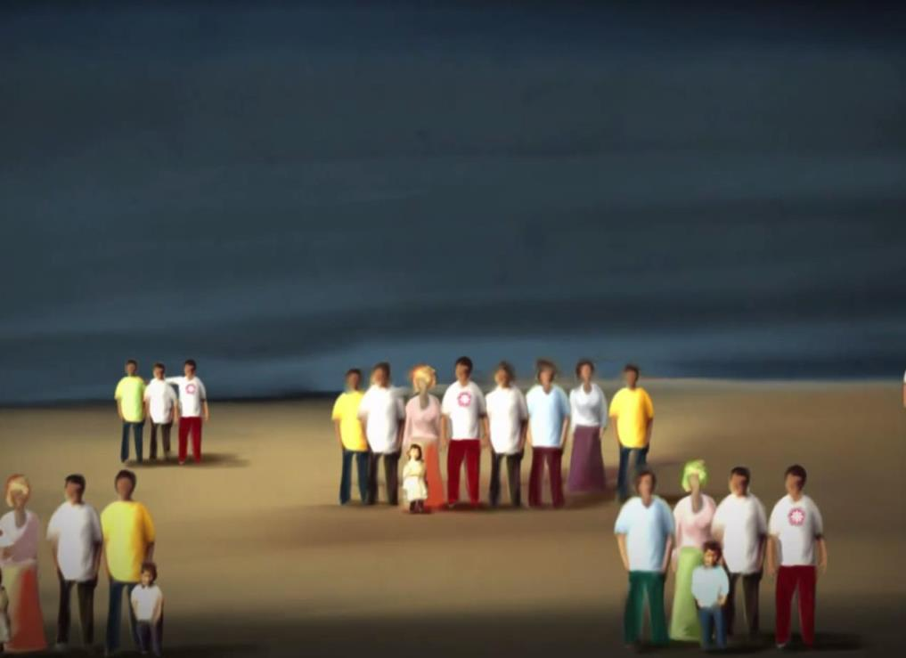
We work with all people.
Because we believe everyone is special.
Notes:
Caritas Australia helps all people help themselves — regardless of ethnicity, religion or political beliefs.

Slide 13
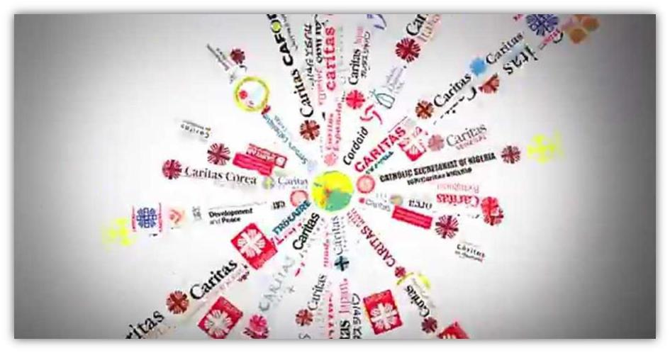
More than 160 Caritas organisations around the world

Slide 14
Why?
Notes:
Discuss questions:
Why do you think the Catholic church has an aid and development agency?
Why do we want to put love and compassion in action?

Slide 15
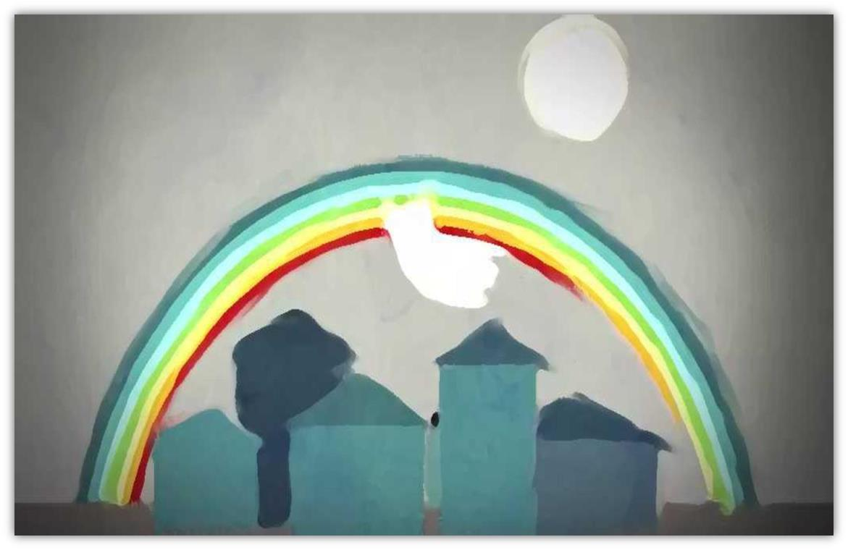
We believe God wants a world where everyone is looked after and treated fairly.
Notes:
This is our vision.

Slide 16
What does
do?
Notes:
You can describe the work of Caritas Australia in three categories:
Aid
Development
Advocacy and Education.

Slide 17
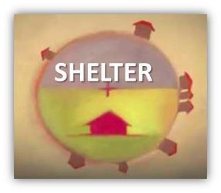
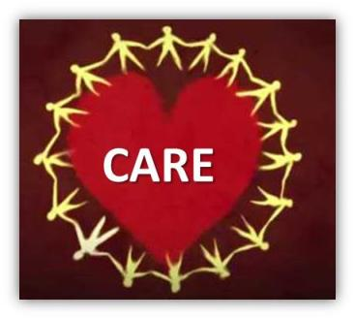
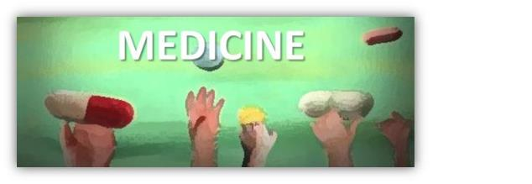
AID
(Emergency Relief)
Notes:
Aid work is concerned with immediate needs- providing shelter, medicine food and care in emergency situations such as Cyclones, Tsunami, Earthquake, or war. Following, are some examples of aid work undertaken by Caritas Australia.

Slide 18
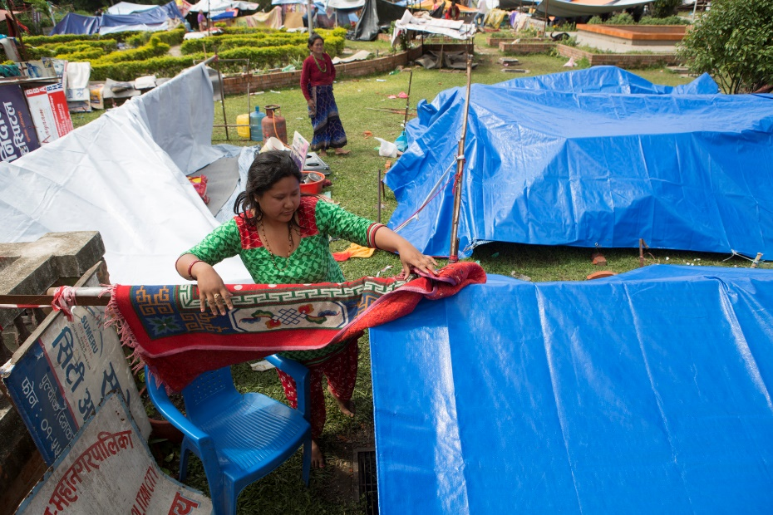
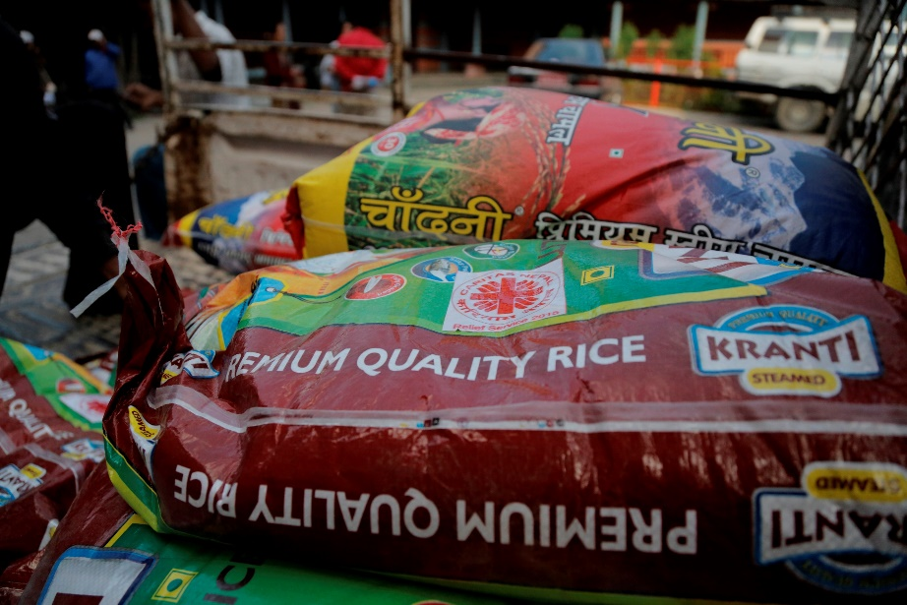
Nepal earthquake
Cyclone Evan
Caritas assisted over 59,000 households with emergency aid such as:
tarpaulins
blankets
water and hygiene kits
non-food items
corrugated iron sheeting
Notes:
On 25 April 2015, communities in Nepal experienced a 7.8 magnitude earthquake. Strong aftershocks, and a second earthquake a fortnight later, continued to devastate lives and cause further damage. Approximately 8,800 people lost their lives, 600,000 houses were completely destroyed and 2.8 million people, nearly one third of the country’s population, were in need of humanitarian assistance.
The massive earthquake devastated Nepali families, with many losing family members, homes and livelihoods. It left people who were already only earning enough to live day-to-day uncertain about how they would rebuild a future for themselves and their families.
However despite losing almost everything, the people of Nepal showed strength and resilience in the face of this tragedy, living out a spirit of cooperation and compassion between neighbours.
Caritas Nepal has already been working with local communities for twenty-five years. In the aftermath of the earthquake, these long-term relationships proved invaluable, as the communities trusted Caritas staff during this traumatic time.
Caritas Australia’s long-term partnership with Caritas Nepal, based on solidarity and subsidiarity, meant that we were able to assist immediately, and have continued to accompany Caritas Nepal throughout the emergency response.
HOW HAS THE CARITAS NETWORK ASSISTED?
The Caritas network responded immediately to earthquake-affected families. Thanks to the generous support of the Australian Catholic community and the Australian Government, the global Caritas network was able to reach over 59,000 households with emergency aid, such as tarpaulins, blankets, water and hygiene kits, non-food items and corrugated iron sheeting.
Caritas staff have persevered through challenging conditions to ensure the most vulnerable and marginalised communities were reached. In some instances, staff travelled by foot to reach mountainous areas, or used helicopters to deliver relief items to remote areas.
REBUILDING A STRONGER FUTURE
Caritas is now continuing to work with communities to recover from the destruction of the earthquake, by supporting them to rebuild their homes and restore their livelihoods.
SHELTER continues to be the key focus of the emergency response. Caritas will be training local construction workers in earthquake-resistant techniques so that new homes will be more resistant to potential future disasters.
CASH FOR WORK opportunities for more than 2,000 households who have been affected by the earthquakes to earn an income. In return for income, local people are helping to clear debris and repair damaged infrastructure.
LIVELIHOOD SUPPORT is re-establishing farming families’ means for income and stability, through providing agricultural training or livestock management training to more than 4,600 families.
WATER, SANITATION AND HYGIENE facility construction or rehabilitation of 56 reservoir tanks to deliver clean water to communities.
DISASTER RISK REDUCTION by supporting communities to develop disaster response plans in case of future disasters.

Slide 19
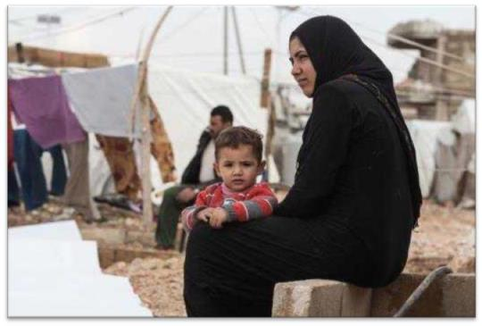
Syria Helping over 100,000 people
Food
Health care Educational services Water and sanitation
Shelter Blankets/clothing
Notes:
Ongoing conflict in Syria has led to one of the worst humanitarian crises in the world today. Over 100,000 people have died, and over 8.3 million people are in need of urgent humanitarian aid from the Syrian war. 1.7 million refugees.
Caritas is providing blankets, clothing and heaters to help the refugees through the extreme cold temperatures experienced in some regions during winter.

Slide 20
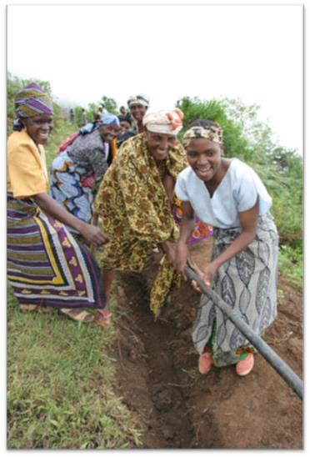
Long-term development
Helping people help themselves out of poverty
Notes:
The second part of our work is called ‘Development’. Development is a term referring to the kind of work that aims to create improved conditions for people to live their lives to their fullest potential- to be the architects of their own futures. Our work tackles a range of global issues which impact on poverty. We do this kind of work through our programs. We talk to the people in the community to see what they need. The following slides provide some examples of the kinds of outcomes and projects undertaken in our development work.

Slide 21
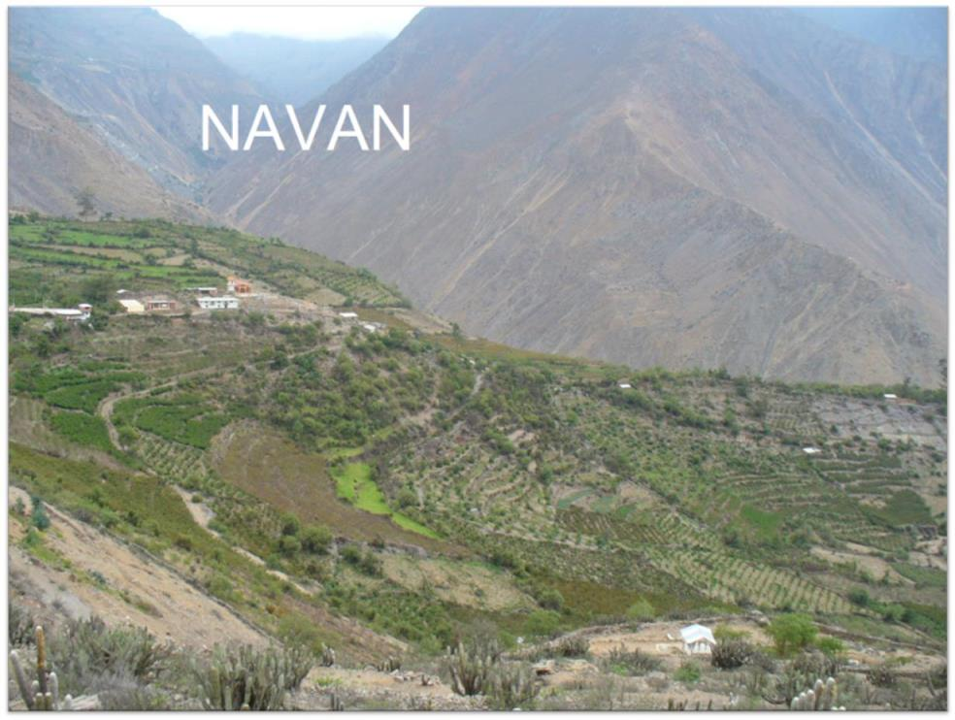
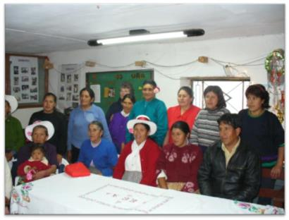
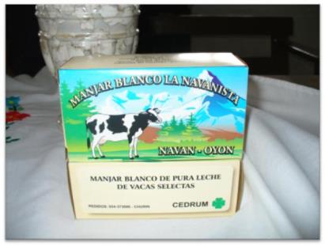
Notes:
Navan is a remote community in the Andes of Peru, South America.
With the assistance given by Caritas Australia they have been able to establish an irrigation system. Previously they did not have the technology to capture all the rainfall they received.
Through this irrigation system they have been able to grow fruit trees to meet the nutritional needs of their community and have now been able to grow excess to sell at the market.
They have also been able to grow alphalpha. This has had a huge impact on the quality of their cattle and milk production. Their dairy cattle have gone from producing 2L per day to 8L per day over the last 4 years and the community is already noticing improvements in the health of their children.
This increased milk production of a high quality has recently led them into producing other dairy products.
They have developed a type of caramel dessert, similar to when you boil condensed milk. They have managed to produce this product, package it and sell it within their local district and now they are looking at how they can market to a wider area.
Caritas Australia no longer provides any financial assistance to this community.
This community provides for themselves and prides themselves on sharing their knowledge and success with the surrounding communities.

Slide 22
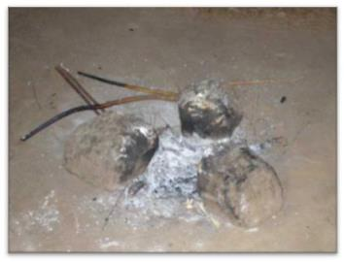
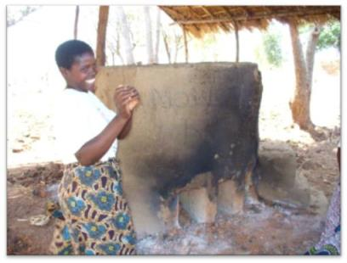
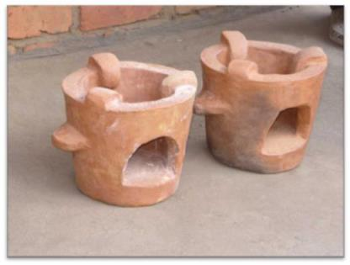
malawi
Energy Saving Stoves
Notes:
Development work can involve the use of a simple idea. In Malawi, these Energy Saving Stoves have made a significant difference.
Previously, cooking and boiling of water were done over an open fire. This involved people having to walk long distances to collect firewood, walking farther and farther as they depleted their nearest wood supplies. Additionally, the smoke produced by cooking over these open fires so frequently was detrimental to health.
Caritas Australia worked with the community to make these energy saving stoves.
The energy saving stoves have meant that families use 35-50% less firewood, the pots are cleaner, and there is less smoke- so there are also health benefits. It is also an income generation activity as everyone in the village has one so now they are selling them at the local market. Each stove is sold for 350MK ($2.50)

Slide 23
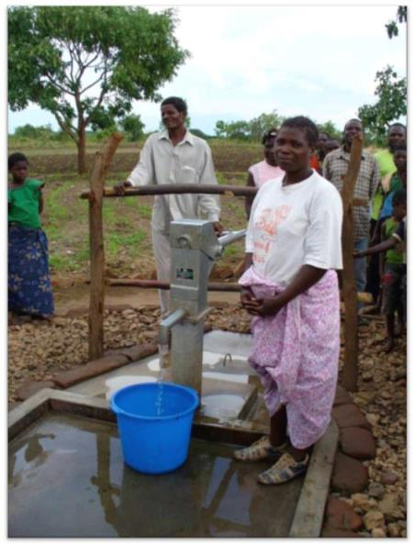
malawi
Water and
Sanitation
Rebecca Marizan- Water and Sanitation Committee Secretary
Notes:
Over the past century, unclean water, poor sanitation and unsafe hygiene practices have claimed more lives than anything else. Today, 783 million people do not have access to clean water, while 2.5 billion people don’t have proper sanitation facilities. Caritas Australia works with communities to develop access to safe drinking water and adequate sanitation facilities, as well as implement better hygiene practices.
In Malawi this included the installation of a borehole. Before the drilling of the boreholes the women and children walked approximately 5km to the stream where the water was unsafe for drinking as they shared the stream with the animals. The women would wake up at 4am, they often had to wait for a long time during the dry season (where they dug a deep hole beside the riverbed to access water). They would get home 5 hours later (9am) because they would need to stop along the way.
Rebecca Marizan (Secretary of the W&S Committee)- “We would just like to express our appreciation for the borehole. We can wash our clothes, clean our bodies. We are free. We are happy.”

Slide 24
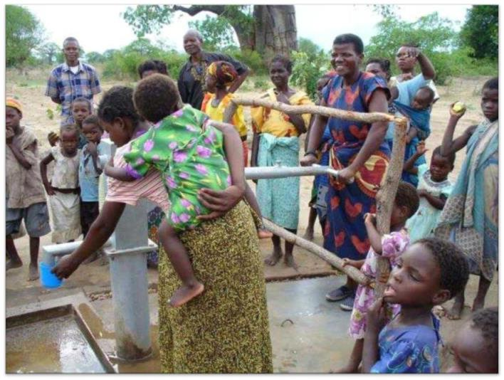
The Borehole
Notes:
Comments from villagers:
“We don’t have cholera anymore.”
“We have more time”
“We can keep clean and tidy and have clean clothes so we can be well presented.”
“We are proud because we contributed labour, stones, bricks. We were not just given it, but we helped to build it.”

Slide 25
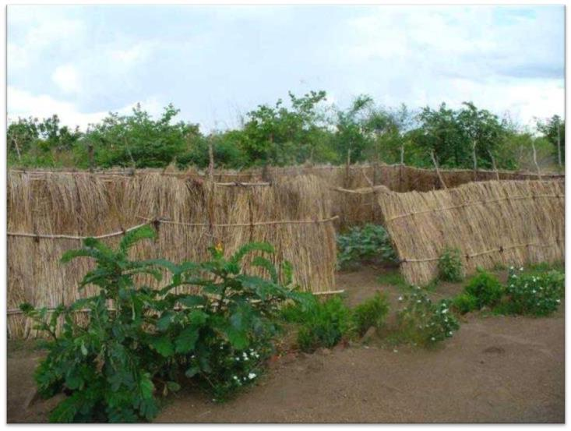
Borehole Community Garden
Notes:
To maintain the boreholes they have a community garden at each. Most of the produce from this garden is sold and the money put into a fund that pays for maintenance and replacement parts.

Slide 26
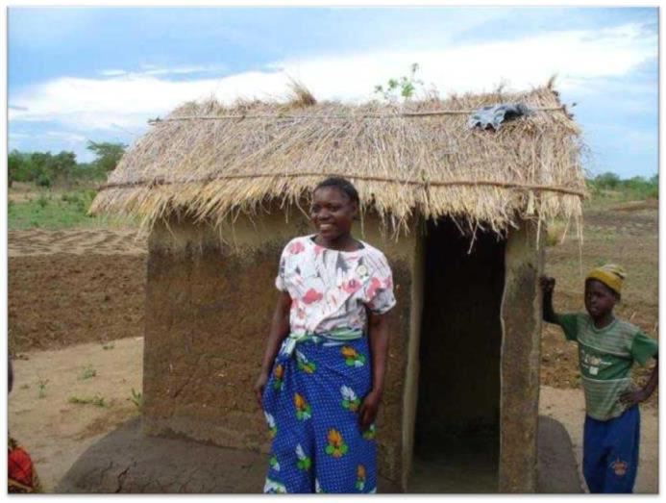
Pit latrine- Charity Whelad
Notes:
Pit latrine

Slide 27
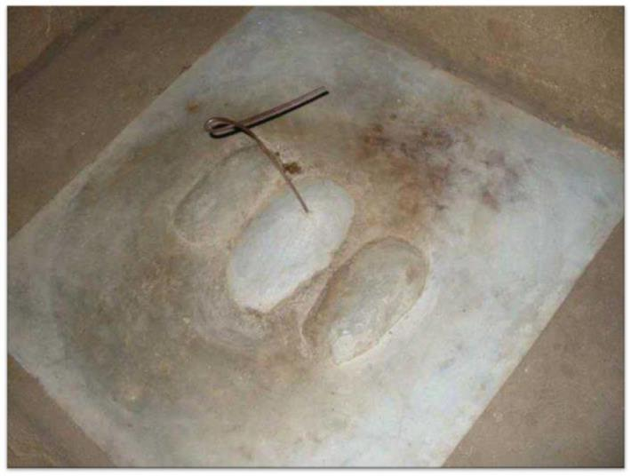
w
Sanitation platform inside a pit latrine
Notes:
Sanitation Platforms- These go over the pit latrine hole. They have a removable centre piece which they replace each time after they go to the toilet to reduce the smell, flies and spread of disease. The pit latrine hole is 2m deep and takes over 5 years to fill.
25 households have benefited from latrines with san plats (Sanitation Platforms)

Slide 28
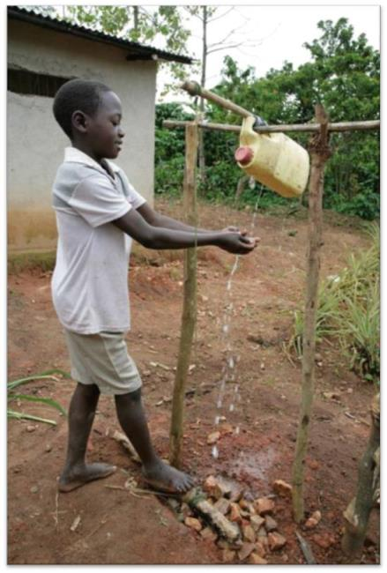
Tippy-tap
Notes:
The Tippy Tap is a hand washing device. Clean hands prevent the spread of disease by 50%! The log at the bottom is connected to string and a stick holding up the bottle. It just needs to be rolled by foot to tip clean water from the bottle.
You can make one of these tippy taps for your school or at home!
Download the instructions here:
http://www.caritas.org.au/docs/primary-school-resources/making-a-tippy-tap.docx?sfvrsn=11?Download=true

Slide 29
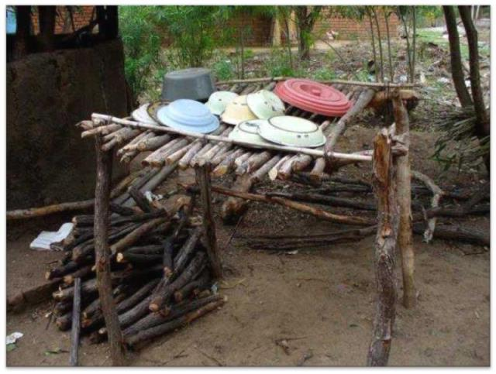
w
Kitchen drying rack
Notes:
Kitchen drying racks also help maintain hygiene.

Slide 30
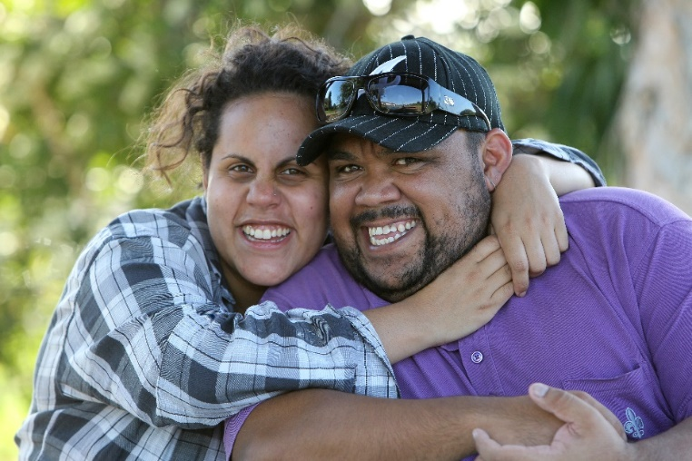
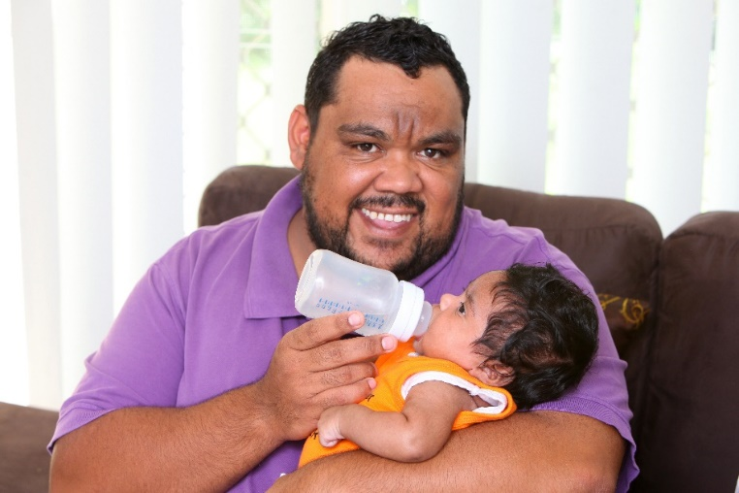
Australia
AUSTRALIA
We have 13 partner-led First Australian programs.
One of these programs is Red Dust Healing.
Red Dust Healing is a cultural healing program, developed from an Aboriginal perspective that provides culturally meaningful tools to overcome past and present hurt and rejection.
The Red Dust Healing program gave Bernard a safe space to talk about his grief and helped him find a way to heal from within.
Bernard became a father and is determined to always be there for his daughter; he understands how important his role within family life is.
Notes:
We have 13 partner-led First Australian programs.
Red Dust Healing is a cultural healing program, developed from an Aboriginal perspective that provides culturally meaningful tools to overcome past and present hurt and rejection. The program leads participants on a personal journey to understand the connections between Australia’s history and the trauma that many families experience, and empowers participants to take ownership of a brighter future.
Program details
Issues: Indigenous rights
Partner Agency: Spread Out and Stick Together
Funding in 2014/15 financial year: AU $150,000
Geographic location: Urban and remote communities Australia-wide
When partnership was established: 2011

Slide 31
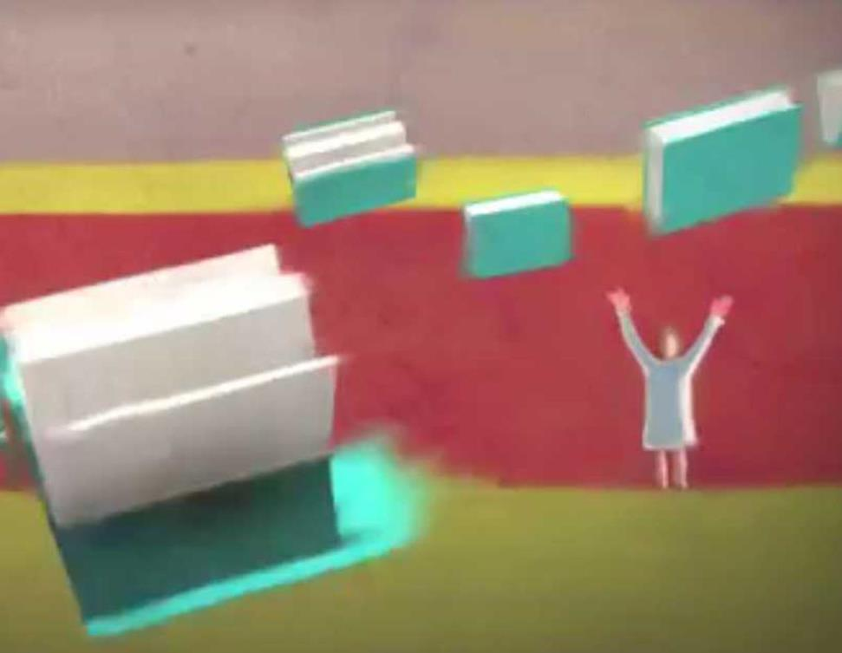
We teach people about the things that make life unfair for other people.
Notes:
The third part of our work is Education and advocacy- teaching people about the things that make life unfair for other people.

Slide 32
Catholic Social Teaching Principles
How?
Human Dignity
Common good
Solidarity
Subsidiarity
Participation
Stewardship
Preferential Option for the poor
Notes:
The bible teaches us about how God wants us to live with other people. We have 7 guiding principles that help us to do this as best- they are Catholic Social Teaching principles.
You can explore this more with your students using:
The Primary Catholic Social Teaching Principles PowerPoint presentation
The Catholic Social Teaching Primary Photo matching activity

Slide 33
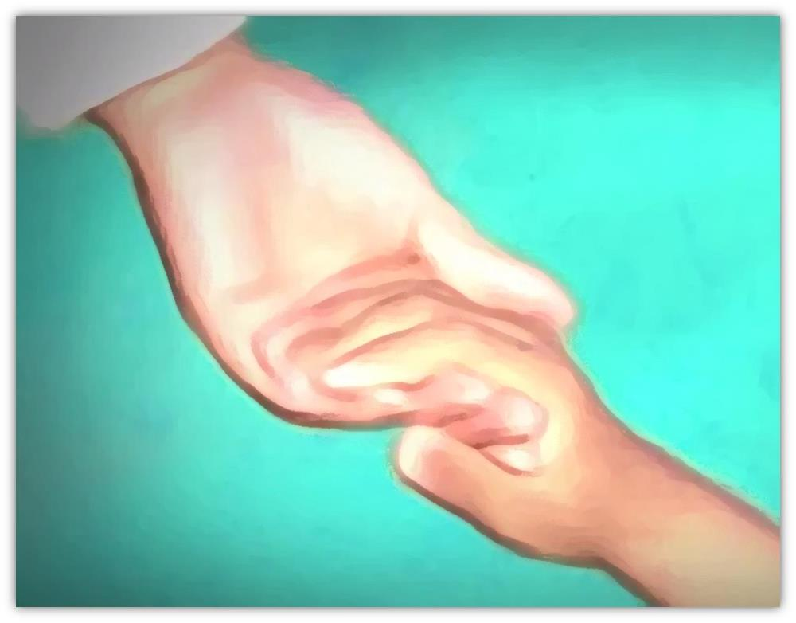
We work with partners overseas, and partners like you!
Notes:
We think working together is really important. We have partners in all our different projects, and people like you are our partners too when you learn about the issues, tell other people, and donate to Project Compassion.

Slide 34
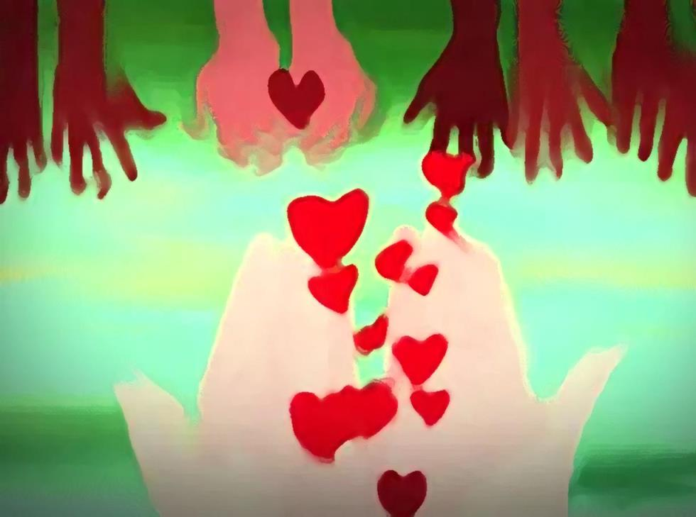
Where do your Project Compassion donations go?
Notes:
Between $500,00 - $1 million goes into the emergency relief fund with the majority going towards long-term development programs.

Slide 35
How can
you be socially
just people?
Notes:
What does social justice mean? Loving concern and to work for those who are treated unfairly.

Slide 36
Who said this?
Notes:
Oscar Romero- A bishop of the Catholic Church in El Salvador, who has been called ‘a voice for the voiceless’.

Slide 37
Be more what?
Notes:
Oscar Romero- A bishop of the Catholic Church in El Salvador, who has been called ‘a voice for the voiceless’.

Slide 38
compassionate
thoughtful
caring
generous
involved
aware
loving
selfless
just
green
supportive
Notes:
A socially just person can ‘Be more’ loving, green, supportive, selfless, aware, caring, thoughtful, involved and generous.

Slide 39
Ideas:
Learn more
Share what you have learned
Support organisations like Caritas Australia
Pray
Notes:
Here are some ideas for actions that can be taken to be a more socially just person.

Slide 41
Picture credits
Caritas Internationalis
‘One human family, zero poverty’ film
http://www.youtube.com/watch?v=Bz2wSNp_B_g
Slide 18- Top photo: Catholic Relief Services, Bottom photo: Caritas Australia
Slide 19 – Caritas Switzerland
Slide 20 – Sean Sprague
Slides 21-29- Caritas Australia
Slide 30 – Rob Maccoll
Find out more:
www.caritas.org.au
Last updated Dec 2016
Notes:
You may like to follow this presentation up with the resources in the zip file:
The Primary Catholic Social Teaching Principles PowerPoint presentation
The Catholic Social Teaching Primary Photo matching activity

