Slide 1
primary
Catechist resource

Slide 2
CONTENTS
Resources Guide | 3
Introduction | 4
About the Theme | 5
Curriculum: Religious Education and Beyond | 6
Lent Link | 7
Catholic Social Teaching (CST) Guide | 8
Project Compassion – Primary Film | 9
Project Compassion Prayer | 10
Ronita’s Story (Philippines): Learning Tasks | 11
Leaia’s Story (Samoa): Learning Tasks | 14
Memory’s Story (Malawi): Learning Tasks | 17
IMPORTANT – STUDENT WELLBEING
At Caritas Australia, we believe that all people should be treated with respect and dignity. Everyone has the right to feel safe, especially children and vulnerable adults. Please consider your audience when selecting which stories and activities to share with your class.
Our new Safeguarding animation recognises that learning about challenges to the health, wellbeing and safety of others and our earth can be hard and encourages young people to talk to their teacher or trusted adult if they’re feeling worried or upset about anything they have learnt through our resources or activities. The animation also acknowledges Caritas Australia’s commitment for children and vulnerable adults to feel valued and heard by encouraging them to share their great ideas with us.
Please use our new animation before sharing the Project Compassion resources with your students.
Watch Caritas Australia’s Safeguarding Animation
Please note: This resource contains links to external web sites. Caritas Australia takes no responsibility for the content of such sites, nor do links to such sites imply endorsement of the views expressed therein. External links are provided for informational purposes only. Access the full policy here: Caritas Australia’s Copyright Policy

Slide 3
RESOURCES GUIDE
All our resources are available online! Access the films and written stories, teaching materials, and our fundraising and awareness raising ideas at caritas.org.au/project-compassion. Below is a list and short description of all the resources you can download, as well as suggestions for use.
 | Resource | Description/Suggested Use
For Students | Photo Storybooks | A Photo Storybook for each Project Compassion story, designed especially for Primary (F–2) students. Download Photo Storybooks Audio described versions also available here.
For Teachers | School’s Guide | A guide for the REC, APRE or Social Justice Leader. Includes tips to plan Project Compassion for the whole school.
 | Teacher Handbook PDF | Available in Lower Primary and Upper Primary versions, provides an explanation of the Project Compassion resources. Briefly explores the curriculum and learning opportunities within Project Compassion.
Media | Films | There is an Introduction Film (Primary)– specifically for Primary Schools along with short ‘Day in the Life’ films for Ronita (Philippines), Leaia (Samoa) and Memory (Malawi).
 | Photo Galleries | View photos from the field. Photos for each story are available through the interactive Upper primary Student Zone.
All Purpose | Introducing Project Compassion (PPT) | Overview of all 3 featured Project Compassion programs and the work of Caritas Australia.
 | Fundraising Booklet | Ideas to inspire fundraising and awareness raising activities linked to the Project Compassion stories. visit schools.projectcompassion.org.au to register your fundraising activities!
 | Resource | Description/Suggested Use
Prayer and Reflection | Ash Wednesday Liturgy | Liturgy of the Word, including distribution of the ashes.
 | Prayer (PPT) | The Project Compassion prayer with beautiful images. Use as a daily or weekly prayer for students or staff, or at an assembly.
 | Weekly Reflections | Weekly reflections for staff, linking the Project Compassion stories to the Sunday Scripture readings. Use for weekly staff reflections during Lent.
 | Way of the Cross (PPT) | A reflection following the Way of the Cross, to use during Holy Week. Leaders’ Notes included.
Telling Others | Newsletter Notices | A brief insert for your weekly school newsletter, explaining the week’s Project Compassion story. Include in print/online school communications. Use on school social media and website.
 | Social Media Toolkit | Content and assets to share your support of Project Compassion through your social media channels.

Slide 4
INTRODUCTION
WELCOME TO PROJECT COMPASSION 2024!
Caritas Australia is the international aid and development organisation of the Catholic Church in Australia and is part of one of the largest aid and development networks in the world – Caritas Internationalis – working in over 200 countries and territories.
Each year, Project Compassion runs during the six weeks of the Church season of Lent. We invite people across Australia to help us raise funds AND act in solidarity with the millions of people across the world with whom we work. We ask you to join us in building a more just and fairer world: a world in balance, at peace and free of poverty.
Project Compassion is an opportunity for students to learn about life in different countries through the personal stories of people who have participated in Caritas Australia-supported programs. The notions of our interconnectedness as one human family are embedded throughout the content and suggested learning tasks. We understand that the curriculum leaves little room for additional content, so we endeavour to offer compelling and interactive content that can be unpacked with high impact teaching strategies, higher order thinking and collaborative learning tasks that capture your students’ imagination intellect, compassion and will to act for social justice.
LENT LINK
This is a weekly Religious Education task that deepens the link between the Project Compassion stories, the Lenten traditions, the themes, and Scripture. ​For Primary (F–2) students, we maintain a focus on prayer, especially for the people and communities in the Project Compassion stories.
PRAYER, FASTING, ALMSGIVING
You may wish to introduce the Lent Link prayer activity in relation to the threefold Lenten tradition of prayer, fasting and almsgiving (as outlined below). By making explicit links, students are encouraged to see how their actions to learn and support the work of the church, through Caritas Australia, are an extension of their faith. ​ ​
Prayer
​During Lent, Christians pray for themselves and others. We encourage you to pray for the people and communities you learn about through the stories we share during Project Compassion.
Fasting ​
Fasting is about giving something up for a time. Many people give up something they love to eat or something they like to do such as spending time watching television. Through 'fasting' we can become more aware of others who don’t have what they need or the opportunities to do what they would like to do.
Almsgiving ​
Almsgiving means donating money or items to people who have less than you. It is a way to show that you care for others and that you are thankful for all God has given you. Caring for others is part of many faiths.
Let’s be brave enough to give generously this Lent. What can you go without during each week of Lent? Maybe it’s a snack or treat that you have each week. You can place the money saved in our Project Compassion boxes. Your support of Project Compassion is a way of saying you care about creating a fairer world, now and ‘for all future generations’.

Slide 5
ABOUT THE THEME
The theme of Project Compassion 2024 is ‘For All Future Generations’. It is an expression of hope and reminds us that the good that we do today will extend and impact the lives of generations to come. It invites us to make the world a better place by working together now and finding long-term solutions to global issues.
This year, For All Future Generations is inspired by the story of the burning bush in the book of Exodus (Exodus 3:1-20).
In this story, God tells Moses that he has heard the cry of his people. God responds to injustice and chooses Moses to speak to Pharaoh. Although Moses is afraid, God promises to be with him. Thus, God says, ‘By this name I shall be invoked for all future generations.’
As God called Moses, so now God calls us to work for all future generations.
Project Compassion 2024 shares the stories of three resilient women from different corners of the world. Although they face vastly different challenges in their day-to-day lives, they are all united by their dream of creating a better tomorrow for all future generations.
We encourage students to discover the power of giving and the impact that their contribution, however big or small, can have in the lives of others. When we lend a hand to someone in need, they will go on to help others and make better opportunities for future generations. Compassion is contagious and creates a ripple effect of kindness and prosperity.
Project Compassion acts as a timely reminder during Lent that by putting our faith and compassion in action today, we have the power to create lasting change for generations to come.
INTRODUCING THE THEME, FOR ALL FUTURE GENERATIONS
Explain to students that when we take care of each other and the earth now, the future is hopeful for everyone: for us and for all future generations.​
Students consider how they would like the future to look. They might think about the future in 10 years, 20 years, or 50 years.
What can they do now to make that future possible?​
Display: Create a tree display in your classroom.
On the trunk of the tree write ‘For all future generations.’
Students write actions they can take to care for the earth and each other on leaves to add to the tree display.
Continue to add to the tree over the season of Lent.
Colouring sheets for Project Compassion are also available to use as a display around your classroom or school.
God said,
“This is my name for all time; by this name I shall be invoked for all generations to come.”
Exodus 3:15

Slide 6
CURRICULUM: RELIGIOUS EDUCATION AND BEYOND
PROJECT COMPASSION AND THE AUSTRALIAN CURRICULUM​
Linking the themes of Project Compassion with the curriculum is an opportunity for students to engage more deeply with justice and the work of Caritas Australia. The stories and learning tasks featured can relate broadly to the following Australian Curriculum areas.
​
RELIGIOUS EDUCATION THEMES ACROSS AUSTRALIA​
There are many Religious Education curricula around the country, however it is not surprising that there are also many common themes. We have drawn on these common themes:​
Living the mission of Jesus​
Catholic Social Teachings: Human Dignity, Preferential Option for the Poor, Solidarity, Subsidiarity and Participation, Care for Our Common Home and The Common Good​
Initiation and belonging​
Action for justice and peace.​
​
CROSS-CURRICULUM PRIORITIES​
Asia and Australia’s engagement with Asia​
Collaboration and engagement with the peoples of Asia support effective regional and global citizenship. Australians play a significant role in social, cultural, political and economic developments in the Asia region. Look for Ronita’s Story (Philippines).
Sustainability​
World views that recognise the dependence of living things on healthy ecosystems, and value diversity and social justice, are essential for achieving sustainability. Look for Leaia’s Story (Samoa).
GENERAL CAPABILITIES KEY IDEAS​
Intercultural Understanding​
Intercultural understanding stimulates students’ interest in the lives of others. It cultivates values and dispositions such as curiosity, care, empathy, reciprocity, respect and responsibility, open-mindedness and critical awareness, and supports new and positive intercultural behaviours.​
Personal and Social Capability​
Students gain an understanding of the role of advocacy in contemporary society and build their capacity to critique societal constructs and forms of discrimination, such as racism and sexism. In developing and acting with personal and social capability, students are encouraged to: appreciate diverse perspectives, contribute to civil society and understand relationships.​ Look for Memory’s Story (Malawi)
Ethical Understanding​
In developing and acting with ethical understanding, students: examine values (see Catholic Social Teaching Guide page 10), explore rights and responsibilities and consider other points of view.

Slide 7
LENT LINK
ABOUT LENT
Discuss: What do you know about Lent? What significance does it have for you?​
Every year throughout Lent we commit to strengthening our faith through prayer, fasting and almsgiving. These are the three pillars or traditions of Lent.
Pope Francis explains, ​“Lent is a time of grace to the extent that we listen to him [Jesus] as he speaks to us. And how does he speak to us? First, in the word of God, which the Church offers us in the liturgy. May that word not fall on deaf ears; if we cannot always attend Mass, let us study its daily biblical readings, even with the help of the internet. In addition to the Scriptures, the Lord speaks to us through our brothers and sisters, especially in the faces and the stories of those who are in need.”
(Pope Francis’s Lenten Message 2023)
Through Project Compassion, we can think about the faces and stories of those in need and learn how, with our support, Caritas Australia is working with local partners around the world to help end poverty, uphold dignity and promote justice. Over the coming weeks, we will hear stories of hope from the Philippines, Samoa and Malawi.
Let’s focus on how we can be people of hope in our family, our school community and with our global family – for all future generations.
PRAYER
During Lent, Christians pray for themselves and others. We are encouraged to pray for the people and communities we learn about through the stories shared during Project Compassion.
FASTING
Fasting is about giving something up for a time. Many people give up something they love to eat. This can help us understand a little more about what it's like for somebody who is different from us. We can also give up something we like to do, like spending time watching television.
ALMSGIVING
Almsgiving means donating money or items to people who have less than you. It is a way to show that we care for others and that we are thankful for all God has given us. Caring for others is part of many faiths. Let’s be brave enough to give generously this Lent.
What can we go without during each week of Lent? Maybe it’s a snack or treat that we have each week. We can place the money saved in our Project Compassion boxes. Our support of Project Compassion is a way of saying we care about creating a fairer world.
Pray: Each week, write a prayer for the community you learn about.
Fast: What will you give up for Lent this year?
Give: What will you give? How will you give it?

Slide 8
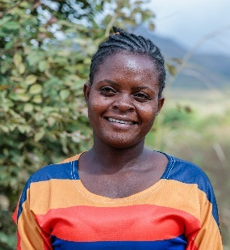
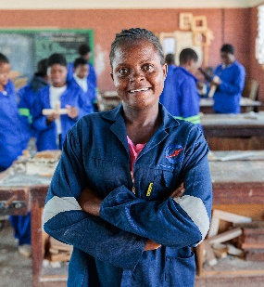
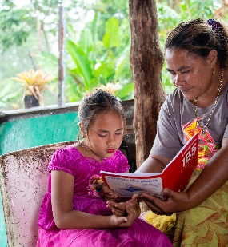
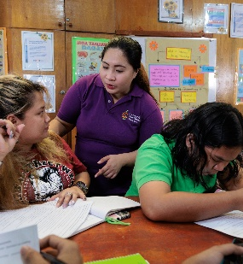
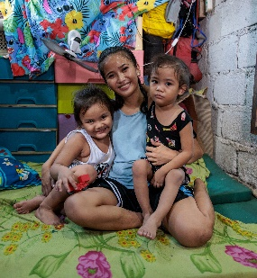
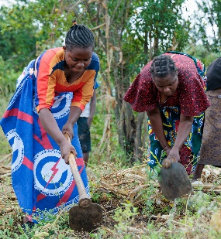
CATHOLIC SOCIAL TEACHING (CST) GUIDE
Catholic Social Teaching (CST) principles cover all spheres of life – the economic, political, ecological, personal and spiritual. The principles are inspired by scripture and the writings of the Pope and other Catholic leaders about social issues.
Caritas Australia’s work is shaped by the tradition of Catholic Social Teaching.
HUMAN DIGNITY
SUBSIDIARITY AND PARTICIPATION
We believe every human being is created in the image and likeness of God and therefore has inherent dignity that should always be safeguarded.
We believe all people have the right to participate in decisions that affect their lives. Subsidiarity requires that decisions are made by people closest and most affected by the issues and concerns of the community.
SOLIDARITY
THE COMMON GOOD
We believe we are part of one human family and have a responsibility to help each person achieve their full potential.
We believe the good of each human person is intimately related to the good of the whole community. We are all responsible for each other.
PREFERENTIAL OPTION FOR THE POOR
CARE FOR OUR COMMON HOME
We believe in prioritising the women, men and children most vulnerable to extreme poverty and injustice.
We believe that care for our common home is vital for the common good of all people. We believe a true ecological approach is a social approach. We are to be protectors of creation and of one another.
For more on Catholic Social Teaching, including classroom activities, short films and other resources, visit our CST Toolkit.
Photo credits: Tim Lam/Caritas Australia (top left, top right, bottom right), Richard Wainwright/Caritas Australia (middle right, bottom left), Laura Womersley/Caritas Australia (middle left)

Slide 9
PROJECT COMPASSION – Primary Film

Slide 10
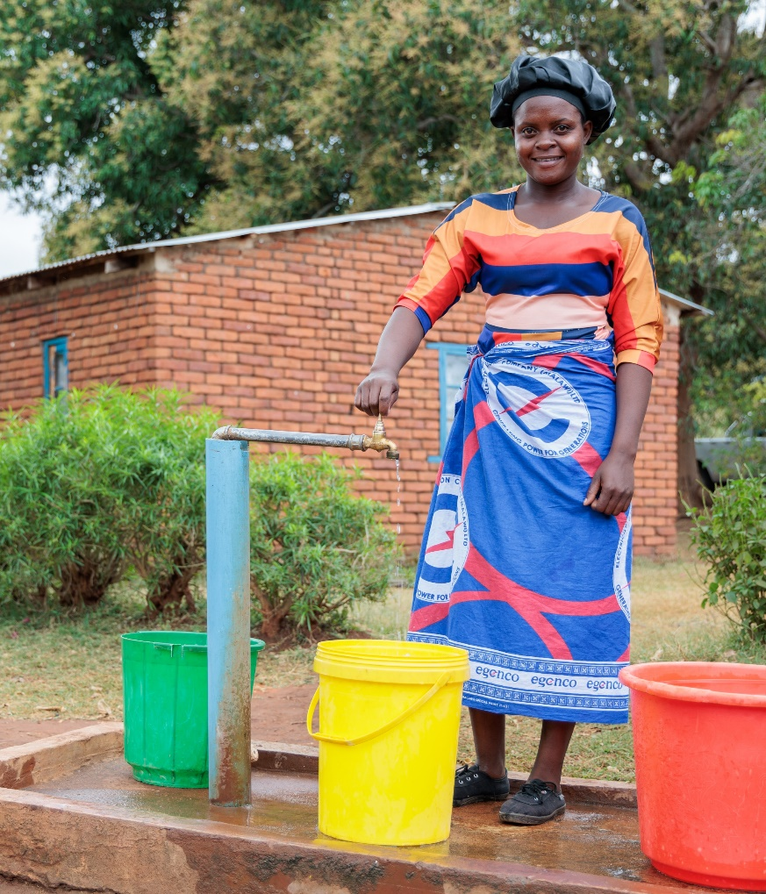
PROJECT COMPASSION PRAYER
God of all hope, we pray for our world with all its beauty and need.
We thank you for the love in our lives that is a mirror of your unending love.
May all creation know your compassion this Lent and may we take courage to share it, especially with those who don’t have what they need.
In our time, we hear the same words you spoke to Moses: ‘I will be with you,’ when you ask us to do courageous things.
Through our prayer, fasting and almsgiving, move us to act in the company of your Spirit, showing compassion and acting for justice to renew the face of the Earth, now and for all future generations.
We ask this in the name of Christ.
Amen.

Slide 11
RONITA’S STORY (PHILIPPINES)
Read Ronita’s Story (Photo Storybook) and watch the ‘Day in the Life’ film.
TASK 1: CLASS DISCUSSION
What challenges did Ronita face?
How did Caritas Australia help?
What is special about the Alternative Learning System program that helped Ronita continue her education?
What are three other activities that FCJ run for the community?
What is Ronita’s hope for the future?
TASK 2: PHOTO STUDY
As a class, view the photos in Ronita’s Photo Storybook.
Ask students:
What do the photos show you about Ronita’s life?
Which photo do you like the best? Why?
What questions would you like to ask Ronita?
What do you want to learn more about?
Ronita (22) smiles as she holds her sons, Egzy Grey (3) and Clark (5), in their small home in Quezon City, Philippines. Photo: Richard Wainwright/Caritas Australia

Slide 12
RONITA’S STORY – LEARNING ACTIVITIES
TASK 3: CATHOLIC SOCIAL TEACHING LINK – SOLIDARITY
Solidarity
We all need each other.
We are one big human family.
It’s about working together and supporting one another.
A. How is solidarity demonstrated in Ronita’s story?
B. How is supporting Project Compassion an act of solidarity?
For more teaching resources on solidarity refer to our CST Toolkit
Curriculum link: Religious Education
TASK 4: RE LINK
Read the ‘The Parable of the Good Samaritan’ (Luke 10:25-37)
Discuss with the class how Jesus concludes the story of the Good Samaritan by telling us that the individual acting as a neighbour to the injured man “was the one who treated him with mercy” and emphasises that an act of mercy demonstrates love. We are then told to ‘go and do likewise’.
Caritas Australia works to love our neighbours all around the world- because we are part of God’s big family and because God’s love is shown when we love and serve others.
Discuss:
Who is our neighbour?
Students record how they can demonstrate their commitment to loving their neighbor through prayer, fasting and almsgiving during Lent.
Class display
In __________ (class) we love our neighbour by …
Students add examples of things they can, or have done, to show love of their neighbour. Encourage students to notice and acknowledge when they have seen others show love for others too.
Curriculum link: Religious Education
TASK 5: WRITE A PRAYER
See next page.

Slide 13
Name:
My Prayer for Ronita

Slide 14
LEAIA’S STORY (SAMOA)
Read Leaia’s Story (Photo Storybook) and watch the ‘Day in the Life’ film.
TASK 1: CLASS DISCUSSION
Where does Leaia’s family get water from?
What impact is climate change having on Leaia’s family’s ability to access clean water?
How does having easy access to clean water help Leaia’s children go to school?
How did Caritas Australia help?
How will you share Leaia’s story with others?
TASK 2: PHOTO STUDY
As a class, view the photos in Leaia’s Photo Storybook.
Ask students:
What do the photos show you about Leaia’s life?
Which photo do you like the best? Why?
What questions would you like to ask Leaia?
What do you want to learn more about?
Leaia (right) stands with her family in front of their home that is now connected to a rainwater tank. Photo: Laura Womersley/Caritas Australia

Slide 15
LEAIA’S STORY – LEARNING ACTIVITIES
TASK 3: CATHOLIC SOCIAL TEACHING LINK – HUMAN DIGNITY
Human Dignity
We are all special because God made us.
All people – ourselves and others – should be treated with respect and fairness because God made each one of us!
How is human dignity demonstrated in Leaia’s story?
How is supporting Project Compassion one way you can uphold the dignity of others?
For more teaching resources on Human Dignity refer to our CST Toolkit
TASK 4: RE LINK
Fratelli Tutti is a letter from Pope Francis about love and friendship. Fratelli Tutti means we are all brothers and sisters. Pope Francis reminds us that we need to treat everyone like a sister or brother and when we do so, this is called fraternal love; love that reaches out and helps others, no matter where they are from or where they live.
Explain the quote above from Fratelli Tutti. For example, some people have more water to use than what they need. Instead of wasting water, they save it for others who don’t have enough. This is an example of fraternal love; thinking about and caring for other people, not just ourselves or our own family and friends. This is the type of love we need to show to everyone all around the world.
Caritas Australia is helping Leaia’s family and community to have enough clean water. When we support Caritas Australia, we are also part of the story, sharing our love and compassion with others. How marvellously human!
Students share ways they can be marvelously human during Lent.
Curriculum Link: Religious Education
TASK 5: WRITE A PRAYER
See next page.
“Those who enjoy a surplus of water yet choose to conserve it for the sake of the greater human family have attained a moral stature that allows them to look beyond themselves and the group to which they belong. How marvellously human! The same attitude is demanded if we are to recognize the rights of all people, even those born beyond our own borders.”
(Pope Francis, Fratelli Tutti n117)

Slide 16
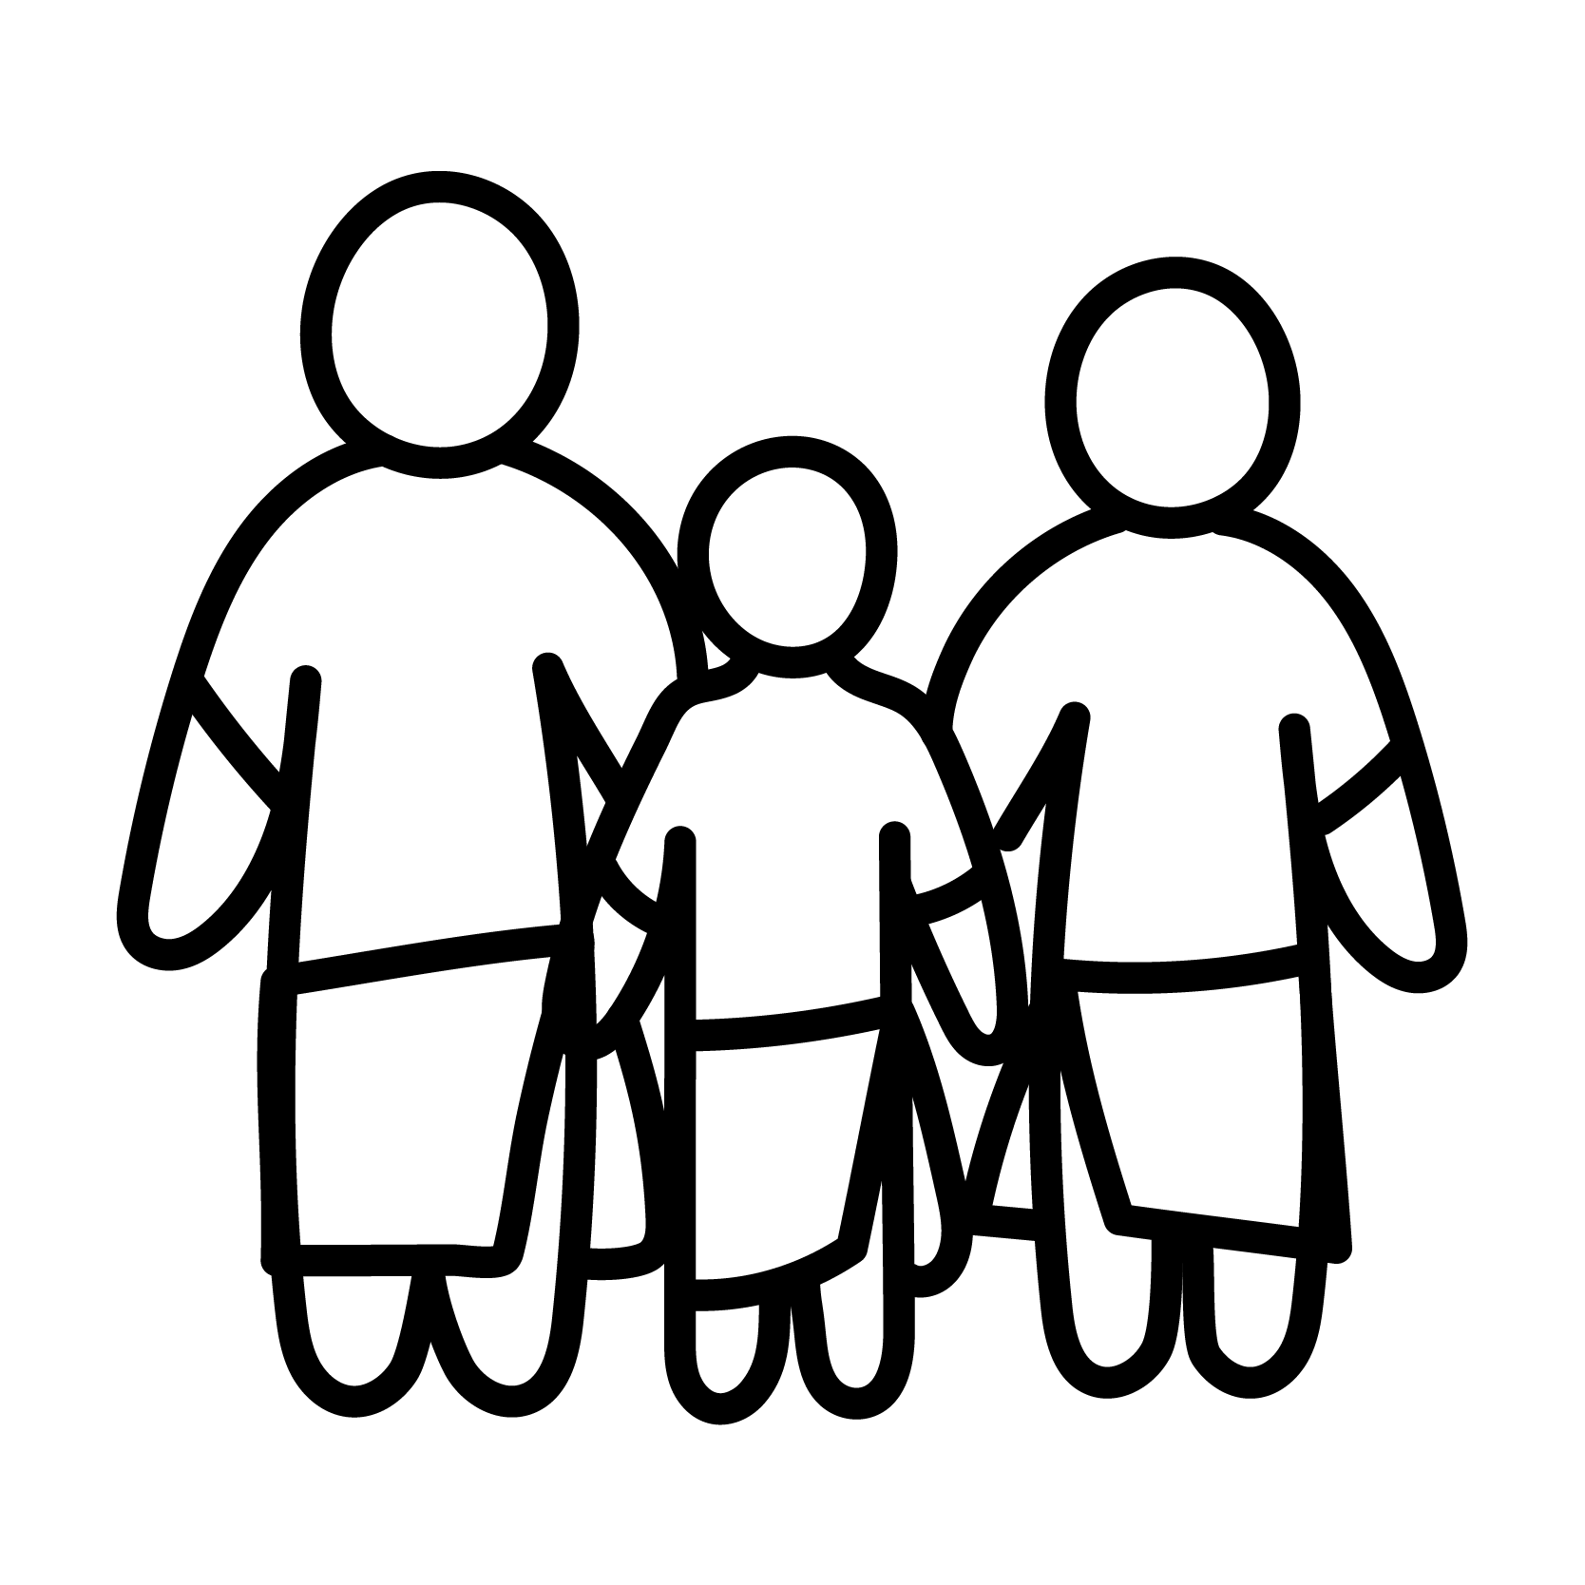
Name:
My Prayer for Leaia

Slide 17
MEMORY’S STORY (MALAWI)
Read Memory’s Story (Photo Storybook) and watch the ‘Day in the Life’ film.
TASK 1: CLASS DISCUSSION
What made life hard for Memory?
How has Memory improved her life and that of her family and community?
How did Caritas Australia help?
How is Memory supporting (or planning to support) future generations?
How will you share Memory’s story with others?
TASK 2: PHOTO STUDY
As a class, view the photos in Memory’s Photo Storybook.
Ask students:
What do the photos show you about Memory’s life?
Which photo do you like the best? Why?
What questions would you like to ask Memory?
What do you want to learn more about?
Memory stands in a workshop at the technical college where she completed her three-year carpentry course. Photo: Tim Lam/Caritas Australia

Slide 18
MEMORY’S STORY – LEARNING ACTIVITIES
TASK 3: CATHOLIC SOCIAL TEACHING LINK – PARTICIPATION
Participation
People and groups have the right to participate in decisions that affect them.
Everyone should be able to work and use the talents God gave them.
How is participation demonstrated in Memory’s story?
How is supporting Project Compassion one way you can participate in making our world for fair?
For more teaching resources on Subsidiarity and Participation refer to our CST Toolkit
Curriculum link: Religious Education
TASK 4: RE LINK – LEADERSHIP
Discuss how Memory has shown she is a great leader.
Answers could include: she worked hard to make her dream of going to college come true; she has proved that women can become carpenters too; she is a good role model for her sisters and brothers; and she hopes to help her whole community in the future by opening her own workshop so she can give others a job too!
Students list some of Memory’s qualities as a leader.
Discuss: What does Scripture say about leaders?
Moses – Read the story of the Burning Bush (Exodus 3:1-20) where this year’s Project Compassion theme is drawn from. God has to be very convincing in order for Moses to take action. At first, Moses gives excuses as to why he isn’t the right person for the job. It took great courage for Moses to approach Pharaoh and boldly passes on the important message: “Let my people go.” The Israelites, Moses’s people, had been made slaves
by Egypt and Moses was the one chosen to lead them to freedom. When the time came, Moses was willing to step up and lead, and God was with him.
Jesus – One of the most powerful events in the life of Jesus is when he washes his disciples’ feet in John 13. When he is finished, he says to them, “You call me teacher and Lord, and you are right, for so I am. If I then, the Lord and teacher, washed your feet, you also ought to wash one another’s feet.” Jesus isn’t just talking about feet. He’s talking about servant leadership. Great leaders focus on serving others.
Brainstorm characteristics/qualities/values of a good leader. Discuss how everyone can be a good leader, not just people who have special leadership roles.
Students choose 2 qualities they already have, 2 qualities they would like to improve or strengthen.
Curriculum link: Religious Education, Health and Physical Education
TASK 5: WRITE A PRAYER
See next page.

Slide 19
Name:
My Prayer for Memory

Slide 20
THANK YOU
PHOTO CREDITS
Ronita’s Story (Philippines) – Richard Wainwright/Caritas Australia
Leaia’s Story (Samoa) – Laura Womersley/Caritas Australia
Memory’s Story (Malawi) – Tim Lam/Caritas Australia
CATECHISTS
For more school resources, please visit: caritas.org.au/resources/school-resources/
Stay up to date with events and resources!
Subscribe to Caritas Australia’s Education e-newsletter.
COMMUNITY ENGAGEMENT ANIMATORS
QLD/NT – Andrew.Knife@caritas.org.au ​
NSW/ACT – Chris.Nolan@caritas.org.au ​
VIC/TAS – Gwen.Michener@caritas.org.au ​
WA/SA – Paul.Reid@caritas.org.au ​
​
JUSTICE RESOURCES TEAM
Nicole.Dobrohotoff@caritas.org.au ​
​
GENERAL ENQUIRIES
education@caritas.org.au ​
Caritas Australia gratefully acknowledges the support of the Australian Government through the Australian NGO Cooperation Program. ​

