Slide 1
A NOTE TO PRESENTERS
This PowerPoint is based upon the Australian Bushfire crisis of 2019/2020.
​
Please note:​
It is our hope that you will use these slides in a way that best suits your purposes. As such, the slides are editable so that the content is flexible for you to adapt to your needs. If you do edit this presentation, please ensure content and photos from this resource remain with the appropriate credit to Caritas Australia and the photographers
​
For copyright information, please see the 'Notes' section of this slide.​
​

Slide 2
THE AUSTRALIAN BUSHFIRE CRISIS

Slide 3
For months, Australia has faced severe drought, record-high temperatures and strong winds, ultimately resulting in one of the worst bushfire seasons it has seen in Australian history.
The catastrophic fires have had a devastating impact on lives, homes, wildlife and bushland, with all states being affected in varying degrees.
Volunteer men and women of the Rural Fire Service across New South Wales, Queensland, Victoria and South Australia have been heroically battling flames since August 2019 PHOTO: CNS/REUTERS

Slide 4
At least 28 people have died nationwide.
Over 10 million hectares of bushland has burnt across Australia.
At least 1700 homes have been damaged or destroyed in NSW alone.
An estimated 1 billion animals* have been killed since bushfires in NSW started in September 2019.
The smoke from the bushfire crisis has drifted more than 2000km away to the South Island of New Zealand.
NSW Premier Gladys Berejiklian stated that the speed of the bushfires are “unprecedented” and that the state is facing “uncharted territory”.
Fires are burning throughout Australia. January 22 NASA satellite map. Source: NASA
Notes:
*According to Chris Dickman, ecology expert from the University of Sydney

Slide 5
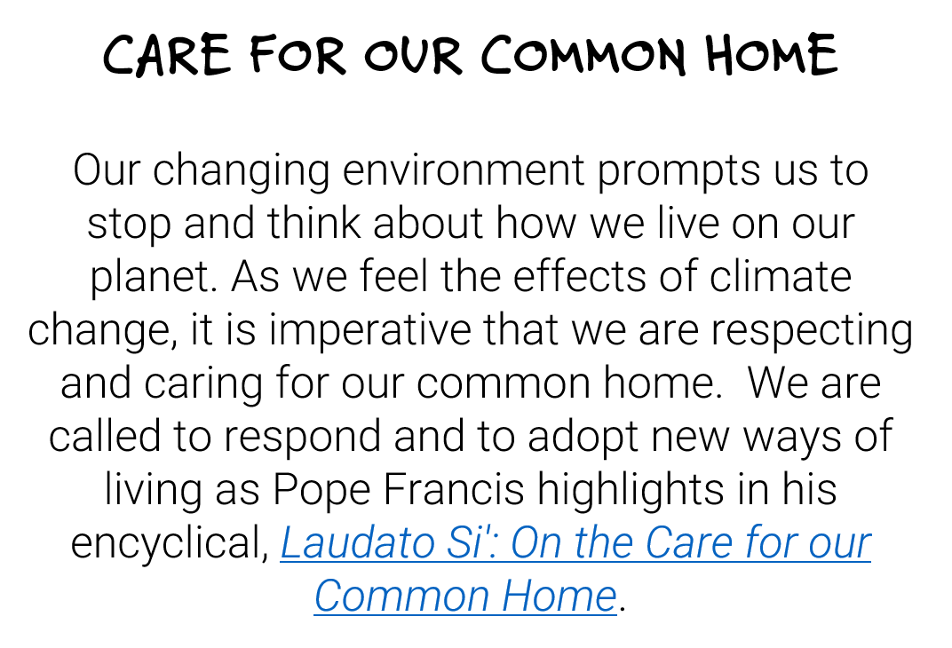
CATHOLIC SOCIAL TEACHING
Farmers have had to abandon livestock in the wake of encroaching flames. It is estimated that approximately half a billion animals- both wildlife and cattle- have already been killed by the fires PHOTO: CNS/REUTERS

Slide 6
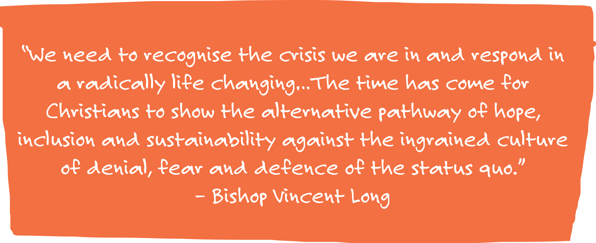
WHAT DO CATHOLIC LEADERS SAY?

Slide 7
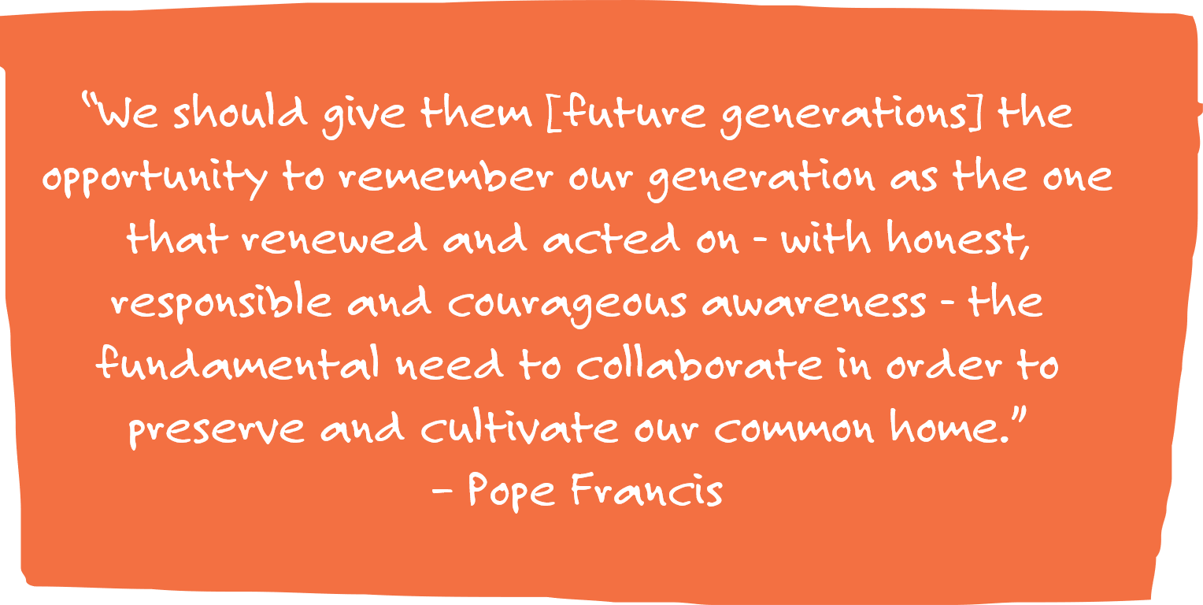
WHAT DO CATHOLIC LEADERS SAY?

Slide 8
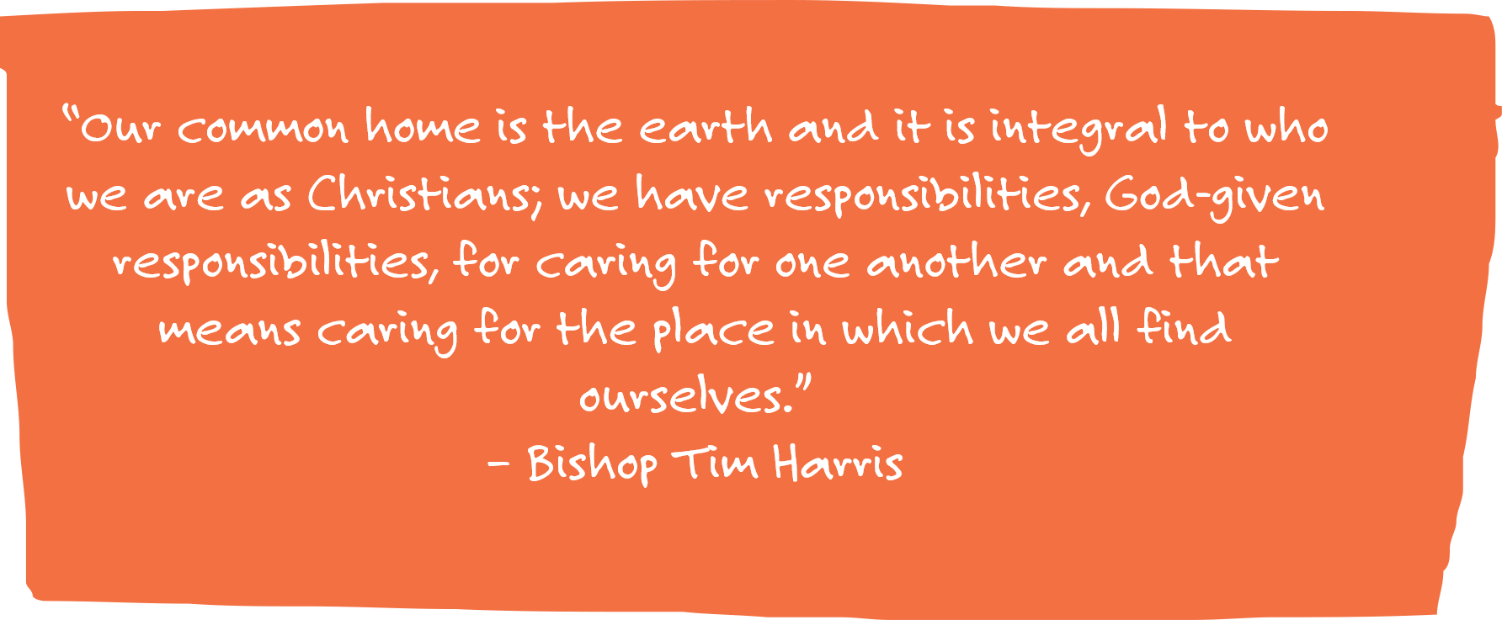
WHAT DO CATHOLIC LEADERS SAY?

Slide 9
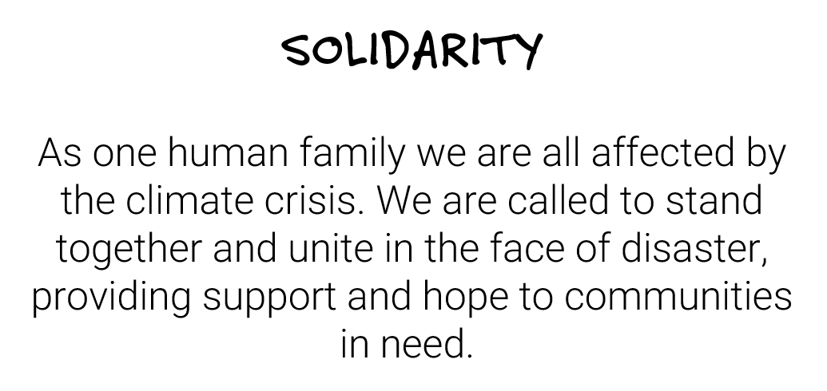
CATHOLIC SOCIAL TEACHING

Slide 10
CARITAS STANDS IN SOLIDARITY
At this time of crisis for Australian communities, Caritas Australia has received many messages of solidarity from the global Catholic community.
Catholic and Caritas agencies have reached out, not only with compassionate messages, but also to find out how they can provide support in these testing times.
Staff at the Catholic Bishops Conference gather in Port Moresby, having expressed their solidarity with Australia during the Bushfire Season.

Slide 11
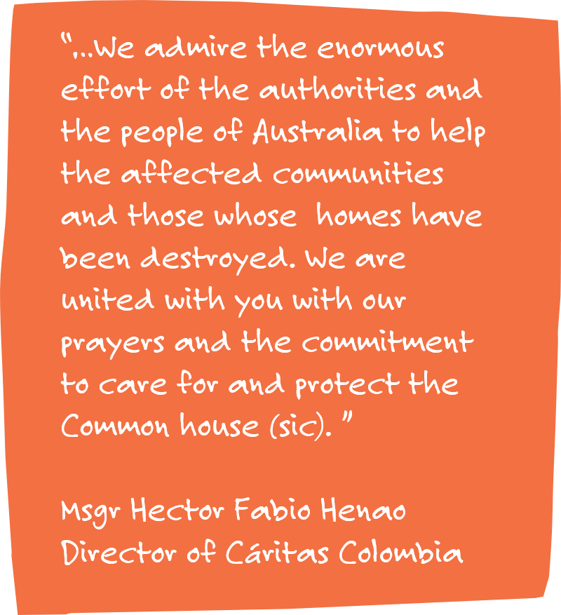
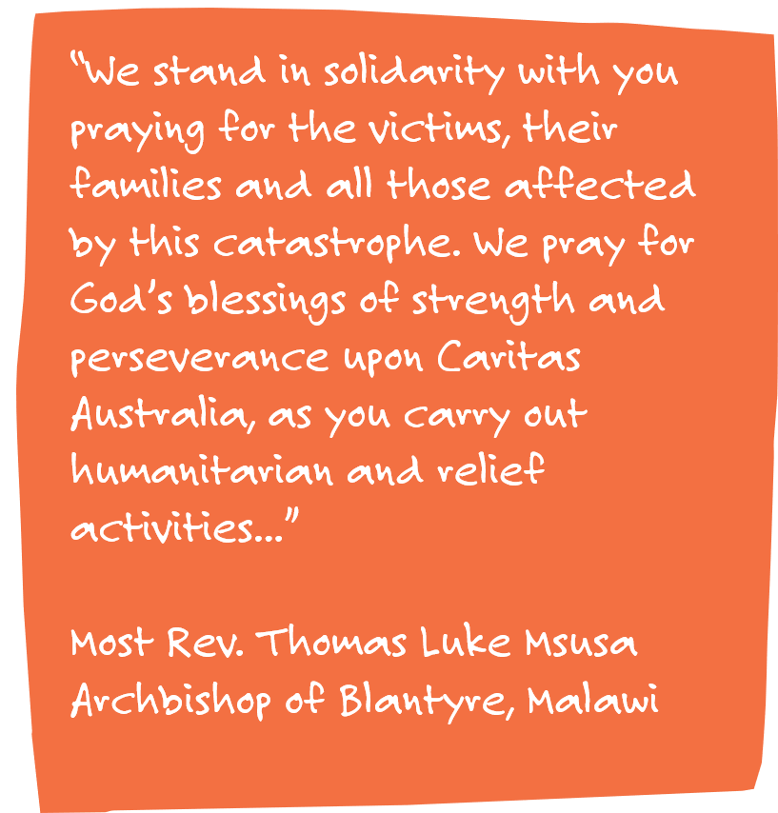
CARITAS STANDS IN SOLIDARITY

Slide 12
2 Corinthians 4: 6-12

Slide 13
REFLECTION
In Paul’s letter, he is encouraging early Christian communities not to lose hope in times of despair or affliction. He calls upon them to have faith in the grace of God who provides hope and comfort during times of need.
So too do we look towards Jesus Christ for hope as our light that burns beyond the destruction caused by the bushfires.
We see Christ in the communities who gather in solidarity to support victims in need.
We see Christ in the strength of our first responders, who face the flames of the fires each day.
We see Christ in the wildlife which emerges from the ashes to find new homes.
And we see Christ in the green glimmers of hope that shine through the burnt bushland as our eco-system begins to renew itself.
As we reflect on the devastation caused by the Australian fires, may we look forward in hope. Let us challenge ourselves to build a better future for the next generation, acting as stewards of the earth and caring for our common home.

Slide 14
PRAYER
Eternal God,
In wisdom and love you created our earth to sustain us and give us life.
We turn to you now in faith, hope and love,
asking you to look with favour on our fire-ravaged and drought-stricken land,
on our starving and displaced animals,
on our failing crops and burning farms, towns and forests.
Strengthen, sustain and give new heart to our farmers and to all who are affected by drought;
be with those who support them.
Strengthen and comfort the victims of the fires,
those who have lost family, friends, property and stock.
Protect our volunteer firefighters and all members of essential services.
In your loving providence, send abundant rain to quench the fires and to restore our parched earth.
Father of all compassion, hear our prayer through Jesus Christ your Son,
in whom the promise of new life has dawned,
and through the power of the Holy Spirit, the Lord the giver of life:
Renew your faithful people; Renew the face of the earth.
Our Lady of the Southern Cross,
Mary, help of Christians – Pray for us.
St Mary of the Cross MacKillop – Pray for us.
(ACBC)
Notes:
Prayer Source: Australian Catholic Bishop’s Conference

Slide 15
LINKS FOR SUPPORT
BEYOND BLUE
https://www.beyondblue.org.au/the-facts/bushfires-and-mental-health/
LIFELINE
https://www.lifeline.org.au/
R U OK BUSHFIRE SUPPORT
https://www.ruok.org.au/supporting-others-through-the-bushfire-crisis
YOUTH BEYOND BLUE
https://www.youthbeyondblue.com/
KIDS HELPLINE
https://kidshelpline.com.au/
Teachers seeking additional support in the classroom may find research on
'Trauma Informed Practice' of some use.

