Slide 1
Prayer for refugees
Adapted from Pope Francis’ message for the
World Day of Migrants and Refugees, 2014

Slide 2
Every stranger who knocks at our door is an opportunity for an encounter with Jesus Christ, who identifies with the welcomed and rejected strangers of every age.
Pope Francis’ message for the World Day of Migrants and Refugees, 2018

Slide 3
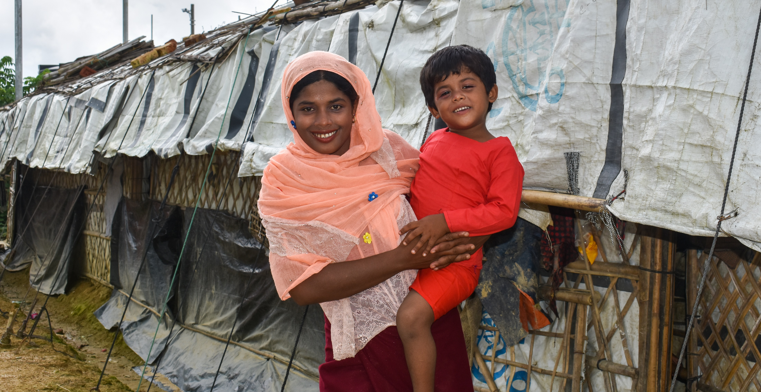
God of Hope,
We pray that refugees never lose hope of a better future.
Jamila holding her daughter in front of their shelter in a refugee camp in Cox’s Bazar, Bangladesh.
Photo credit: : Inmanuel Biswas/Caritas Bangladesh

Slide 4
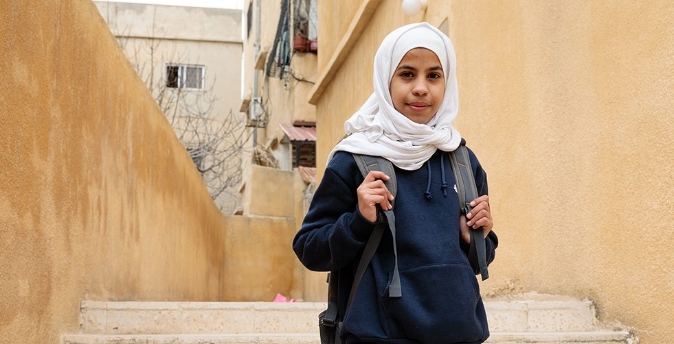
We pray that refugees will be welcomed.
Bayan in front of her home as she waits for the program’s private bus to take her to the Caritas Education Program, which is at a school 30 minutes away.
Photo credit: Richard Wainwright, Caritas Australia

Slide 5
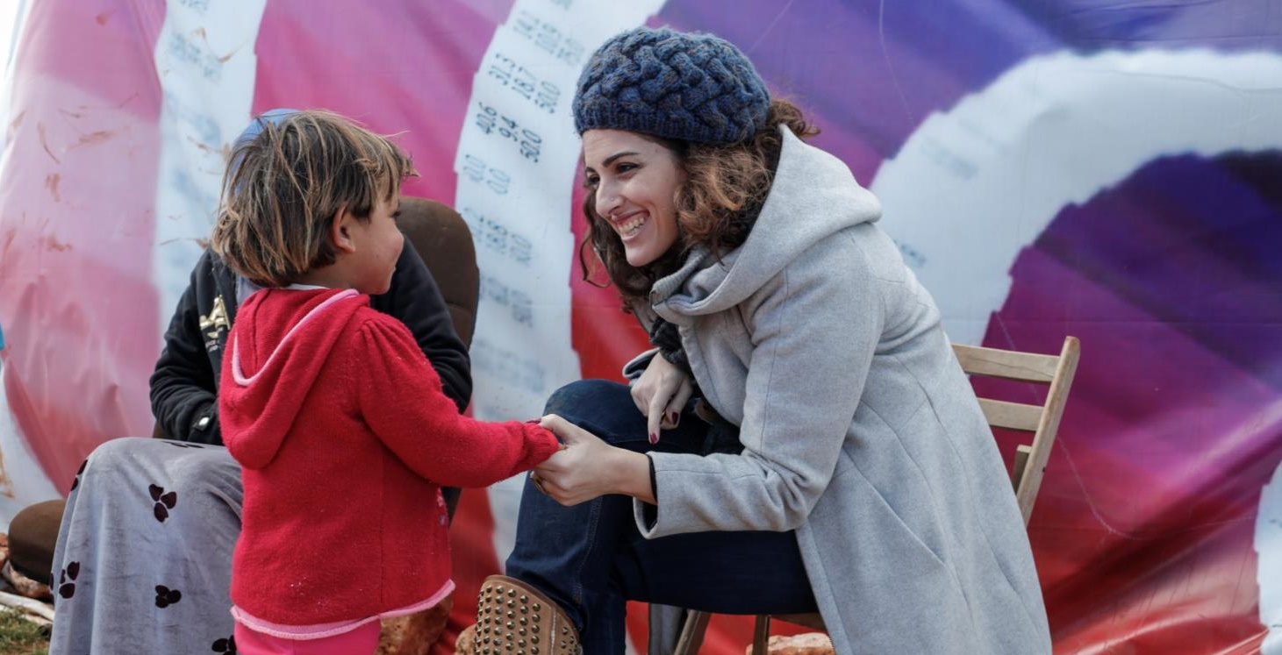
We pray for those devoting their lives to helping refugees, that they will find strength in your love.
Syrian refugees
Photo credit: Catholic Relief Services

Slide 6
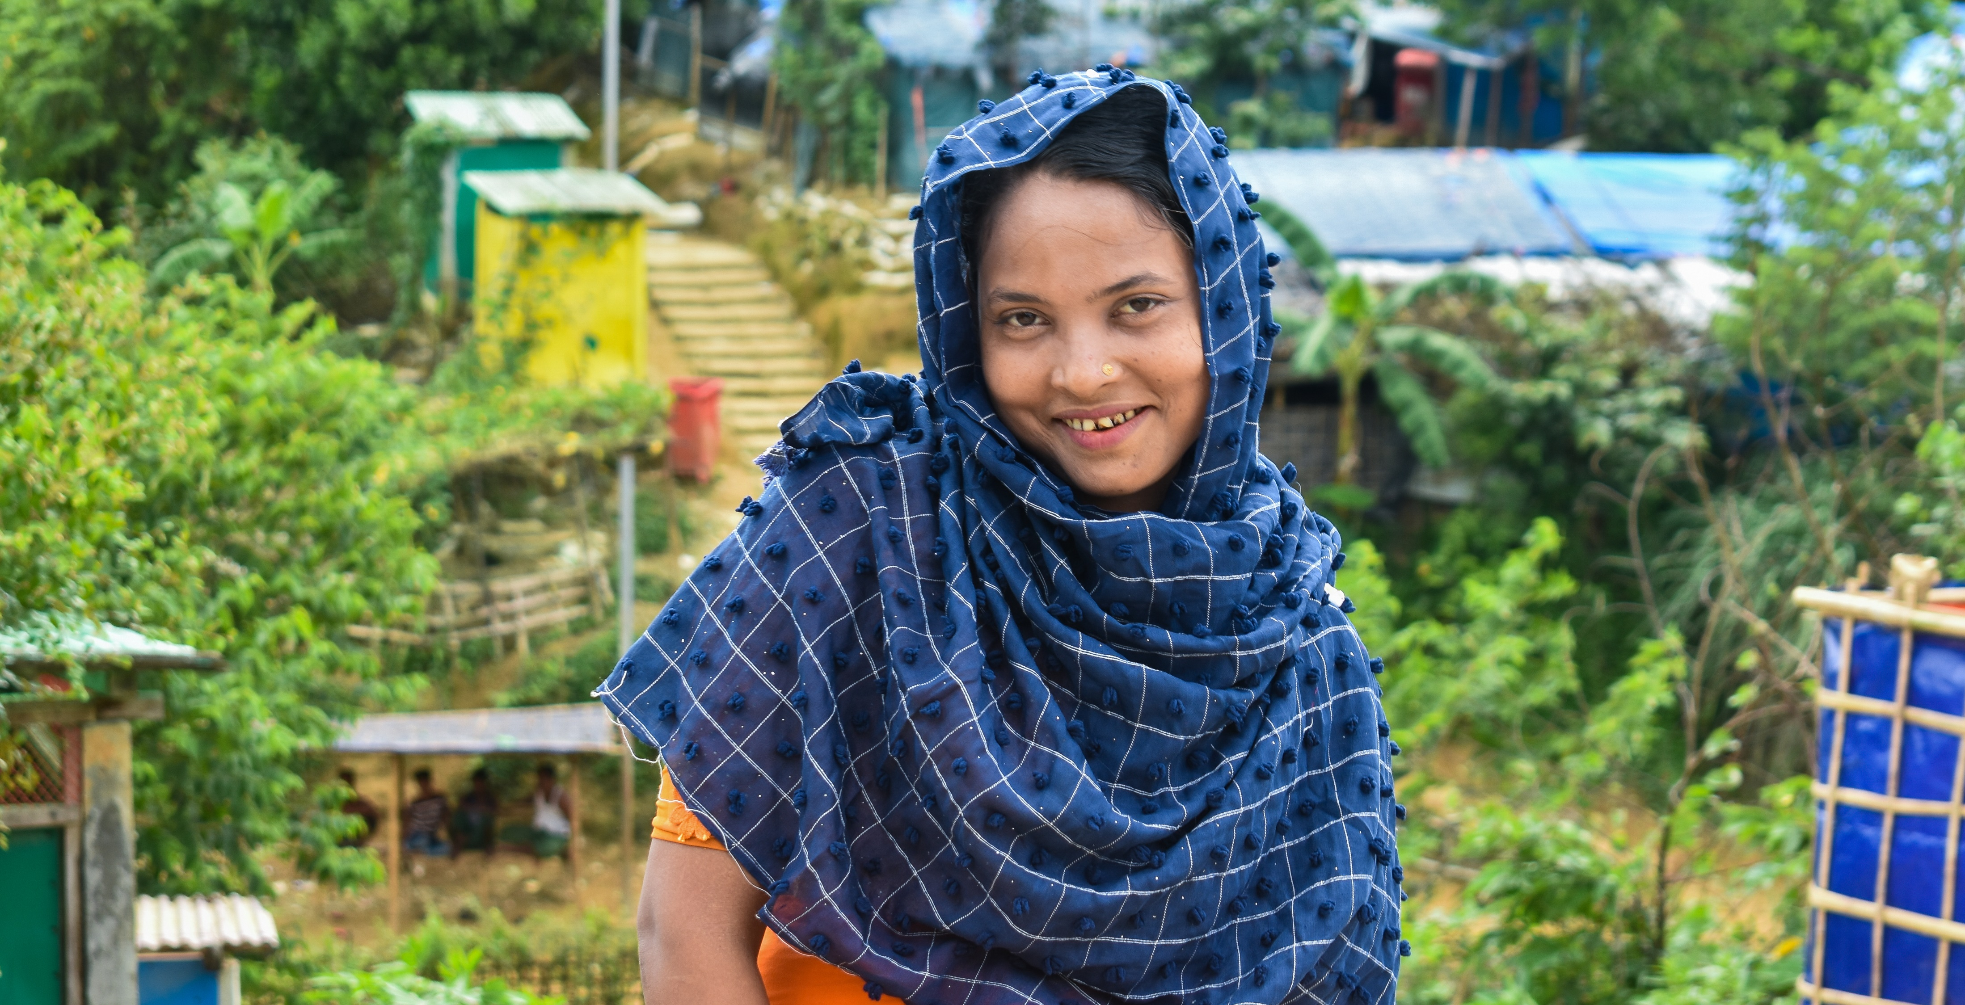
We pray for ourselves, that we will think of Jesus when we think about or meet refugees.
Halima returning from collecting water from a pump near her shelter in a refugee camp in Cox’s Bazar, Bangladesh.
Photo credit: Inmanuel Biswas/Caritas Bangladesh

Slide 7
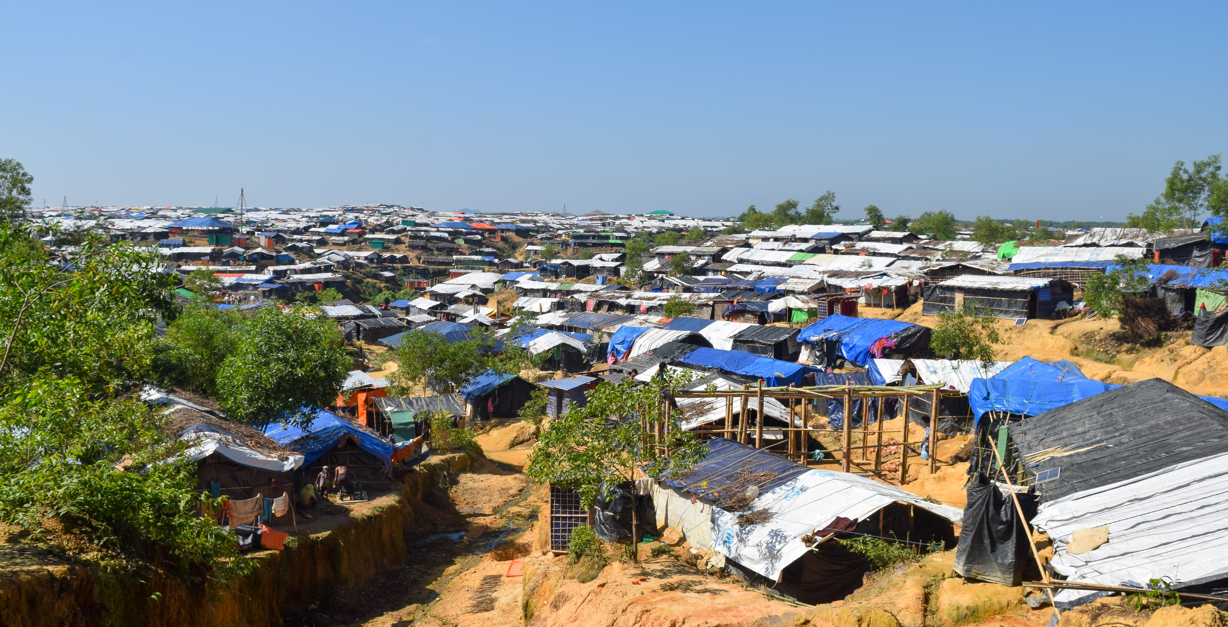
We pray for justice and peace in our world.
Amen.
A view of one of the world’s largest refugee camps in Cox’s Bazar, Bangladesh.
Photo credit: Inmanuel Biswas/Caritas Bangladesh

Slide 8
Thank You
Note: Many of the PowerPoints are editable so you can adapt them to your needs. If you do edit these resources please ensure content and photos remain with the appropriate credit to Caritas Australia and the photographers.
Copyright Policy: Material within the resources listed comes from a variety of sources and authors, including Caritas staff volunteers, overseas partners and news organisations. These resources and the information, names, images, pictures, logos are provided “as is”, without warranty. Any mistakes brought to the attention of Caritas Australia will be corrected as soon as possible. To review the full Caritas Copyright Policy, please visit: Caritas Australia​

