Slide 1
Refugee quiz
Last updated: February 2021
Notes:
Photo credits:
Jamila and her daughter stand outside their shelter in a refugee camp in Cox’s Bazar, Bangladesh. Credit: Inmanuel Biswas/Caritas Bangladesh

Slide 2
instructions
Click here to play this quiz on the Kahoot interactive learning platform.
This is an interactive resource. As you go through this quiz use your mouse to click on the correct answer for each question.
If you make a mistake you can go back by clicking on the arrow and trying again.
The source for the answers to each question is recorded in the ‘Notes’ section of the slides
For more resources on Refugees and Forced Migration, click here.
Start Quiz
Note: If you do edit this resource please ensure content and photos remain with the appropriate credit to Caritas Australia and the photographers.
Copyright Policy: Material within our resources comes from a variety of sources and authors, including Caritas staff volunteers, overseas partners and news organisations. Our resources and the information, names, images, pictures, logos are provided “as is”, without warranty. Any mistakes brought to the attention of Caritas Australia will be corrected as soon as possible. To review the full Caritas Copyright Policy, please visit: Caritas Australia​

Slide 3
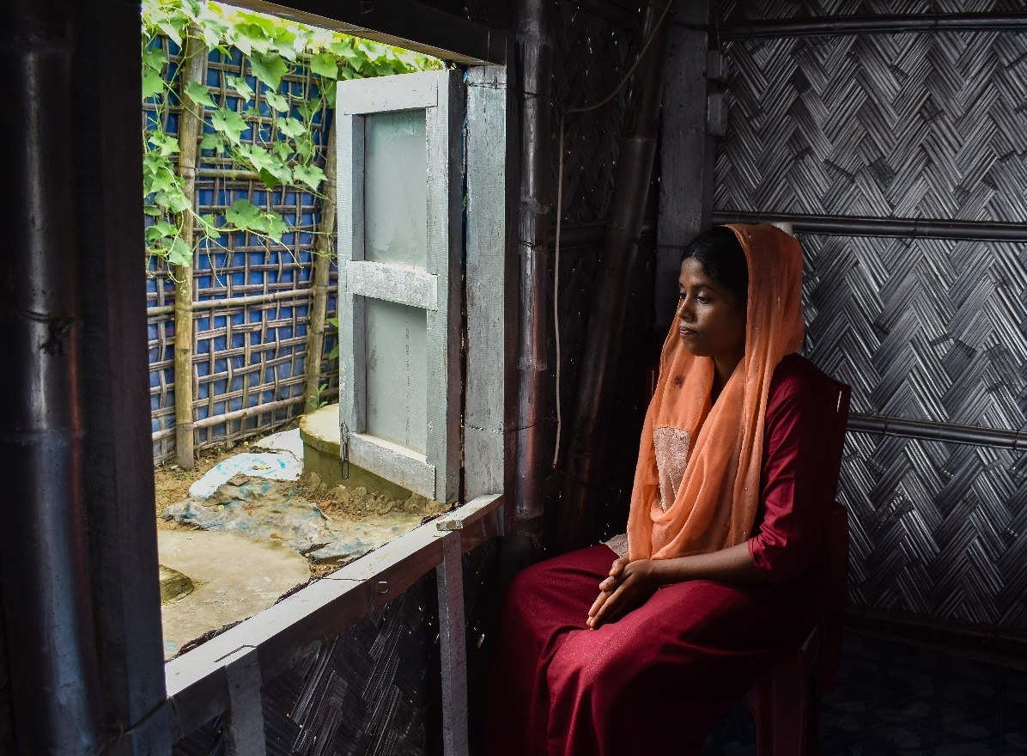
Question 1
A refugee is:
A. Someone who chooses to leave their country for a better life
B. Someone who is forced to leave their country from fear of persecution
C. Anyone who is asking for asylum in another country
.
Jamila looks out from her shelter in a Rohingya refugee camp in Cox’s Bazar, Bangladesh. Photo credit: Inmanuel Biswas/Caritas Bangladesh

Slide 4
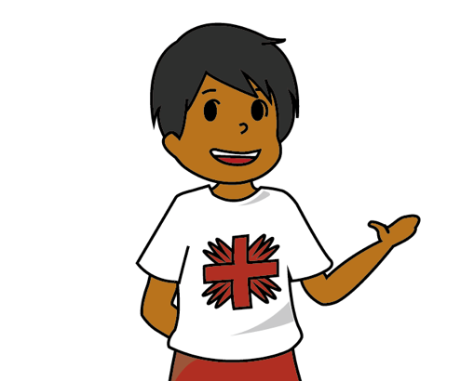
Answer incorrect
TRY AGAIN!

Slide 5
Answer correct!
CORRECT!
Someone who is forced to leave their country from fear of persecution.
This persecution may occur because of their race, religion, nationality, the social group they belong to or the political opinions they hold.
B
Jamila looks out from her shelter in a Rohingya refugee camp in Cox’s Bazar, Bangladesh. Photo credit: Inmanuel Biswas/Caritas Bangladesh

Slide 6
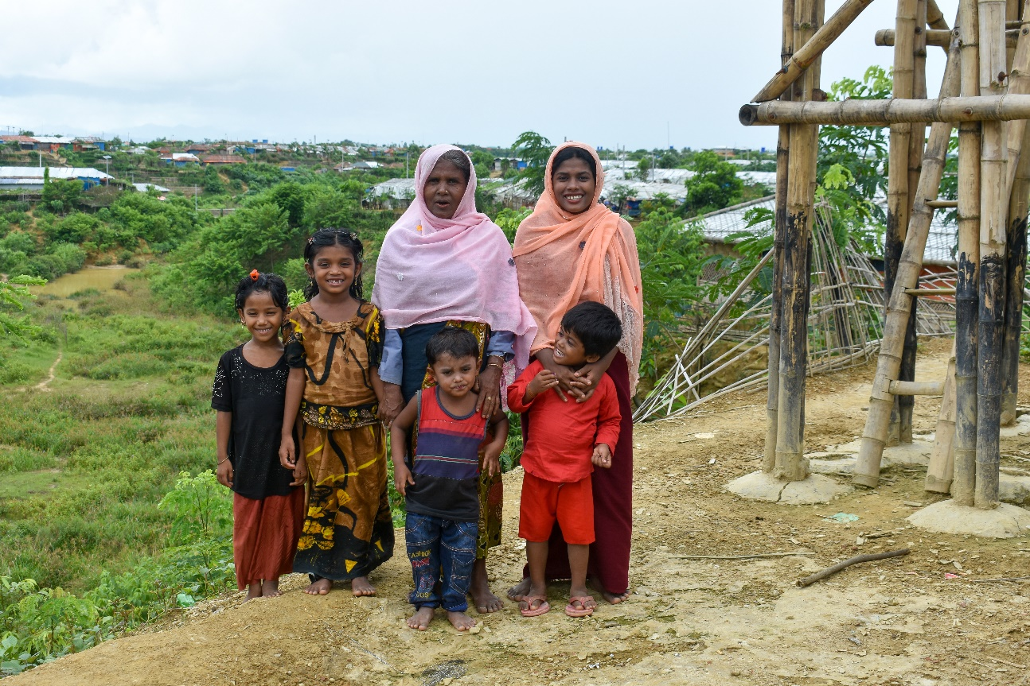
Question 2
How many refugees are in the world?
A. 7.8 million
B. 26 million
C. 16.7 million
Jamila and her daughter (right) stands with her mother and extended family near their shelter in a refugee camp in Cox’s Bazar, Bangladesh. Photo credit: Inmanuel Biswas/Caritas Bangladesh

Slide 7
Answer incorrect
TRY AGAIN!

Slide 8
Answer correct!
B. 26 million
CORRECT!
26 million. However there is an additional 45.7 million internally displaced persons and 4.2 million asylum seekers.
Jamila and her daughter (right) stands with her mother and extended family near their shelter in a refugee camp in Cox’s Bazar, Bangladesh. Photo credit: Inmanuel Biswas/Caritas Bangladesh
Notes:
Source: https://www.unhcr.org/en-au/figures-at-a-glance.html

Slide 9
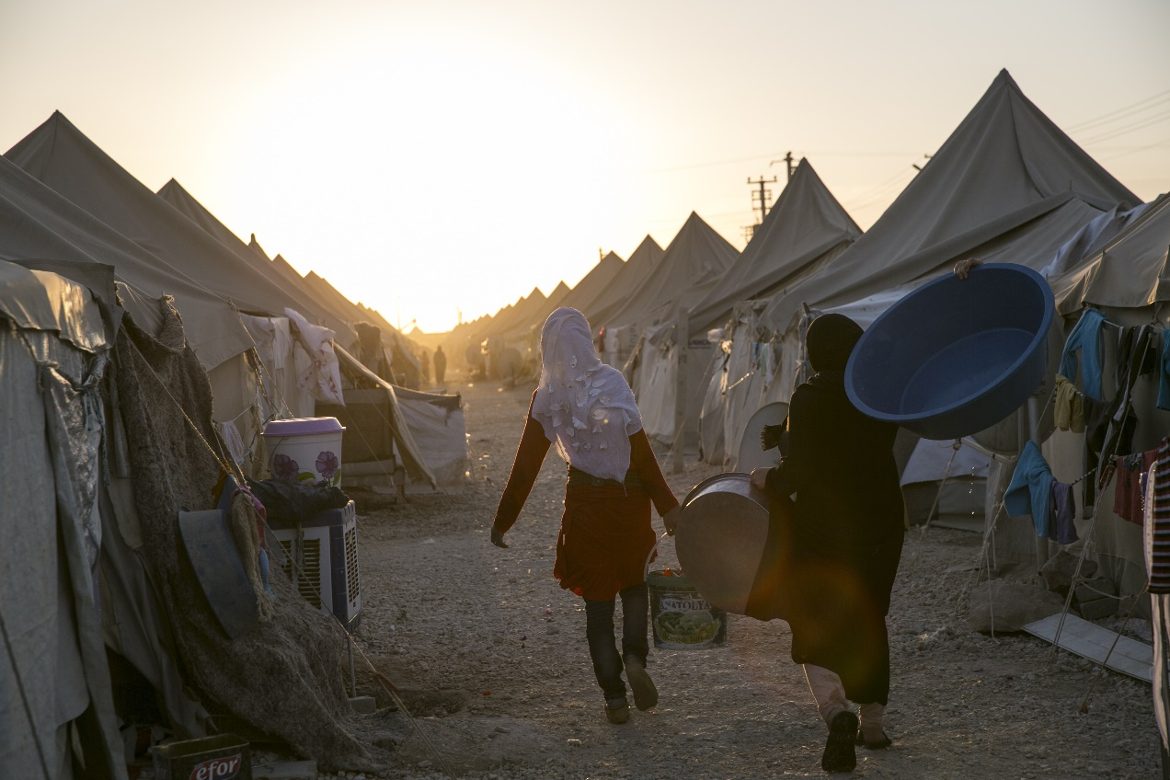
Question 3
Which country hosts the most refugees?
A. Pakistan
B. France
C. Turkey
A refugee camp in Turkey where approximately 28.000 Syrian refugees reside. Photo credit: Tolga Sezgin/Shutterstock.com
Notes:
Source: https://www.unhcr.org/en-au/figures-at-a-glance.html

Slide 10
Answer incorrect
TRY AGAIN!

Slide 11
Answer correct!
C. Turkey
CORRECT!
Turkey hosts the most with 3.6 million refugees compared to Columbia with 1.8 million refugees and Pakistan with 1.4 million.
A refugee camp in Turkey where approximately 28.000 Syrian refugees reside. Photo credit: Tolga Sezgin/Shutterstock.com
Notes:
Source: https://www.unhcr.org/en-au/figures-at-a-glance.html

Slide 12
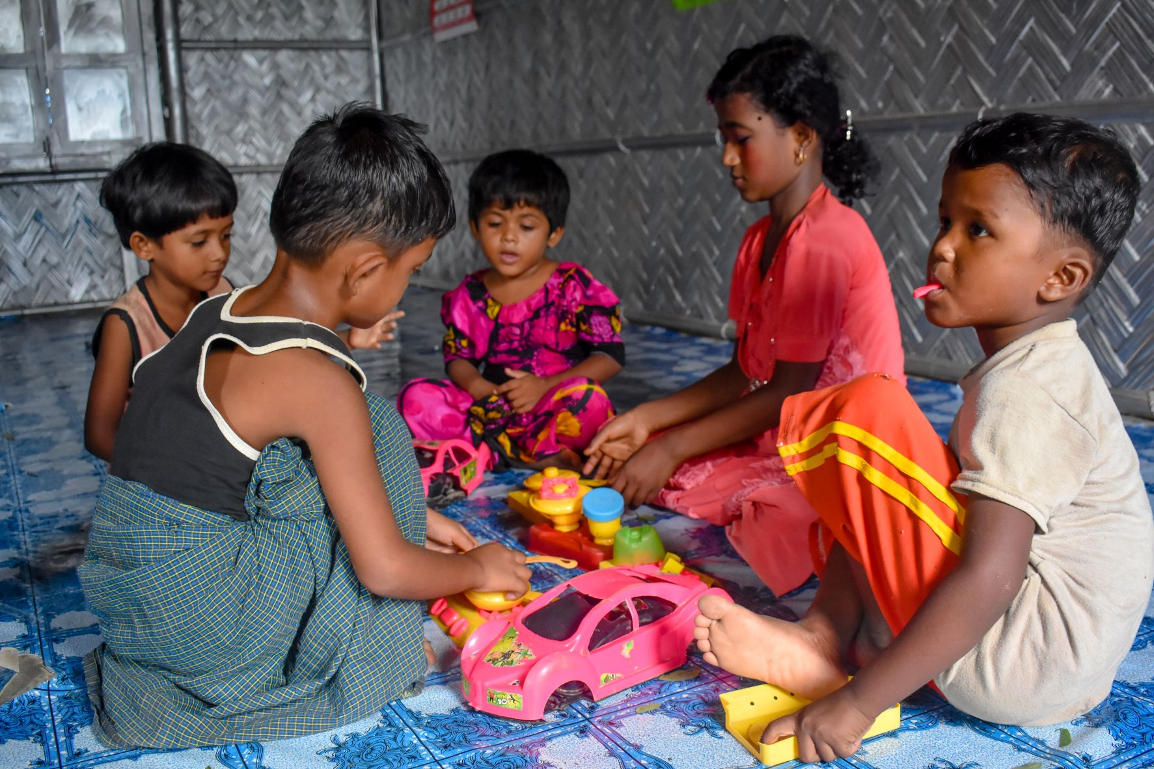
Question 4
Approximately what percentage of refugees are under the age of 18?
A. 23%
B. 40%
C. 60%
Children plays games in the Women Friendly Space, run by Caritas Bangladesh. Photo credit: Inmanuel Biswas/Caritas Bangladesh
Notes:
https://www.unhcr.org/en-au/figures-at-a-glance.html

Slide 13
Answer incorrect
TRY AGAIN!

Slide 14
Answer correct!
CORRECT!
Children below 18 years constituted 40 per cent of the refugee population in 2019, the highest figure in a decade.
B. 40%
Children plays games in the Women Friendly Space, run by Caritas Bangladesh. Photo credit: Inmanuel Biswas/Caritas Bangladesh
Notes:
Source: https://www.unhcr.org/en-au/figures-at-a-glance.html

Slide 15
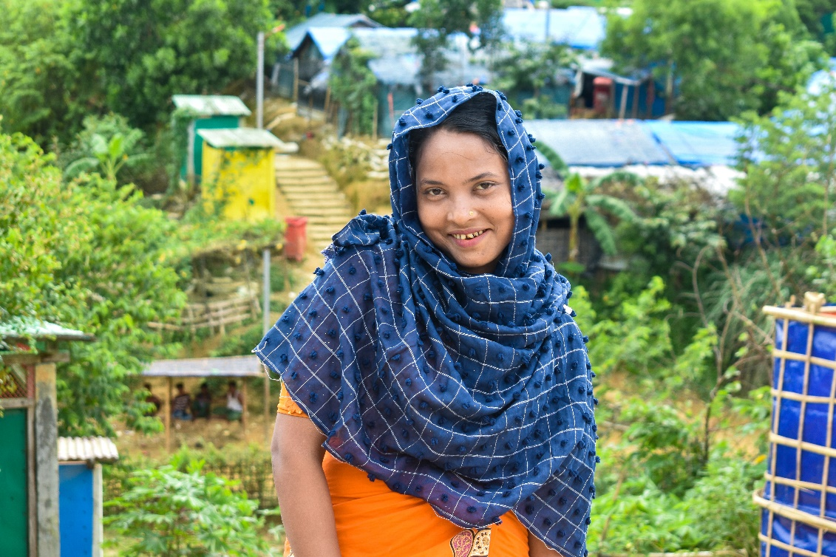
Question 5
Approximately how many people applied for asylum applications worldwide in 2019?
A. 2 million
B. 1.1 million
C. 650, 000
Halima returning from collecting water from a pump near her shelter in a refugee camp in Cox's Bazar, Bangladesh. Photo credit: Inmanuel Biswas/Caritas Bangladesh
Notes:
https://www.unhcr.org/en-au/figures-at-a-glance.html

Slide 16
Answer incorrect
TRY AGAIN!

Slide 17
Answer correct!
CORRECT!
2 million individuals applied for asylum in 2019.
A. 2 million
Halima returning from collecting water from a pump near her shelter in a refugee camp in Cox's Bazar, Bangladesh. Photo credit: Inmanuel Biswas/Caritas Bangladesh
Notes:
Source: https://www.unhcr.org/en-au/figures-at-a-glance.html

Slide 18
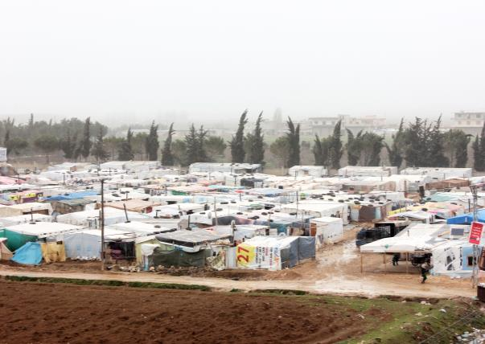
Question 6
In 2019, the greatest number of refugees came from which country?
A. South Africa
B. U.S.A
C. Syria
Photo credit: Caritas Internationalis/ CLMC J. Khoury
Notes:
https://www.unhcr.org/en-au/figures-at-a-glance.html

Slide 19
Answer incorrect
TRY AGAIN!

Slide 20
Answer correct!
C. Syria
CORRECT!
In 2019 the greatest number of refugees came from Syria, with 6.6 million people seeking refuge.
Photo credit: Caritas Internationalis/ CLMC J. Khoury
Notes:
Source: https://www.unhcr.org/en-au/figures-at-a-glance.html

Slide 21
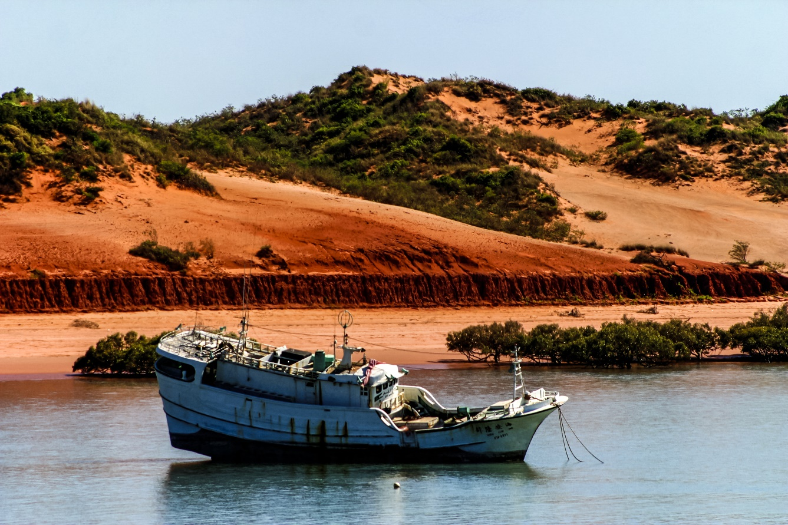
Question 7
Most asylum seekers arrive in Australia by boat. True or False?
True
False
Photo credit: tonympix /Shutterstock.com
Notes:
Source: https://www.refugeecouncil.org.au/asylum-community/2/
https://www.refugeecouncil.org.au/asylum-community/6/

Slide 22
Answer incorrect
TRY AGAIN!

Slide 23
Answer correct!
False
CORRECT!
Most asylum seekers arrive to Australia by plane.
Photo credit: tonympix /Shutterstock.com
Notes:
Source: https://www.refugeecouncil.org.au/asylum-community/2/
https://www.refugeecouncil.org.au/asylum-community/6/

Slide 24
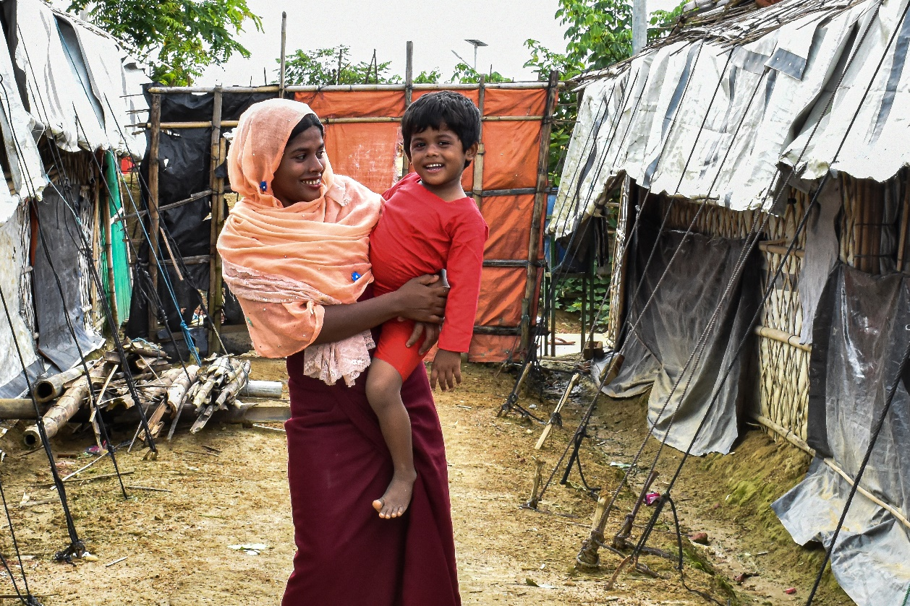
Question 8
By the end of 2018, what was the approximate number of people who had spent more than five years in exile (not settled)?
A. 6.5 million
B. 11.9 million
C. 3.2 million
Jamila and her daughter stand outside their shelter in a refugee camp in Cox’s Bazar, Bangladesh. Credit: Inmanuel Biswas/Caritas Bangladesh
Notes:
Source: Global Trends 2019, UNHCR, analysed by the World Bank - https://blogs.worldbank.org/dev4peace/2019-update-how-long-do-refugees-stay-exile-find-out-beware-averages#:~:text=%22The%20average%20length%20of%20time,are%20spinning%20out%20of%20control.

Slide 25
Answer incorrect
TRY AGAIN!

Slide 26
Answer correct!
B. 11.9 million
CORRECT!
As of end-2018, the number of people who have spent more than 5 years in exile stands at 11.9 million.
Jamila and her daughter stand outside their shelter in a refugee camp in Cox’s Bazar, Bangladesh. Credit: Inmanuel Biswas/Caritas Bangladesh
Notes:
Source: Global Trends 2019, UNHCR, analysed by the World Bank - https://blogs.worldbank.org/dev4peace/2019-update-how-long-do-refugees-stay-exile-find-out-beware-averages#:~:text=%22The%20average%20length%20of%20time,are%20spinning%20out%20of%20control.

Slide 27
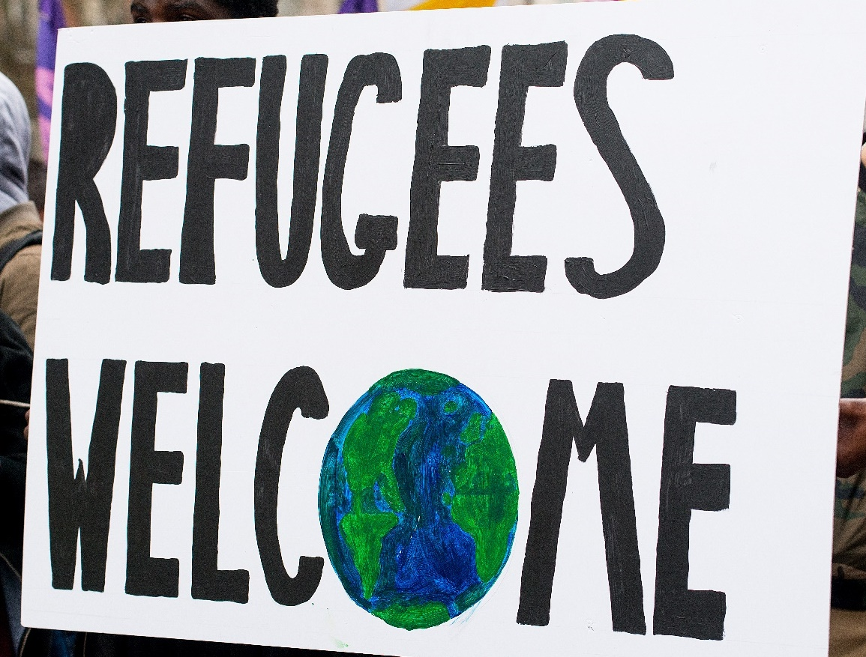
Question 9
In 2019, approximately what percentage of resettled refugees were admitted into Australia?
A. 17%
B. 35%
C. 46%
Photo credit: John Gomez/Shutterstock
Notes:
Source: UNHCR Global Trends Report 2019- https://www.unhcr.org/5ee200e37.pdf

Slide 28
Answer incorrect
TRY AGAIN!

Slide 29
Answer correct!
A. 17%
CORRECT!
In 2019, 107,800 refugees were resettled to 26 countries. Out of these, Australia admitted
18,200.
Photo credit: John Gomez/Shutterstock
Notes:
Source: UNHCR Global Trends Report 2019- https://www.unhcr.org/5ee200e37.pdf

Slide 30
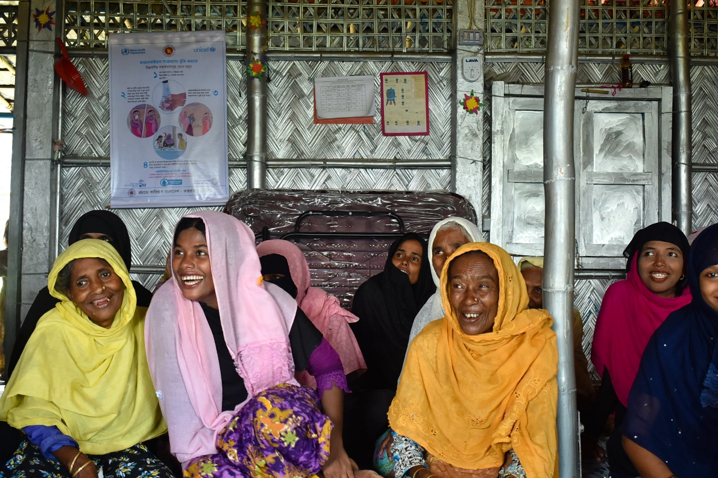
Question 10
What percentage of refugees are hosted by developed countries?
A. 30%
B. 75%
C. 15%
Jamila (centre) joins other women in the Women Friendly Spaces project, run by Caritas Bangladesh, in a refugee camp in Cox’s Bazar, Bangladesh. Photo credit: Inmanuel Biswas/Caritas Bangladesh
Notes:
https://www.unhcr.org/en-au/figures-at-a-glance.html

Slide 31
Answer incorrect
TRY AGAIN!

Slide 32
Answer correct!
C. 15%
CORRECT!
Only 15% of refugees are hosted by developed countries, meaning 85% are hosted by developing countries.
Jamila (centre) joins other women in the Women Friendly Spaces project, run by Caritas Bangladesh, in a refugee camp in Cox’s Bazar, Bangladesh. Photo credit: Inmanuel Biswas/Caritas Bangladesh
Notes:
https://www.unhcr.org/en-au/figures-at-a-glance.html

Slide 33
Thank You

