Slide 1
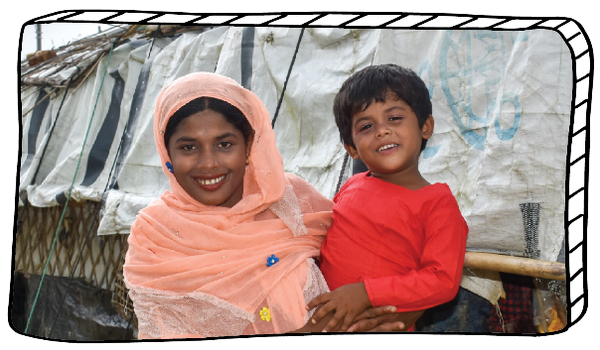
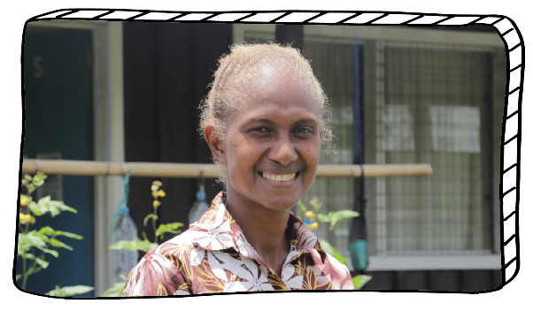
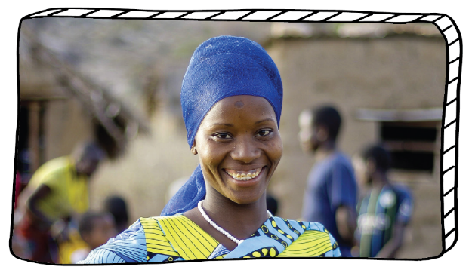
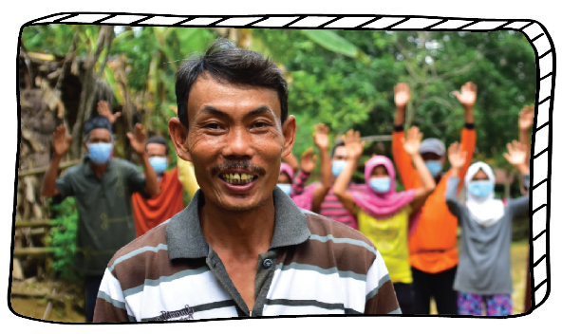
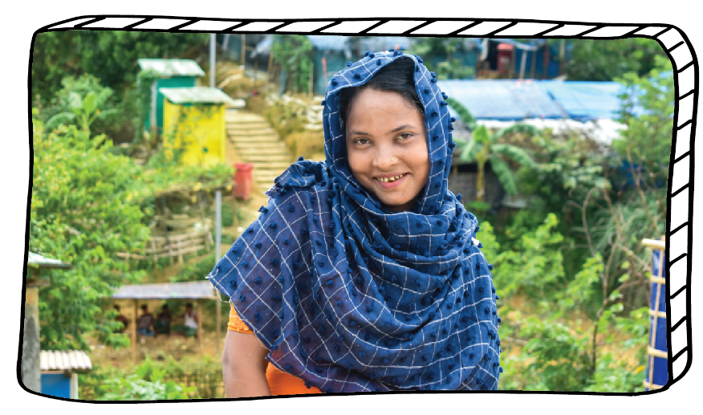
SCRIPTURAL WAY OF THE CROSS REFLECTION
FOR SECONDARY SCHOOLS
lent.caritas.org.au
1800 024 413
#projectcompassion
Notes:
Photo credits: Top right: Inmanuel Biswas/Caritas Bangladesh
From left to right: Neil Nuia, August Lucky, Laz Harfa
Bottom left: Inmanuel Biswas/Caritas Bangladesh

Slide 2
Information for Secondary Teachers The following PowerPoint of the Way of the Cross is to be used as a prayerful reflection. Please feel free to adapt this resource to your community’s needs.
One possible way to use this resource:
Print the ‘Notes Slides’.
Leader/Teacher reads the Scripture for each station (see the ‘Notes’ section of each slide).
A different student reads the text allocated on each slide.
Everyone says the response together.
Pause for reflection.
All the photos are from the stories featured in Project Compassion 2021. We reflect on the suffering Christ, alive in the lives of people experiencing poverty and marginalisation today.
Important note: The following Stations of the Cross are based on those introduced by Pope John Paul II on Good Friday 1991. They are an alternative to the traditional stations and a way of reflecting more deeply on the Scriptural accounts of Christ's passion. Source: United States Conference of Catholic Bishops.

Slide 3
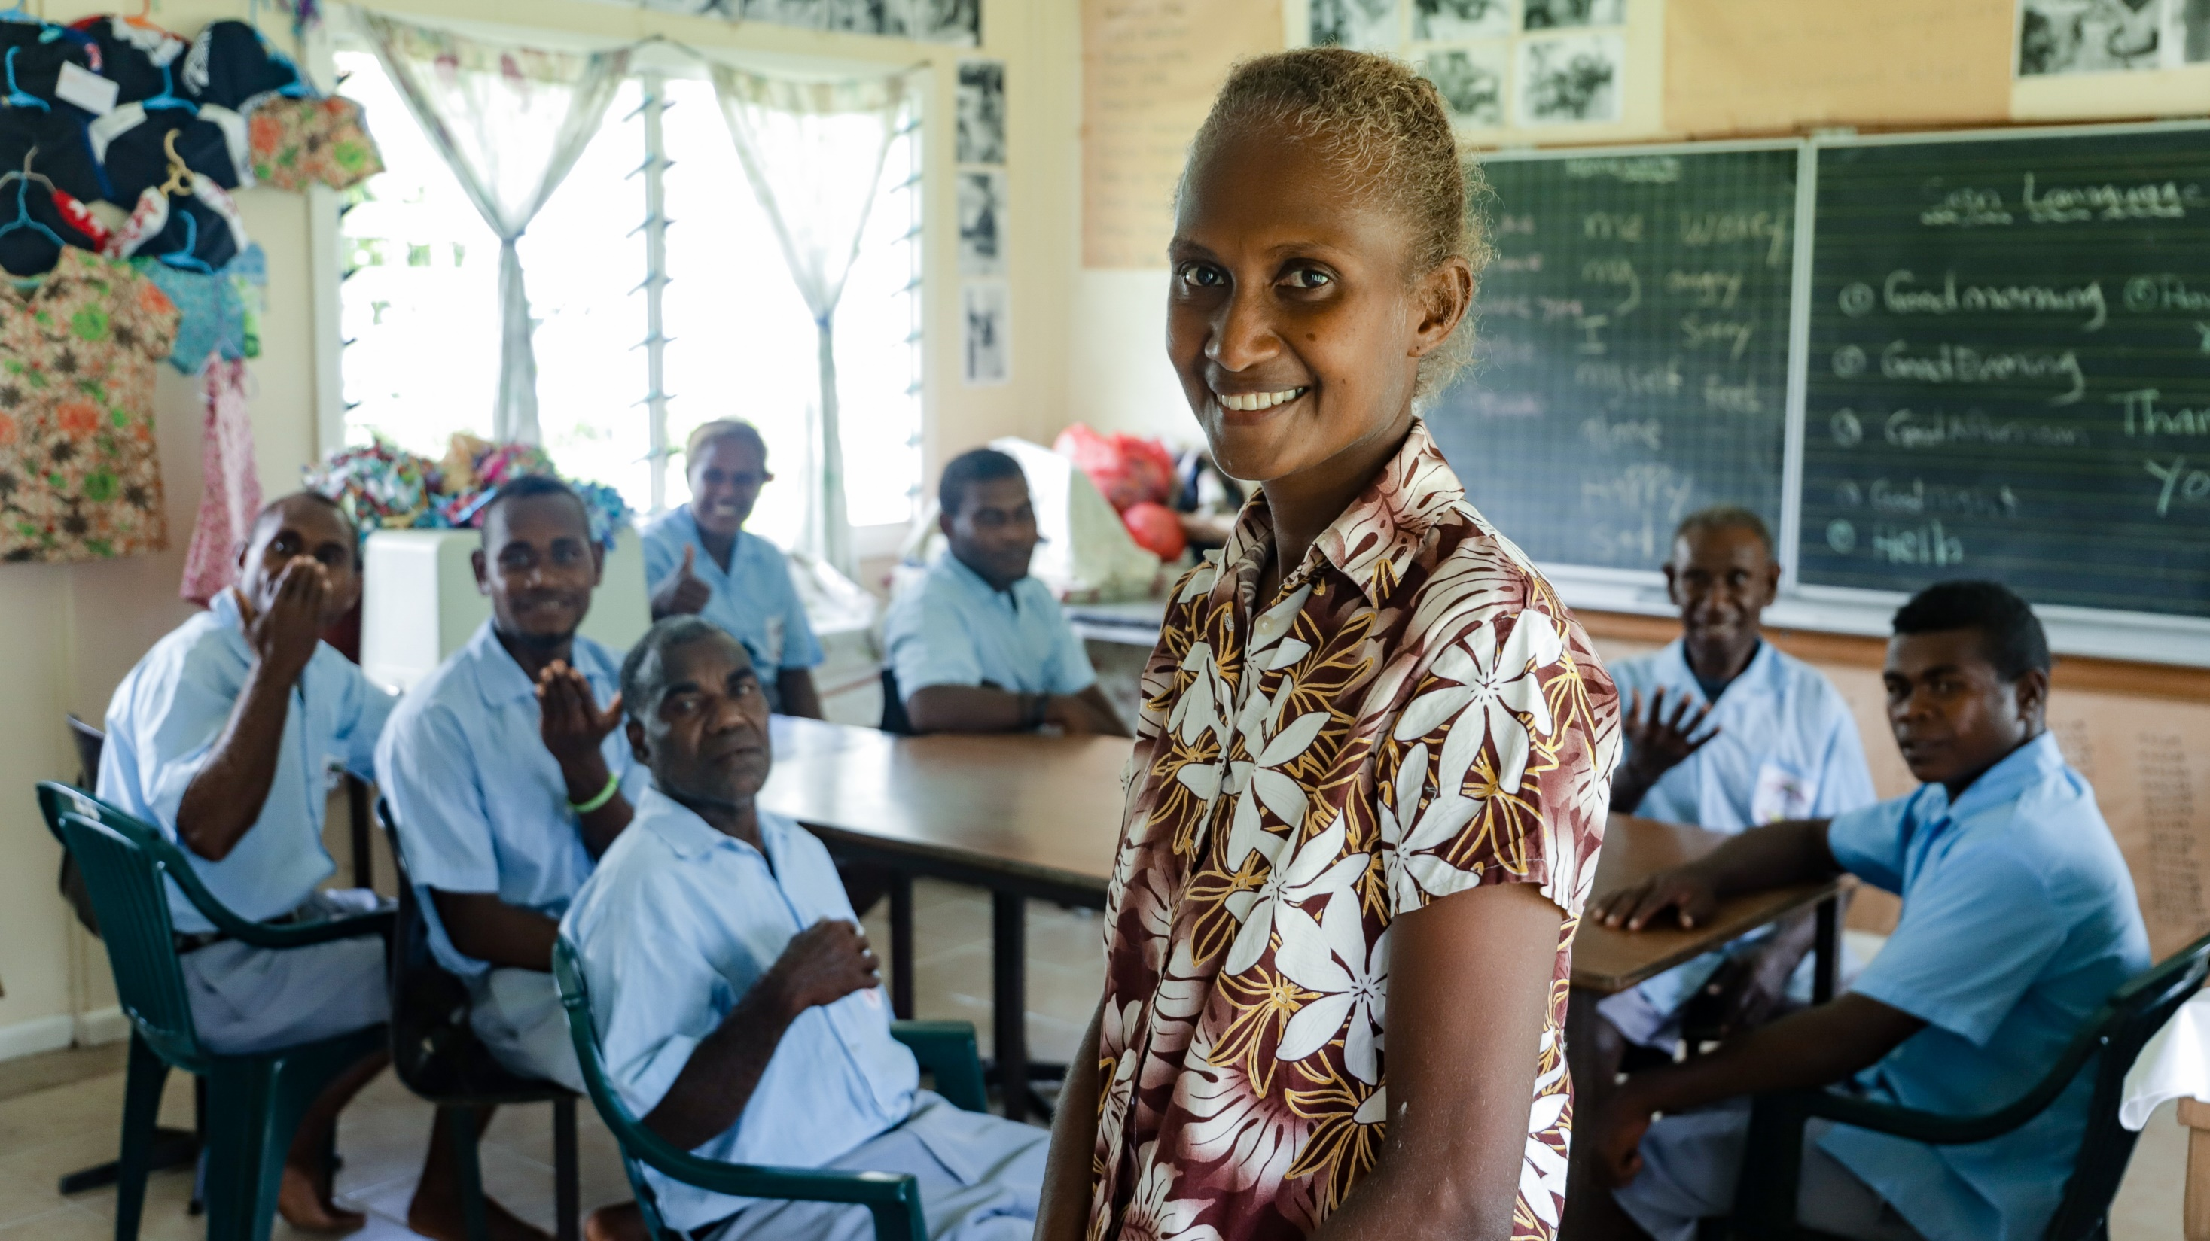
Notes:
Margret teaches sign language and vocational skills at the San Isidro Care Centre in the Solomon Islands. Photo credit: Neil Nuia

Slide 4
“STAY AWAKE”
Leader: Matthew 26: 36-41
Reader: Jesus, when praying for comfort, your friends fell asleep and abandoned you.
Response: May we walk in your way.
Notes:
First Station: Jesus in the garden
Then Jesus went with them to a place called Gethsemane; and he said to his disciples, “Sit here while I go over there and pray.” He took with him Peter and the two sons of Zebedee, and began to be grieved and agitated. Then he said to them, “I am deeply grieved, even to death; remain here, and stay awake with me.” And going a little farther, he threw himself on the ground and prayed, “My Father, if it is possible, let this cup pass from me; yet not what I want but what you want.” Then he came to the disciples and found them sleeping; and he said to Peter, “So, could you not stay awake with me one hour? Stay awake and pray that you may not come into the time of trial; the spirit indeed is willing, but the flesh is weak.”
Matthew 26: 36-41

Slide 5
REFLECT
How can we be moved to “stay awake” and stand in solidarity with our neighbours?
Notes:
Arsad and his neighbours cultivate rice in Pandeglang District, Indonesia. Photo credit: Laz Harfa

Slide 6
“…THEY LAID HANDS ON HIM AND ARRESTED HIM”
Leader: Mark 14: 43-46
Reader: Judas betrayed you.
Response: May we walk in your way.
Notes:
Second station: Jesus betrayed by Judas
Immediately, while he was still speaking, Judas, one of the twelve, arrived; and with him there was a crowd with swords and clubs, from the chief priests, the scribes, and the elders.
Now the betrayer had given them a sign, saying, “The one I will kiss is the man; arrest him and lead him away under guard.” So when he came, he went up to him at once and said, “Rabbi!” and kissed him. Then they laid hands on him and arrested him.
Mark 14: 43-46

Slide 7
REFLECT
How can we stand together and acknowledge God’s presence within each person?
Notes:
Oliva with other students in the Adult Learning Program run by Caritas Australia's partner agency in Tanzania. Photo credit: August Lucky

Slide 8
ARE YOU, THEN, THE SON OF GOD?” HE SAID TO THEM, “YOU SAY THAT I AM.”
Leader: Luke 22: 66-71
Reader: Jesus, you are the son of God.
Response: May we walk in your way.
Notes:
Third station: Jesus condemned by the Sanhedrin
When day came, the assembly of the elders of the people, both chief priests and scribes, gathered together, and they brought him to their council. They said, “If you are the Messiah, tell us.” He replied, “If I tell you, you will not believe; and if I question you, you will not answer. But from now on the Son of Man will be seated at the right hand of the power of God.” All of them asked, “Are you, then, the Son of God?” He said to them, “You say that I am.” Then they said, “What further testimony do we need? We have heard it ourselves from his own lips!”
Luke 22: 66-71

Slide 9
REFLECT
How can we help to amplify the voice of the marginalised in our world?
Notes:
Arsad's wife, Kasniti, works on her vegetable garden in Pandeglang District, Indonesia. Photo credit: Laz Harfa

Slide 10
“THIS MAN WAS WITH JESUS OF NAZARETH.” AGAIN HE DENIED IT…”
Leader: Matthew 26: 69-75
Reader: Jesus, Peter let you down.
Response: May we walk in your way.
Notes:
Fourth station: Jesus denied by Peter
Now Peter was sitting outside in the courtyard. A servant-girl came to him and said, “You also were with Jesus the Galilean.” But he denied it before all of them, saying,
“I do not know what you are talking about.” When he went out to the porch, another servant-girl saw him, and she said to the bystanders, “This man was with Jesus of Nazareth.”
Again he denied it with an oath, “I do not know the man.” After a little while the bystanders came up and said to Peter, “Certainly you are also one of them, for your accent betrays you.” Then he began to curse, and he swore an oath, “I do not know the man!” At that moment the cock crowed. Then Peter remembered what Jesus had said: “Before the cock crows, you will deny me three times.” And he went out and wept bitterly.
Matthew 26: 69-75

Slide 11
REFLECT
Jesus, help us to find the courage to speak out against injustices.
Notes:
Jamila holds up an item of clothing she made after receiving tailoring training. Photo credit: Inmanuel Biswas/Caritas Bangladesh

Slide 12
“THEY BOUND JESUS, LED HIM AWAY AND HANDED HIM TO PILATE.”
Leader: Mark 15: 1-5, 15
Reader: Jesus, you were alone and innocent before Pontius Pilate.
Response: May we walk in your way.
Notes:
Fifth station: Jesus is judged by Pontius Pilate
As soon as it was morning, the chief priests held a consultation with the elders and scribes and the whole council. They bound Jesus, led him away, and handed him over to Pilate. Pilate asked him, “Are you the King of the Jews?” He answered him, “You say so.” Then the chief priests accused him of many things. Pilate asked him again, “Have you no answer? See how many charges they bring against you.” But Jesus made no further reply, so that Pilate was amazed.... Pilate, wishing to satisfy the crowd, released Barabbas.... [and] handed [Jesus] over to be crucified.
Mark 15: 1-5, 15

Slide 13
REFLECT
What would it cost us to speak the “truth” to those in power?
Notes:
Arsad (left) has a meeting with the Laz Harfa field coordinator in Pandeglang District, Indonesia. Photo credit: Laz Harfa

Slide 14
“HAIL KING OF THE JEWS!”
Leader: John 19: 1-3
Reader: Jesus, you suffered alone, even when no one in the crowd seemed to care.
Response: May we walk in your way.
Notes:
Sixth station: Jesus crowned with thorns and clothes in purple
Then Pilate took Jesus and had him flogged. And the soldiers wove a crown of thorns and put it on his head, and they dressed him in a purple robe. They kept coming up to him, saying, “Hail, King of the Jews!” and striking him on the face.
John 19: 1-3

Slide 15
REFLECT
How can we be the catalyst for change for issues that are often ignored?
Notes:
Community members and Arsad place flags in an Open Defecation area as part of a Community Led Total Sanitation (CLTS) training program in Pandeglang District, about 150km west of Jakarta, Indonesia.
Credit: Laz Harfa

Slide 16
“SO THEY TOOK JESUS; AND CARRYING THE CROSS BY HIMSELF…”
Leader: John 19: 6, 15-17
Reader: Jesus you carried your cross.
Response: May we walk in your way.
Notes:
Seventh station: Jesus carries the cross
When the chief priests and the police saw him, they shouted, “Crucify him! Crucify him!” Pilate said to them, “Take him yourselves and crucify him; I find no case against him.” ... They cried out, “Away with him! Away with him! Crucify him!” Pilate asked them, “Shall I crucify your King?” The chief priests answered, “We have no king but the emperor.” So they took Jesus; and carrying the cross by himself, he went out to what is called The Place of the Skull, which in Hebrew is called Golgotha.
John 19: 6, 15-17

Slide 17
REFLECT
How can we carry the cross for our brothers and sisters who face injustices?
Notes:
Halima sweeps her shelter in the Rohingya refugee camp, Cox’s Bazar region, Bangladesh.
Photo Credit: Inmanuel Biswas/Caritas Bangladesh

Slide 18
“SIMON OF CYRENE HELPS JESUS”
Leader: Mark 15: 21
Reader: Jesus, you received help from a “passer-by” who became a neighbour.
Response: May we walk in your way.
Notes:
Eighth station: Simon of Cyrene helps Jesus
They compelled a passer-by, who was coming in from the country, to carry his cross; it was Simon of Cyrene, the father of Alexander and Rufus.
Mark 15: 21

Slide 19
REFLECT
How can we work together as a global community to support those in need?
Notes:
Halima shows her daughter how to wash her hands correctly outside their shelter in a Rohingya refugee camp. Photo credit: Inmanuel Biswas/ Caritas Bangladesh

Slide 20
JESUS MEETS THE WOMEN OF JERUSALEM
Leader: Luke 23: 27-31
Reader: On the way to Calvary you met the women of Jerusalem.
Response: May we walk in your way.
Notes:
Ninth station: Jesus meets the women of Jerusalem
A great number of the people followed him, and among them were women who were beating their breasts and wailing for him. But Jesus turned to them and said, “Daughters of Jerusalem, do not weep for me, but weep for yourselves and for your children. For the days are surely coming when they will say, ‘Blessed are the barren, and the wombs that never bore, and the breasts that never nursed. ’Then they will begin to say to the mountains, ‘Fall on us’; and to the hills, ‘Cover us.’ For if they do this when the wood is green, what will happen when it is dry?”
Luke 23: 27-31

Slide 21
REFLECT
How can we ensure the voices of all women are heard and respected?
Notes:
Oliva looks out from her kiosk in her home in Karatu District, Tanzania. Photo credit: August Lucky

Slide 22
“FATHER, FORGIVE THEM …”
Leader: Luke 23: 33-34
Reader: Jesus, you were abandoned and cried out from the cross.
Response: May we walk in your way.
Notes:
Tenth station: Jesus is crucified
When they came to the place that is called The Skull, they crucified Jesus there with the criminals, one on his right and one on his left. (( Then Jesus said, “Father, forgive them; for they do not know what they are doing.”))
Luke 23: 33-34

Slide 23
REFLECT
Jesus, help us to show mercy to others as you have shown endless mercy to us.
Notes:
Arsad has a meal with his wife, Kasniti, and their daughter in their home, Pandeglang District, Indonesia. Photo credit: Laz Harfa

Slide 24
“REMEMBER ME WHEN YOU COME INTO YOUR KINGDOM …”
Leader: Luke 23: 39-43
Reader: Jesus, your life is an example of mercy and forgiveness.
Response: May we walk in your way.
Notes:
Eleventh station: Jesus speaks to the thief
One of the criminals who were hanged there kept deriding him and saying, “Are you not the Messiah? Save yourself and us!” But the other rebuked him, saying, “Do you not fear God, since you are under the same sentence of condemnation? And we indeed have been condemned justly, for we are getting what we deserve for our deeds, but this man has done nothing wrong.” Then he said, “Jesus, remember me when you come into your kingdom.” He replied, “Truly I tell you, today you will be with me in Paradise.”
Luke 23: 39-43

Slide 25
REFLECT
How can we live in compassion with those who do not have access to basic human rights?
Notes:
Halima carries fresh water from a pump near her shelter in a Rohingya refugee camp in Cox’s Bazar. Photo credit: Inmanuel Biswas/ Caritas Bangladesh

Slide 26
“AND FROM THAT HOUR THE DISCIPLE TOOK HER INTO HIS HOME”
Leader: John 19: 25-27
Reader: Jesus, you invite your mother and your beloved disciple to strengthen and help one another.
Response: May we walk in your way.
Notes:
Twelfth station: Jesus speaks to his mother
Standing by the cross of Jesus were his mother and his mother's sister, Mary the wife of Clopas, and Mary of Magdala. When Jesus saw his mother and the disciple there whom he loved, he said to his mother, "Woman, behold, your son." Then he said to the disciple, "Behold, your mother." And from that hour the disciple took her into his home.
John 19: 25-27

Slide 27
REFLECT
How can we be modern day disciples that follow in the footsteps of Christ?
Notes:
Caritas Australia is helping to boost food security at the San Isidro Care Centre, Solomon Islands. Photo credit: Neil Nuia

Slide 28
“INTO YOUR HANDS I COMMEND MY SPIRIT.”
Leader: Luke 23: 44-46
Reader: Jesus has completed his earthly journey.
Response: May we walk in your way.
Notes:
Thirteenth station: Jesus dies on the cross
It was now about noon, and darkness came over the whole land until three in the afternoon, while the sun’s light failed; and the curtain of the temple was torn in two. Then Jesus, crying with a loud voice, said, “Father, into your hands I commend my spirit.” Having said this, he breathed his last.
Luke 23: 44-46

Slide 29
REFLECT
How can we follow in the footsteps of Christ and live a life of service and compassion?
Notes:
Oliva works in the field growing beans in Karatu District, Tanzania. Photo credit: August Lucky

Slide 30
“JOSEPH TOOK THE BODY AND WRAPPED IT IN A CLEAN CLOTH AND LAID IT IN HIS OWN TOMB.”
Leader: Matthew 27: 57-60
Reader: Jesus was placed in the darkness of the tomb.
Response: May we walk in your way.
Notes:
Fourteenth station: Jesus is buried
When it was evening, there came a rich man from Arimathea, named Joseph, who was also a disciple of Jesus. He went to Pilate and asked for the body of Jesus; then Pilate ordered it to be given to him. So Joseph took the body and wrapped it in a clean linen cloth and laid it in his own new tomb, which he had hewn in the rock. He then rolled a great stone to the door of the tomb and went away.
Matthew 27: 57-60

Slide 31
REFLECT
Let us make our hearts ready for the love of Christ to shine through.
Notes:
Oliva stands near her home in Karatu District, Tanzania. Photo credit: August Lucky

Slide 32
The Scriptural Way of the Cross reminds us that we are “protected” by God’s Love.
We are given the task to be loving protectors of all creation, every person especially the poor, ourselves and our families.
In this way, we will make the star of hope shine forth in our world.
Adapted from Way of the Cross led by his holiness Pope Francis, 9 April 2015.

Slide 33
lent.caritas.org.au
1800 024 413
#projectcompassion

