Slide 1
Information
This resource provides information about the food crisis in the Horn of Africa and how the church is responding.
It is our hope that you will use these slides in a way that best suits your purposes. As such, the slides are editable so that the content is flexible for you to adapt to your needs. If you do edit this presentation, please ensure content and photos from this resource remain with the appropriate credit to Caritas Australia and the photographers. ​
Additional resources: Prayer PowerPoint , Grace Prayer, Posters, School’s Guide
Raise awareness and support for the people affected by this food crisis. Donate at caritas.org.au/food-crisis
Primary Students ​
Learning about people not having what they need to live a healthy and safe life can be hard. If you are feeling worried or upset about anything you have learnt about through this resource, make sure you talk to your teacher or trusted adult. They can share your concerns via our website. ​
Do you have an idea for how Caritas Australia can improve our school resources? We would love to hear it! Please email education@caritas.org.au
Teachers
For comprehensive classroom activities to deepen students’ understanding of food insecurity in our world, please use our Food Security – Primary PPT and Food Security in Our World - Primary Lessons
For more school resources, please visit: caritas.org.au/resources/school-resources/
Stay up to date with events and resources! Subscribe to Caritas Australia’s Education e-newsletter
Copyright Policy: Material within our resources comes from a variety of sources and authors, including Caritas Australia staff, volunteers, overseas partners and news organisations. These resources and the information, names, images, pictures, logos are provided ’as is’, without warranty. Any mistakes brought to the attention of Caritas Australia will be corrected as soon as possible. To review the full Caritas Australia Copyright Policy, please visit: Caritas Australia​​
Links to external sites: This site contains links to external websites. Caritas Australia takes no responsibility for the content of such sites, nor do links to such sites imply endorsement of the views expressed therein. External links are provided for informational purposes only.

Slide 3
Africa Food Crisis
There is a food crisis in the Horn of Africa.
This means there are millions of children, women and men who do not have enough food and water.
Many people are very hungry and are becoming sick.
Video (1min)
Hear from our CEO, Kirsty Robertson, on the food crisis in Ethiopia

Slide 4
facts
Over 18 million people across Somalia, Ethiopia and Kenya are already facing extreme hunger.
10.5 million households do not have reliable access to clean and safe water.
Food prices that were already on the rise are now skyrocketing. Basics like bread are now too expensive for many families.
Source: reliefweb, unicef

Slide 5
drought
For three years in a row, there has been little to no rainfall in countries such as Ethiopia, Kenya, South Sudan, Eritrea and Somalia.
This has meant they have been unable to grow enough food to eat and sell.

Slide 7
CONFLICT
Another reason for lack of food is ongoing conflict.
Many people have needed to leave their homes and farms to find safety. They are now living in camps without adequate shelter, water and food.
Tens of thousands of displaced families are unable to sow crops, reducing next year's harvest even more.

Slide 8
“I came here [IDP camp] because of the conflict. I had to walk on foot for over 30km with my children. I’m getting the support I need. I’m receiving food, things like blankets and pots as well.”​
Mahwash​

Slide 9
CONFLICT
The war in Ukraine is also affecting people in Africa.
Many people rely on grain and fertiliser from Ukraine and Russia, which are no longer available.
The World Food Program relies on Ukraine and Russia for 50% of their wheat and corn. This is making the humanitarian response even harder.

Slide 10
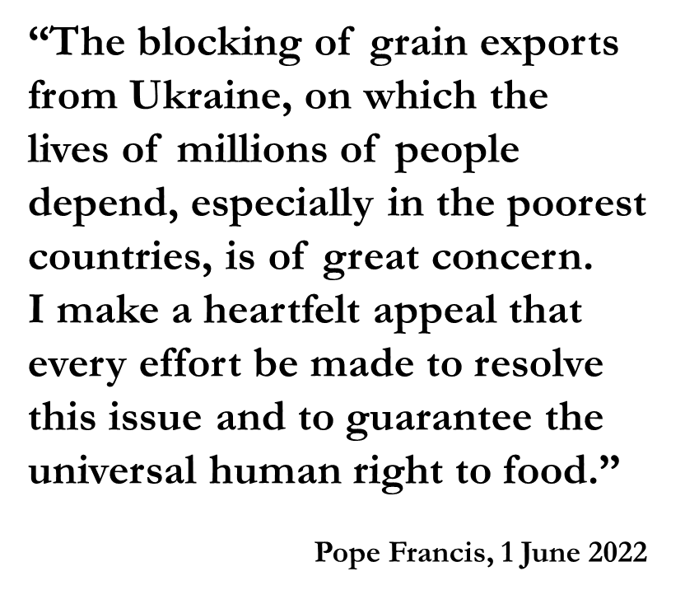
Notes:
https://www.vatican.va/content/francesco/en/audiences/2022/documents/20220601-udienza-generale.html

Slide 11
Caritas Australia’s Response
With your support, Caritas Australia is working with its partners on the ground in Africa to provide much-needed aid to vulnerable communities:
Emergency food rations
Support to children impacted by malnutrition
Clean drinking water and support for sanitation

Slide 12
Caritas Australia’s Response
Cash transfers to households at risk of poverty
Support for families forced from their homes
Hygiene supplies, including soap and hand sanitisers to help prevent the spread of COVID-19
Seeds and household items for families impacted by conflict and displacement

Slide 13
How we can help
There are a number of ways we can support communities affected by the food crisis.
PRAY
RAISE AWARENESS
ACT IN SOLIDARITY
ADVOCATE
DONATE
Pray for people without enough food to eat.
Say Grace before meals.
Share what you have learnt with your family and friends.
Have a simple meal of bread or rice.
Hold a Caritas Ks or Walk for Water event.
Write to your member of parliament asking for increased funding for countries facing famine.
Help provide vital food and water by donating to caritas.org.au/food-crisis

Slide 14
PRAYER
Living God,
You made the earth and everything in it to live life to the full.
But today, in the Horn of Africa, waterholes run dry, desert locusts swarm, crops die and people go hungry.
Help us to bring the world back to life.

Slide 15
Loving Christ,
You walk alongside all people in need.
May Caritas Australia and its local partners help the people in Africa. With our support, may the people and their communities survive, rebuild and recover.
Help us to share what we have so that everyone has what they need.

Slide 16
Inspiring Spirit,
You make all things possible!
May we love and care for the earth and each other as you do.
Help us to work together and make hunger history.
Amen.

Slide 17
Photo Captions and Credits
Slide
2. A mother and her children in southwestern Ethiopia. Photo: Zacharias Abubeker/Caritas Australia
5. Ethiopian landscape. Photo: Caritas Australia
6. Ayoyo, a community leader, works at the cash distribution centre in southwestern Ethiopia. Photo: Zacharias Abubeker/Caritas Australia
7. Shelter at an IDP camp in Ethiopia. Photo: Caritas Australia
8. A woman with her family at an IDP camp in northern Ethiopia. Photo: Caritas Australia
9. Large bags of yellow split peas for distribution in Ethiopia. Photo: Caritas Australia
10. International supplies of split peas, vegetable oil and water bring relief to people at an IDP Camp in Ethiopia. Photo: Caritas Australia
11. Caritas Australia’s local partners help communities access supplies in the Horn of Africa. Photo: Caritas Australia
12. A woman with her family inside a tent in an IDP camp in Ethiopia. Photo: Caritas Australia
14. A field of maize in the Horn of Africa. Photo: Zacharias Abubeker /Caritas Australia
15. Ayoyo, a community leader, works at the cash distribution centre in southern Ethiopia. Photo: Zacharias Abubeker/Caritas Australia
16. Community in discussion with Caritas Australia staff and local partners in Ethiopia. Photo: Zacharias Abubeker/Caritas Australia
Prayer by Dr Rebekah Pryor/Caritas Australia
Resource first published on 25 July 2022.

Slide 18
Thank you

