Slide 1
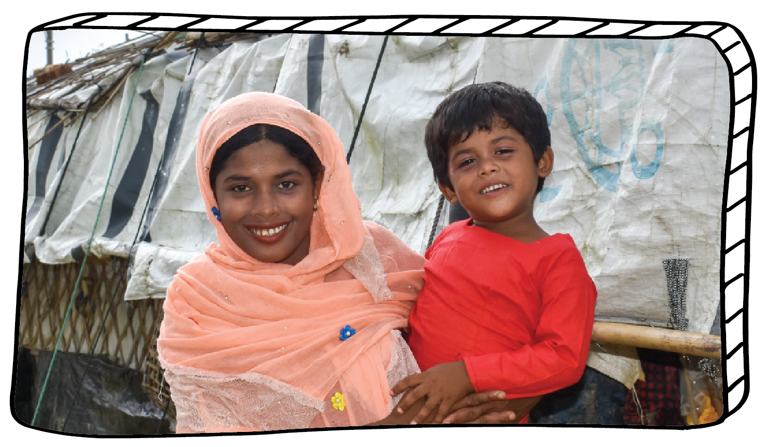
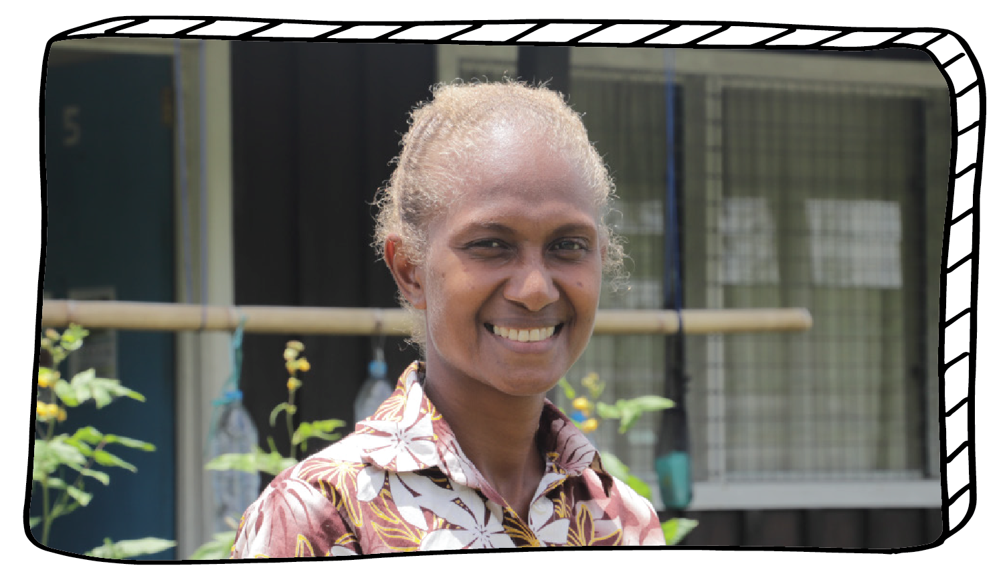
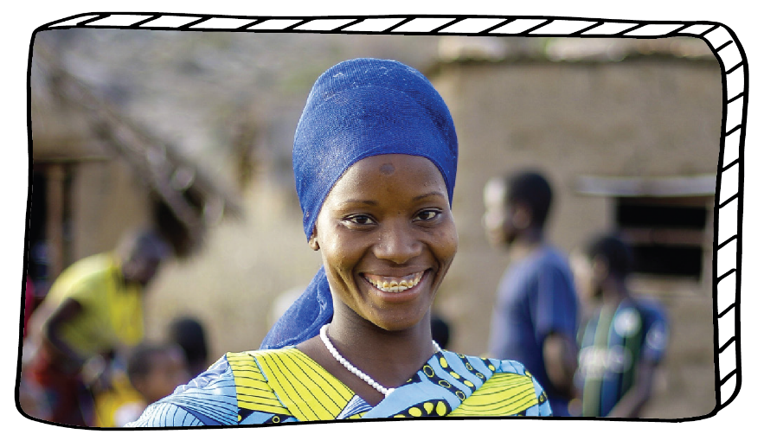
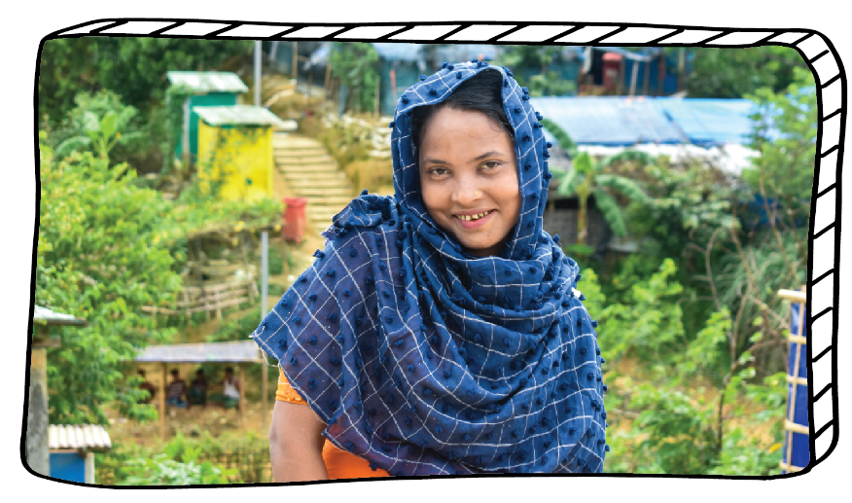
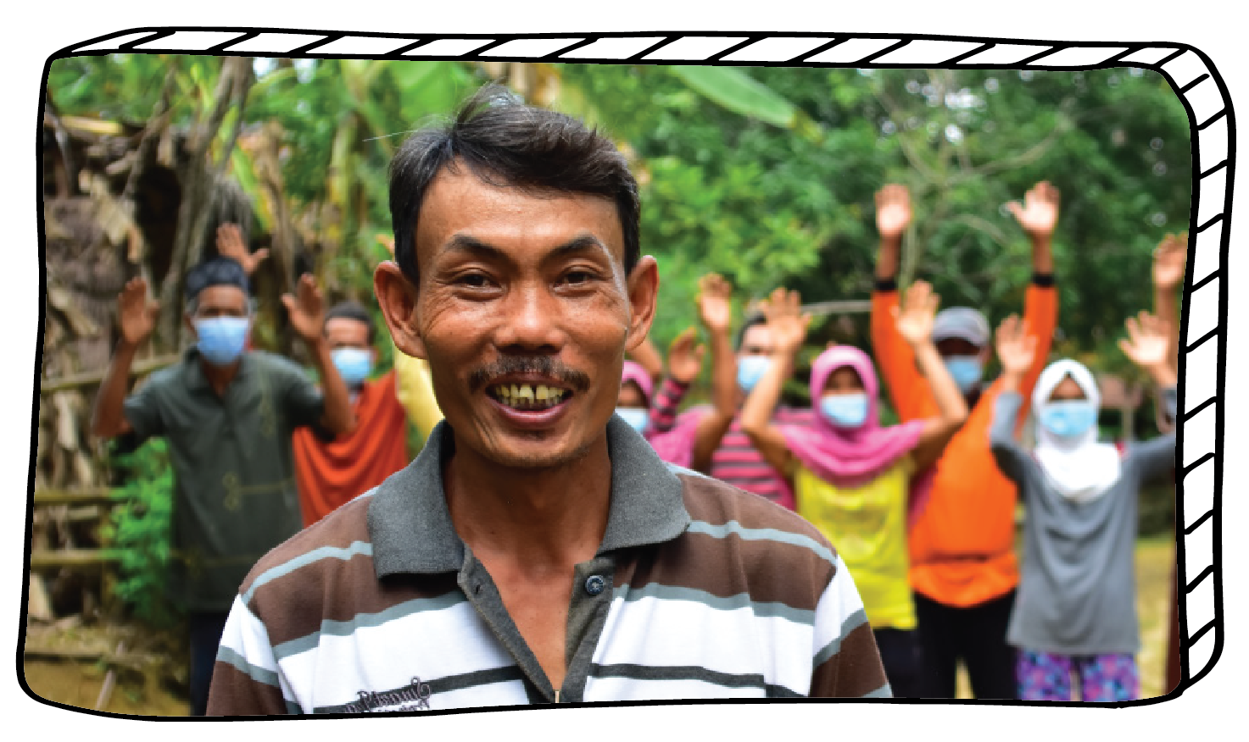
FOR PRIMARY SCHOOLS
lent.caritas.org.au
1800 024 413
#projectcompassion

Slide 2
The theme for Project Compassion 2021 is:
We are inspired by the quote from St Oscar Romero, “Aspire not to have more, but to be more.”
Instead of aspiring to have more, we can focus on how we can BE more. Be more kind, more green, more involved, more aware, more giving.
This Lent, let us consider how we can ‘BE MORE’ for our neighbours around the world.

Slide 3
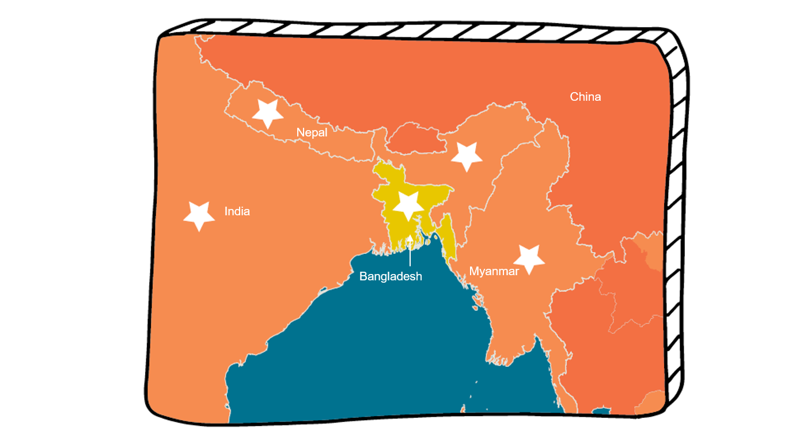
Countries where Caritas Australia work
Notes:
Jamila and her daughter stand outside their shelter in a refugee camp in Cox’s
Bazar, Bangladesh. Credit: Inmanuel Biswas/Caritas Bangladesh

Slide 4
Jamila is a single mother, living in the world’s largest refugee camp in in Bangladesh.
She left fighting in Myanmar to save herself, her elderly mother and baby daughter.
Jamila helps her daughter wash her hands outside their shelter in a Rohingya refugee camp in Cox’s Bazar, Bangladesh. Photo credit: Inmanuel Biswas/Caritas Bangladesh

Slide 5
Hundreds of thousands of Rohingya people have crossed into Bangladesh since August 2017.
Over 1.3 million people need support.
A general view of a Rohingya refugee camp in Cox’s Bazar region of Bangladesh. Photo credit: Inmanuel Biswas/Caritas Bangladesh

Slide 6
Caritas provided Jamila with food and shelter along with emotional support through the Women Friendly Spaces program.
Jamila (centre) participates in the Women Friendly Spaces project in the refugee camp, run by Caritas Bangladesh. Credit: Inmanuel Biswas/Caritas Bangladesh

Slide 7
Jamila joined a Caritas sewing class. Learning to sew provides a way for women to earn an income.
Jamila now has a sense of community around and feels more supported.
Jamila holds up an item of clothing she made after learning to sew at the Women Friendly Spaces project run by Caritas Bangladesh. Photo credit: Caritas Bangladesh

Slide 8
“For the first time in my life, in the camp, I felt cared for and accepted. My worries of an uncertain future are disappearing.”
- Jamila
Notes:
Jamila (centre) joins other women in the Women Friendly Spaces project, run by Caritas Bangladesh, in a refugee camp in Cox’s Bazar, Bangladesh. Photo credit: Inmanuel Biswas/Caritas Bangladesh

Slide 9
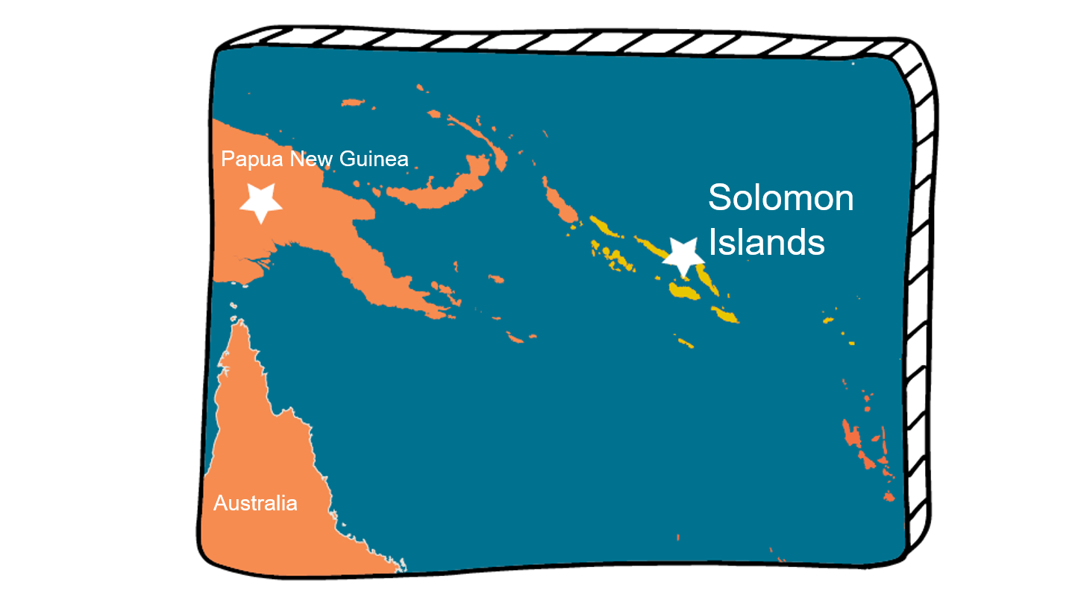
Countries where Caritas Australia work
Notes:
Margret standing outside a classroom at the San Isidro Care Centre in the Solomon Islands. Photo credit: Neil Nuia

Slide 10
Margret teaches sign language and other skills to students who are deaf, to help them earn an income.
Margret was born deaf, so she understands the challenges her students face.
Margret teaches sign language at the San Isidro Care Centre in the Solomon Islands. Photo credit: Neil Nuia

Slide 11
The school’s small water tanks always ran out of water quickly or remained empty during the dry season.
Caritas helped the school to install eight large water tanks, and a system to catch rainwater.
Now they have enough water for drinking, cooking, washing and growing vegetables for their food.
Some of the new water tanks installed by Caritas Australia at the San Isidro Care Centre in the Solomon Islands. Photo credit: Neil Nuia

Slide 12
Then in April 2020, amidst COVID-19, Tropical Cyclone Harold struck. The school buildings and vegetable garden was damaged.
Caritas helped to fix the roof and helped the school increase their vegetable and animal farming.
Now they have enough food for their meals and to sell at the market.
Pumpkin is grown as part of the food security project at the San Isidro Care Centre in the Solomon Islands. Photo credit: Neil Nuia

Slide 13
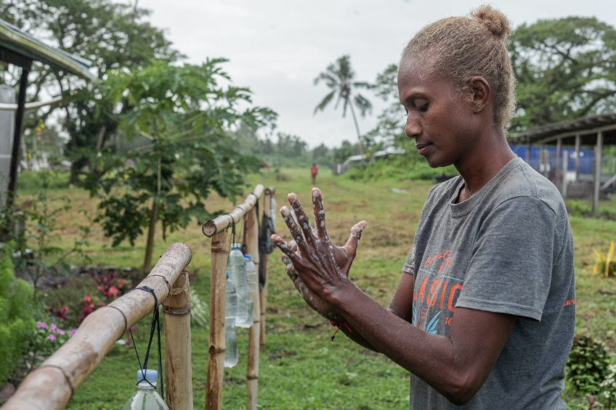
Sewing face masks (left) and washing hands using a tippy tap (below) as part of the COVID-19 prevention measures. Photo credit: Neil Nuia
Caritas also helped to raise awareness about preventing COVID-19.
Fabric was provided for students to sew face masks and they built ‘tippy taps’ outside classrooms to wash their hands.

Slide 14
“I am proud that our school community works together with Caritas Australia as our partner in ensuring that we live in a healthier environment.”
- Margret
Notes:
Margret standing in from of the new water tanks built with the support of Caritas Australia at the San Isidro Care Centre in the Solomon Islands. Photo credit: Neil Nuia

Slide 15
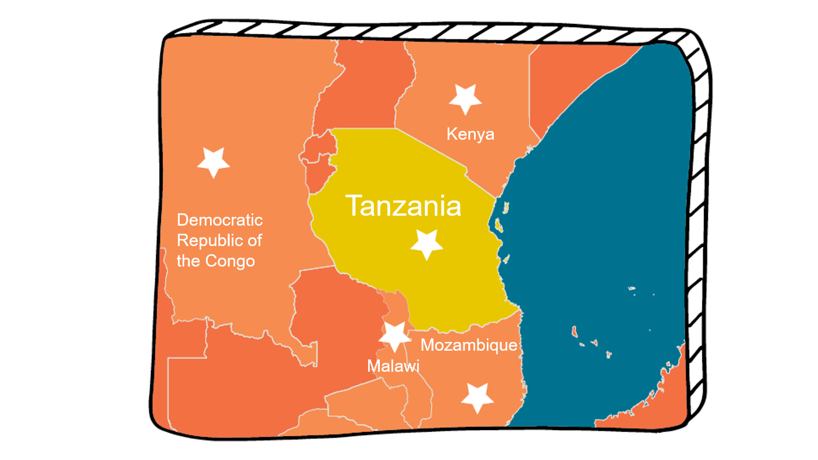
Countries where Caritas Australia work
Notes:
Oliva stands near her home in Karatu District, Tanzania. Photo credit: August Lucky

Slide 16
Oliva lives with her family in Tanzania.
Oliva didn’t have the chance to go to school and as an adult she could not read, write or count.
Without an education it was hard for Oliva to make money from running her kiosk.
Thomas and Oliva with their sons outside their home in Tanzania. Photo credit: August Lucky

Slide 17
Around a quarter of Tanzanian girls and women over 15 years cannot read or write, with many families unable to afford school fees or uniforms.
When Oliva heard about literacy and numeracy classes being run in her local village, with the support of Caritas, she was keen to participate.
Oliva (right) studies in class during an Adults Learning Program near her home in Karatu District in Tanzania. Photo credit: August Lucky

Slide 18
Oliva noticed other adults didn’t feel comfortable attending the community class, so she set up a classroom in her house to share her new skills with her neighbours.
Oliva has now graduated, more people are attending her home-based classes, and her kiosk is thriving.
Oliva teaches adults from her community inside her home in Tanzania. Photo credit: August Lucky

Slide 19
“I am proud to be a teacher who helps others to achieve their dream.”
- Oliva
Notes:
Oliva (second right) with other students outside the classroom of the Adults Learning Program. Photo credit: August Lucky

Slide 20
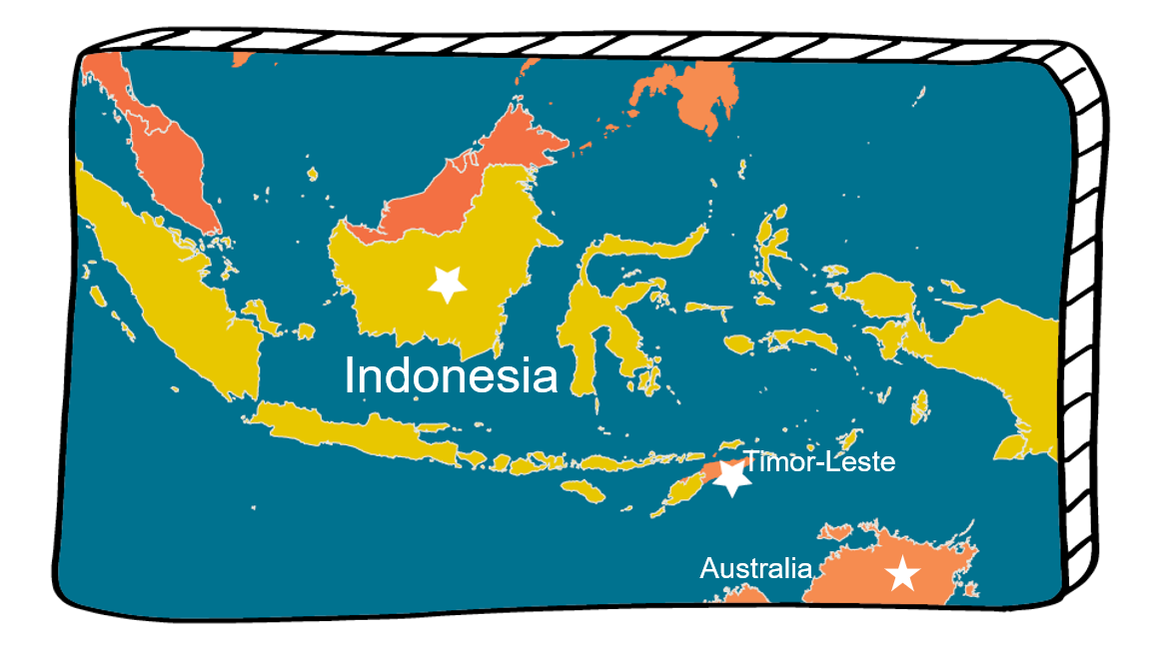
Countries where Caritas Australia work
Notes:
Arsad is photographed with his neighbours in Pandeglang District, Indonesia. Photo credit: Laz Harfa

Slide 21
If we didn’t have access to toilets, what would we do?
Arsad lives with his family in Indonesia.
He had no toilet in his home, so he and his family needed to go outside into the forest, even at night and in the rain.
Arsad with his family outside their home in Pandeglang District, Indonesia. Photo credit: Laz Harfa

Slide 22
When Arsad heard about hygiene and sanitation training, supported by Caritas, he was keen to get involved.
He decided to save money to build a toilet and piped water system himself.
Arsad washes his hands next to his new toilet in his house in Pandeglang District, Indonesia. Photo credit: Laz Harfa

Slide 23
Arsad set a good example and then slowly encouraged and helped his neighbours build toilets too.
With over 280 toilets built as a result of the program, Arsad’s community can now enjoy a safe clean environment.
Arsad (centre) helps a neighbour build a pit latrine at his home in Pandeglang District, Indonesia. Photo credit: Laz Harfa

Slide 24
“We help each other, the ‘togetherness’ is growing. Our solidarity had increased.”
- Arsad
Notes:
Arsad (left) cultivates rice in his community in Pandeglang District, Indonesia. Photo credit: Laz Harfa

Slide 25
Countries where Caritas Australia work
Notes:
Halima returning from collecting water from a pump near her shelter in a refugee camp in Cox's
Bazar, Bangladesh. Photo credit: Inmanuel Biswas/Caritas Bangladesh

Slide 26
Halima is a strong, young woman, raising her two children and caring for her mother in a refugee camp in Bangladesh.
They fled fighting in Myanmar, crossing the border into Bangladesh to stay safe.
Halima with her children and mother near their shelter in a Rohingya refugee camp in Cox’s Bazar, Bangladesh. Photo credit: Inmanuel Biswas/Caritas Bangladesh

Slide 27
Caritas helped Halima with shelter and cooking equipment so that she could feed her family.
Halima learnt how to access clean drinking water and how to keep her family healthy in the crowded camp.
Halima shows her daughter how to wash her hands correctly outside their shelter in a Rohingya refugee camp in Cox’s Bazar, Bangladesh. Photo: Caritas Bangladesh

Slide 28
Halima then got a job as a community mobiliser.
She organises the cleaning of the washrooms, wells and toilets in her block as well as teaching others how to stay healthy.
Halima (left) leading a COVID-19 related health and hygiene session with children in her Rohingya refugee camp in Cox’s Bazar , Bangladesh. Photo: Caritas Bangladesh

Slide 29
“Before, my kids fell sick. Now I can keep my children clean, educate them and cover expenses for their needs. I can feed them.”
- Halima
Notes:
Halima stands on a bridge near her shelter in a Rohingya refugee camp in Cox’s Bazar, Bangladesh.
Photo credit: Inmanuel Biswas/Caritas Bangladesh

Slide 30
For over 55 years, Australians have put their love and compassion into action by supporting Project Compassion - one of the nation’s longest running charity campaigns.
Image from The Catholic Weekly, 20 February 1969.

Slide 31
We would like to thank you, your family and your school for supporting Caritas Australia.
Last year. with your support, Caritas helped to reach:
3.6 million people through its long-term development programs
3.2 million people affected by disaster or conflict.
Olivia washes her hands with her sons outside their home. Photo credit: August Lucky Olivia (right) studies in class during an Adults Learning Program near her

Slide 32
By supporting Project Compassion you can help people to have what they need to live a healthy and happy life.
“Aspire not to have more, but to BE more.”
- Saint Oscar Romero

Slide 33
lent.caritas.org.au
1800 024 413
#projectcompassion

Slide 34
lent.caritas.org.au
1800 024 413
#projectcompassion

