Slide 1
Global POVERTY QUIZ
Notes:
Credit from left to right:
First Australians - Red Dust Healing. Red Dust Healing is a specific cultural healing program written from an Indigenous perspective.
Credit: Rob Maccoll
Bangladesh - Woman from an Adivasi community
Caritas Australia works in the Dinajpur region of northern Bangladesh with the Indigenous Adivasi communities.
Credit: Caritas Australia
Myanmar - Man playing drum
Karuna Kengtung Social Services (one of Caritas Australia’s partners) works with the Akha Indigenous minority group to maintain their language, culture and traditional way of life.
Credit: Fr Stephen Ano

Slide 2
Instructions
Click here to play this quiz on the Kahoot interactive learning platform.
This is an interactive resource. As you go through this quiz use your mouse to click on the correct answer for each question.
If you make a mistake you can go back and try again.
Click on the arrows to take you to the next question.
Good luck!

Slide 3
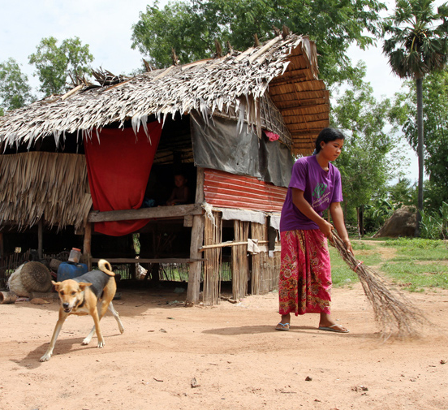
QUESTION 1: Approximately how many people are experiencing extreme poverty with less than US $1.90 a day?
a) 250 million
b) 736 million
c) 1.5 billion
Caritas Australia and Catholic Relief Services, work in partnership with local NGOs in Cambodia to support families most vulnerable to poverty and alleviate rural and urban poverty. Credit: Caritas Australia

Slide 4
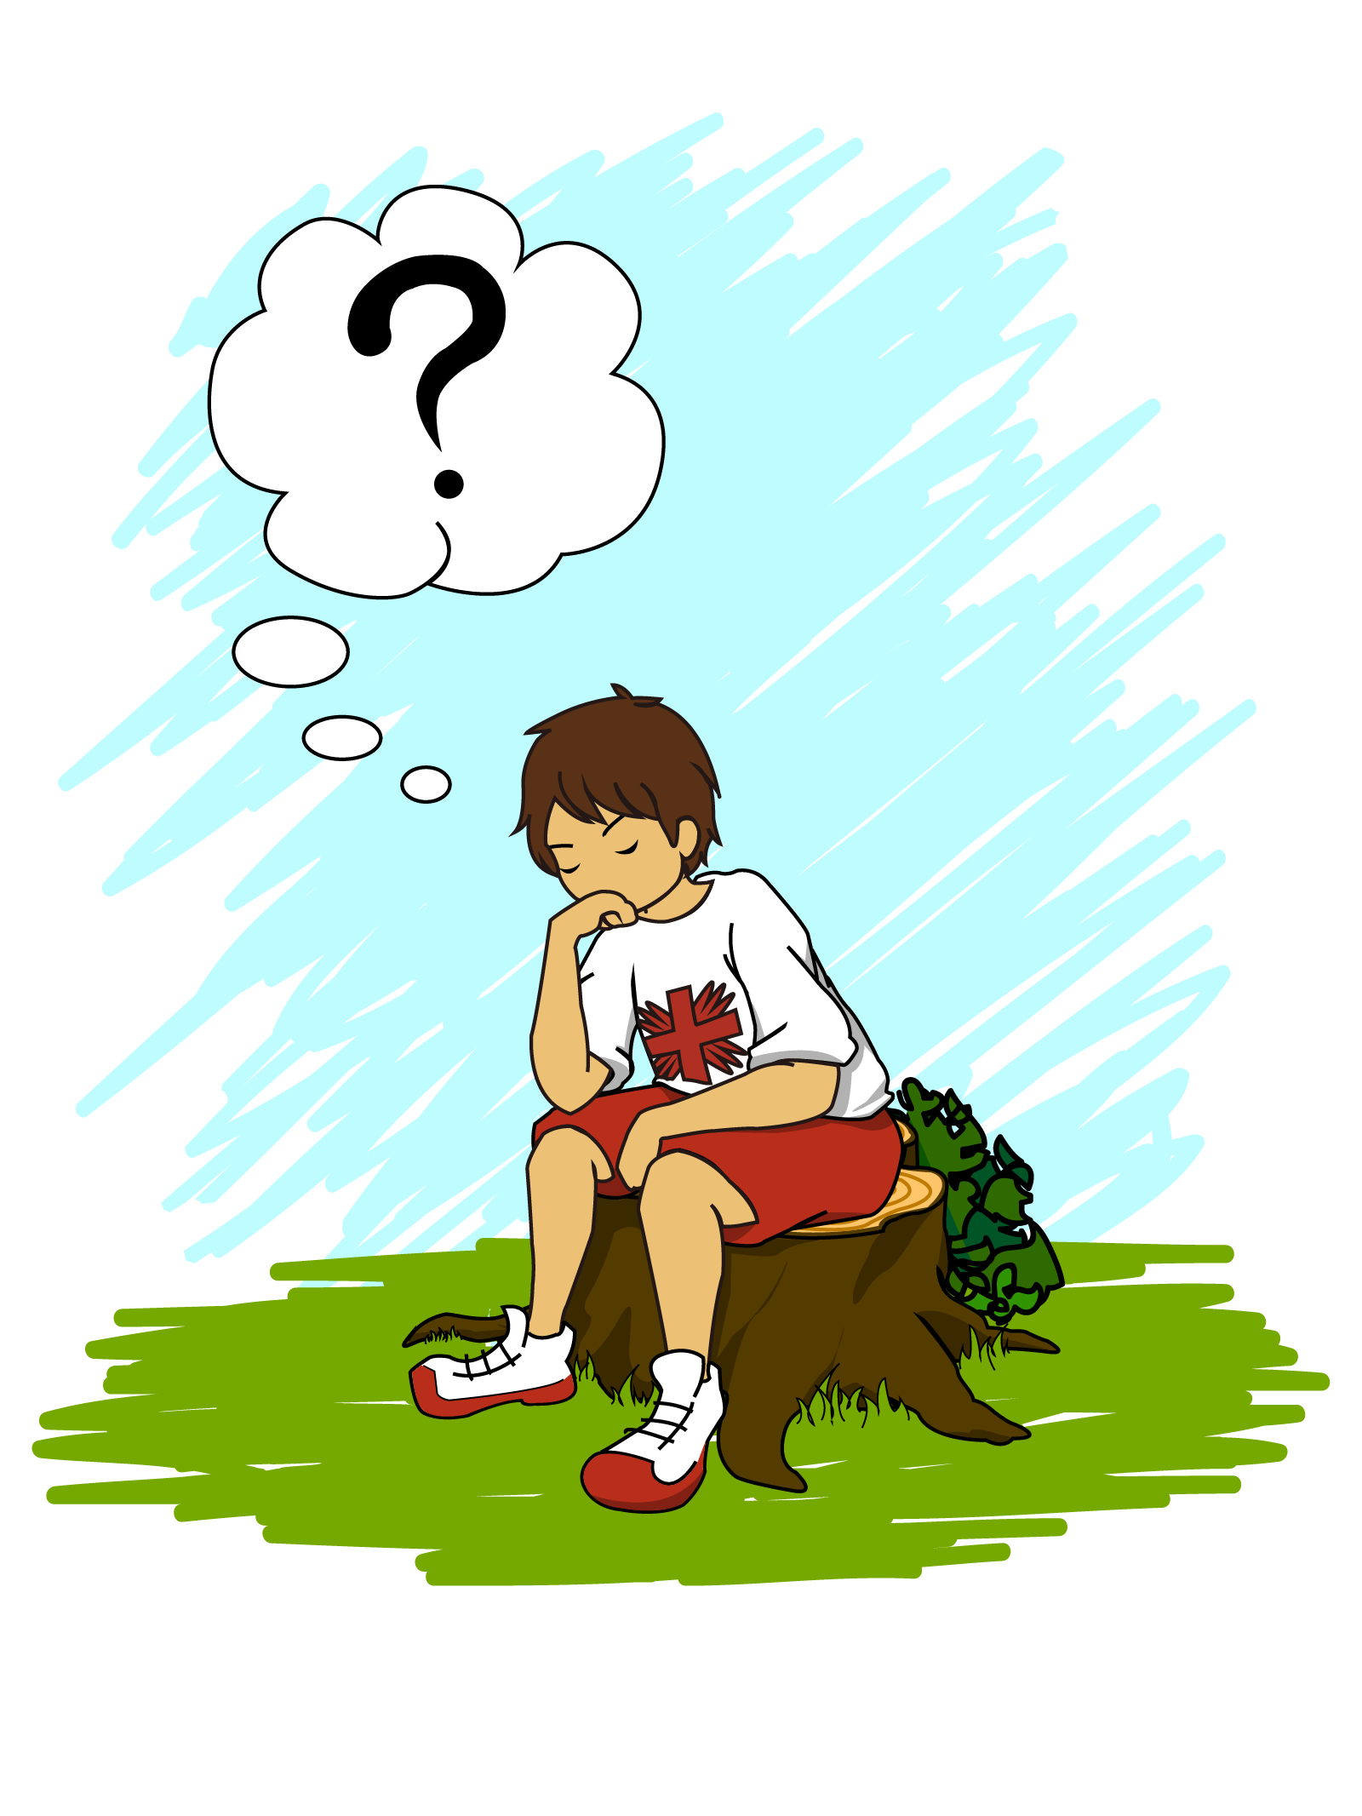
Incorrect, TRY AGAIN!

Slide 5
b) 736 million
The world bank defines ‘extreme poverty’ as living on less than the equivalent of US $1.90 per day. Globally the number of people experiencing extreme poverty has declined by more than half, falling from 1.85 billion in 1990 to 736 million in 2015. Most progress has occurred since 2000, with the introduction of the Millennium Development Goals.
Caritas Australia and Catholic Relief Services, work in partnership with local NGOs in Cambodia to support families most vulnerable to poverty and alleviate rural and urban poverty. Credit: Caritas Australia
Notes:
In 2015, 10 percent of the world’s population lived on less than US$1.90 a day, compared to 11 percent in 2013. That’s down from nearly 36 percent in 1990.
Source 1:
World Bank
https://www.worldbank.org/en/topic/poverty/overview

Slide 6
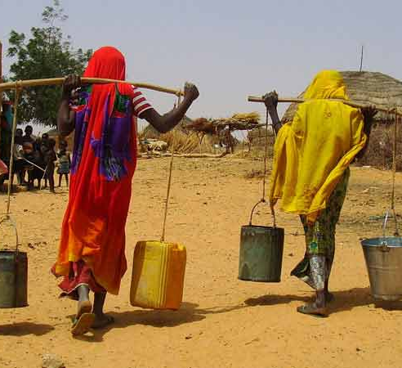
QUESTION 2: How many people do not have safe, clean water close to home?
a) 844 million
b) 1.4 billion
c) 323 million
Women carrying home water in Niger.
Credit: Catholic Relief Services

Slide 7
Incorrect, TRY AGAIN!

Slide 8
a) 844 million
In Australia, many of us are fortunate enough to be able to simply turn on a tap; 844 million other people do not have this luxury. Nearly half of all people using unimproved sources live in sub-Saharan Africa, while one-fifth live in South Asia.
Women carrying home water in Niger.
Credit: Catholic Relief Services
Notes:
1 in 9 don't have clean water close to home.
Source 1:
(WHO/UNICEF Joint Monitoring Programme (JMP) Report 2017)
https://www.wateraid.org/au/why-wateraid/facts-and-statistics
Source 2:
Progress on Sanitation and Drinking Water : 2015 Update and MDG Assessment
By World Health Organization

Slide 9
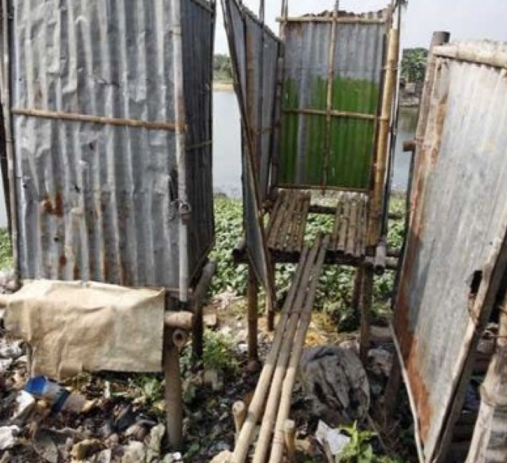
QUESTION 3: How many people do not have access to a decent toilet of their own?
a) 785 million
b) 1.8 billion
c) 2.3 billion
A hanging latrine in Bangladesh. Credit: Adam Hart-Davis

Slide 10
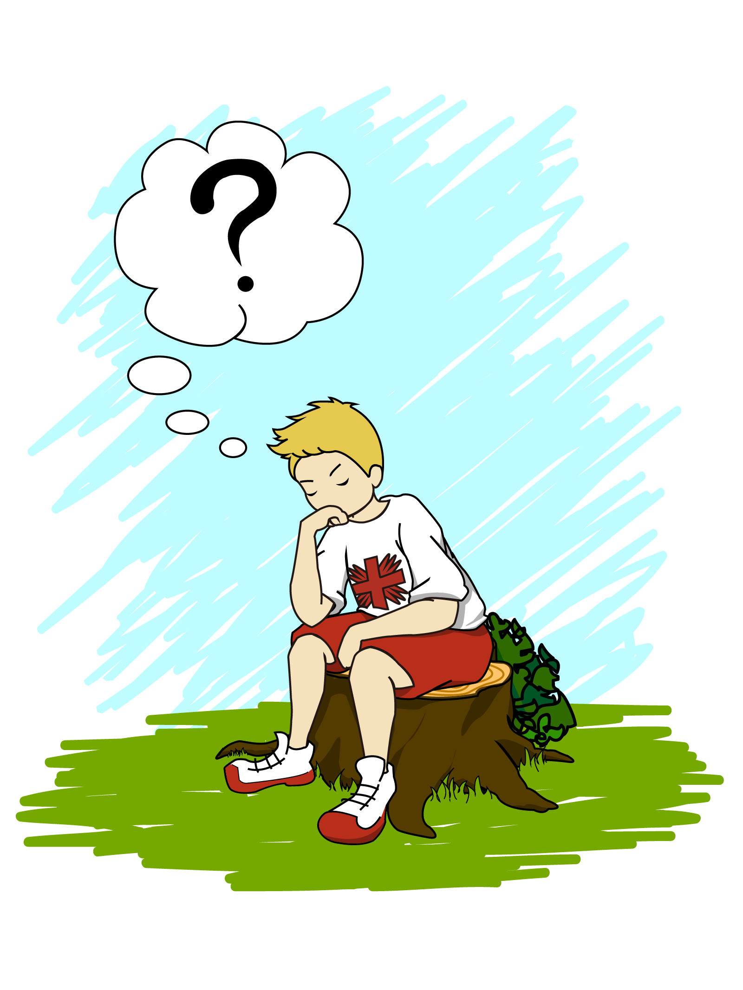
Incorrect, TRY AGAIN!

Slide 11
c) 2.3 billion
If you did not have a flushing toilet or a pit latrine, what would you use? Probably a plastic bag, a bucket, a field or a hanging latrine. Lack of sanitation results in disease, and unfortunately death, for millions of people every year.
A hanging latrine in Bangladesh. Credit: Adam Hart-Davis
Notes:
Source 1:
(WHO/UNICEF Joint Monitoring Programme (JMP) Report 2017)
https://www.wateraid.org/au/why-wateraid/facts-and-statistics

Slide 12
QUESTION 4: How many people worldwide suffer from malnutrition?
a) 380 million
b) 670 million
c) 821 million
Caritas helped with the distribution of sorghum so that people had at least one meal a day until the next harvest, during the west Africa food crisis in 2012. Sorghum is a main food source for people in Chad during the food crisis. Credit: Caritas Switzerland

Slide 13
Incorrect, TRY AGAIN!

Slide 14
c) 821 million
In 2017, it was estimated that 821 million – around one person out of every nine in the world, were without adequate nutrition.
The world produces enough food to feed everyone, yet 821 million people do not have enough nutritious food to meet their daily needs. How can we address the unjust structures that fail to distribute the food effectively?
Caritas helped with the distribution of sorghum so that people had at least one meal a day until the next harvest, during the west Africa food crisis in 2012. Sorghum is a main food source for people in Chad during the food crisis. Credit: Caritas Switzerland
Notes:
Source 1:
2018 The state of food security and nutrition in the world: Building climate resilience for food security and nutrition.
http://www.fao.org/3/I9553EN/i9553en.pdf

Slide 15
QUESTION 5: How many primary school aged children are not going to school around the world?
a) 61 million
b) 118 million
c) 205 million
Debaki and Nirmala are studying outside of their house in the (destroyed) market of Melamchi, Nepal. Credit: Isabel Corthier, Caritas Internationalis

Slide 16
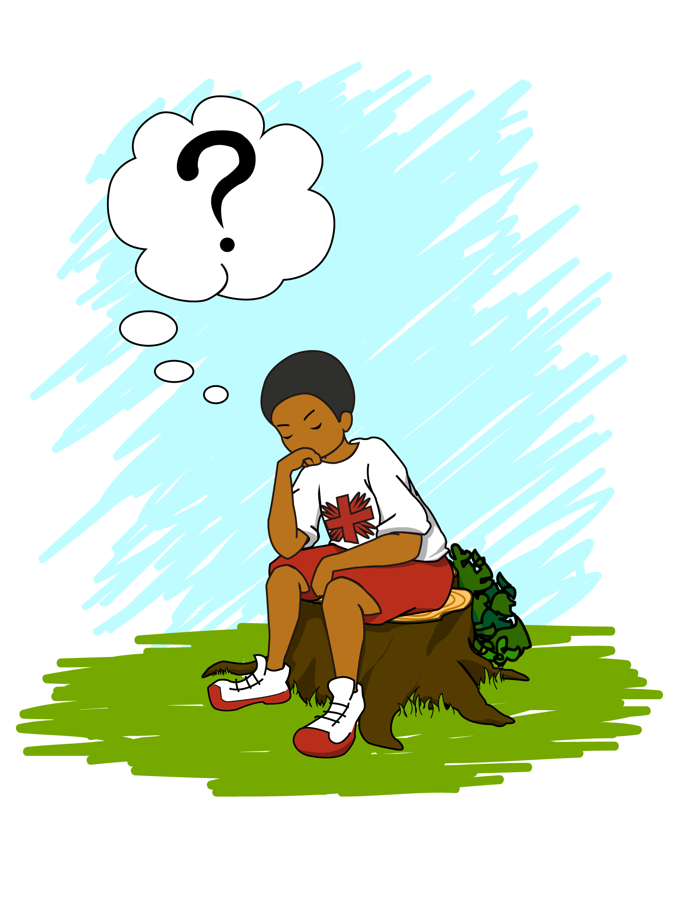
Incorrect, TRY AGAIN!

Slide 17
a) 61 million
Girls are more likely than boys never to set foot in a classroom, despite all the efforts and progress made over the past two decades.
15 million girls of primary-school age will never get the chance to learn to read or write in primary school compared to about 10 million boys. Over half of these girls - 9 million - live in sub-Saharan Africa.
Debaki and Nirmala are studying outside of their house in the (destroyed) market of Melamchi, Nepal. Credit: Isabel Corthier, Caritas Internationalis
Notes:
Source 1:
According to UNESCO Institute of Statistics (UIS) data
http://uis.unesco.org/en/news/263-million-children-and-youth-are-out-school

Slide 18
QUESTION 6: How many children die each year before the age of five?
a) 2.8 million
b) 5.4 million
c) 12 million
Poor harvests have left millions hungry across West Africa with many eating only one meal a day. Credit: Caritas Switzerland

Slide 19
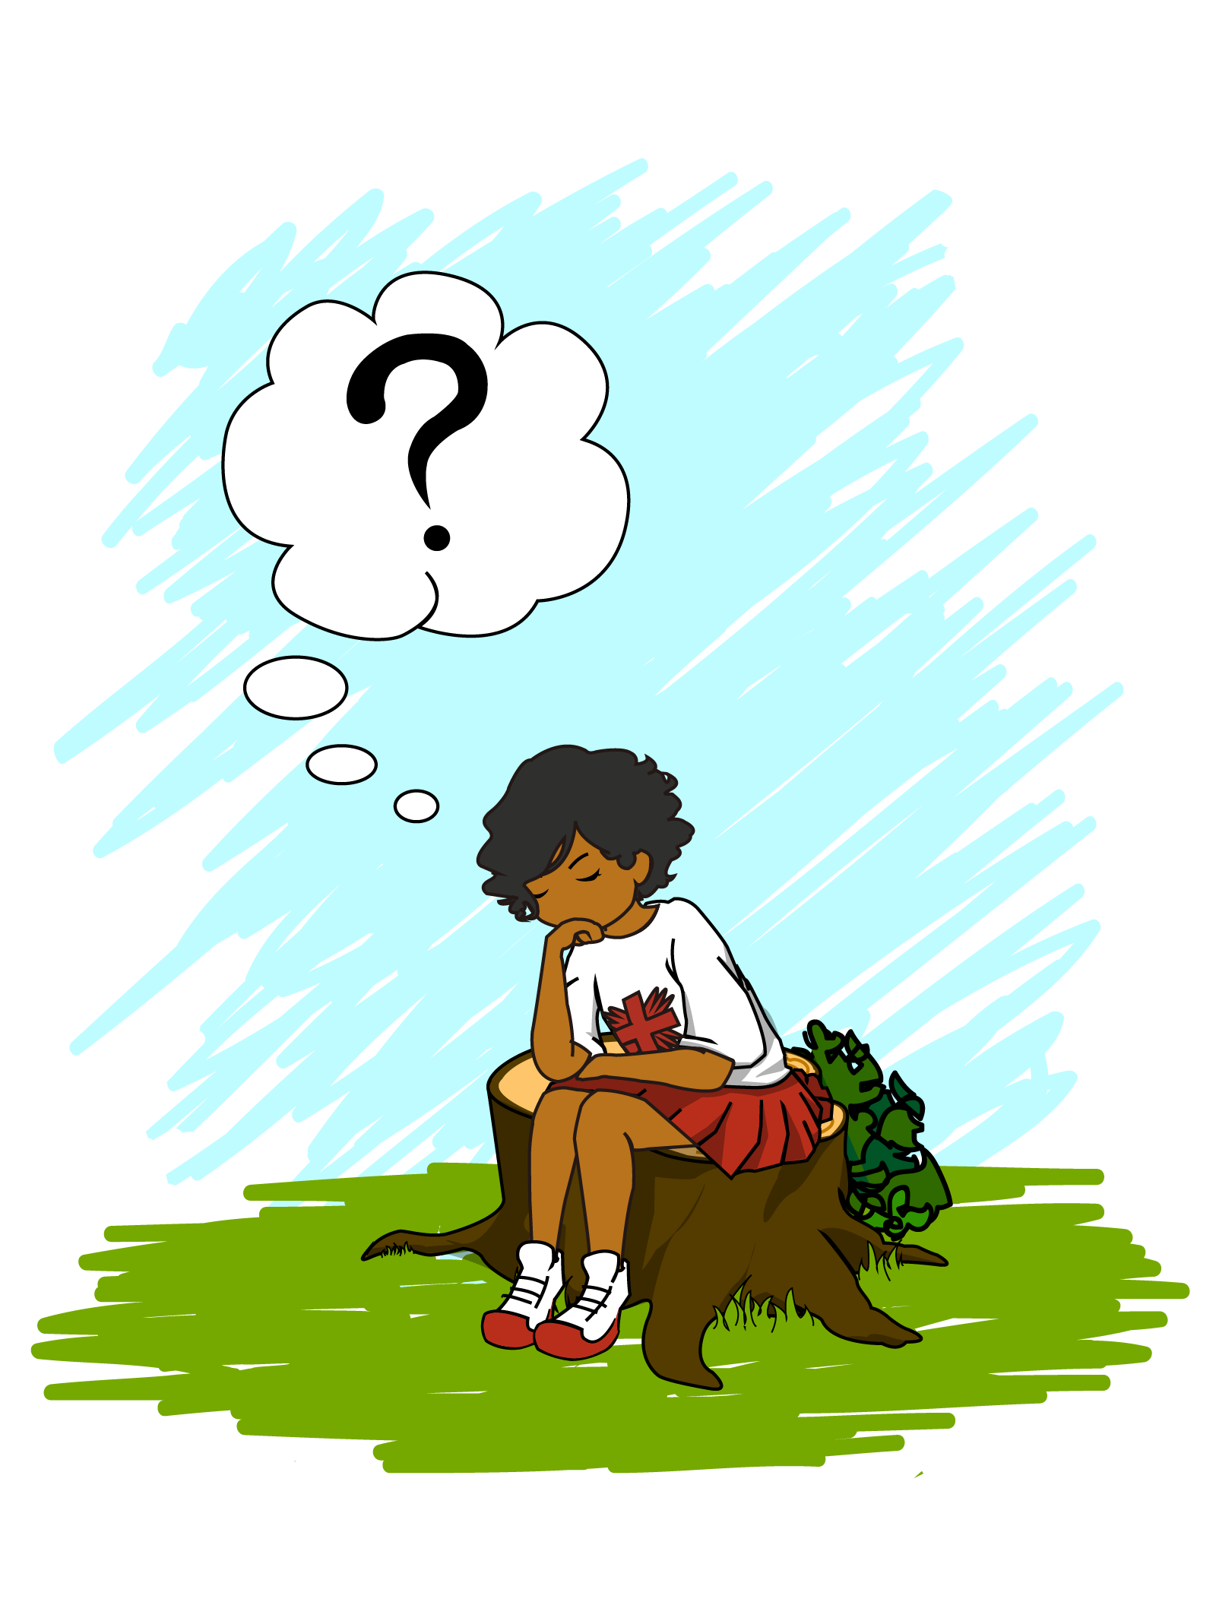
Incorrect, TRY AGAIN!

Slide 20
b) 5.4 million
The most worrying news is that the leading cause of childhood deaths, pneumonia, diarrhoea and malaria, are all easily preventable.
Diarrhoea caused by dirty water and poor toilets kills a child under 5 every 2 minutes.
Poor harvests have left millions hungry across West Africa with many eating only one meal a day. Credit: Caritas Switzerland
Notes:
Source 1:
2018 Report: Levels and Trends in Child Mortality.
https://data.unicef.org/wp-content/uploads/2018/10/Child-Mortality-Report-2018.pdf
Source 2:
www.WASHWatch.org

Slide 21
QUESTION 7: How many people have been forcibly displaced from their homes worldwide?
a) 28 million
b) 43 million
c) 68.5 million
Bayan in front of her home as she waits for the program’s private bus to take her to the Caritas Education Program, which is at a school 30 minutes away.
Credit: Richard Wainwright, Caritas Australia

Slide 22
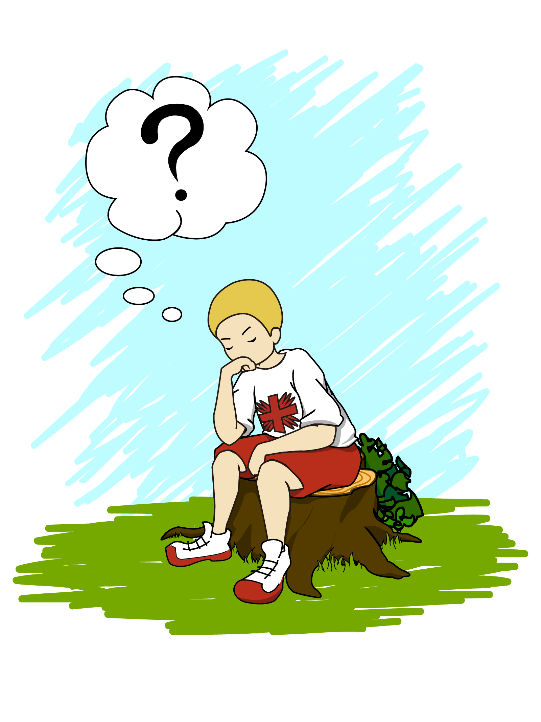
Incorrect, TRY AGAIN!

Slide 23
c) 68.5 million
UNHCR’s annual Global Trends report shows an average of one person was displaced every two seconds in 2017, with developing countries most affected.
People are forcibly displaced as a result of persecution, conflict, violence, or human rights violations.
Bayan, a refugee from Syria in front of her home as she waits for the program’s private bus to take her to the Caritas Education Program, which is at a school 30 minutes away in Jordan. Credit: Richard Wainwright, Caritas Australia
Notes:
Source 1:
UNHCR
https://www.unhcr.org/news/stories/2018/6/5b222c494/forced-displacement-record-685-million.html

Slide 24
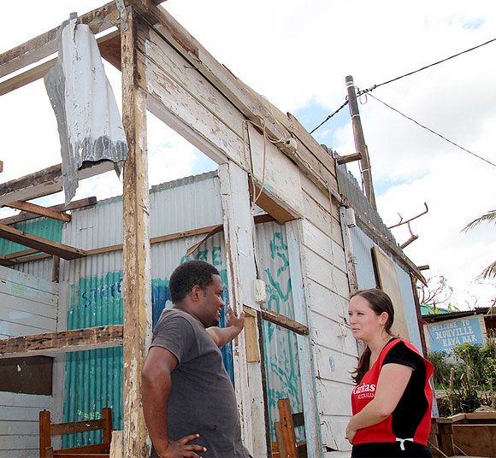
QUESTION 8: What percentage of Australia’s Gross National Income (GNI) was given in Australian Aid in 2018-2019?
a) 3.5 %
b) 0.22 %
c) 0.7 %
Caritas Australia's Pacific Program manager Stephanie Lalor talks to men rebuilding their home, following cyclone Pam. The men were given a tarpaulin to make the home more weatherproof while they rebuild. Credit: Mark Mitchell Caritas Aotearoa New Zealand

Slide 25
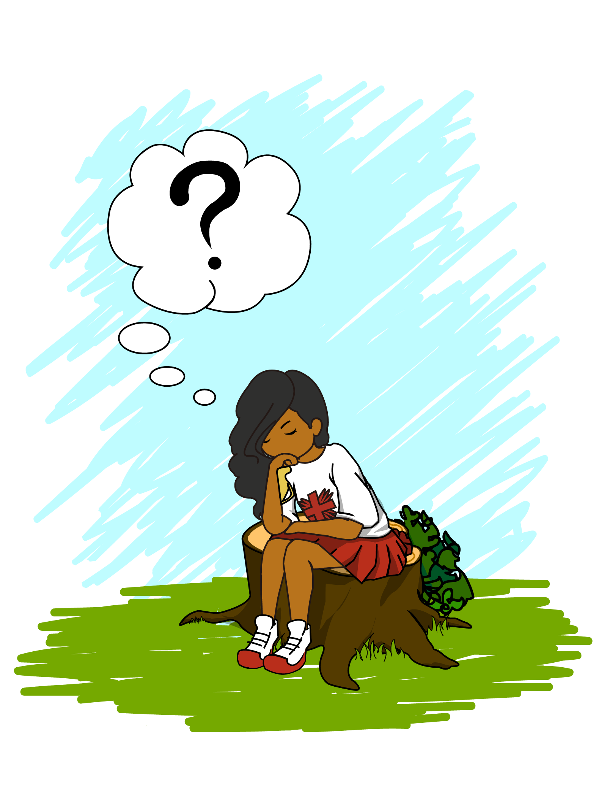
Incorrect, TRY AGAIN!

Slide 26
b) 0.22 %
Australia committed to give 0.7% of their Gross National Income (GNI) in aid. However, in 2018-2019, Australian Aid stood at a historic low of 0.22% of GNI. The forecast budget predicts it will continue to fall.
Caritas Australia's Pacific Program manager Stephanie Lalor talks to men rebuilding their home, following cyclone Pam, Vanuatu.
Credit: Mark Mitchell Caritas Aotearoa New Zealand
Notes:
Source 1:
Micah, Beating Extreme Poverty Together, Voices for Justice, 2018, Policy Overview.

Slide 27
End poverty
Promote justice
Uphold dignity

