Slide 1
Saint Oscar romero prayer

Slide 2
Aspire not to have more,
but to be more.
Saint Oscar Romero

Slide 3
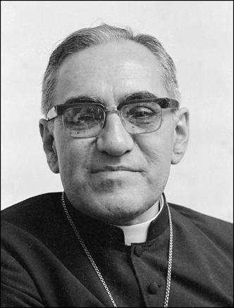
Saint Oscar romero
In El Salvador on March 24, 1980, Oscar A. Romero, Archbishop of San Salvador, was assassinated while celebrating Mass in a small chapel in a cancer hospital where he lived.
He had always been close to his people and denounced the injustice in his country.
Pope Francis canonized Oscar Romero as a saint on 14 October 2018.
His dedication to social justice and Catholic social teaching, particularly the preferential option of the poor, has since earned him the title of Patron Saint of Caritas Internationalis.
The following prayer was composed by Bishop Ken Untener of Saginaw, drafted for a homily by Card. John Dearden in Nov. 1979 for a celebration of departed priests. As a reflection on the anniversary of the martyrdom of Bishop Romero, Bishop Untener included in a reflection book a passage titled "The mystery of the Romero Prayer." The mystery is that the words of the prayer are attributed to Oscar Romero, but they were never spoken by him.
Credit: Australian Picture Library

Slide 4
It helps, now and then, to step back and take a long view.
Aerial photo of farming in Tanzania. Credit August Lucky

Slide 5
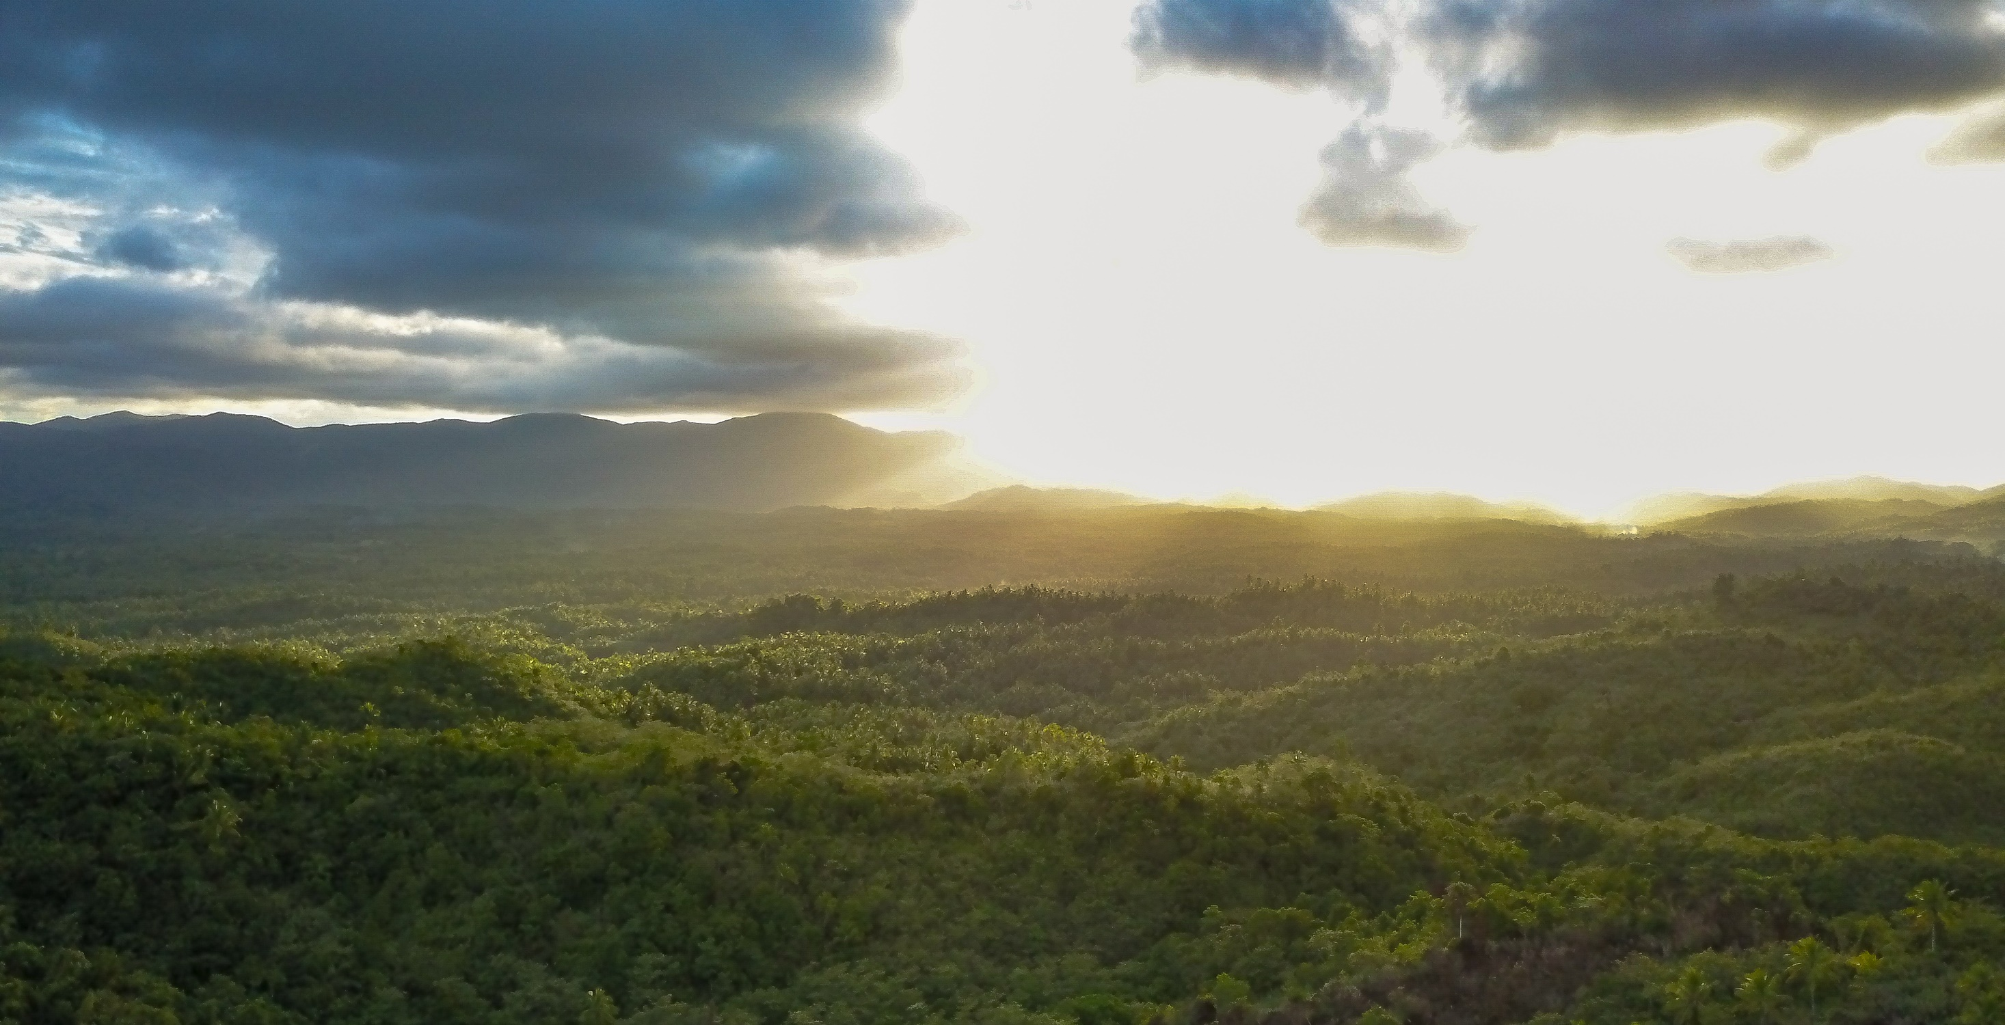
The kingdom is not only beyond our efforts, it is even beyond our vision.
Camarines Norte province in the Philippines. Photo credit: Richard Wainwright

Slide 6
We accomplish in our lifetime only a tiny fraction of the magnificent enterprise that is God’s work.
Trainee Michaela grinds some irmangka to use in the next batch of bush balm. The Purple House produces a range of bush products to help nourish and soothe the skin using traditional recipes. Credit: Emma Murray

Slide 7
Nothing we do is complete, which is a way of saying that the Kingdom always lies beyond us.
Margret teaches sign language and vocational skills at the San Isidro Care Centre in the Solomon Islands. Photo credit: Neil Nuia

Slide 8
No statement says all that could be said.
No prayer fully expresses our faith
Children in Nepal praying at school following the Nepal earthquake. Photo credit: Ben White/CAFOD

Slide 9
No confession brings perfection.
No pastoral visit brings wholeness.
Community members gather in Nepal. Credit: Richard Wainwright

Slide 10
No program accomplishes the Church’s mission.
No set of goals and objectives includes everything.
Students stand outside the classroom of the Adults Learning Program in Tanzania. Photo credit: August Lucky

Slide 11
This is what we are about:
We plant the seeds that will one day grow.
Phany planting seedlings in a nursery at their home in Pursat District, Western Cambodia. Photo Credit: Richard Wainwright

Slide 12
We water the seeds already planted, knowing that they hold future promise.
A community in Malawi banded together to develop a seed bank and dug boreholes to enable access to safe water at shorter distances. With these new techniques, their production of crops almost tripled. A community member holds one of tree seedlings. Credit: Pilirani Chimombo

Slide 13
We lay foundations that will need further development.
Jamila helps her daughter wash her hands outside their shelter in a Rohingya refugee camp in Cox’s Bazar, Bangladesh. Photo credit: Inmanuel Biswas/Caritas Bangladesh

Slide 14
We provide yeast that produces far beyond our capabilities.
Barry teaching his daughter (7) dot painting at their home in Bateman's Bay, Australia.

Slide 15
We cannot do everything, and there is a sense of liberation in realising that.
This enables us to do something, and do it very well.
Oliva works in fields growing beans near her home in Tanzania. Photo credit: August Lucky

Slide 16
It may be incomplete, but it is a beginning, a step along the way, an opportunity for the Lord’s grace to enter and do the rest.
Thandolwayo (9) outside her home holding a 5 litre water container she uses to collect water in Msuna Hills, Zimbabwe. Credit: Richard Wainwright/Caritas Australia

Slide 17
We may never see the end results, but that is the difference between the master builder and the worker.
Neighbours cultivate rice in their community in Pandeglang District, Indonesia. Credit: Laz Harfa

Slide 18
We are workers, not master builders; ministers, not messiahs.
Margret (left) teaching a student how to sew face masks as part of the COVID-19 prevention measures at the San Isidro Care Centre in the Solomon Islands. Photo credit: Neil Nuia

Slide 19
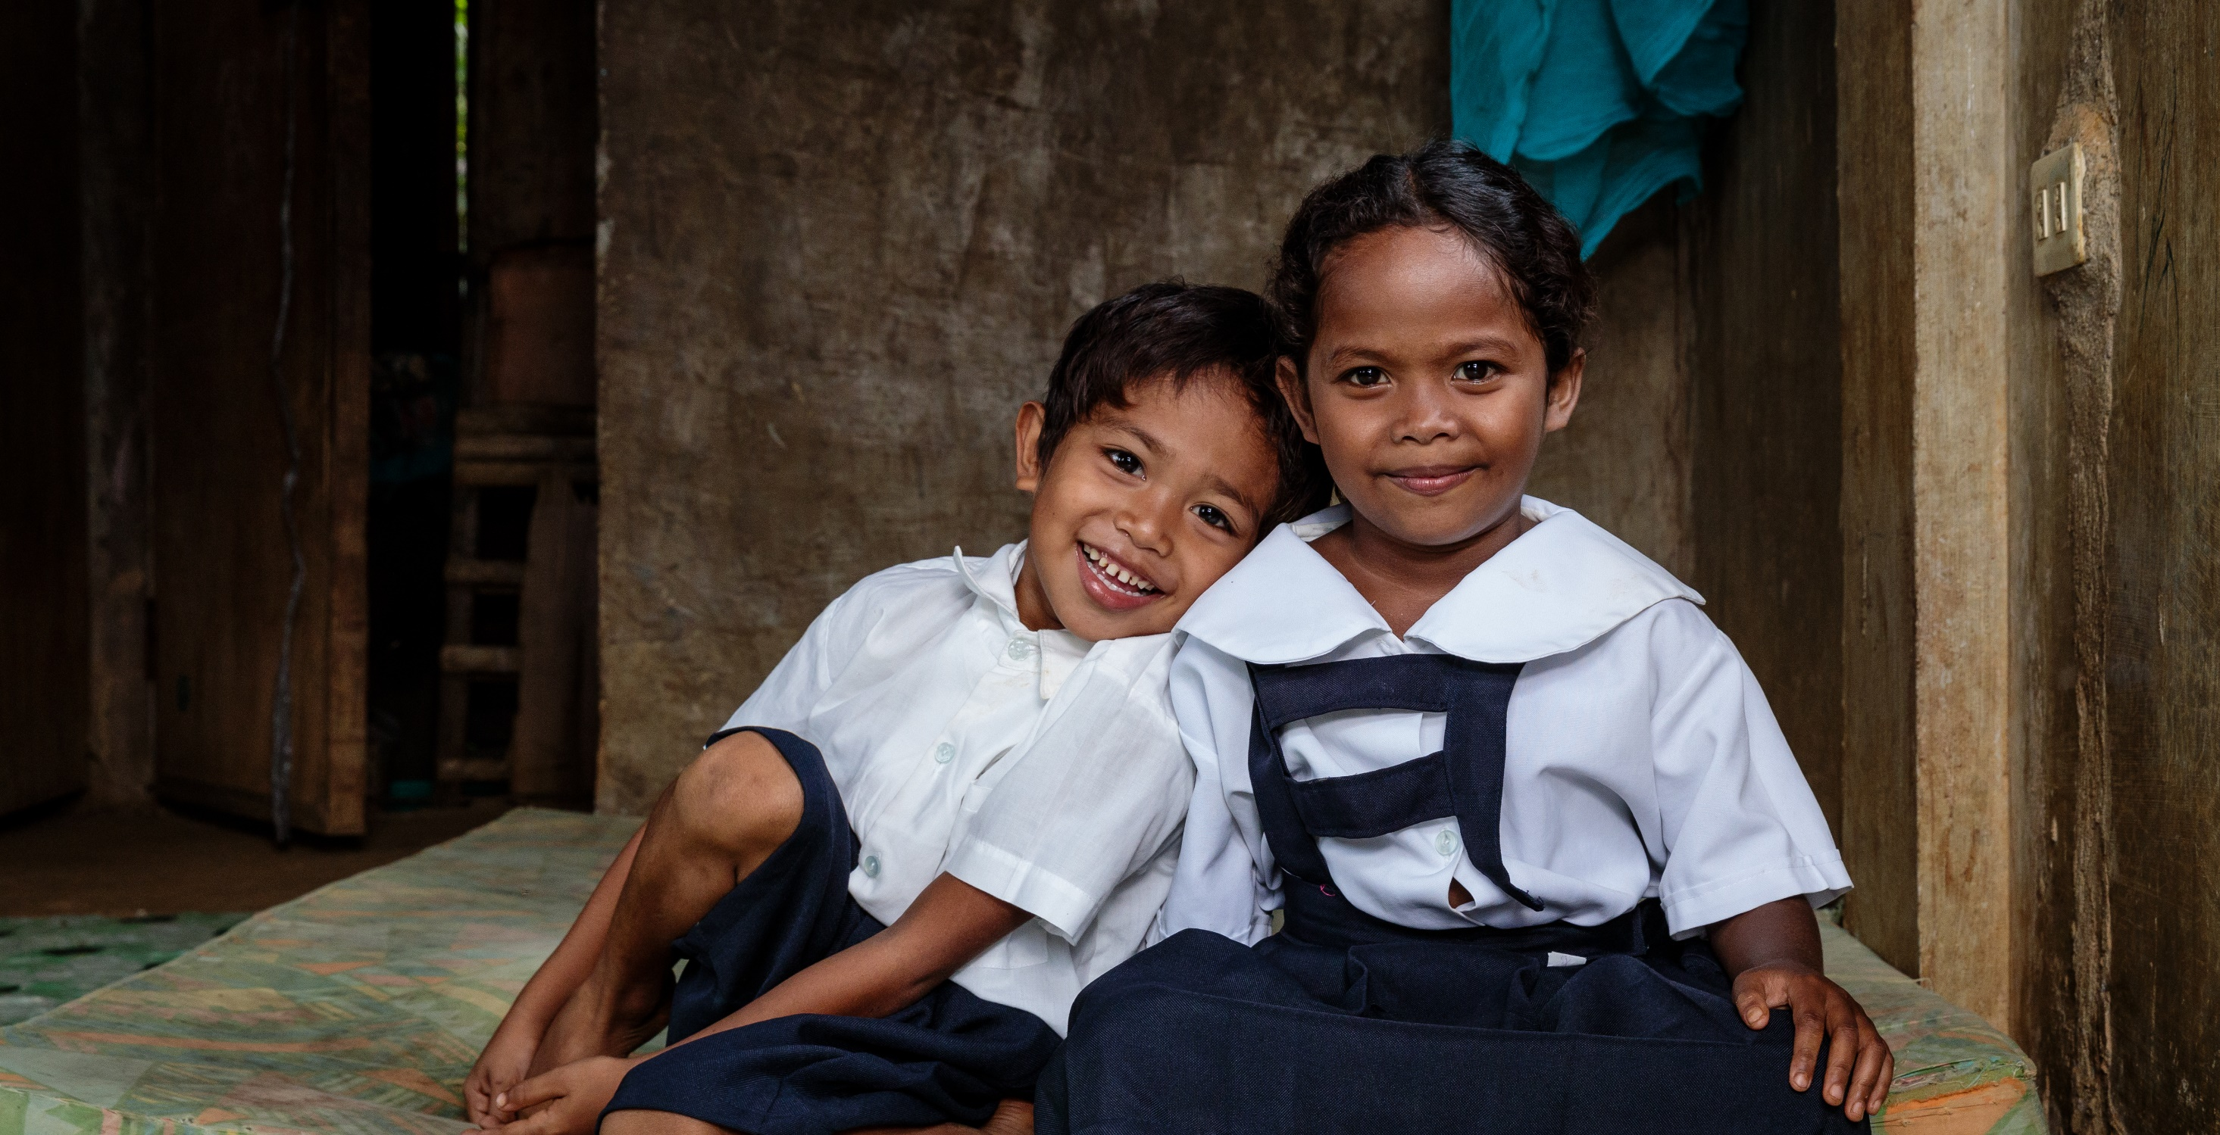
We are prophets of a future not our own.
Amen
Children play at home before leaving for the local school which is close to their Manide community in Camarines Norte, Philippines. Photo credit: Richard Wainwright

Slide 20
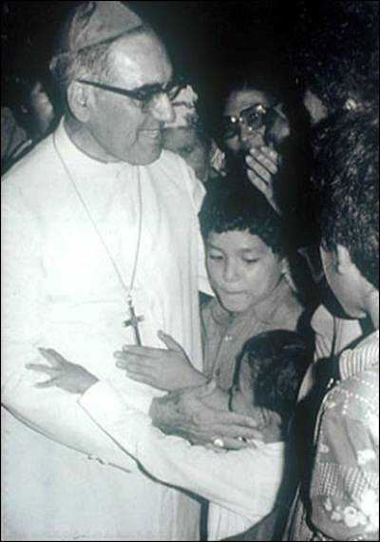
Archbishop Romero’s life and teachings have had a profound impact on people and communities all around the world.
He dared to speak out for his people.
Romero inspires us to make a difference.
How will you make a difference, and BE MORE in the lives of others?
Photo credit: Euipo Maiz

Slide 21
Thank You
Note: Many of the PowerPoints are editable so you can adapt them to your needs. If you do edit these resources please ensure content and photos remain with the appropriate credit to Caritas Australia and the photographers.
Copyright Policy: Material within the resources listed comes from a variety of sources and authors, including Caritas staff volunteers, overseas partners and news organisations. These resources and the information, names, images, pictures, logos are provided “as is”, without warranty. Any mistakes brought to the attention of Caritas Australia will be corrected as soon as possible. To review the full Caritas Copyright Policy, please visit: Caritas Australia​

