Slide 1
Key Principles of catholic social teaching
Rosalie outside her home in Bukavu, eastern Democratic Republic of Congo. Photo: Arlette Bashiz

Slide 2
Information for users
Aboriginal and Torres Strait Islander people are advised that videos, images and external links contained in this resource may contain images, voices or names of people who have since passed away.
This PowerPoint has been designed as a broad introduction to the key principles of Catholic Social Teaching.
Please note:
It is our hope that you will use these slides in a way that best suits your purposes. As such, the slides are editable so that the content is flexible for you to adapt to your needs. If you do edit this presentation, please ensure content and photos from this resource remain with the appropriate credit to Caritas Australia and the photographers.
For copyright information and photo captions, please see the 'Notes' section of the slides.
Notes:
Copyright notice:
Use of website materials
Use of material on this site for educational purposes is encouraged. Caritas Australia gives permission for articles, illustrations and other materials to be reproduced for educational purposes or personal use, provided the information is not changed, and that the source is acknowledged appropriately. Use of material on this website for purposes other than educational or personal use must have prior authorisation from Caritas Australia's Webteam [mailto:webteam@caritas.org.au] (Webteam@caritas.org.au)
Permissions
In some cases the copyright for text or images on this site may held by someone other than Caritas Australia. All rights are reserved on such material and permission to use them must be requested from the copyright owner. The source of this material is indicated on the relevant sections of the site.
Photos without a specified photo credit are the property of Caritas Australia or the international partners of the Caritas network.
Our logo
The Caritas Australia logo must not be downloaded, copied and or used for any purpose without the expressed permission of Caritas Australia. Please contact Caritas Australia's web team [mailto:webteam@caritas.org.au] for any further information that you may require about using content from this website.

Slide 3
Background on catholic social teaching
Catholic Social Teaching sums up the teachings of the Church on social justice issues.
It promotes a vision of a just society that is grounded in the Bible and in the wisdom gathered from experience by the Christian community as it has responded to social justice issues through history.
The main Catholic Social Teachings are:
The Dignity of the Human Person
Preferential Option for the Poor
Care for our Common Home
Subsidiarity and Participation
The Common Good
Solidarity

Slide 4
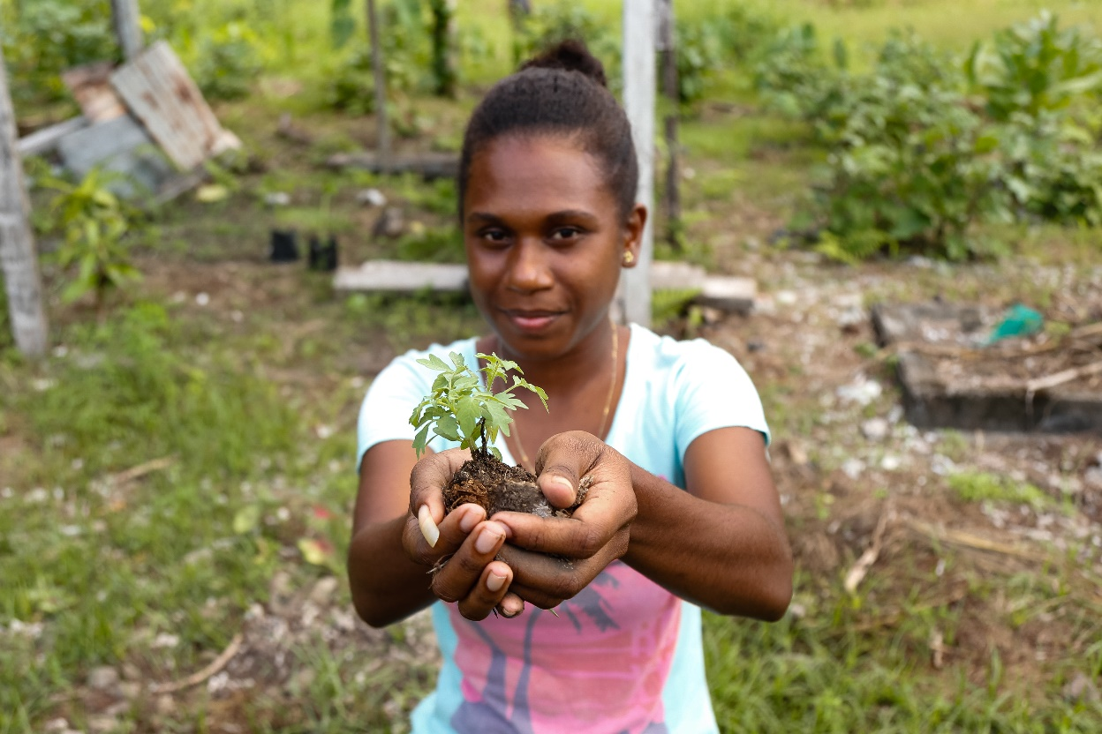
CARITAS AUSTRALIA AND catholic social teaching
Our long-term development and emergency aid work is shaped by the tradition of Catholic Social Teaching (CST).
CST covers all spheres of life – the economic, political, personal and spiritual. With human dignity at its centre, a holistic approach to development, founded on the principles of CST, is what Pope Paul VI called ‘authentic development’.
Shaniella works in the gardens at a Rural Training Centre near the capital Honiara, Solomon Islands. Photo: Neil Nuia

Slide 5
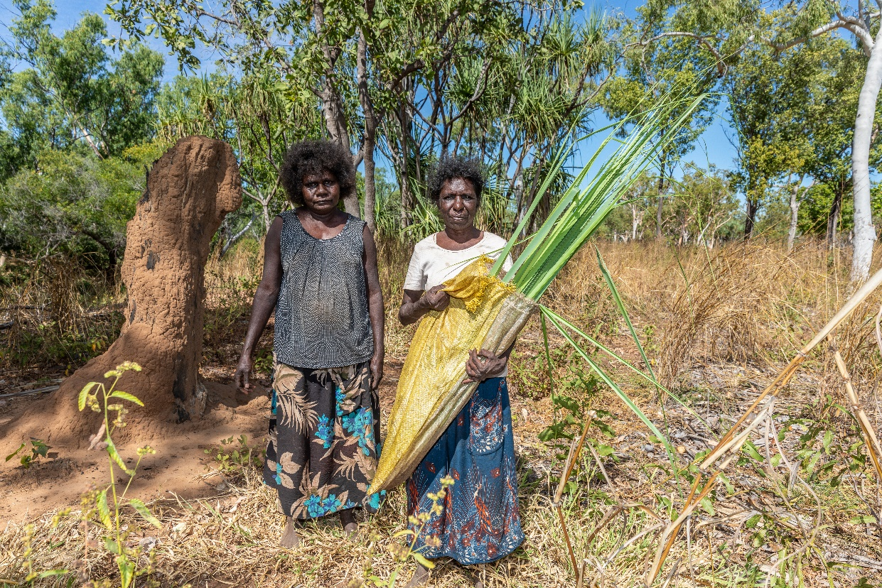
THE DIGNITY OF THE HUMAN PERSON
We believe that every person is made in God’s image. We believe that every person has inherent dignity and every life is sacred.
The innate dignity of each person is the foundation and inspiration of our vision for a just and compassionate world.
We see the image of God in every person, no matter their circumstance. The women, men and children most vulnerable to extreme poverty and injustice should not be hindered from living a life equal to their dignity.
Janice (right) and artworker and elder Noreena pose for a photograph holding pandanus leaves collected from a forest near Djilpin Arts, Northern Territory, Australia. Photo: Richard Wainwright

Slide 6
COMMON GOOD
Besides the good of the individual, there is a good that is linked to living in society: the common good. It is the good of ‘all of us’, made up of individuals, families and intermediate groups who together constitute society.”
Pope Benedict, Charity in Truth n 7
We believe that humans are not only sacred but social and that we experience the fullness of life in our relationships with others. Working towards the common good requires a commitment from each of us to respect the rights and responsibilities of all people.
We believe every person is entitled to share society’s resources - the common good - with others. This extends beyond our personal interests, and beyond national borders, to our one global human family.

Slide 7
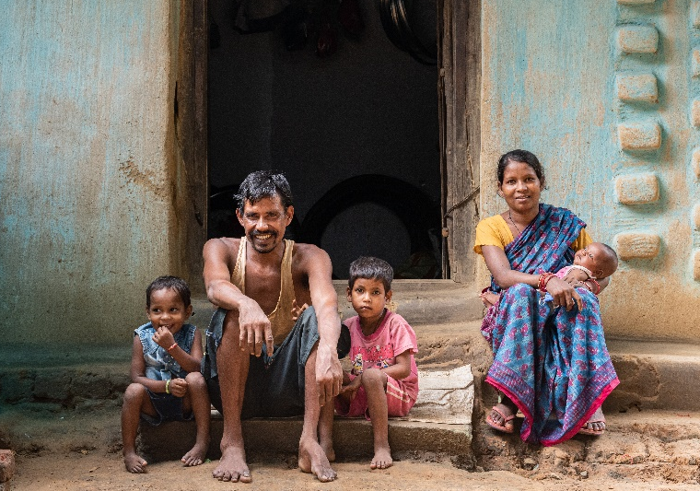
SOLIDARITY
Solidarity requires that we see another person as a neighbour, a fellow human who is equal in dignity.
Solidarity means recognising the responsibilities we have to each other, and taking an active role in helping others attain their full potential. This is more than just a feeling. It drives us to action.
We are called by the principle of solidarity to take the parable of the Good Samaritan (Luke 10:29-37) to heart, and to express this understanding in how we live and interact with others, not as a matter of charity, but of justice. Solidarity makes it impossible for us to look away from the injustices that our sisters and brothers experience.
Biru and his wife Budhni sit with their children outside their house in the state of Jharkhand, India. Photo: Sameer Bara

Slide 8
SUBSIDIARITY and participation
Development programmes, if they are to be adapted to individual situations, need to be flexible; and the people who benefit from them ought to be directly involved in their planning and implementation
Caritas in Veritate
Pope Benedict, Charity in Truth n 47
Subsidiarity means that all people have the right to participate in decisions that affect their lives.
These decisions should be made at the appropriate level, by the people most affected by the decision.
It also means that those in positions of authority have the responsibility to listen to everyone’s voice, and make decisions according to the common good.
Partnerships and collaboration amongst groups, including all levels of government and social institutions, are necessary to work toward a shared, unified vision for society.

Slide 9
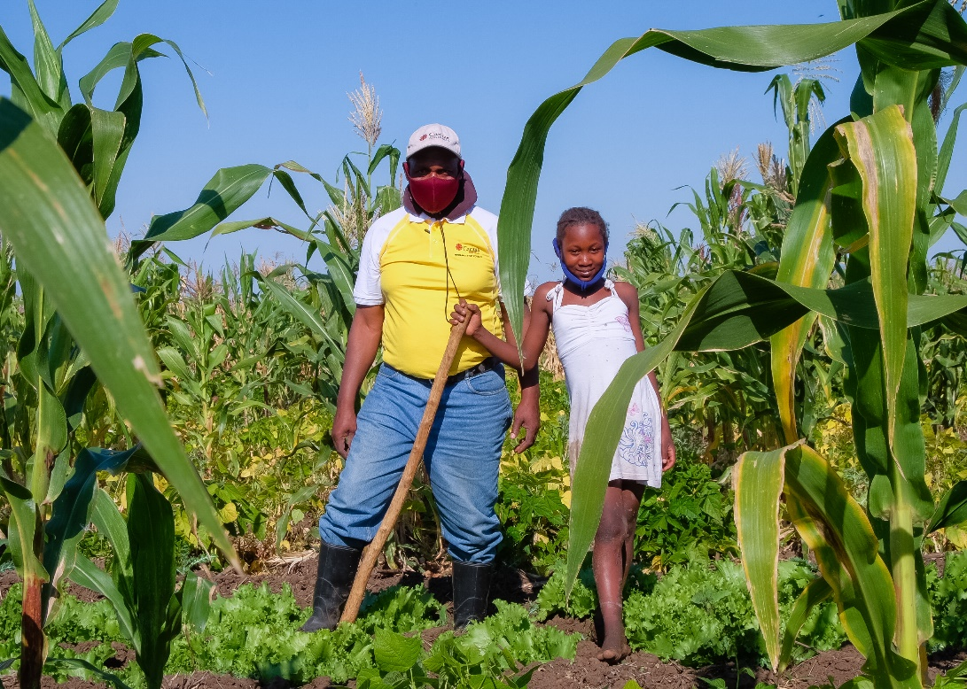
PREFERENTIAL OPTION FOR THE POOR
Children, women and men most vulnerable to extreme poverty and injustice are rich in the eyes of Jesus.
We are called to be companions to women, men and children who are in vulnerable circumstances.
We recognise that extreme poverty is not inherent but constructed in societies and cultures. We are called to expose the institutions and structures which create and perpetuate inequality and hold them to account.
We are called to mobilise our resources, our networks and our prayers in support of the children, women and men who are systematically denied opportunities to exercise and enjoy their rights, freedoms and dignity.
Anatercia (right) poses for a photograph with Domingos, a Caritas Chokwe Extension Technician, after being shown how to use the gravity irrigation system in her fields in Gaza province, Mozambique. Photo: Emidio Josine

Slide 10
CARE FOR OUR COMMON HOME
“We are faced not with two separate crises, one environmental and the other social, but rather with one complex crisis which is both social and environmental. Strategies for a solution demand an integrated approach to combating poverty, restoring dignity to the excluded, and at the same time protecting nature.”
Pope Francis, Laudato Si’ n 139
As Christians we believe that the whole universe was created by God. We are part of creation, connected to all beings.
Furthermore, we have been entrusted by God with the responsibility of caring for His creation.
As stewards of creation, we must respect, care for and share all gifts God has given us – including animals, land, the environment, our own personal talents and other resources.
We must care for our common home responsibly, as true stewards rather than consumers.

Slide 11
Learn more
Learn more using our Catholic Social Teaching Online Toolkit which includes a video, learning sequence and accompanying resources for reach principle.
The toolkit provides students with an in-depth understanding of the Catholic Social Teaching principles using a See, Jude, Act and Pray model.
Catholic Social Teaching Online Toolkit

Slide 12
ADDITIONAL INFORMATION
Students
Caritas Australia’s Code of Conduct demonstrates our commitment to treating others with respect and dignity; keeping everyone safe; protecting the rights of everyone, especially children and vulnerable adults; using Caritas Australia’s money, resources and information responsibly; and acting with integrity.
Learning about global social and ecological justice issues can be overwhelming. If there is anything in our work or resources that concerns you, please speak with your teacher or trusted adult. Concerns can also be lodged via our website: https://www.caritas.org.au/complaints/
Caritas Australia appreciates the unique and valuable perspectives young people have to offer. We would love to receive your ideas and feedback. If you have a suggestion on how we can improve our school resources please email: education@caritas.org.au
Teachers
For more school resources, please visit: caritas.org.au/resources/school-resources/
Stay up to date with events and resources! Subscribe to Caritas Australia’s Education e-newsletter

Slide 13
Thank You

