Slide 1
teacher information
Over half a million Aboriginal and Torres Strait Islander people live in Australia. Caritas Australia is working in partnership with our First Australians to support self-determination and foster Aboriginal and Torres Strait Islander led solutions.
This resource is divided into the following sections:
Section 1: The Stolen Generations
Who are the Stolen Generations and why were children removed from their families?
Section 2: Case Study- Kinchela Boys Home
Learning about what it was like for the children and the impact it had on them and their families.
Section 3: A Path to Justice
Exploring rights, recognition and what we can do.

Slide 2
teacher information
How to use this resource:
This slide deck is intended for use in a classroom presentation to students.
Additional information for teachers are in the ‘Notes’ section of this PowerPoint.
Copyright Information
It is our hope that you will take part/all of these slides and use them in a way that best suits your purposes. As such, the slides are editable so that the content, case studies and tools included in this resource are flexible for teachers and students to use in classroom instruction, independent student research or presentations.
If you do edit this presentation, please ensure content and photos from this resources remain with the appropriate credit to Caritas Australia and the photographers.
Links to external sites
This resource contains links to external web sites. Caritas Australia takes no responsibility for the content of such sites, nor do links to such sites imply endorsement of the views expressed therein. External links are provided for informational purposes only.

Slide 3
Curriculum links
Note: The following links are from the Australian Curriculum.
Year 6 History Experiences of Australian democracy and citizenship, including the status and rights of Aboriginal and Torres Strait Islander Peoples, migrants, women and children. (ACHASSK135) Investigating the lack of citizenship rights for Aboriginal Peoples and Torres Strait Islander Peoples in Australia, illustrated by controls on movement and residence, the forcible removal of children from their families leading to the Stolen Generations, and poor pay and working conditions. Investigating the experiences of democracy and citizenship of children who were placed in orphanages, homes and other institutions (for example, their food and shelter, protection, education and contacts with family). Year 6 Geography The world’s cultural diversity, including that of its indigenous peoples. (ACHASSK140 ) Exploring the United Nations Declaration on the Rights of Indigenous Peoples. | Year 6 English Make connections between students’ own experiences and those of characters and events represented in texts drawn from different historical, social and cultural contexts (ACELT1613) Recognising the influence our different historical, social and cultural experiences may have on the meaning we make from the text and the attitudes we may develop towards characters, actions and events. Year 6 English Analyse strategies authors use to influence readers (ACELY1801) Identify how authors use language to position the reader and give reasons.
Year 6 Civics and Citizenship The shared values of Australian citizenship and the formal rights and responsibilities of Australian citizens (ACHASSK147) Exploring how laws protect human rights (for example, gender, disability, race and age discrimination law).

Slide 4
Curriculum links
Cross-curriculum priorities
Aboriginal and Torres Strait Islander Histories and Cultures. | This priority is designed for all students to engage in reconciliation, respect and recognition of the world’s oldest continuous living cultures. Aboriginal and Torres Strait Islander Peoples live in Australia as first peoples of Country or Place and demonstrate resilience in responding to historic and contemporary impacts of colonisation.
Ethical Understanding | Students develop ethical understanding of behaviour as they critically explore the character traits, actions and motivations of people in the past that may be the result of different standards and expectations and changing societal attitudes and values. Students recognise that examining the nature of evidence deepens their understanding of ethical issues and investigate the ways that diverse values and principles have influenced human affairs.
Personal and Social Capability | As students gain understanding about human experience, past and present, and about their own interconnectedness to people and places across local and global settings, they identify issues and others’ perspectives which inform reflective practice, empathy, communication skills, teamwork and advocacy.
Intercultural Understanding | Students explore how people interact across cultural boundaries and the notion of citizenship, the contribution of diverse cultural influences through migration and media, and the critical role of shared beliefs and values in an evolving Australian identity. This includes learning about the origins and development of Australia’s national identity and the forging of its cultural heritage. Students recognise the significance of Aboriginal and Torres Strait Islander Peoples’ histories and cultures, past and present.

Slide 5
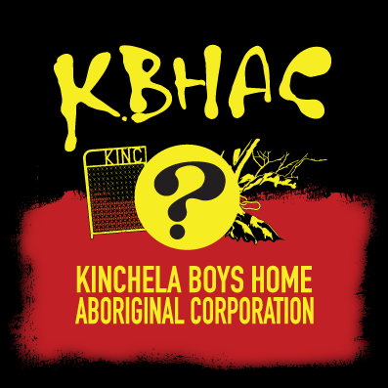
Aboriginal and Torres Strait Islander people should be aware that the videos, images and external links contained in this presentation do contain images or names of people who have since passed away.

Slide 6
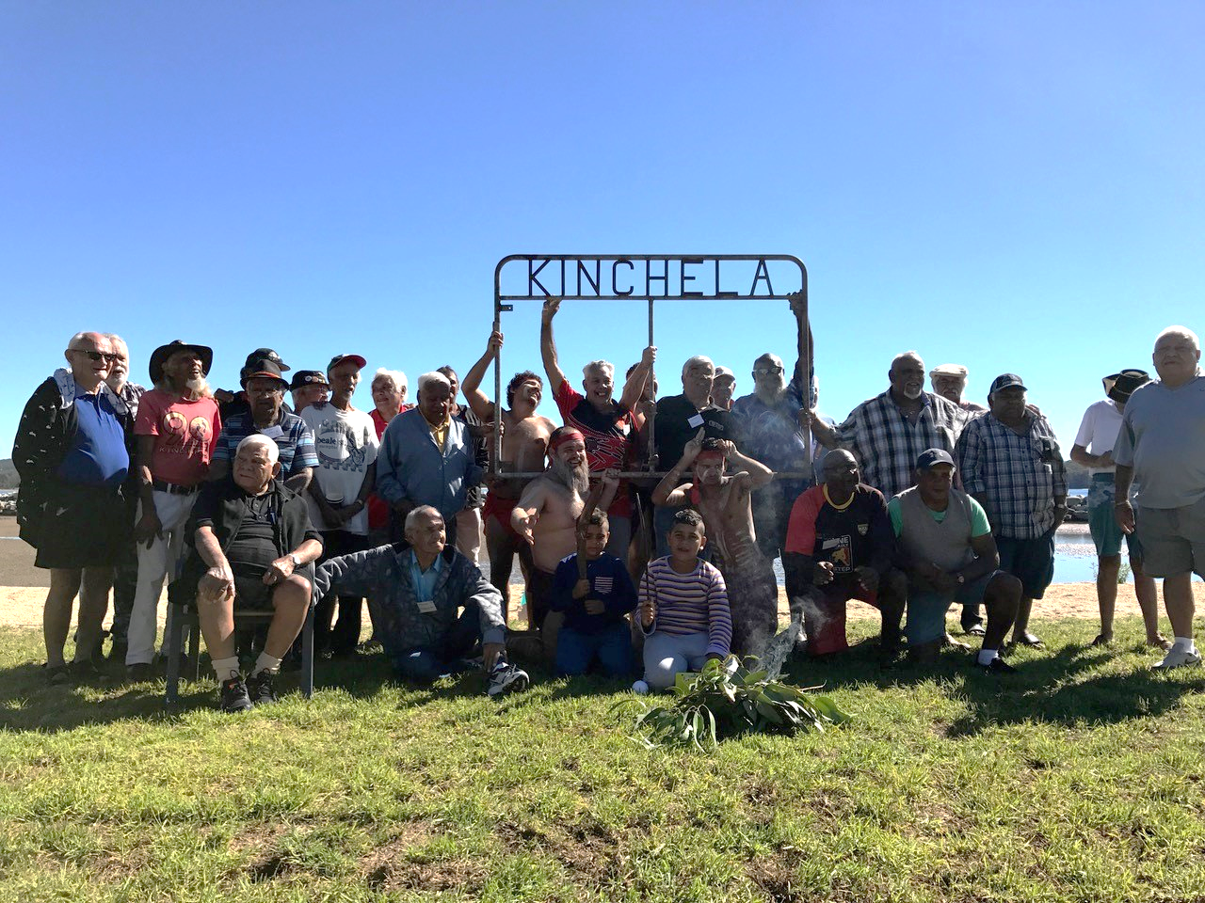
The Stolen Generations Upper primary school resource
Kinchela Boys Home (KBH) Survivors at gate at the site of KBH in Kempsey, NSW. A symbol of the forcible removal of Aboriginal children form their families, this gate has been added to the National Museum of Australia’s Collection. Photograph credits: Peter Minniecon
Notes:
http://www.kinchelaboyshome.org.au/

Slide 7
Big Idea: Who are the stolen generations and how can we walk in solidarity with them?
We begin with an Acknowledgment of Country.
Notes:
Teacher’s Note:
For information on how to write an Acknowledgment of Country, visit:
https://mgnsw.org.au/sector/resources/online-resources/aboriginal/prepare-acknowledgment-country-statement/

Slide 8
Section 1: The Stolen generations
1. Create a KWL chart
2. Who does the term Stolen Generations refer to? (Define)
What I already Know. | What do I Want to know? | What I have learned.
Notes:
Teacher’s Notes
Activity 1- KWL chart- complete as a class or as individuals.
Activity 2- Explore a definition for Stolen Generations. Brainstorm, think-pair-share to get the students involved. Display a definition like the one below (on next slide) in the classroom while learning about this topic. Add other definitions of terms used as needed.
Definition of the Stolen Generations:
The Stolen Generations are Aboriginal and Torres Strait Islander people who, when they were children, were taken away from their families and communities as the result of past government policies.
Source: https://aiatsis.gov.au/research/finding-your-family/before-you-start/stolen-generations
More information for Teachers
Reconciliation Australia: https://www.reconciliation.org.au/wp-content/uploads/2017/11/150520-Sorry-Day.pdf

Slide 9
the Stolen generations
The Stolen Generations are Aboriginal and Torres Strait Islander people who, when they were children, were systematically kidnapped and taken away from their families and communities as the result of past government policies.
Notes:
Teacher’s Notes
Children were removed by governments, churches and welfare bodies to be brought up in institutions, fostered out or adopted by white families.
The removal of Aboriginal children took place from the early days of British colonisation in Australia. It broke important cultural, spiritual and family ties and has left a lasting and intergenerational impact on the lives and wellbeing of Aboriginal and Torres Strait Islander people.
Government policies concerning Aboriginal people were implemented under different laws in the different states and territories of Australia. These laws meant nearly every aspect of the lives of Indigenous people was closely controlled by government: relationships and marriage, children, work, travel, wages, housing and land, and access to health care and education.
Source: https://aiatsis.gov.au/research/finding-your-family/before-you-start/stolen-generations

Slide 10
the Stolen generations
Children were forcibly taken by governments, churches and welfare bodies from their families to be brought up in institutions, fostered out or adopted by white families.
The forced removal of children began in the 1800s and continued until the 1970s.
Notes:
Teacher’s Notes
Children were removed by governments, churches and welfare bodies to be brought up in institutions, fostered out or adopted by white families.
The removal of Aboriginal children took place from the early days of British colonisation in Australia. It broke important cultural, spiritual and family ties and has left a lasting and intergenerational impact on the lives and wellbeing of Aboriginal and Torres Strait Islander people.
Government policies concerning Aboriginal people were implemented under different laws in the different states and territories of Australia. These laws meant nearly every aspect of the lives of Indigenous people was closely controlled by government: relationships and marriage, children, work, travel, wages, housing and land, and access to health care and education.
Source: https://aiatsis.gov.au/research/finding-your-family/before-you-start/stolen-generations

Slide 11
Why? The assimilation policy
Recall previous learning that from the early decades of colonisation onwards, many Aboriginal and Torres Strait Islander peoples died as a result of violence, starvation and introduced European diseases.
Many colonial officials had believed that Indigenous people would simply ‘die out’. However, by the 1930s, they realised that this was not going to happen. Aboriginal and Torres Strait Islander peoples had resisted colonial violence and adapted their lives in order to survive.
The Australian Government decided that it needed a plan to deal with what it called the ‘Aboriginal problem’. Their new idea was to try and ‘assimilate’ Aboriginal and Torres Strait Islander peoples into Australian society.
NOTE: Aboriginal and Torres Strait Islander peoples were never, and are never, a ‘problem’. This was the language used by the Australian Government and state governments during a certain period in history. This term and the ideas behind it are racist and are not in keeping with human rights or Catholic Social Teaching.
Notes:
Teacher’s Notes
Source: Australian Human Rights Commission, 2017: Bringing Them Home Educational Resource

Slide 12
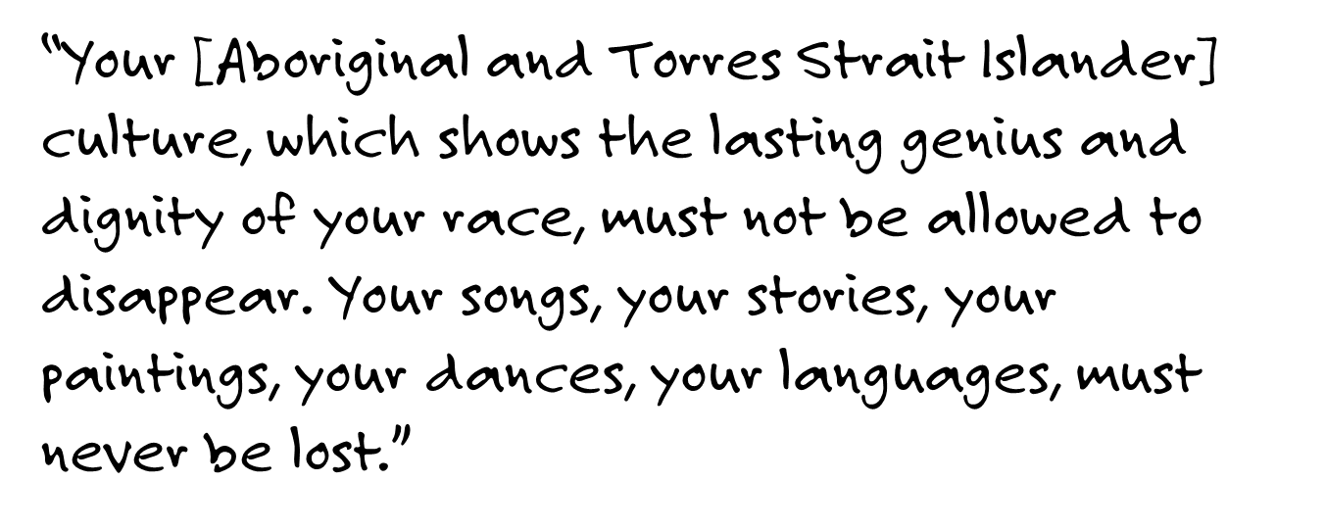
Pope John Paul II
Alice Springs
29 November 1986

Slide 13
Note: Offensive terms
Assimilation: The process of one group being absorbed by another.
Under the Assimilation Policy, the Australian Government sought to assimilate Aboriginal and Torres Strait Islander people into ‘white Australia’ by trying to make them ‘look’ and act ‘white’.
The following terms are very offensive and should no longer be used:
‘Full-blood’: A historical term previously used to describe Aboriginal and Torres Strait Islander people who have no non-Indigenous ancestry.
‘Half-caste’: A historical term previously used to describe Aboriginal and Torres Strait Islander people who had one Aboriginal and/or Torres Strait Islander parent, and one non-Indigenous (usually ‘white’ or European parent).
‘Quadroon’: A historical term previously used to describe Aboriginal and Torres Strait Islander people who had one quarter Aboriginal and/or Torres Strait Islander ancestry.
Notes:
Teacher’s Notes
The Glossary of Terms below is from Australian Human Rights Commission 2017- Bringing Them Home Educational Resource
Assimilation: The process of one group being absorbed by another. Under the Assimilation Policy, the Australian Government sought to assimilate Aboriginal and Torres Strait Islander people into ‘white Australia’ by trying to make them ‘look’ and act ‘white’.
‘Full-blood’: A historical term previously used to describe Aboriginal and Torres Strait Islander people who have no non-Indigenous ancestry. This term is considered very offensive and should no longer be used.
‘Half-caste’: A historical term previously used to describe Aboriginal and Torres Strait Islander people who had one Aboriginal and/or Torres Strait Islander parent, and one non-Indigenous (usually ‘white’ or European parent). This term is considered very offensive and should no longer be used.
‘Quadroon’: A historical term previously used to describe Aboriginal and Torres Strait Islander people who had one quarter Aboriginal and/or Torres Strait Islander ancestry. This term is considered very offensive and should no longer be used.

Slide 14
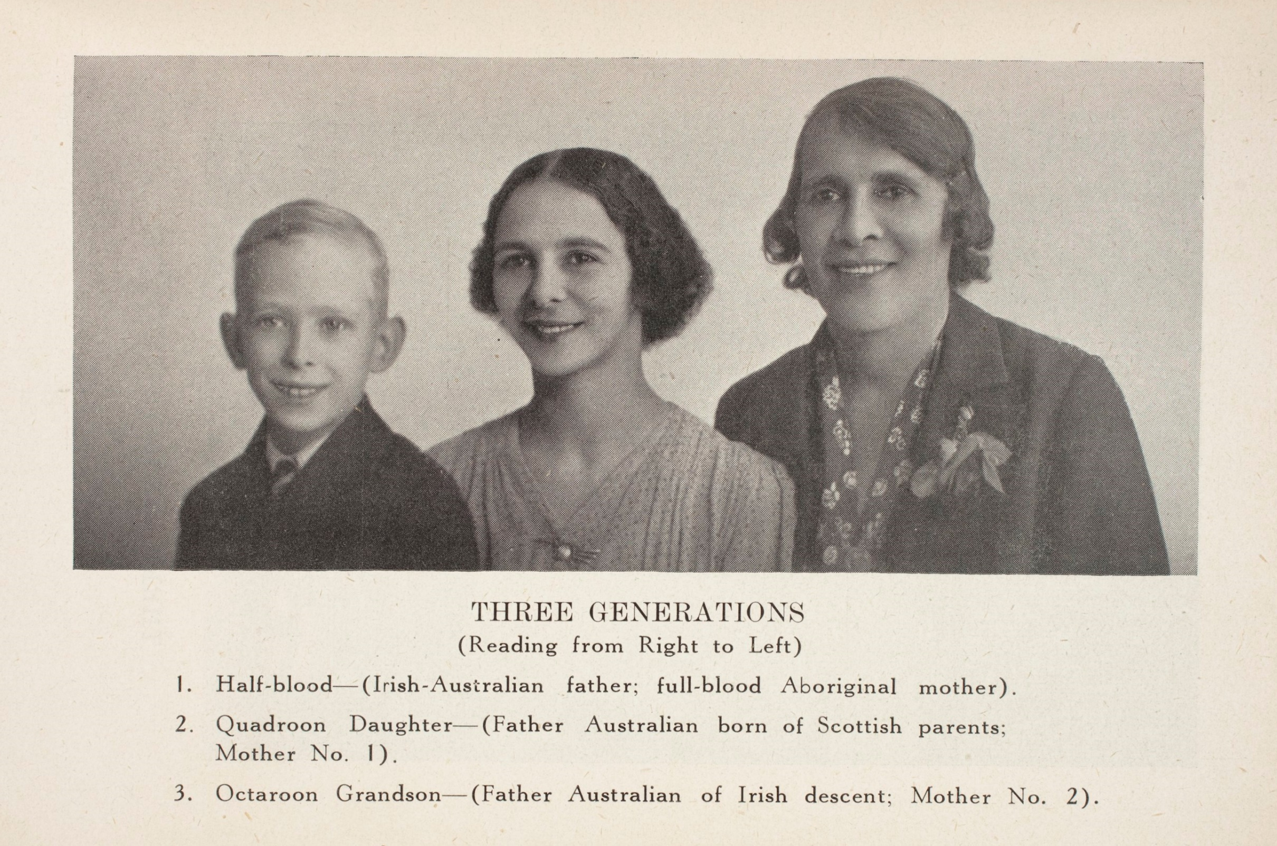
assimilation policy
Source: Author: A.O. Neville, Museums Victoria
https://collections.museumvictoria.com.au/items/1496210
Notes:
Teacher’s Notes
The Glossary of Terms below is from Australian Human Rights Commission 2017- Bringing Them Home Educational Resource
Assimilation: The process of one group being absorbed by another. Under the Assimilation Policy, the Australian Government sought to assimilate Aboriginal and Torres Strait Islander people into ‘white Australia’ by trying to make them ‘look’ and act ‘white’.
‘Full-blood’: A historical term previously used to describe Aboriginal and Torres Strait Islander people who have no non-Indigenous ancestry. This term is considered very offensive and should no longer be used.
‘Half-caste’: A historical term previously used to describe Aboriginal and Torres Strait Islander people who had one Aboriginal and/or Torres Strait Islander parent, and one non-Indigenous (usually ‘white’ or European parent). This term is considered very offensive and should no longer be used.
‘Quadroon’: A historical term previously used to describe Aboriginal and Torres Strait Islander people who had one quarter Aboriginal and/or Torres Strait Islander ancestry. This term is considered very offensive and should no longer be used.

Slide 15
Activity: Assimilation policy
Discuss:
What does this photograph show?
How does this photograph relate to assimilation?
In your own words describe the purpose of the government’s assimilation policies.
How do you think these policies made and perhaps continue to make Aboriginal and Torres Strait Islander families feel?
Do you think Australia is still trying to assimilate Aboriginal and Torres Strait Islander peoples into the mainstream Australian culture?
This activity is adapted from the Australian Human Rights Commission, 2017: Bringing Them Home Educational Resource
Source: Author: A.O. Neville, Museums Victoria
https://collections.museumvictoria.com.au/items/1496210

Slide 16
Section 2: Case study - Kinchela Boys home
Kinchela Boys Home (KBH) was established by the Aboriginal Protection Board in 1924 and closed in 1970. It is estimated that between 400-600 Aboriginal boys were removed from their families and placed in KBH.
Inside KBH the boys suffered abuses of all kinds on a daily basis, because they were Aboriginal. They were denied the love of their families, and a childhood filled with laughter, safety and joy. They were denied the basic rights every child deserves.
Kinchela Boys Home (KBH) Survivors at gate at the site of KBH in Kempsey, NSW. A symbol of the forcible removal of Aboriginal children form their families, this gate has been added to the National Museum of Australia’s Collection. Photograph credits: Peter Minniecon
Notes:
Teacher Notes:
Explain to students that thousands of Aboriginal and Torres Strait Islander children were removed from their families and placed in government or church-run institutions. Kinchela Boys Home was just one of these institutions. Life in these homes was extremely difficult for most children and the conditions were very harsh and abusive.

Slide 17
SOURCE: Unlocking the Past to Free the Future: A KBH Conservation Management Plan
Notes:
Teacher Notes:
Reflect: Students spend time recalling their previous learning about the importance of place to Aboriginal and Torres Strait Islander Peoples and how being removed from not only their family, but their place, would have had a great impact on their social and emotional wellbeing.

Slide 18
KBHAC – Kinchela boys home aboriginal corporation
KBHAC has been operational since 2001. Formed by the KBH survivors and their families, KBHAC encourages and supports a group healing model of care, which helps survivors address the abuse experienced by the KBH survivors as well as the intergenerational trauma experienced by their descendants.
Caritas Australia have partnered with KBHAC since 2011, supporting group healing work as well as core operational costs.
Kinchela Boys Home (KBH) Survivors at the tree, near the site of Kinchela Boys Home in Kempsey. Photo credit: Peter Solness 2015
Notes:
Teacher’s Note:
The term ‘intergenerational trauma’ will need to be discussed/defined.

Slide 19
Uncle Richard’s story
Many years ago when he was just eight years old, Uncle Richard was taken from his parents. He was kidnapped as part of The Stolen Generation policies.
Uncle Richard had to live with other First Australian children in a house for boys called Kinchela Boys Home (KBH).
He was not allowed to speak his language or use his name. He was referred to by a number. The managers were cruel and abusive. He missed his family. He was desperately unhappy.
Kinchela Boys Home (KBH) Survivor, Uncle Richard
Credit: Caritas Australia
Notes:
Teacher’s Note:
Caritas Australia uses the term First Australian to refer to Aboriginal and Torres Strait Islander Peoples.
Our Aboriginal and Torres Strait Islander Partners feel that the term Indigenous’ is a generic term and does not express their unique belonging to the country within which our organisation is based.

Slide 20
Uncle Richard’s story
All KBH boys were assigned numbers and were prohibited from using their names.
Uncle Richard will never forget the terrible times and the brutal managers.
He was very angry when he finally left KBH. He had lost so much. Not only his family, but his language, his mob and his country. He also lost his identity.

Slide 21
Uncle Richard’s story
Uncle Richard was denied his family, his identity and his Aboriginal culture: “They just kept saying, you’re white, not black,” Uncle Richard says.
His life spiralled out of control. He was lost.
He tried to get his life together. He began to paint. And through his art he told his story – the story of his life at the Kinchela Boys Home and of the effect it had on him. He studied Fine Art, gained a degree and now teaches art.
Kinchela Boys Home (KBH) Survivor, Uncle Richard working on his painting of the Good Samaritan.
Credit: Caritas Australia

Slide 22
Uncle Richard’s story
Uncle Richard joined Kinchela Boys Home Aboriginal Corporation (KBHAC); a group made up of men who were in the home with him.
To support their friends, they listen to each other’s stories as they deal with the hurt and loss they have experienced.
Uncle Richard and his friends tell their stories to young people and old people. He will never forget what happened. Uncle Richard and his friends try to be role models for First Australian children helping them to be happy and proud of who they are.
Traditional smoking ceremony performed at a KBHAC gathering of Kinchela Boys Home (KBH) survivors and their families in Kempsey, NSW. Credit: Caritas Australia

Slide 23
Uncle Richard’s story
One of Uncle Richard’s paintings is about the story of the Good Samaritan. It shows an indigenous man helping a white man.
Uncle Richard says it signifies that Australian Indigenous people have always been good neighbours.
When you support Caritas Australia you are walking with Uncle Richard and his brothers as they strive to live their lives to the full.
Kinchela Boys Home (KBH) Survivor, Uncle Richard working on his painting of the Good Samaritan.
Credit: Caritas Australia

Slide 24
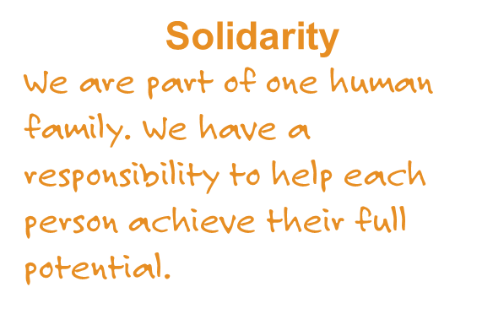
discuss
What made uncle Richard’s life challenging?
What caused positive changes in his life?
How did Caritas Australia contribute?
Where do you see solidarity demonstrated in Uncle Richard’s story?

Slide 25
More stories
The quotes on the following slides are from other survivors of the Kinchela Boys Home.
These help us to understand more about what it was like growing up in institutions like the Kinchela Boys Home.
Kinchela Boys Home (KBH) Survivors at the tree, near the site of Kinchela Boys Home in Kempsey. Photo credit: Peter Solness 2015

Slide 27
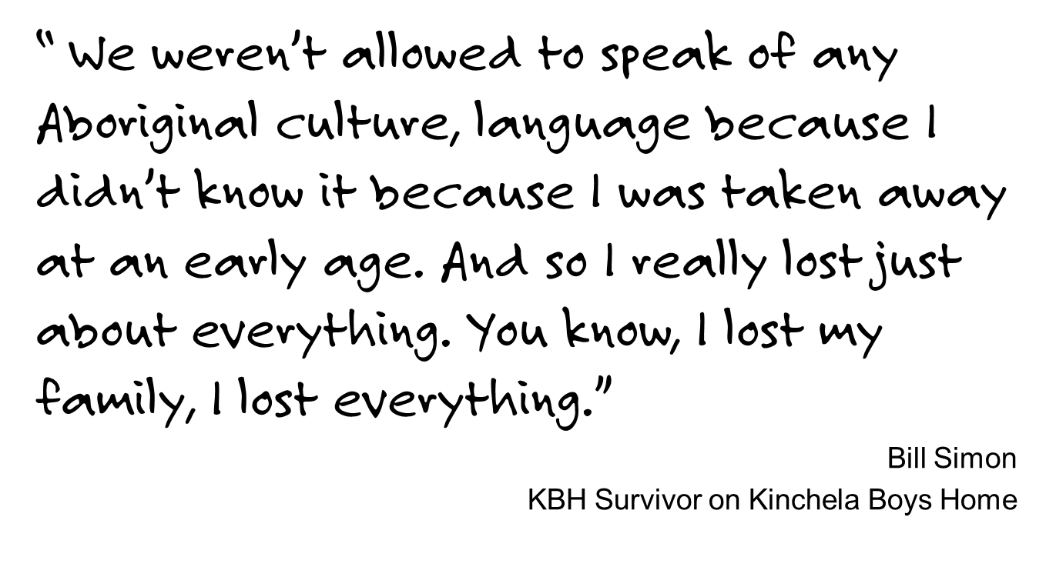

Slide 28
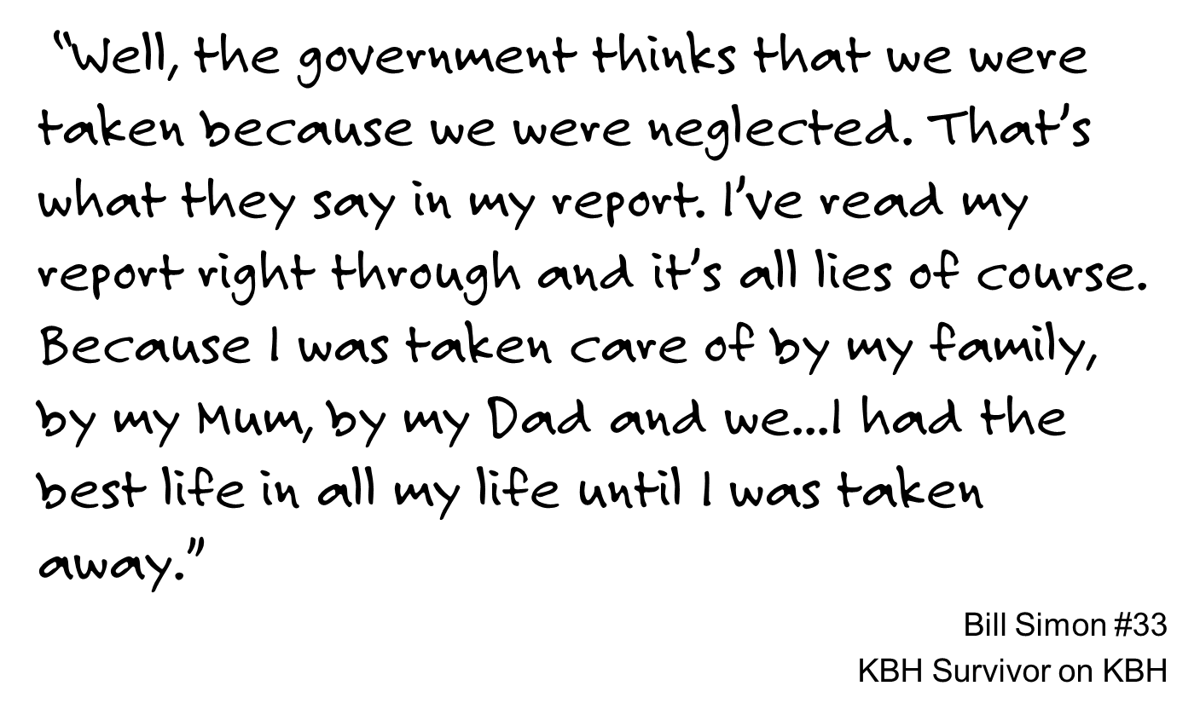
KBH survivor

Slide 29
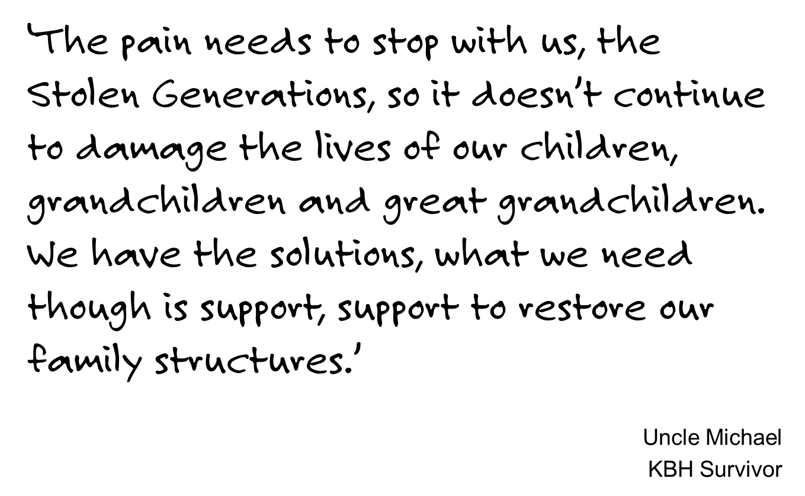

Slide 30
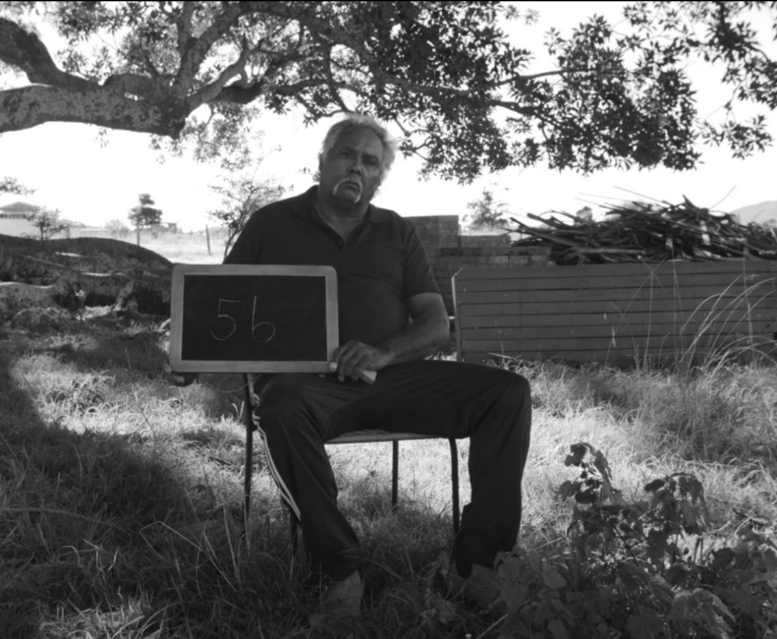
Watch / Listen: ‘Our Pain’
Crow (Ian Lowe, #41) uses poetry to share his experiences of KBH and the legacies KBH has had on his life.
In 2013, Crow sat down with New Zealand born Australian based singer and musician, Mark Ferris, who set Crow’s poetry to music.
Included in this music journey was didj player Rhys Waite who lives in Kempsey.
In November of 2013, the three of them had the song ‘Our Pain’ professionally recorded at Vienna People in Sydney.
Our Pain is a music video directed by award winning film maker Sean McFerran. The music is written and performed by New Zealand born singer/songwriter Mark Ferris
Notes:
Teacher Notes:
This clip is quite powerful and full of discussion points. The clip may be watched initially without sound, and then with the lyrics.
Lyrics: OUR PAIN
For we are the Kinchela Boys.
Just little kids.
Taken away from our families.
Learnt to be slaves and soldiers,
marching everywhere.
We are the Kinchela Boys and you destroyed the most innocent people in the world, us little kids.
We are still the Kinchela Boy’s.
Brainwashed through the years.
And we found out
that we were black, not gammon.
Now we are still lost.
Today. Tomorrow Yesterday.

Slide 31
‘Our Pain’ – reflect
1. What does this song and the photos in the video tell us about the experience of living in Kinchela Boys Home?
2. “They never called you by name, they called you by number.”
How do the numbers represent the attempted destruction of cultural and personal identity?
3. What feelings and emotions were evident in the faces of the men and children in this clip? How does this align with messages in the song?
4. “We found out we were black, not human. Now we’re still lost; today; tomorrow; yesterday.”
Why do you think Uncle Crow uses the words “not human” and “lost”?
5. Why do you think the Kinchela Boys Home photographed the children in shoes and nice clothes?
6. What message would these images portray to the wider community about life in the home for the boys?

Slide 32
Did you know?
Many members of the Stolen Generations have reported that they:
were forbidden to speak in their own languages
were told their parents did not want them
experienced neglect, as well as physical, emotional and sexual abuse
received little or no education
were refused contact with their families.
Notes:
Source: https://www.humanrights.gov.au/publications/face-facts-2012/2012-face-facts-chapter-1#Heading475

Slide 33
Activity: Effect of removal
Experience of children | What lasting affects might these experiences had on children of the Stolen Generations? (Social, cultural, emotional, physical)
forbidden to speak in their own languages
told their parents did not want them
experienced neglect, as well as physical, emotional abuse
not provided with a good education
often refused contact with their families

Slide 34
propaganda
The way conditions at KBH were publicised to the wider community was in stark contrast to the reality of living there. These quotes are from Dawn Magazine, August 1965 :
“It’s almost like a country club at Kinchela.”
“Boys stay till they are sixteen and most are sorry to leave, because while they are there they have a wonderful time.”
Having learned about the actual experiences of KBH Survivors at KBH, what is your response to these quotes?
How could misinformation like this have contributed to the pace of justice, reconciliation and healing in Australian society?
Why is challenging this misinformation with truth essential in order for reconciliation and healing to become a reality?
A magazine for the NSW Aboriginal Protection Board issued monthly between 1915 to 1969 to the Aboriginal people of NSW. Photos and Pamphlets like these were used to promote the ‘benefits’ of the Assimilation policy to the Australian Public. Source: Dawn Magazine, August 1965
Notes:
Teacher Notes:
More photographs, stories and images can be found by clicking Dawn Magazine, August 1965 in the slides to enhance discussions in this area.

Slide 35
reflect
How is knowing and telling the truth about something that happened in the past, important for the future?

Slide 36
Section 3: A path to justice
In this next section we will explore:
United Nations Declaration of Human Rights
United Nations Declaration on the Rights of Indigenous peoples (UNDRIP)
Australia’s National Apology to the Stolen Generations
Church Apology
Subsidiarity
Preserving the Truth
Closing the Gap
What can we do?
Kinchela Boys Home (KBH) survivor, Uncle Richard with one of his paintings. Credit: Caritas Australia

Slide 37
International obligations
United Nations Declaration of Human Rights
Australia was a founding member of the UN. The Universal Declaration of Human Rights is not a treaty and so does not have any legal obligations. It does however provide a set of values to be adhered to such as:
Article 5: No one shall be subjected to torture or to cruel, inhuman or degrading treatment or punishment.
Convention on the Prevention and Punishment of the Crime of Genocide
This is a treaty Australia enforced in 1951.
In the present Convention, genocide means any of the following acts committed with intent to destroy, in whole or in part, a national, ethnical, racial or religious group, as such: (e) forcibly transferring children of the group to another group.
Discuss
Having learned of the experiences of the KBH Survivors, do you believe Australia was living up to their international obligations? Why/why not?
Notes:
Teacher Notes:
Students can access the full declaration here: http://www.ohchr.org/EN/UDHR/Documents/UDHR_Translations/eng.pdf
Explore the role Australia had in the development of the declaration.
Convention on the Prevention and Punishment of the Crime of Genocide: http://www.austlii.edu.au/au/other/dfat/treaties/1951/2.html
(Paris, 9 December 1948)
Entry into force for Australia and generally: 12 January 1951

Slide 38
United Nations Declaration on the Rights of Indigenous peoples (Undrip)
UNDRIP affirms the minimum standards for the survival, dignity and well-being of the Indigenous peoples worldwide.
It was passed by the General Assembly in 2007 but Australia was one of four countries that voted against it at first. In 2009 Australia endorsed UNDRIP.
Discuss:
Why do you think this was not endorsed until 2009?
Source: National Congress of Australia’s First Peoples
Notes:
Teacher Notes:
There is a video giving background information about UNDRIP that can be played prior to investigating this document.
Further Discussion:
Investigate the role Australia played in the development of this charter. Why do you think the Australian Government was so resistant to specific rights?

Slide 39
United Nations Declaration on the Rights of Indigenous peoples (Undrip)
Click here to open to the Community Guide.
In light of what you have learnt about the Stolen Generations, and the experiences of the KBH Survivors, what do you believe is the significance of UNDRIP?
Which articles of the UNDRIP stand out as particularly significant having learned of the stories of survivors of the Stolen Generations?
Where can you see Catholic Social Teaching (CST) in this document? How are the CSTs of Subsidiarity, Solidarity and Dignity of the Human Person reflected in this document?
Source: National Congress of Australia’s First Peoples
Notes:
Teacher Notes:
Download or share this document with students so they are able to have a close look at the Articles. You could break the students into groups and give them a section of the declaration each.
- Abridged Community Guide (8 pages) - http://declaration.humanrights.gov.au/sites/default/files/declaration_abridged_community_guide.pdf
- Poster- http://declaration.humanrights.gov.au/sites/default/files/declaration_poster.pdf
Catholic Social Teaching:
Dignity of the Human Person
Solidarity
Subsidiarity and Participation
Common Good
Preferential Option for the Poor
Care for Creation
Find out more about Catholic Social Teaching- http://www.caritas.org.au/learn/catholic-social-teaching

Slide 40
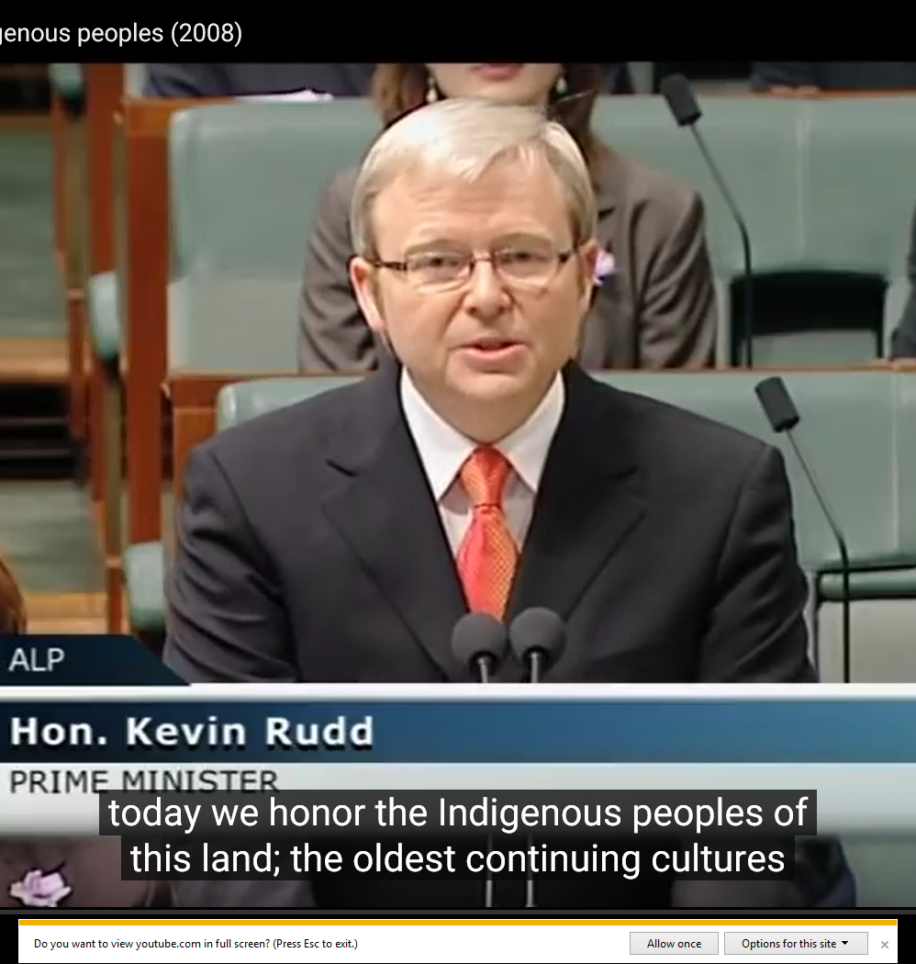
National Apology
On 13 February 2008, the then Prime Minister Kevin Rudd apologised on behalf of all Australians for the laws and policies which afflicted pain, suffering and loss on the Stolen Generations of Aboriginal and Torres Strait Islander peoples.
Watch Prime Minister Kevin Rudd’s National Apology Speech.
Why do you think the Federal Government apologised to the Stolen Generations?
How do you think the apology would have affected members of the Stolen Generations?
YouTube link to video of The Apology.
Notes:
Teachers Notes: Transcript of the Apology
The Speaker: Prime Minister.
Prime Minister (Hon Kevin Rudd MP): Mr Speaker, I move:
That today we honour the Indigenous peoples of this land, the oldest continuing cultures in human history.
We reflect on their past mistreatment.
We reflect in particular on the mistreatment of those who were Stolen Generations - this blemished chapter in our nation's history.
The time has now come for the nation to turn a new page in Australia's history by righting the wrongs of the past and so moving forward with confidence to the future.
We apologise for the laws and policies of successive Parliaments and governments that have inflicted profound grief, suffering and loss on these our fellow Australians.
We apologise especially for the removal of Aboriginal and Torres Strait Islander children from their families, their communities and their country.
For the pain, suffering and hurt of these Stolen Generations, their descendants and for their families left behind, we say sorry.
To the mothers and the fathers, the brothers and the sisters, for the breaking up of families and communities, we say sorry.
And for the indignity and degradation thus inflicted on a proud people and a proud culture, we say sorry.
We the Parliament of Australia respectfully request that this apology be received in the spirit in which it is offered as part of the healing of the nation.
For the future we take heart; resolving that this new page in the history of our great continent can now be written.
We today take this first step by acknowledging the past and laying claim to a future that embraces all Australians.
A future where this Parliament resolves that the injustices of the past must never, never happen again.
A future where we harness the determination of all Australians, Indigenous and non-Indigenous, to close the gap that lies between us in life expectancy, educational achievement and economic opportunity.
A future where we embrace the possibility of new solutions to enduring problems where old approaches have failed.
A future based on mutual respect, mutual resolve and mutual responsibility.
A future where all Australians, whatever their origins, are truly equal partners, with equal opportunities and with an equal stake in shaping the next chapter in the history of this great country, Australia.

Slide 41
Church Apology
“ The Church expresses deep regret and asks forgiveness where her children have been or still are party to these wrongs. Aware of the shameful injustices done to indigenous peoples in Oceania, the Synod Fathers apologized unreservedly for the part played in these by members of the Church, especially where children were forcibly separated from their families.”
Pope John Paull II, 2001 para. 28
Post-Synodal Apostolic Exhortation Ecclesia in Oceania
Discuss:
Why do you think it was important for the Catholic Church to apologise?
Notes:
Teacher’s Notes
Below is an excerpt from Post-Synodal Apostolic Exhortation Ecclesia in Oceania, by John Paul II.
Indigenous Peoples
28. Unjust economic policies are especially damaging to indigenous peoples, young nations and their traditional cultures; and it is the Church's task to help indigenous cultures preserve their identity and maintain their traditions. The Synod strongly encouraged the Holy See to continue its advocacy of the United Nations Declaration on the Rights of Indigenous Peoples.⁽⁹⁸⁾
A special case is that of the Australian Aborigines whose culture struggles to survive. For many thousands of years they have sought to live in harmony with the often harsh environment of their "big country"; but now their identity and culture are gravely threatened. In more recent times, however, their joint efforts to ensure survival and gain justice have begun to bear fruit. There was a saying from Australian bush life heard in the Synod Hall: "If you stay closely united, you are like a tree standing in the middle of a bush-fire sweeping through the timber: the leaves are scorched, the tough bark is scarred and burned, but inside the tree the sap still flows, and under the ground the roots are still strong. Like that tree you have survived the flames, and you have still the power to be born. The time for rebirth is now".⁽⁹⁹⁾ The Church will support the cause of all indigenous peoples who seek a just and equitable recognition of their identity and their rights;⁽¹⁰⁰⁾ and the Synod Fathers expressed support for the aspirations of indigenous people for a just solution to the complex question of the alienation of their lands.⁽¹⁰¹⁾
Whenever the truth has been suppressed by governments and their agencies or even by Christian communities, the wrongs done to the indigenous peoples need to be honestly acknowledged. The Synod supported the establishment of "Truth Commissions",⁽¹⁰²⁾where these can help resolve historical injustices and bring about reconciliation within the wider community or the nation. The past cannot be undone, but honest recognition of past injustices can lead to measures and attitudes which will help to rectify the damaging effects for both the indigenous community and the wider society. The Church expresses deep regret and asks forgiveness where her children have been or still are party to these wrongs. Aware of the shameful injustices done to indigenous peoples in Oceania, the Synod Fathers apologized unreservedly for the part played in these by members of the Church, especially where children were forcibly separated from their families.⁽¹⁰³⁾ Governments are encouraged to pursue with still greater energy programmes to improve the conditions and the standard of living of indigenous groups in the vital areas of health, education, employment and housing.
Catholic Church Response
In 1997 the Australian Catholic Bishops Conference issued a Statement of Sorry and request for forgiveness. In that statement the Bishops committed to the process of ongoing reconciliation.

Slide 42
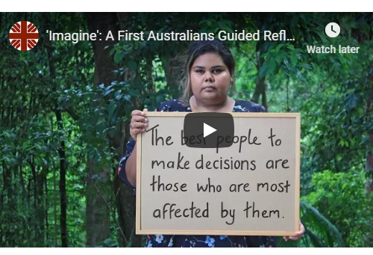
subsidiarity
Caritas Australia believes every person has a right to participate in the decisions that affect their own lives.
Too often many First Australians are denied this right.
We encourage you to watch our short reflection to consider why it’s so critical people have a voice in decisions that affect them.
How were the Stolen Generations denied their right to subsidiarity?
How can we support subsidiarity for First Australians?
Notes:
Teacher’s Note:
To learn more about the principle of Subsidiarity, visit: https://www.caritas.org.au/learn/cst

Slide 43
Preserving the truth
Kinchela Boys Home was one of many institutions around the country where Aboriginal children who were forcibly removed from their families were taken.
Throughout Australia there were extensive networks of ‘homes’ and temporary accommodations that kidnapped children were housed in and moved between. The process of taking children involved extensive collaboration between Government, Police, Churches and everyday citizens who reported the whereabouts of Aboriginal families.
There are many sites of significance that are being destroyed without any recognition of the historical role they played in housing or transporting stolen Aboriginal children.
Notes:
Further Discussion:
See Resources from the Healing Foundation to further explore how you can learn and take action;
https://healingfoundation.org.au/bth20/bth20-school-resources/

Slide 44
Kinchela Boys Home Gate
Kinchela Boys Home (KBH) Survivors at gate at the site of KBH in Kempsey, NSW. A symbol of the forcible removal of Aboriginal children form their families, this gate has been added to the National Museum of Australia’s Collection. Photograph credits: Peter Minniecon
What is the significance of these gates for the Survivors of KBH?
What is the significance of these gates for the Australian public?
The Survivors of KBH intend that eventually the original gates will be exhibited at the Kinchela Boys Home Museum at the site of the Boys Home.
Why is it important for the KBH Survivors to hold on to their history?
Notes:
http://www.kinchelaboyshome.org.au/

Slide 45
Kbh conservation management plan
One thing of critical importance to Survivors is for Government support to preserve sites of significance and establish museums and healing centres.
Kinchela Boys Home Aboriginal Corporation is in the process of negotiating for control of the former KBH site.
KBHAC has developed a Conservation Management Plan for the site. They intend to retain, and where possible reinforce and communicate the deep significance (values and associations) of this place.
Why is it important for Survivor communities to have control of their significant historical sites and records?
SOURCE: Unlocking the Past to Free the Future: A KBH Conservation Management Plan

Slide 46
Close the gap
Those affected by the forced removal of children – the Stolen Generations and their children and grandchildren – are:
50% more likely to be charged by police
30% less likely to be in good health, and
10% less likely to have a job.
Discuss
What are some of the social, cultural, emotional and physical consequences for individuals, families and communities impacted by the Stolen Generations?
Notes:
Source: http://healingfoundation.org.au//app/uploads/2018/02/HF_Apology10_Media_Fact_Sheet_A4_Jan2018_V3_WEB.pdf

Slide 47
What is the path to justice?
We believe justice for First Australians can only be achieved by:
Having First Australian organisations and First Australian solutions lead conversations and services at local, state and national level.
Ensuring First Australian cultures are valued, supported and shared to strengthen the identity and wellbeing of First Australians.
Increasing willingness and relationships within the Australian and International community to engage proactively with First Australians.
First Australians - Beswick community. This area is the land of the Jawoyn people. It is the home of the Djilpin Arts Aboriginal Corporation, one of Caritas Australia’s long term partners. Photo credit: Richard Wainwright

Slide 48
what can I do?
Learn more about the history of the Stolen Generations in your local area. Share your knowledge with others.
Support organisations to achieve greater recognition, reconciliation, civil rights, and improvements in education and health for First Australians.
Build a relationship with First Australians in your local area and listen to ways in which they would like support.
Pledge to work towards reconciliation.
Sorry Day Prayer Service - includes a drama activity that could be done in class to demonstrate that we all need to be part of the change.
Notes:
Teacher’s Notes
Below is an example pledge that you can use/adapt or students can write their own pledge.
Pledge - Committing to the Future: Daily Steps Towards Reconciliation
Today I will treat everyone equally and fairly.
Today I will respect the rights of others no matter who they are.
Today I will be sensitive and thoughtful to those around me.
Today I will see people and not colours or race or clothes labels.
Today I will accept that everybody is unique and special in some way.
Today I will talk to someone I don’t usually talk to.
Today I will speak out against racism, discrimination and injustice.
Today I won’t shut out someone because they don’t fit with my group.
Today I won’t laugh at racist jokes.
Today I won’t make fun of someone who cannot speak English.
Today I won’t be condescending and patronising towards others.
Today I won’t judge someone on how they look.
Today I won’t start a sentence with “I’m not racist but…”
Today I will speak out against racism, discrimination and injustice.
Today, I will be the change I want to see in the world.

