Slide 1
A note to teachers
This PowerPoint highlights some challenges and inequalities faced by women around the world.
Please note:
It is our hope that you will use these slides in a way that best suits your purposes. As such, the slides are editable so that the content is flexible for you to adapt to your needs. If you do edit this presentation, please ensure content and photos from this resource remain with the appropriate credit to Caritas Australia and the photographers.
There are links to additional information in the ‘Notes’ section of some of the slides.
There are links to additional classroom resources and an International Women’s Day prayer at the end of this presentation.
For copyright information, please see the ‘Notes’ section of this slide.
Notes:
Updated January 2019
Copyright notice:
Use of website materials
Use of material on this site for educational purposes is encouraged. Caritas Australia gives permission for articles, illustrations and other materials to be reproduced for educational purposes or personal use, provided the information is not changed, and that the source is acknowledged appropriately. Use of material on this website for purposes other than educational or personal use must have prior authorisation from Caritas Australia's Webteam [mailto:webteam@caritas.org.au] (Webteam@caritas.org.au)
Permissions
In some cases the copyright for text or images on this site may held by someone other than Caritas Australia. All rights are reserved on such material and permission to use them must be requested from the copyright owner. The source of this material is indicated on the relevant sections of the site.
Photos without a specified photo credit are the property of Caritas Australia or the international partners of the Caritas network.
Our logo
The Caritas Australia logo must not be downloaded, copied and or used for any purpose without the expressed permission of Caritas Australia. Please contact Caritas Australia's webteam [mailto:webteam@caritas.org.au] for any further information that you may require about using content from this website.
Links to external sites
This site contains links to external web sites. Caritas Australia takes no responsibility for the content of such sites, nor do links to such sites imply endorsement of the views expressed therein. External links are provided for informational purposes only.

Slide 2
Women and Development
Notes:
Photo 1: Sreymom in Cambodia. Photograph Credit: Richard Wainwright.
Photo 2: Hum Noy and his mother Duangmala in Laos.
Photograph Credit: Richard Wainwright.
Photo 3: Doney in Malawi.
Photograph Credit: Andrew Garrick and Andrew McClymont

Slide 3
Why do we need a special focus on women?
Notes:
Members of the community where Sarita lives and takes part in the Fish Raising Cooperative, supported by Caritas Australia. Location: Nepal.
Photo Credit: Stephen Kadlec.

Slide 4
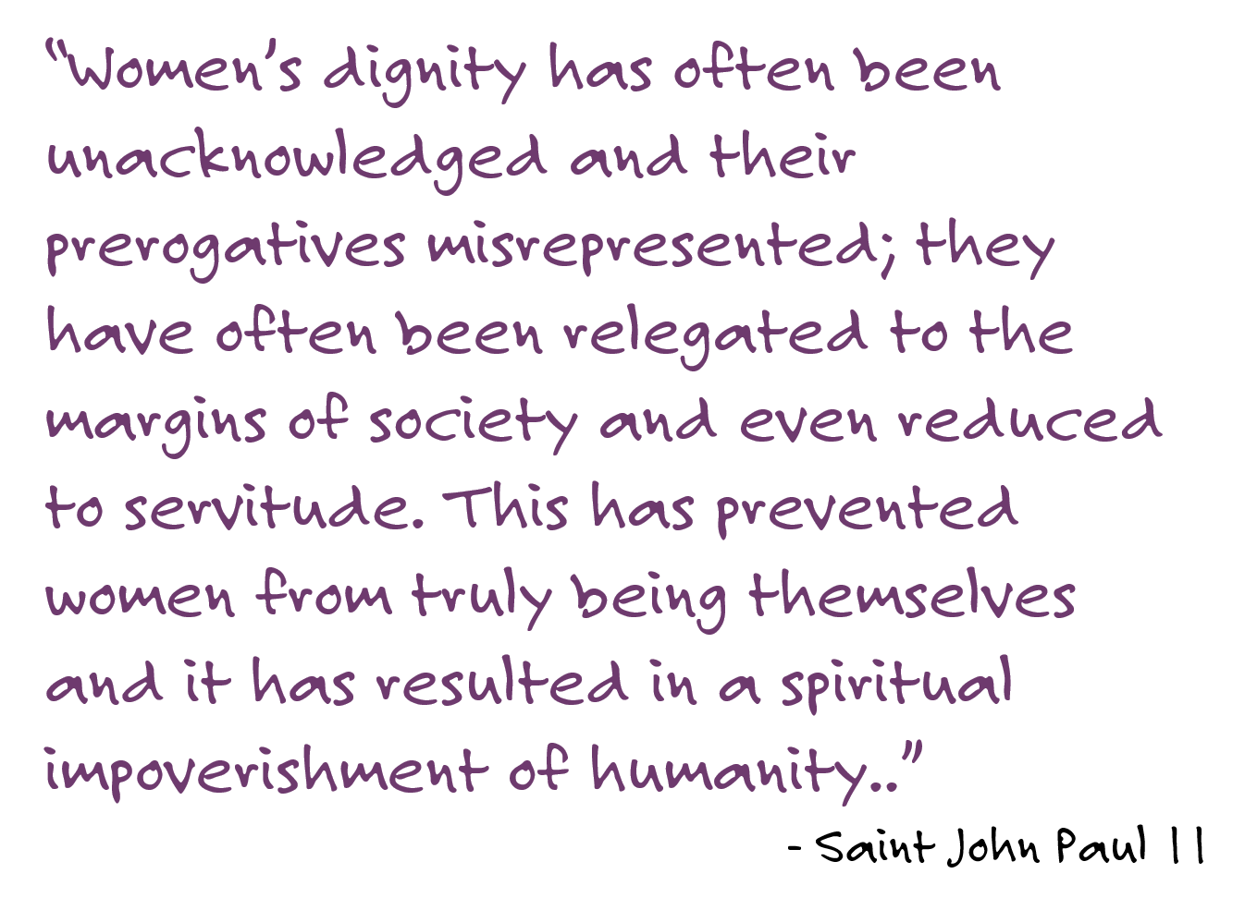
Notes:
Letter of Saint John Paul II to Women, 1995, #1, 3

Slide 5
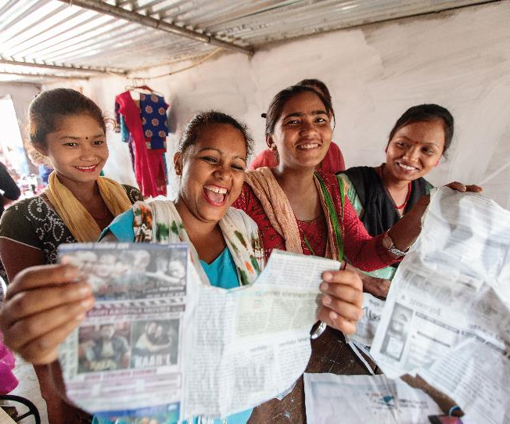
Two-thirds of adults unable to read and write worldwide are women.
Janaki teaches other vulnerable women and youth in her community how to sew so they too can be empowered and earn a living. Janaki’s students feel empowered as they learn new skills, Nepal. Photo Credit: Richard Wainwright
Notes:
Source: United Nations Statistics Division (2015). “The World’s Women.” Available online: https://unstats.un.org/unsd/gender/worldswomen.html
The World’s Women 2015 comprises eight chapters covering critical areas of policy concern: population and families, health, education, work, power and decision-making, violence against women, environment, and poverty. The statistics and analyses presented in the report are based on a comprehensive and careful assessment of a large set of available data from international and national statistical agencies.
Source: International Literacy Day 2017
http://uis.unesco.org/en/news/international-literacy-day-2017
Source: Literacy Rates Continue to Rise from One Generation to the Next
http://uis.unesco.org/sites/default/files/documents/fs45-literacy-rates-continue-rise-generation-to-next-en-2017.pdf

Slide 6
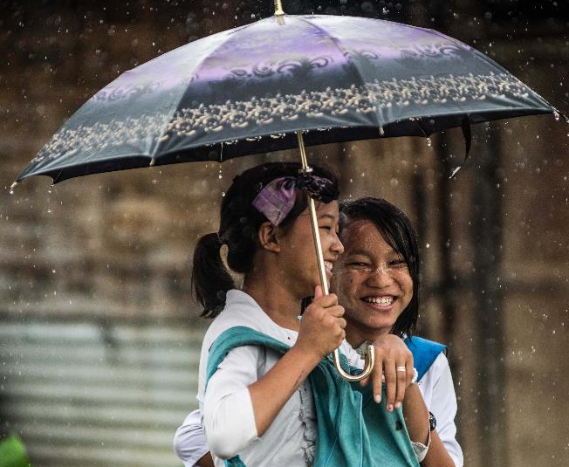
75% of people in need of humanitarian assistance were women and children in 2015.
Rohingya refugees walking through the rain.
Photo Credit: Caritas Internationalis.
Notes:
Source:
https://interagencystandingcommittee.org/system/files/inter-agency_standing_committee_placing_women_and_girls_at_the_centre-2.pdf
Go further with this interactive data resource from United Nations Women:
http://interactive.unwomen.org/multimedia/infographic/humanitarianaction/en/index.html

Slide 7
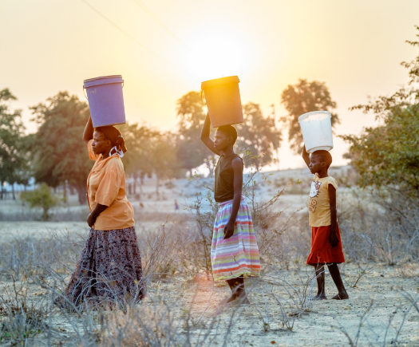
Women and children spend up to 200 million hours a day collecting water.
Mrs Chimwanda together with her daughters fetching water in Zimbabwe.
Photo Credit: Isabel Corthier
Notes:
Source: UNICEF https://www.unicef.org/esaro/5440_2016_collecting-water.html
In 80 per cent of households with water shortages, women and girls are responsible for water collection. This often means travelling long distances and carrying heavy loads, in some cases with a high risk of violence. The time required can pull girls out of school and leave women with fewer options to earn an income.
Source: http://www.unwomen.org/en/news/in-focus/women-and-the-sdgs/sdg-6-clean-water-sanitation
In Sub-Saharan Africa women and girls in low-income countries spend 40 billion hours a year collecting water – the equivalent of a year’s worth of labour by the entire French workforce
UN (2006-2010) http://www.un.org/waterforlifedecade/gender.shtml
While slightly dated this statistic does highlight the undervalued work undertaken by women using a strong comparison to an entire nation’s workforce, and is therefore quite powerful.

Slide 8
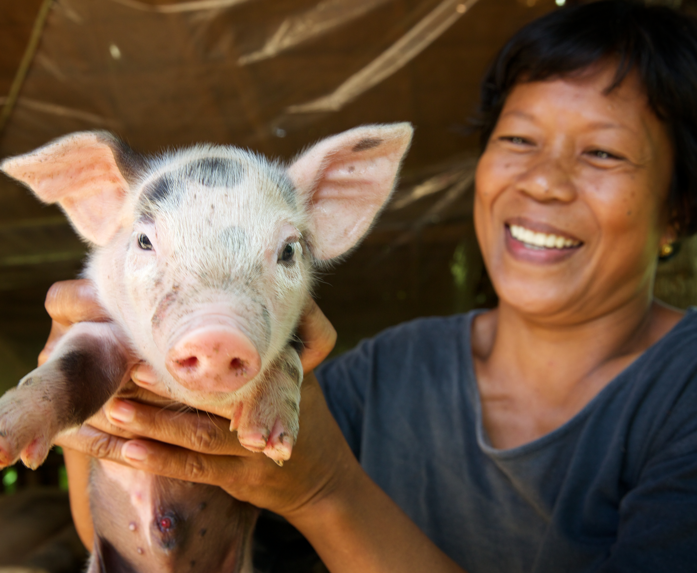
Globally, over 2.7 billion women are legally restricted from having the same job choices as men.
Dinia with one of her piglets of her pig breeding program. Through this successful program, Dinia earns a livelihood and helps her neighbours earn income too by providing them with some piglets. The Hog Dispersal Program is a community system of sharing. Photo Credit: Richard Wainwright
Notes:
Source: World Bank (2018)
http://wbl.worldbank.org/
This further demonstrates challenges facing women in poverty, as well as a reason behind women and girls being more predisposed to poverty.

Slide 9
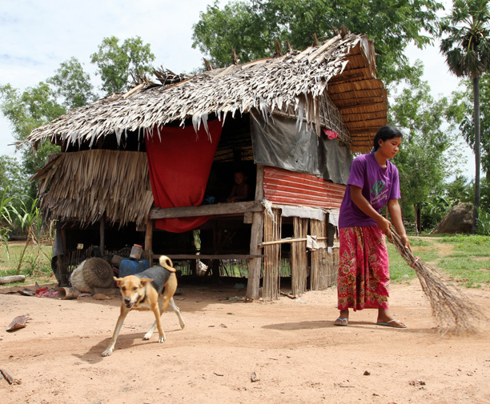
Girls spend 160 million more hours than boys doing household chores everyday.
Caritas Australia and Catholic Relief Services (CRS) work in partnership with local NGOs in Cambodia to support families most vulnerable to poverty and alleviate rural and urban poverty through community ‘self-help groups’, livelihood development and infrastructure support.
Photo Credit: Caritas Australia
Notes:
Source: World Bank (2018)
http://wbl.worldbank.org/
This further demonstrates challenges facing women in poverty, as well as a reason behind women and girls being more predisposed to poverty.

Slide 10
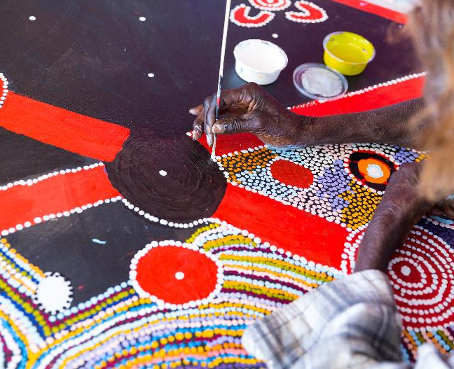
In Australia
Life expectancy for Aboriginal and Torres Strait Islander women is 73.7 years, 9.5 years less than non-Indigenous women.
Dialysis patient Rosie paints while spending time at the Purple House. Patients quite often paint to pass the time and as a social outlet. Photo Credit: Emma Murray
Notes:
Source: Australian Government – Australian Institute of Health and Welfare
“For the Aboriginal and Torres Strait Islander population born in 2010–2012, life expectancy was estimated to be 10.6 years lower than that of the non-Indigenous population for males (69.1 years compared with 79.7) and 9.5 years for females (73.7 compared with 83.1).
Between 2005–2007 and 2010–2012, Indigenous life expectancy at birth for boys increased by 1.6 years and by 0.6 years for girls. Over the same period, the gap between Indigenous and non-Indigenous life expectancy narrowed by 0.8 years for males and 0.1 years for females.”
https://www.aihw.gov.au/reports/life-expectancy-death/deaths-in-australia/contents/life-expectancy
Go further with this 2018 Close the Gap report: “A ten-year review: the Closing the Gap Strategy and Recommendations for Reset”
https://www.humanrights.gov.au/sites/default/files/document/publication/CTG%202018_FINAL-WEB.pdf

Slide 11
Caritas Australia
Our Vision
Notes:
Our Mission
Children, women and men most vulnerable to extreme poverty and injustice are rich in the eyes of Jesus, whose life and compassion inspires Caritas Australia.
Through effective partnerships in humanitarian relief and development and by transforming hearts and minds in the Australian community, Caritas Australia helps to end poverty, promote justice and uphold dignity.

Slide 12
Thandolwayo, zimbabwe
Thandolwayo’s life has changed since her community got a water tap in her village.
Life wasn’t easy for twelve-year-old Thandolwayo. Every morning she would walk seven kilometres to collect water for her family from the river.
Thandolwayo would then go to school feeling very tired.
Thandolwayo outside her home holding a 5 litre water container she uses to collect water. Photo Credit: Richard Wainwright.

Slide 13
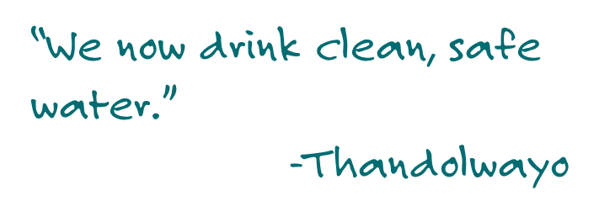
Thandolwayo, zimbabwe
It was hard for her to listen and learn at school when she was so tired and sick from drinking unclean water.
Thandolwayo’s community worked together with Caritas to get a tap with clean water in the village.
Thandolwayo drinks from the newly installed solar powered piped water system. Before the pipe was installed she would often get sick and miss school from illness and being tired from collecting water. Photo Credit: Richard Wainwright.

Slide 14
Thandolwayo, zimbabwe
In her village they are using the water to make bricks and have plans of building a fish farm as a business.
Thandolwayo wants to be a nurse. She is no longer tired at school and has time to study and play with her friends.
Thandolwayo (centre) and her student friends sing and dance outside school before lessons. Since the installation of a solar powered piped water system into her village bringing fresh clean drinking water, she is now able to spend more time at school and study and lives a healthier life. Photo Credit: Richard Wainwright.

Slide 15
Michaela, australia
The Purple House is a ‘home away from home’ for First Australians needing special medical treatment.
Michaela, a twenty-one year old Alywarr woman, is helping to care for sick patients living far away from their traditional lands at The Purple House in Alice Springs.
The patients are also teaching Michaela, passing on their traditional knowledge to her.
Trainee Michaela grinds some irmangka to use in the next batch of bush balm. Photo Credit: Emma Murray.

Slide 16
Michaela, australia
Michaela has learned many new skills. Staff and patients make bush balms and soaps which helps them remain connected to culture.
The soaps and balms are then sold in stores across Australia. This money is used to help support patients at the Purple House and back on country.
Trainee Michaela at Jessie Gap, about 10km outside of Alice Springs. This is where arrenthe leaves are picked to be used in bush balms produced by Michaela at Purple House.
Photo Credit: Emma Murray.

Slide 17
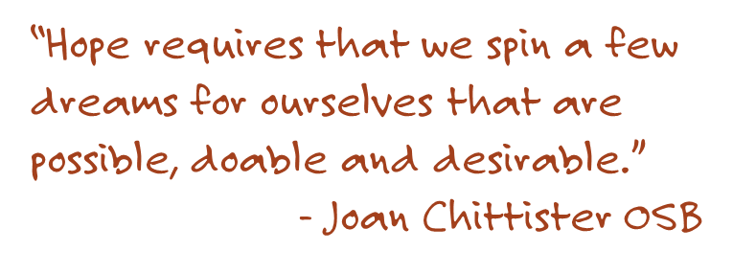
Michaela, australia
Michaela says that making and using the bush balms helps patients to feel a sense of home. “If we keep our culture alive we can feel strong,” Michaela says.
Trainee Michaela next to the colourful exterior of the Purple Truck, which is fitted with two dialysis units. The truck allows patients in communities without dialysis units to return home for treatment, if only for a few weeks. Photo Credit: Emma Murray.

Slide 18
Salma, bangladesh
Salma was helped by a midwife trained by Caritas’ Safe Motherhood Program.
Salma lives with her husband, Masud, in rural Bangladesh, and was expecting a baby when she featured in Project Compassion in 2013.
There are no hospitals or doctors near Salma’s village, so having a baby can be very dangerous.
Salma, her husband Masud and children Maya and baby Samiul live in a remote area. Salma is a stay at home Mum.
Photo Credit: Ashish Peter Gomes.

Slide 19
Salma, bangladesh
Thankfully, Salma was helped by a Caritas-trained midwife called Pronoti. There are many healthy babies being born in the area with help from midwives trained through the Safe Motherhood program, like Pronoti.
The Caritas Safe Motherhoods Program not only trains the Rural Midwives, but very often they meet and talk with women to build awareness about women’s health, nutrition, pregnancy and post pregnancy issues. Photo Credit: Ashish Peter Gomes.

Slide 20
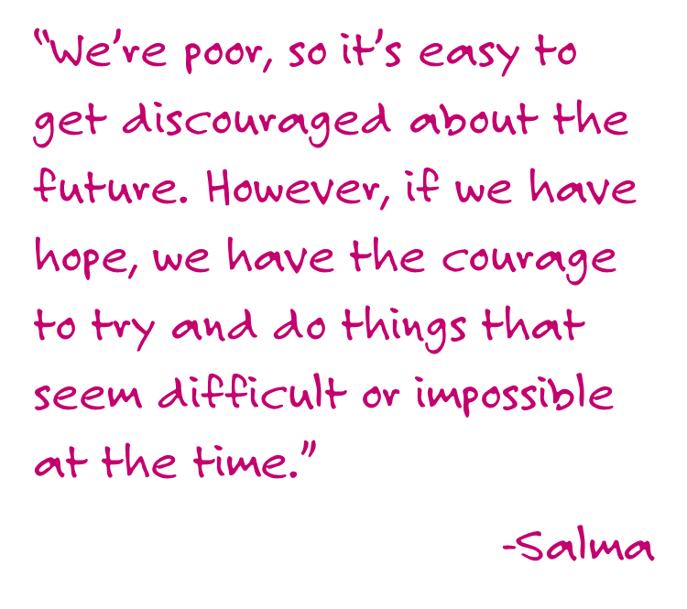
Salma, bangladesh
Now 24, Salma watches her two children play happily.
Salma’s children baby Samiul and 6 year old Maya are healthy, happy children thanks to the Caritas supported Safe Motherhood’s program. Photo Credit: Ashish Peter Gomes.

Slide 21
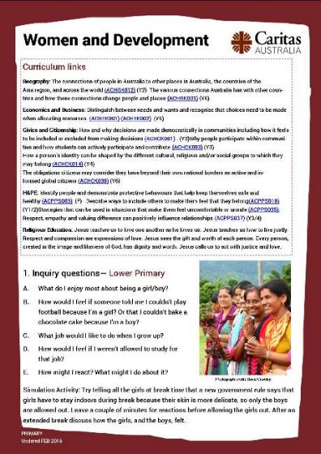
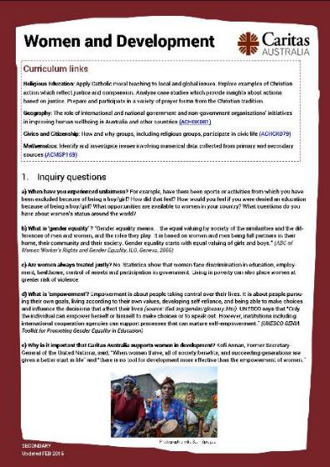
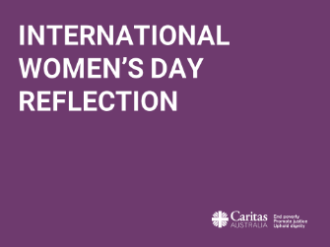
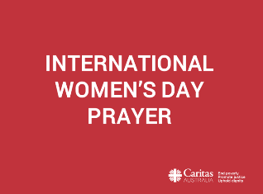
Teaching resources
PRIMARY | SECONDARY | REFLECTION
PRAYER

Slide 22
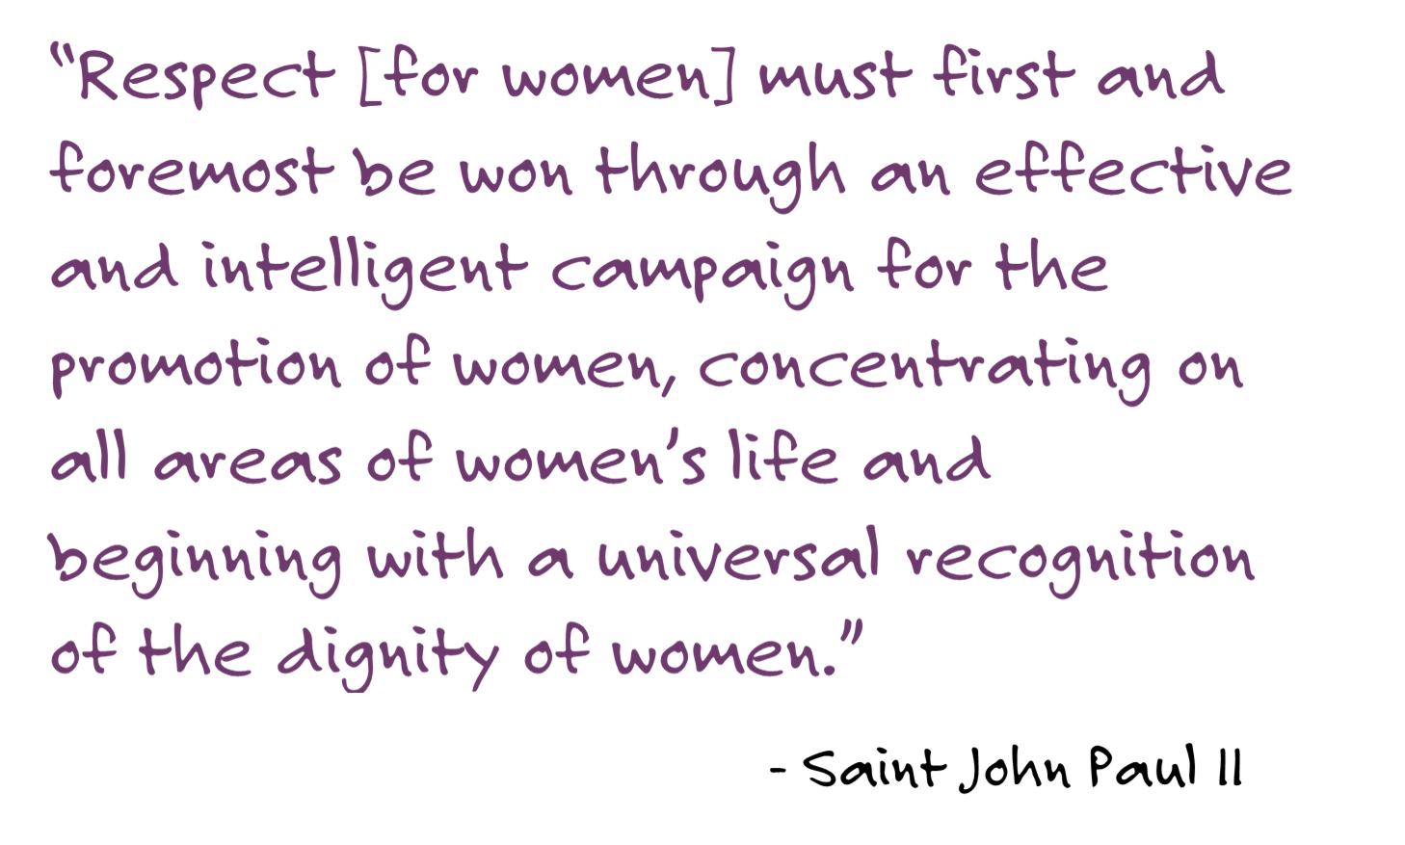
Notes:
- Letter of St John Paul II to Women, 1995

