Slide 1
A NOTE To Presenters
The following prayer was composed by Bishop Ken Untener of Saginaw, drafted for a homily by Cardinal John Dearden in Nov. 1979 for a celebration of departed priests. As a reflection on the anniversary of the martyrdom of Bishop Romero, Bishop Untener included in a reflection book a passage titled "The mystery of the Romero Prayer." The mystery is that the words of the prayer are attributed to Oscar Romero, but they were never spoken by him.
Photo captions and credits are in the ‘Notes’ section of each slide.
Note: This PowerPoint is editable so you can adapt it to your needs. If you do edit this resource please ensure content and photos remain with the appropriate credit to Caritas Australia and the photographers.
Copyright Policy: Material within the resources listed comes from a variety of sources and authors, including Caritas staff volunteers, overseas partners and news organisations. These resources and the information, names, images, pictures, logos are provided “as is”, without warranty. Any mistakes brought to the attention of Caritas Australia will be corrected as soon as possible. To review the full Caritas Copyright Policy, please visit: Caritas Australia​
Last updated February 2024

Slide 2
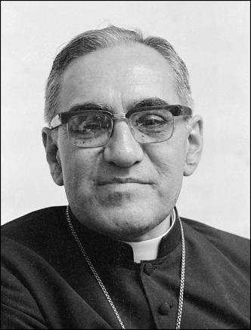
Saint Oscar romero
In El Salvador on March 24, 1980, Oscar A. Romero, Archbishop of San Salvador, was assassinated while celebrating Mass in a small chapel in a cancer hospital where he lived.
He had always been close to his people and denounced the injustice in his country.
Pope Francis canonized Oscar Romero as a saint on 14 October 2018.
His dedication to social justice and Catholic social teaching, particularly the preferential option of the poor, has since earned him the title of Patron Saint of Caritas Internationalis.
Credit: Australian Picture Library

Slide 3
First Nations people are advised that this resource and external links may contain images, voices and names of people who have died.

Slide 4
Saint Oscar romero prayer
Notes:
Lan (right) participated in the Empowerment of People with Disability program to support her two children Quan and Loah, both living with low vision, to connect in with community-based classrooms where they have interacted with other children living with a disability. Photo credit: Phan Tan Lam

Slide 5
It helps, now and then, to step back and take a long view.
Notes:
Aerial photo of farming in Tanzania. Credit: August Lucky

Slide 6
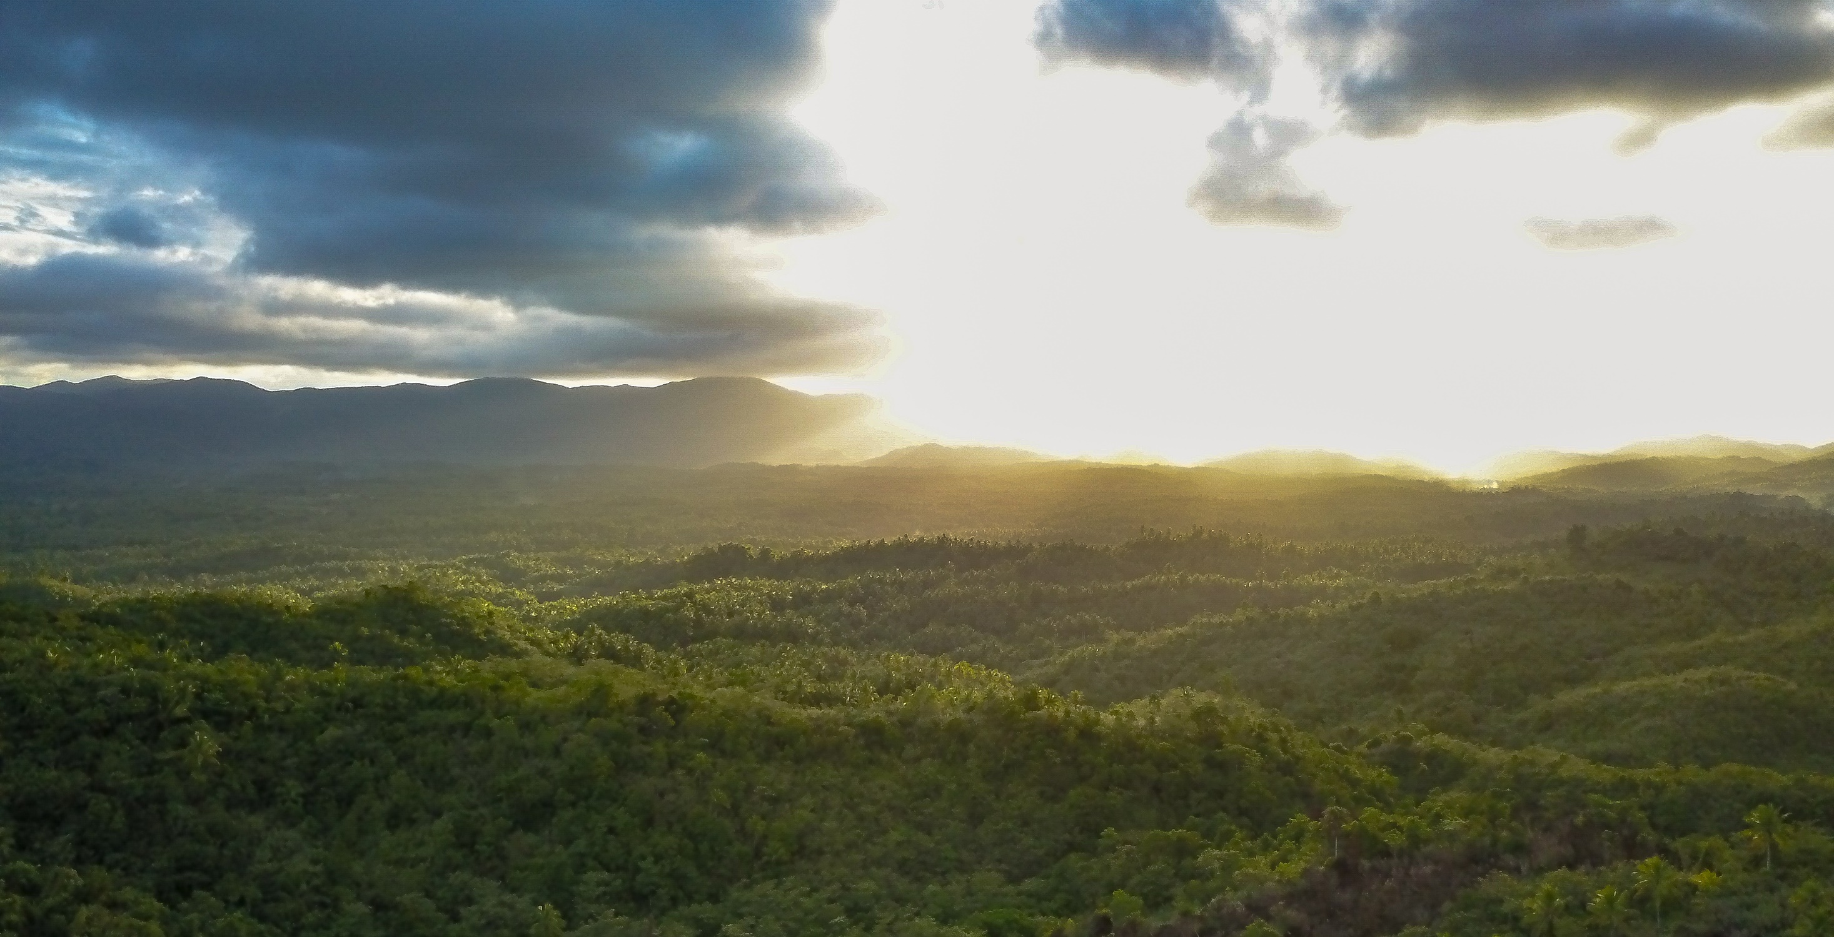
The kingdom is not only beyond our efforts, it is even beyond our vision.
Notes:
Camarines Norte province in the Philippines. Photo credit: Richard Wainwright

Slide 7
We accomplish in our lifetime only a tiny fraction of the magnificent enterprise that is God’s work.
Notes:
Janice performs a traditional dance near Djilpin Arts, Northern Territory, Australia. Photo: Richard Wainwright

Slide 8
Nothing we do is complete, which is a way of saying that the Kingdom always lies beyond us.
Notes:
Leaia carries a large container of water she has filled from a neighbour’s water tap. Photo credit: Laura Womersley / Caritas Australia

Slide 9
No statement says all that could be said.
No prayer fully expresses our faith.
Notes:
Laxmi (16) organising group games with Child Club members at her old school in Jajarkot district, western Nepal. Photo: Richard Wainwright/Caritas Australia

Slide 10
No confession brings perfection.
No pastoral visit brings wholeness.
Notes:
Charles fills water storage drums at his home in Hwange district, north western Zimbabwe. Photo: Richard Wainwright/Caritas Australia

Slide 11
No program accomplishes the Church’s mission.
No set of goals and objectives includes everything.
Notes:
Rosalie (standing) attends a Saving and Internal Lending Community group (SILC) meeting near her home in Bukavu, eastern Democratic Republic of Congo. Photo: Arlette Bashizi

Slide 12
This is what we are about:
We plant the seeds that will one day grow.
Notes:
A participant of a Caritas-supported program run by Laz Harfa, plants seeds on his family farm in Indonesia. Photo credit: Laz Harfa

Slide 13
We water the seeds already planted, knowing that they hold future promise.
Notes:
Priscilla holds millet from this year’s harvest in her storeroom at her home in Hwange district, north western Zimbabwe. Photo: Richard Wainwright/Caritas Australia

Slide 14
We lay foundations that will need further development.
Notes:
Laxmi (16) facilitating a wall magazine poster making session with Child Club members at her old school in Jajarkot district, western Nepal. Wall magazines are used to highlight issues such as child rights, child protection, child marriage and labour exploitation.
Photo: Richard Wainwright/Caritas Australia

Slide 15
We provide yeast that produces far beyond our capabilities.
Notes:
Ronita (22) smiles outside her front door in a neighbourhood in Quezon City, Philippines. Photo: Richard Wainwright/Caritas Australia

Slide 16
We cannot do everything, and there is a sense of liberation in realising that.
This enables us to do something, and do it very well.
Notes:
Memory sawing a piece of timber in a workshop. Photo: Tim Lam/Caritas Australia

Slide 17
It may be incomplete, but it is a beginning, a step along the way, an opportunity for the Lord’s grace to enter and do the rest.
Notes:
Volunteers help to distribute supplies for Caritas Ukraine to families affected by the war. Photo credit: Caritas Ukraine

Slide 18
We may never see the end results, but that is the difference between the master builder and the worker.
Notes:
Amey is a 14-year-old student in Cambodia. With support of Caritas Australia, she now has access to clean water at school. Photo: Tim Lam/Caritas Australia

Slide 19
We are workers, not master builders; ministers, not messiahs.
Notes:
Thu helps make incense sticks near his home in Quang Tri province, Vietnam. Photo: Phan Tan Lam/Caritas Australia

Slide 20
We are prophets of a future not our own.
Amen
Notes:
Budhni plays with her children outside their home in India. Photo: Sameer Bara

Slide 21
Thank You

