Slide 1
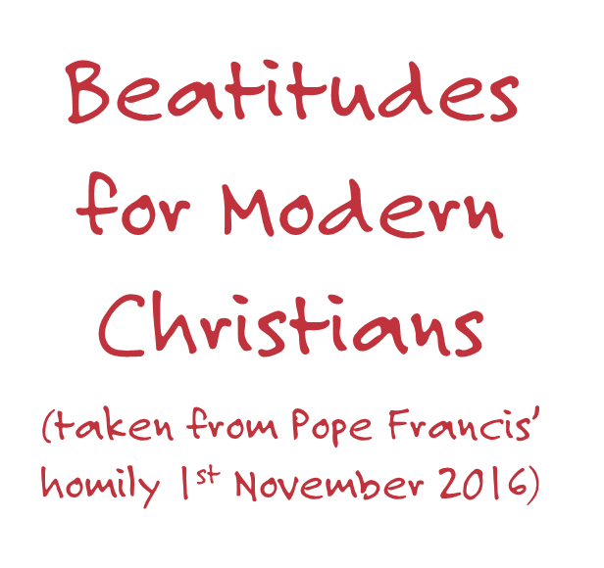
Notes:
Source: Apostolic Journey of His Holiness Pope Francis to Sweden. Holy Mass in Swedbank Stadion, Malmo.
Homily of His Holiness Pope Francis – Tuesday, 1 November 2016 https://w2.vatican.va/content/francesco/en/homilies/2016/documents/papa-francesco_20161101_omelia-svezia-malmo.html

Slide 3
Photo credit: Sam Tarling
Notes:
Photo Caption: Shayma, 3, from Raqqa and her mother sit amid the muddy camp in which they now live in an informal tempted settlement in Kafr Zabat, in Lebanon's Bekaa Valley, on December 17, 2013. Shayma and her family fled the violence in Syria one month ago.

Slide 4
Photo credit: Mark Mitchell/Caritas Aotearoa New Zealand
Notes:
Photo caption: Elias from SVDP talks to displaced man at No. 2 Lagoon, North Port Vila, Vanuatu.

Slide 5
Photo Credit: Catholic Relief Services

Slide 6
Photo credit: Isabel Corthier
Notes:
Photo caption: Shepherd (13y) is disabled. His best time of the day is feeding his 9 birds. He keeps them in a small birdhouse.

Slide 7
Photo credit: Paul Jeffrey
Notes:
Photo Caption: Sister Cathy Arata, a School Sister of Notre Dame from New Jersey, talks with a woman during a women's conference on peacebuilding in Abyei, a contested region along the border between Sudan and South Sudan. Under a 2005 peace agreement, the region was supposed to have a referendum to decide which country it would join, but the two countries have yet to agree on who can vote. In 2011, militias aligned with Khartoum drove out most of the Dinka Ngok residents, pushing them across a river into the town of Agok. Yet more than 40,000 Dinka Ngok have since returned with support from Caritas South Sudan, which has drilled wells, built houses, opened clinics and provided seeds and tools for the returnees. Peace remains elusive, however, and Caritas is supporting a series of conferences between all the stakeholders in the area. Sister Arata works with Solidarity with South Sudan, a network of Catholic groups supporting education and pastoral work in the new African country.

Slide 8
Photo credit: Paul Jeffrey
Notes:
Photo caption: A girl covers her face as she prays during a Palm Sunday Mass at the Catholic Church in Abyei, a contested region along the border between Sudan and South Sudan. Under a 2005 peace agreement, the region was supposed to have a referendum to decide which country it would join, but the two countries have yet to agree on who can vote. In 2011, militias aligned with Khartoum looted and destroyed much of the church and drove out most of the Dinka Ngok residents, pushing them across a river into the town of Agok. Yet more than 40,000 Dinka Ngok have since returned, with support from Caritas South Sudan, which has drilled well, built houses, opened clinics and provided seeds and tools for the returnees. Yet violence has continued, with a March 1 militia attack killing four residents, according to the United Nations.

